Slide 1
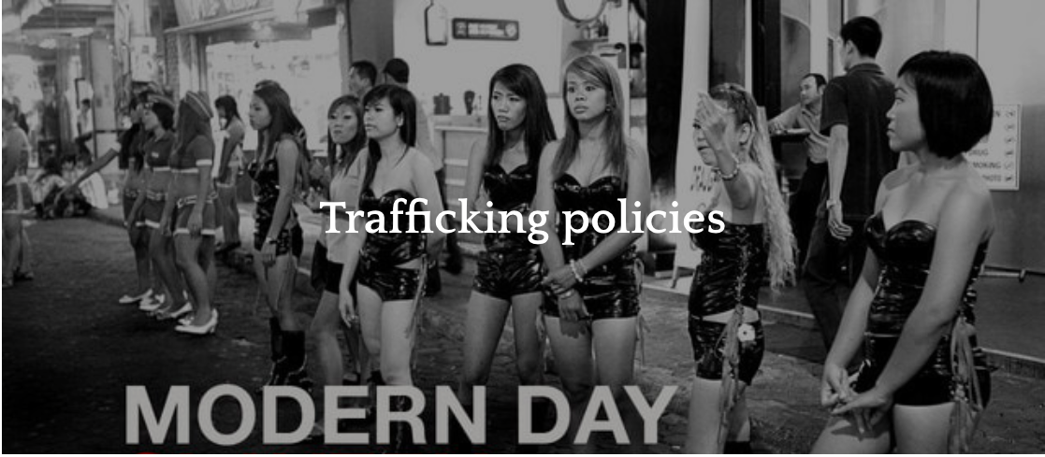
What: Policies associated with managing population change, focusing on anti-trafficking policies

Slide 2
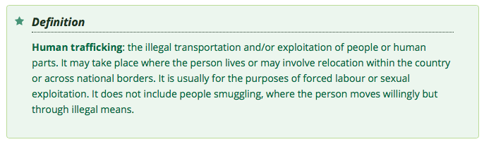

Slide 3
Why: Links to migration and gender
The International Labour Organization estimates that there are 20.9 million victims of human trafficking globally.
  68% of them are trapped in forced labor.
  26% of them are children.
  55% are women and girls.
The International Labor Organization estimates that forced labor and human trafficking is a $150 billion industry worldwide.
The U.S. Department of Labor has identified 139 goods from 75 countries made by forced and child labor.

Slide 4
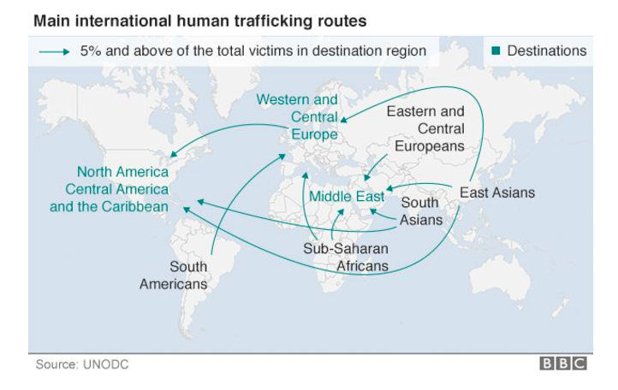
HL links: international flows

Slide 5
How:
Enquiry question: What is trafficking and how big an issue is it?
​Use the materials on the weebly to write definitions of:
Human trafficking
Labour trafficking (Nepal)
Sex trafficking (Houston)
Use data to explain the size of this issue worldwide.

Slide 6
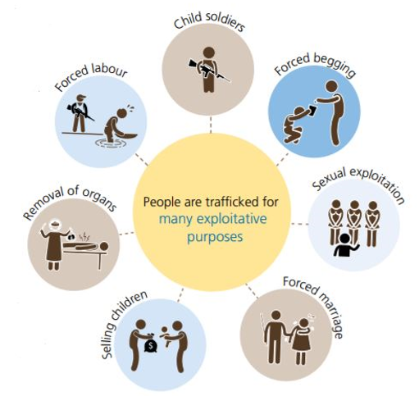
Human trafficking

Slide 7
Human trafficking
Human trafficking is a violation of human rights. The person is usually moved by force and for commercial exploitation. It covers a broad range of activities, including:
forced labour (modern-day slavery)
sexual slavery or commercial exploitation
forced marriage
extraction of organs such as kidneys and/or tissue (surrogacy, removal of a woman's ova, or eggs).

Slide 8
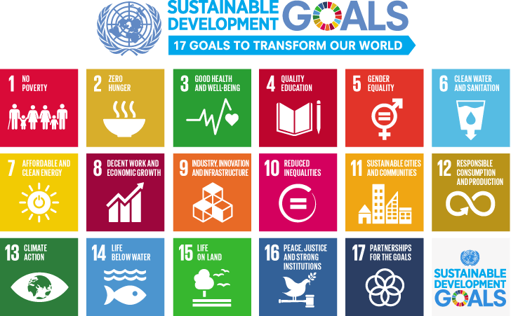
To
To explore policies associated with managing population change, focusing on anti-trafficking policies
How do we stop trafficking?

Slide 9



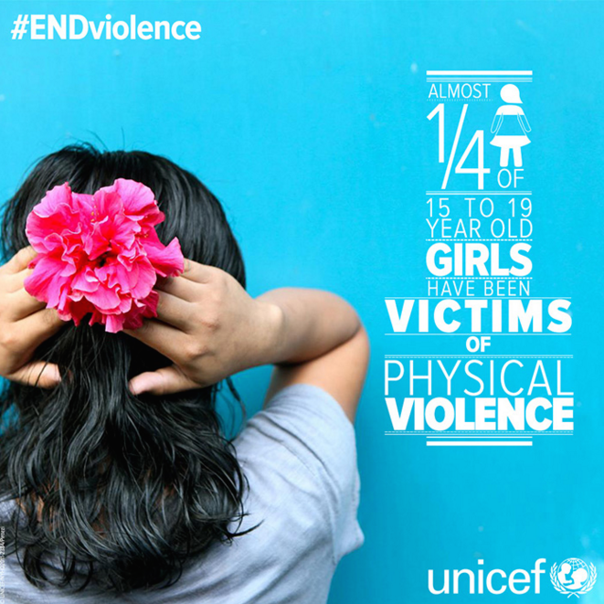
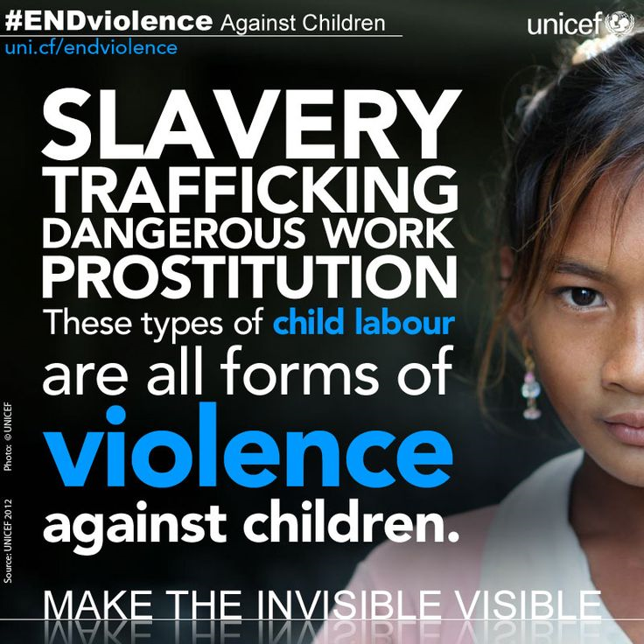
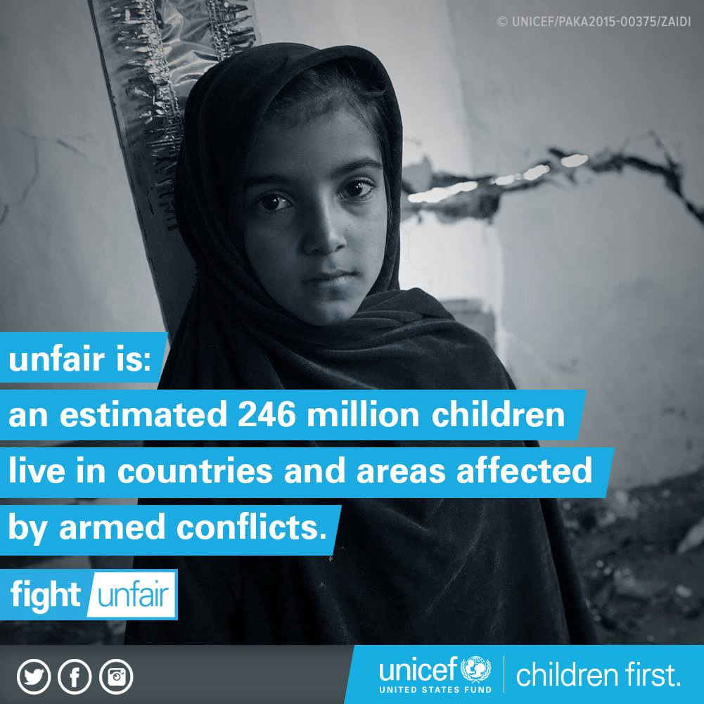
To
To explore policies associated with managing population change, focusing on anti-trafficking policies
Sustainable Development Goals

Slide 10
Sex trafficking in Houston
Houston is the main port of entry and the hub of human sex trafficking in the U.S.
1. Houston is close to the Mexican border, where most sex trafficking victims enter the U.S.
2. Houston is home to energy and medical industries, and hosts many conventions and sports events. Bottom line, anything that attracts men with money attracts sex trafficking.
3. Houston has one of the busiest ports in the world.
4. Houston is midway along the I-10 corridor from Florida to California.
5. Houston has many upscale strip clubs.

Slide 11
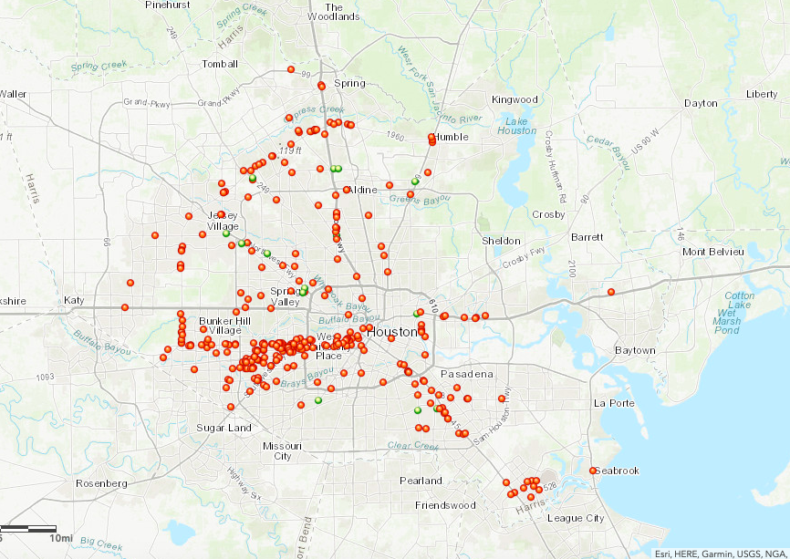
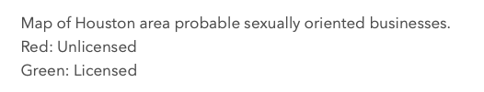
Sex trafficking in Houston map
https://www.arcgis.com/home/webmap/viewer.html?webmap=24a13ce70032475aba9e89388281fabd
Link to crime in urban environments

Slide 12
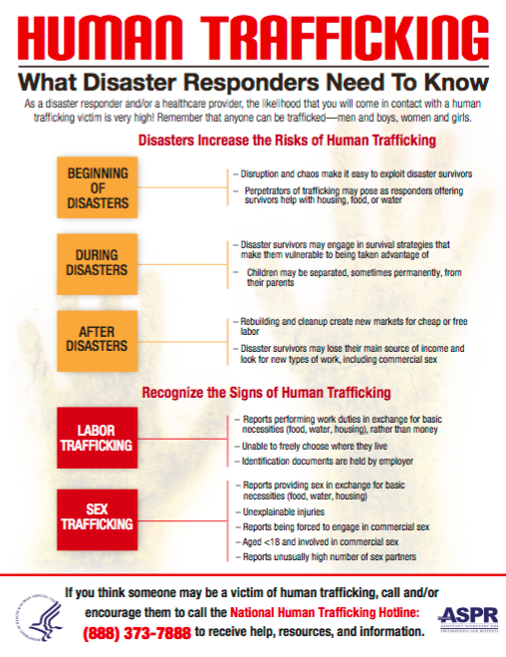
Sex trafficking in Houston
Links to hurricane Harvey- trafficking greater at times of disaster

Slide 13
Sex trafficking in Houston
Texas has more than 300,000 human trafficking victims, including nearly 79,000 youths or minors who have been forced into prostitution or other forms of sex trafficking, a new University of Texas study has found.
Task
Use the resources on the weebly to create a case study of Sex trafficking in Houston.
Include:
Why is it happening?
Where is it happening?
Who does it involve?
What is/could be done about it?

Slide 14
To
To explore policies associated with managing population change, focusing on anti-trafficking policies
The USA publishes a Trafficking in Persons Report annually (http://www.state.gov/j/tip/rls/tiprpt/) and the United Nations has produced two reports on global trafficking.
The USA’s Trafficking and Violence Protection Act (TVPA, 2000) encourages governments to join in the fight against human trafficking.
The TVPA contains three main components:
protection – increased efforts to protect foreign national victims as well as non-immigrants;
prosecution – of traffickers related to forced labour and sexual exploitation
prevention – to assist other governments to reduce trafficking.
There’s more on this on page 416-417

Slide 15
To
To explore policies associated with managing population change, focusing on anti-trafficking policies
The 3P Anti-Trafficking Policy Index evaluates governmental anti-trafficking efforts in the three main policy dimensions (3Ps), based on the requirements prescribed by the United Nations Protocol to Prevent, Suppress and Punish Trafficking in Persons, especially Women and Children (2000).
Each of the 3P areas is evaluated on a 5-point scale and each index is combined to give the overall 3P Anti-trafficking Index as the sum (score 3-15).
Prosecution Index Score: 1 (no compliance) - 5 (full compliance)
Prevention Index Score: 1 (no compliance) - 5 (full compliance)
Protection Index Score: 1 (no compliance) - 5 (full compliance)
3P Anti-trafficking Policy Index Score: 3 (no compliance for any of the three areas) - 15 (full compliance for all of the three areas)

Slide 16
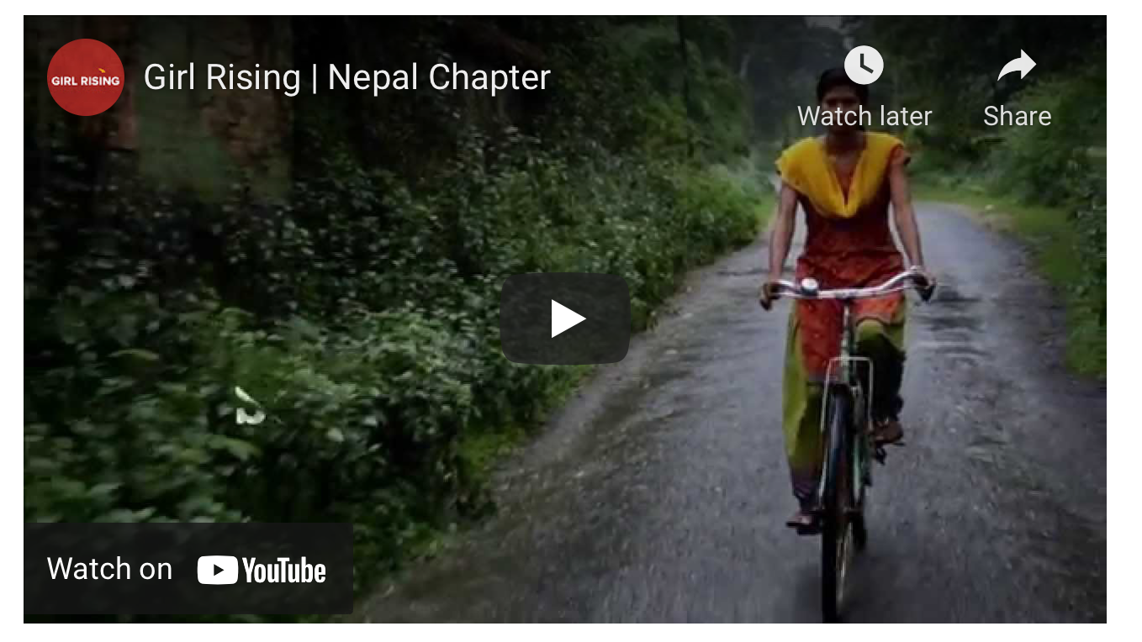
Labour trafficking
Read through the information on the weebly and Kognity. Make notes on what labour trafficking with a case study of Nepal.
Bonded labour (debt bondage) is where the victim's labour is required as repayment of a debt; conditions are unclear and unfair and the labour provided is generally worth a lot more than the original debt.
Forced labour is where the victim works under threat of violence to themselves or their family. Work may be as a domestic servant, as an agricultural hand or in factory sweat shops.
https://www.youtube.com/watch?v=Hk2Q7WLzn0s&feature=emb_logo

Slide 17
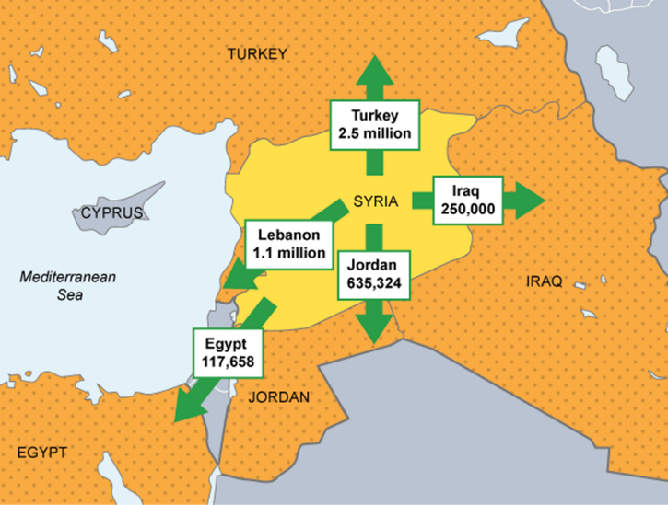
To
To explore policies associated with managing population change, focusing on anti-trafficking policies
Forced Migration & Trafficking Case Study: Syria
Background
The Syrian crisis is an on-going armed conflict in Syria between forces loyal to the Ba'ath government and those opposing them.
In 2016, reports estimated that fatalities caused by the civil war in Syria amounted to 470,000.
An estimated 4.5 million refugees have fled the country, many to neighbouring countries such as Lebanon and Jordan.
Whilst over 6 million are estimated to be internally displaced.

Slide 18
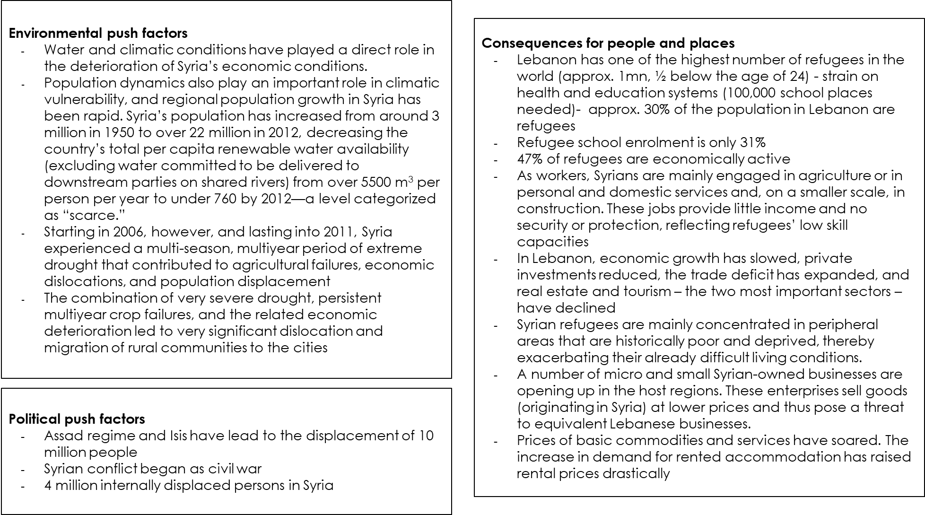
To
To explore policies associated with managing population change, focusing on anti-trafficking policies
Forced Migration & Trafficking Case Study: Syria

Slide 19
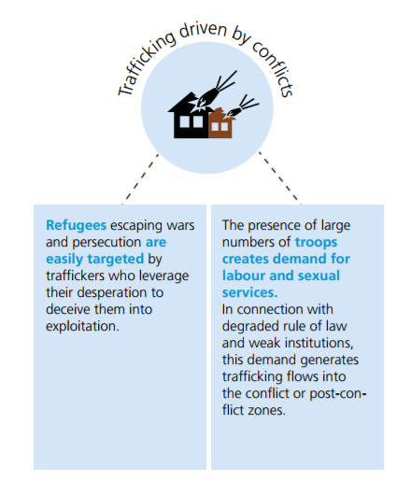
Trafficking: Links to Syrian Conflict
Source: UNODC 2016

Slide 20
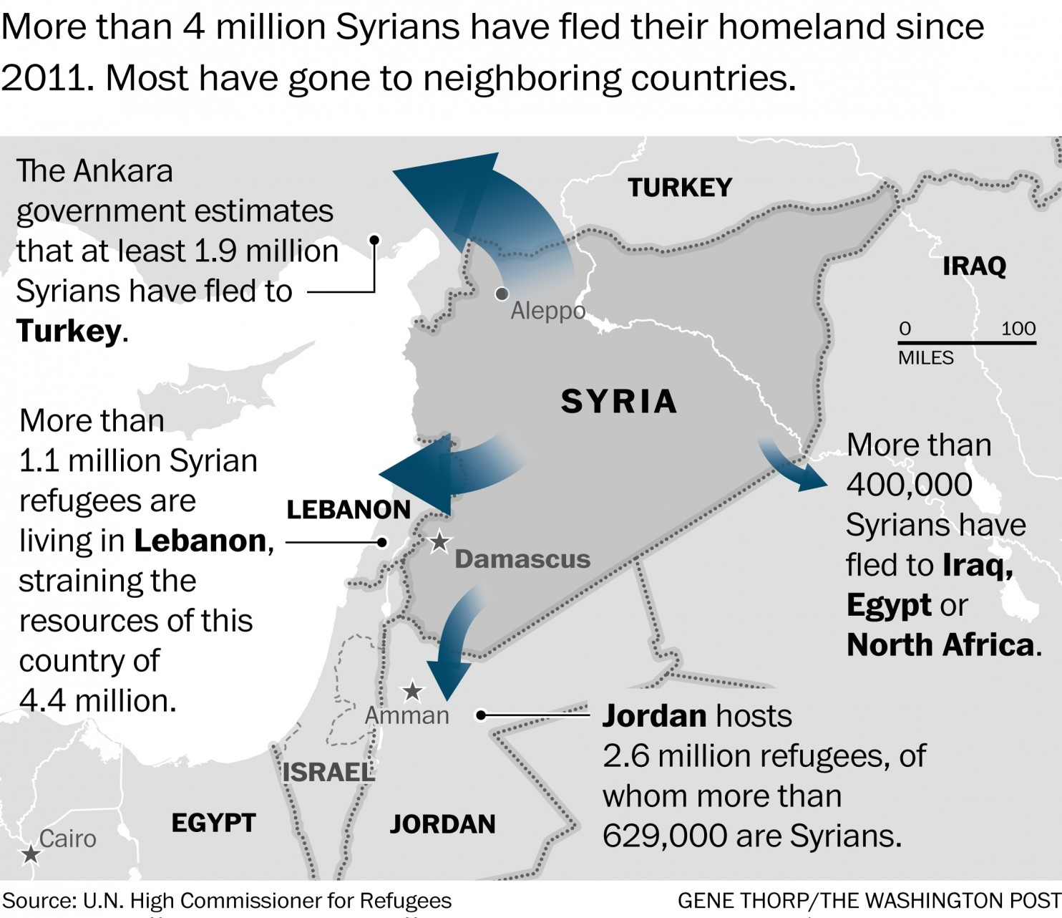
To
To explore policies associated with managing population change, focusing on anti-trafficking policies
Forced Migration & Trafficking Case Study: Syria
Since 2015 migrants and refuges fleeing to Europe has increased.
Many are being trafficked and are still at risk of being trafficked once at their destination. Those without papers (identity etc) are at huge risk of being trafficked.
Governments can reduce the risk by increasing staff at ports, distributing leaflets to migrants and refugees explain the risks and inspecting documentation at work places

Slide 21
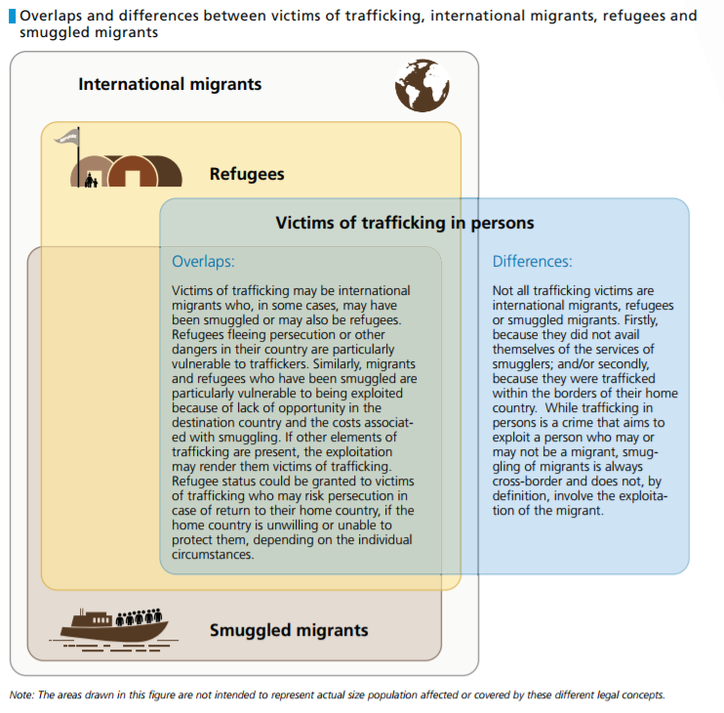
Trafficking: Links to Syrian Conflict
Source: UNODC 2016

Slide 22
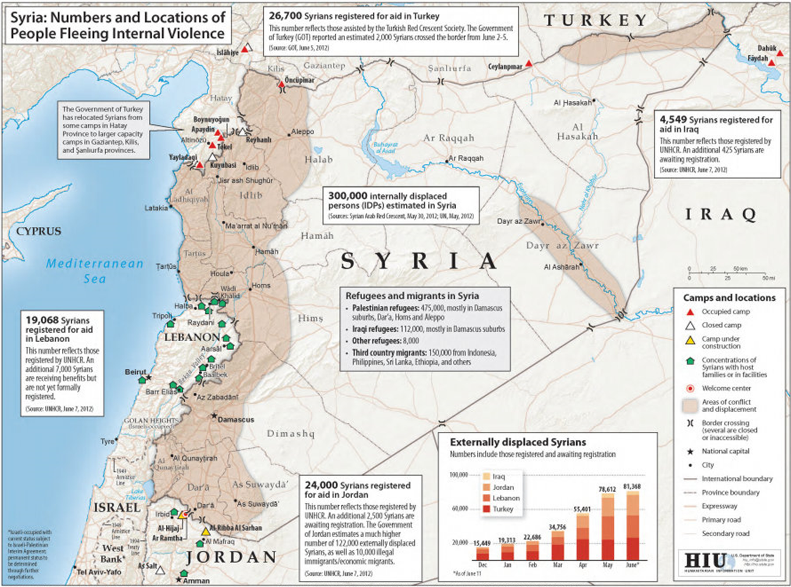

Slide 23
Trafficking: Links to Syrian Conflict
Refugee Crisis: A 'greenhouse' for human trafficking
Refugee camps put women at risk
SDGs aimed at addressing human trafficking
Read the following and take notes on why Syrian refugees are particularly vulnerable to being trafficked.

Slide 24
Solutions 1:
Using the information on the weebly and kognity create a simple mind-map to show the key aspects of UN strategy against human trafficking.

Slide 25
Solutions 2:
Choose one of the projects/NGOs embedded on the weebly (or find your own) and create a simple case study file which includes:
Location, the nature of the problem and the goals of the project
Strategies used to tackle the problem
Impact and evaluation:
  What have been the successes?
  What still needs to be done/what are the limitations?

Slide 26

To
To explore policies associated with managing population change, focusing on anti-trafficking policies
Exam Style Question
Examine the effectiveness of methods to combat the trafficking of people [10 marks]
Notes:
VHE 12D only because they are so far ahead.

Slide 27
Examine the effectiveness of methods to combat the trafficking of people [10 marks]
1. defines key terms (what is human trafficking)
2. outlines the geographical context (where, why, how etc.) may include facts
3. Describes and explains at least TWO methods of combatting trafficking
4. Discusses the successes of the each method referred to
5. Discusses the challenges/limitations of each method referred to
6. Uses facts, stats and specifics from the examples referred to
7. Gives an overall judgement on the effectiveness of the methods referred to

Slide 28
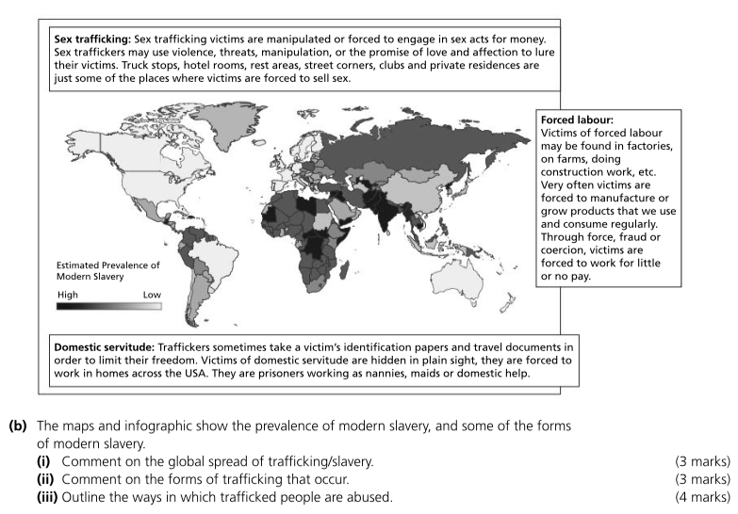
Infographic question- 10 marks

