Slide 1
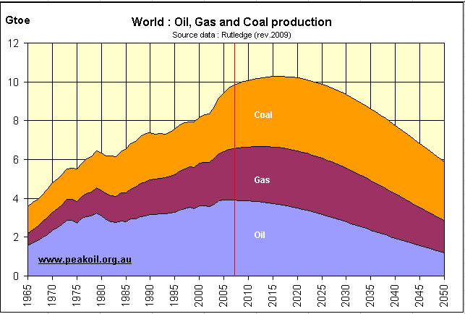
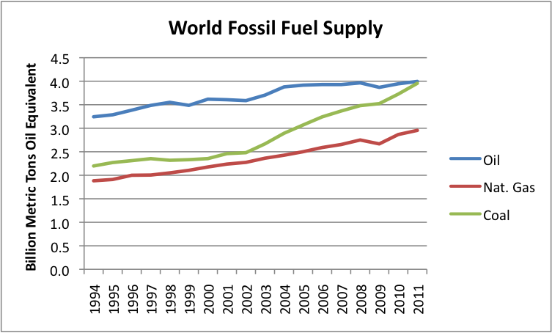
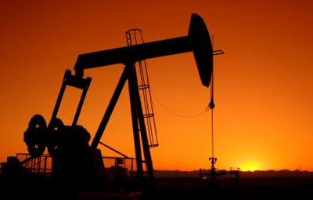
Fossil Fuels
How are Fossil Fuels adding to climate change?
When fossil fuels are burned - by industry, in power stations and by vehicles and planes - gases (as unwanted by-products known as carbon emissions) enter the atmosphere. Carbon dioxide (CO₂), in particular, is given off when fossil fuels, such as oil and coal, are burned. Although these gases have always been present in the world's atmosphere, their concentration is gradually increasing as more and more fossil fuels are burned. This adds to the green house effect as they can trap more of the suns energy in the earths atmosphere which leading to the planet getting warmer.
How are Humans using Fossil Fuels to make the climate worse?
Fossil fuels are used to fuel cars and airplanes, power electricity plants, heat our homes and make plastics
When you brushed your teeth today, you used a product made from oil – toothpaste.
Look at your shoes – they are a product made from oil. Sunglasses, tires, tennis balls and TV’s are all products of oil and gas.
As the population grows/as people get richer we require more of the above products and uses/can afford more which means more fossil fuels are burnt.
What are Fossil Fuels?
The fossil fuels are coal, oil and natural gas. They are fuels because they release heat energy when they are burned. They are fossil fuels because they were formed from the remains of living organisms millions of years ago.
Left: The machine is called a pump jack is designed to bring oil to the surface
Right: A graph showing the production of three main fossil fuels since 1994.
Notes:
Levels 5-9

Slide 2
Fossil Fuels
How are Fossil Fuels adding to climate change?
When fossil fuels are burned - by industry, in power stations and by vehicles and planes – gases (such as CO₂₎ enter the atmosphere. These gases have always been present in the world's atmosphere, but their amount is slowly increasing as more and more fossil fuels are burned. This adds to the green house effect as they can trap more of the suns energy in the earths atmosphere which leading to the planet getting warmer.
How are Humans using Fossil Fuels to make the climate worse?
Fossil fuels are used to fuel cars and airplanes, power electricity plants, heat our homes and make plastics
As the population grows/as people get richer we require more of the above products and uses/can afford more which means more fossil fuels are burnt.
What are Fossil Fuels?
The fossil fuels are coal, oil and natural gas. They are fuels because they release heat energy when they are burned.
Left: The machine is called a pump jack is designed to bring oil to the surface
Right: A graph showing the production of three main fossil fuels since 1994.
Notes:
Levels 1-4

Slide 3
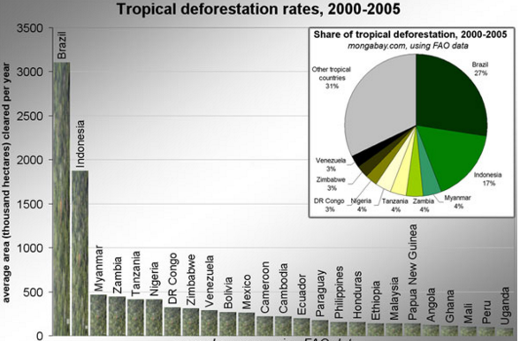
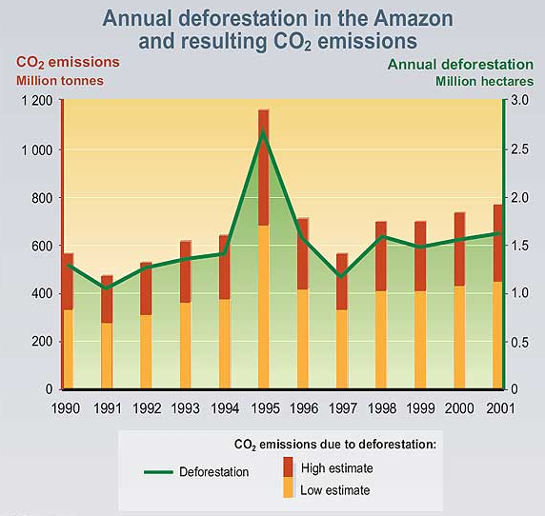
Deforestation
How does deforestation lead to climate change?
Deforestation is considered to be one of the contributing factors to global climate change. The no. 1 problem caused by deforestation is the impact on the global carbon cycle. Trees can store carbon (which makes the green house effect worse) with around 300 billion tons of carbon, 40 times the annual greenhouse gas emissions from fossil fuels, being stored in trees. The deforestation of trees not only lessens the amount of carbon stored, it also releases carbon dioxide into the air. This is because when trees die, they release the stored carbon.
Why are humans causing deforestation?
There are many causes of deforestation but the main reasons are:
To make more land available for housing and urbanization
To harvest timber to create commercial items such as paper, furniture and homes
To create ingredients that are highly prized consumer items, such as the oil from palm trees
To create room for cattle ranching. This cattle is then used as food.
Common methods of deforestation are burning trees and clear cutting. These tactics leave the land completely barren and are controversial practices. As the worlds population gets bigger/richer, more people require the above needs which increase the amount of deforestation that takes place.
Above: this shows the amount each country contributes towards deforestation each year.
What is deforestation?
Deforestation is the permanent destruction of forests in order to make the land available for other uses. An estimated 18 million acres (7.3 million hectares) of forest, which is roughly the size of the country of Panama, are lost each year, with about half of world's original forests being destroyed since the start of the industrial revelation
Above: This graph is showing the amount of deforestation in the Amazon and the amount of C02 that is released as a result.
Notes:
Levels 5-9

Slide 4
Deforestation
How does deforestation lead to climate change?
Deforestation one of the main causes of climate change. Trees can store carbon (which if realised would make the green house effect worse). The deforestation of trees reduces the amount of carbon stored in trees and it also releases the carbon stored into the air. This is because when trees die, they release the stored carbon.
Why are humans causing deforestation?
The main causes are:
To make more land available for housing and cities.
To collect timber (wood) to create new items.
To create ingredients that are worth a lot of money
To create room for cattle farms. This cattle is then used as food.
As the worlds population gets bigger/richer, more people require the above needs which increase the amount of deforestation that takes place.
Above: This graph is showing the amount of deforestation in the Amazon and the amount of C02 that is released as a result.
What is deforestation?
Deforestation is the permanent destruction of forests in order to make the land available for other uses.
Above: this shows the amount each country contributes towards deforestation each year.
Notes:
Levels 1-4

Slide 5
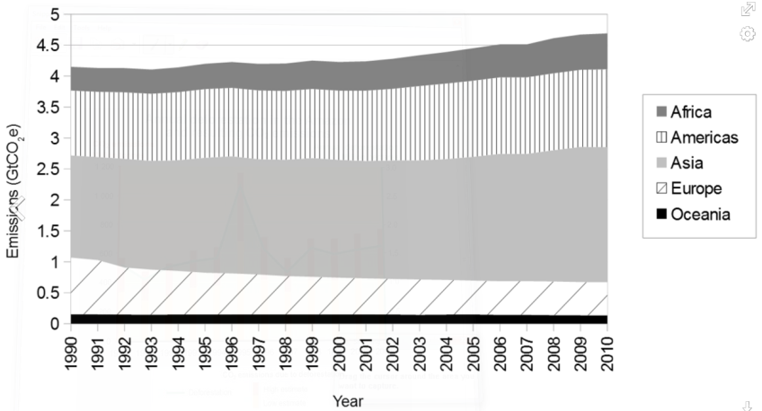
Agriculture
How are humans causing climate change through agriculture?
Humans love to eat. As a result more and more land is needed for farming. The agricultural sector is a driving force in gas emissions and land use effects thought to cause climate change. In addition to being a significant user of land and consumer of fossil fuel, agriculture contributes directly to greenhouse gas emissions through practices such as rice production and the raising of livestock.
Agriculture contributes to greenhouse gas increases through land use in four main ways:
CO₂ releases linked to deforestation
Methane releases from rice cultivation
Methane releases from enteric fermentation in cattle
Nitrous oxide releases from fertilizer application
Together, these agricultural processes comprise 54% of methane emissions, roughly 80% of nitrous oxide emissions, and virtually all carbon dioxide emissions tied to land use
How does agriculture leas to climate change?
Agriculture contributes to climate change by (1) anthropogenic emissions of greenhouse gases (GHGs), and (2) by the conversion of non-agricultural land (e.g.,forests) into agricultural land. Agriculture, forestry and land-use change contributed around 20 to 25% to global annual emissions in 2010
What is agriculture?
Agriculture is the cultivation of animals, plants, fungi, and other life forms for food, fiber, biofuel,medicinal and other products used to sustain and enhance human life
Above: This shows the Greenhouse gas emissions from agriculture, by region, 1990-2010
Left: Shows the amount of methane produces by animals per year
Notes:
Levels 5-9

Slide 6
Agriculture
How are humans causing climate change through agriculture?
Humans love to eat. As a result more and more land is needed for farming which then releases more gases into the atmosphere.
Agriculture contributes to greenhouse gas increases through land use in four main ways:
CO₂ releases linked to deforestation
Methane releases from rice cultivation
Methane releases from enteric fermentation in cattle
Nitrous oxide releases from fertilizer application
Livestock contribute to climate change as well with:
9% of global carbon dioxide emissions
35–40% of global methane emissions
64% of global nitrous oxide emissions
How does agriculture leas to climate change?
Agriculture contributes to climate change by (1) releasing greenhouse gases (GHGs), and (2) by the conversion of farming land (e.g.,forests) into farming land.
What is agriculture?
Agriculture is the farming of animals, plants, fungi, and other life forms for food, fiber, biofuel and medicines
Left: This shows the Greenhouse gas emissions from agriculture, by region, 1990-2010
Notes:
Levels 1-4

