Slide 1
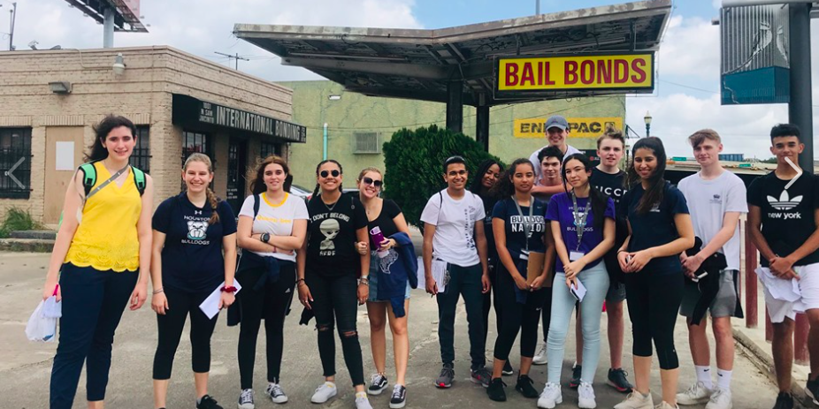
How to write section B: Method
B: Methods of investigation (0-3 marks) – 300 words

Slide 3
Checklist
Details (what to include ) | Complete
Introduction to location of data collection including a map and explanation of how the sites were selected
Clear description of how each method was carried out. This could include e.g.s of tables, times, equipment etc.
Explanation/ justification of why this information is important and how it will prove/ disprove your hypothesis
Details of any sampling techniques used
Explanation of how the PLVI was determined
Explanation of how the distances from PLVI were calculated
Dates of data collection
Indication of how the data may be used for statistical tests may be used

Slide 4
Sites for data collection and how they were chosen
Where- did you choose
Why- did you choose these locations?
How- did you choose you sites in your chosen area (sampling technique)

Slide 5
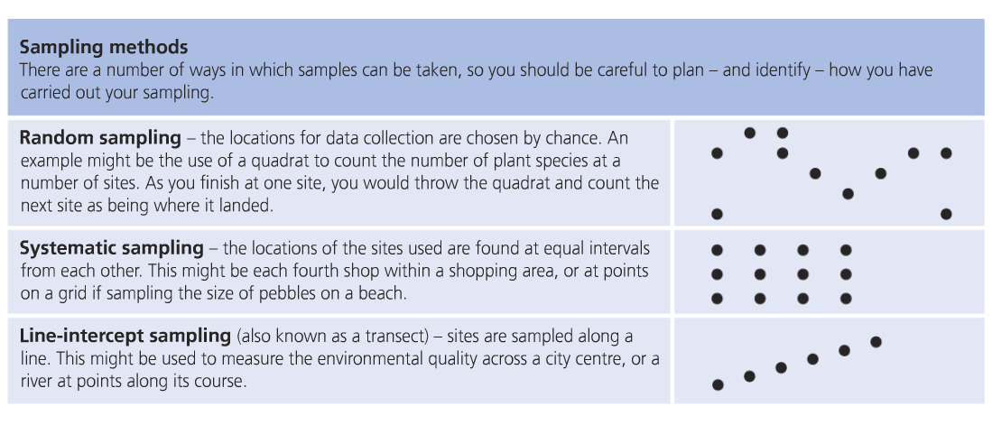

Slide 6
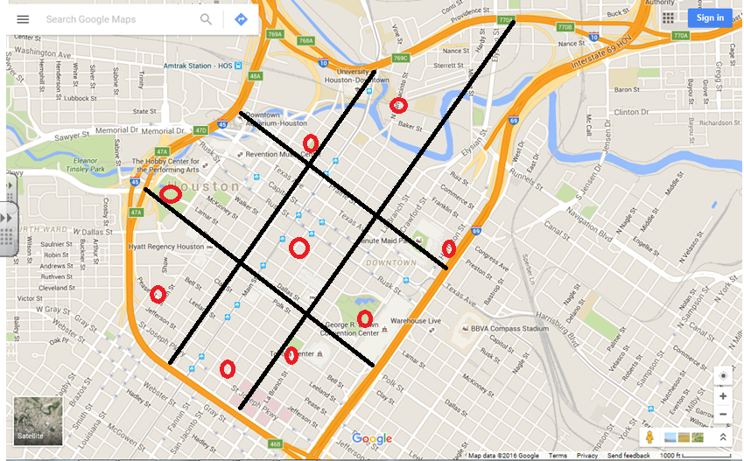
Include a map of the sites with a clear label of the ‘names’ of each site
Remember scales etc.

Slide 7
Sites
Include a map of the sites in your method
1: Chevron
2: Cathedral of the Sacred Heart
3: Toyota Centre
4: Discovery Green
5: Minute Maid Park (by 59)
6: Jail District
7: Chase Tower/ theatre district
8: Green Street: shopping district
9: City Hall/ Library

Slide 8
What are your sub-questions?
(These will be laid put in the introduction (section A))
you should have 2-3 sub- questions
How do these relate to the big questions
What methods will be used to answer these?

Slide 9
Which methods did will you use that are appropriate for your sub-questions?
What extra appropriate secondary data could be collected- don’t forget to mention the how and why of this in the method

Slide 10
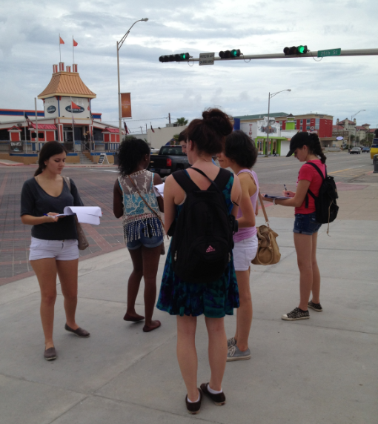
Photographs
This is a good section to include photographs of students collecting data. Remember that any photographs used should be relevant and directly mentioned in the text of your coursework (the examiner does not want to see a photo of someone eating their lunch!).

Slide 11
How will you make your conclusions?
Will you set out the PVLI in the method?
Will you use any tests (i.e. the building intensity test from Waugh to help you determine the core/ frame)
How will you be able to use statistical tests to analyse your data? – you need to explain how the data will help you with statistical tests

Slide 12
Secondary data?
Are you going to be using any other data (i.e. statistics regarding Houston from websites)? If so you need to include these as secondary methods in your methodology .

Slide 13
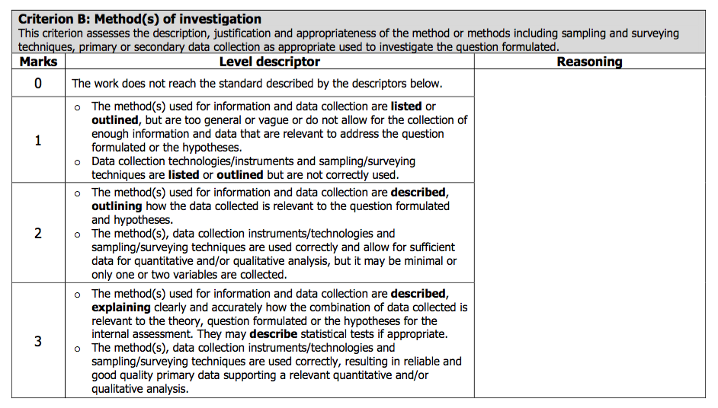

Slide 14
Tip
This section could be put into a table to save words
Method | How was it carried out ? | Why was it carried out like this? | How will this help understand the core/ frame model?

