Slide 1
How to create a Choropleth Map
Using Google Sheets

Slide 2
Step 1
Open a new google sheets document

Slide 3
Step 2
Enter your data
States in column A
Population Density in Column B
Populate the sheet with your data.
In Column A – enter the name of the states
In column B – enter the population Density for each state.

Slide 4
Step 3
Select Insert
Once you have entered the data highlight columns A and B .
Select insert at the top bar and select Chart.
Select Chart

Slide 5
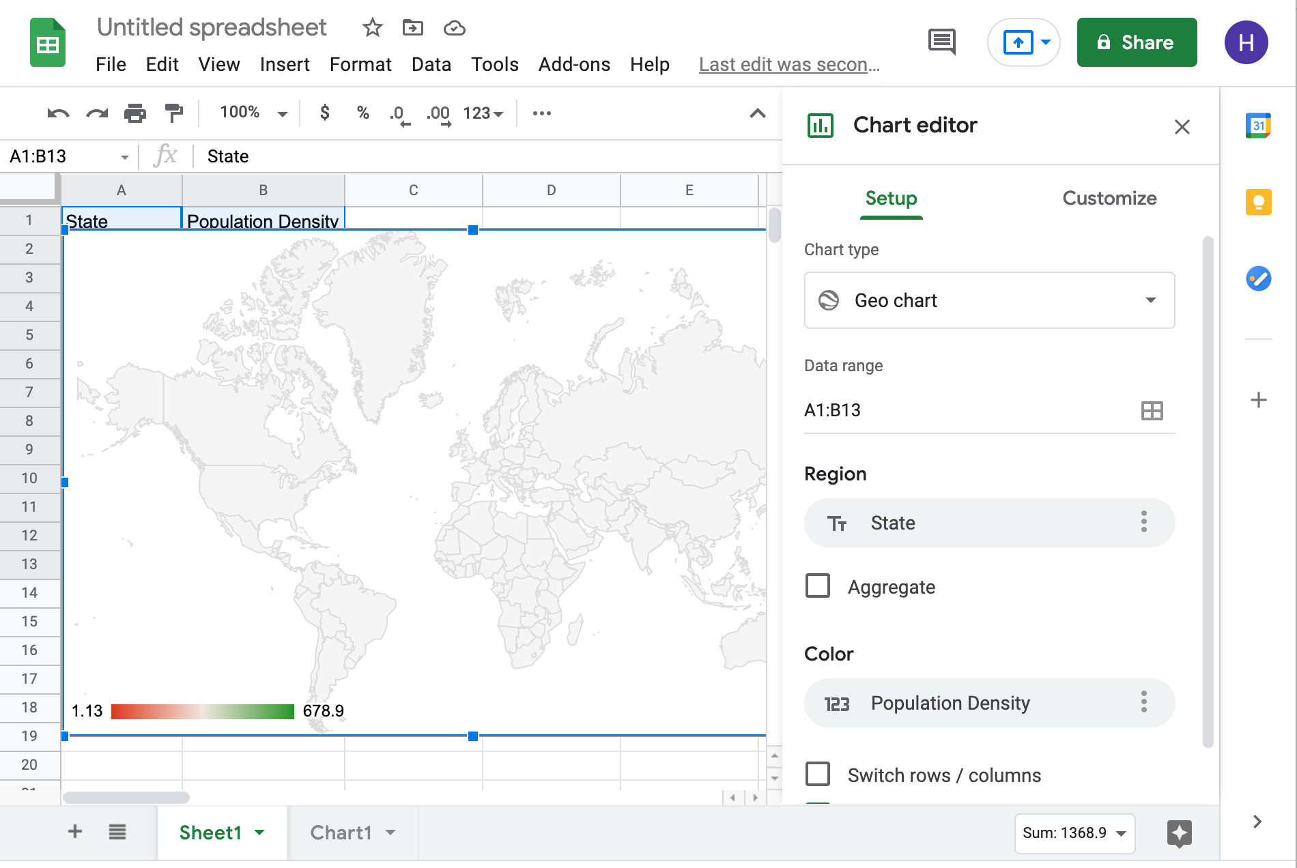
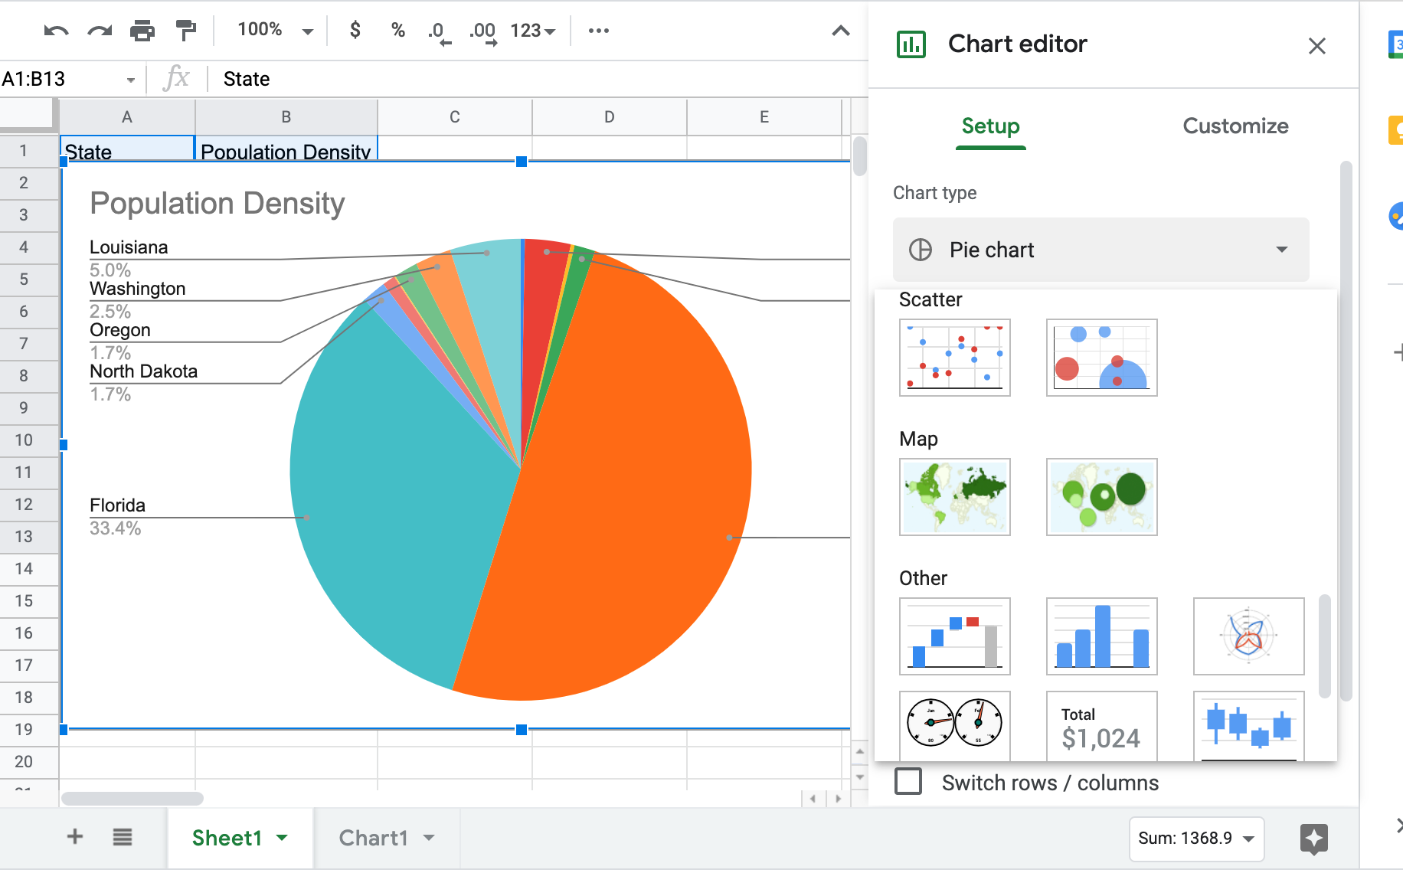
Step 4
Once you have selected Map press customise
In the drop down box select the Map option
Click on the drop down box
Scroll down and select map

Slide 6
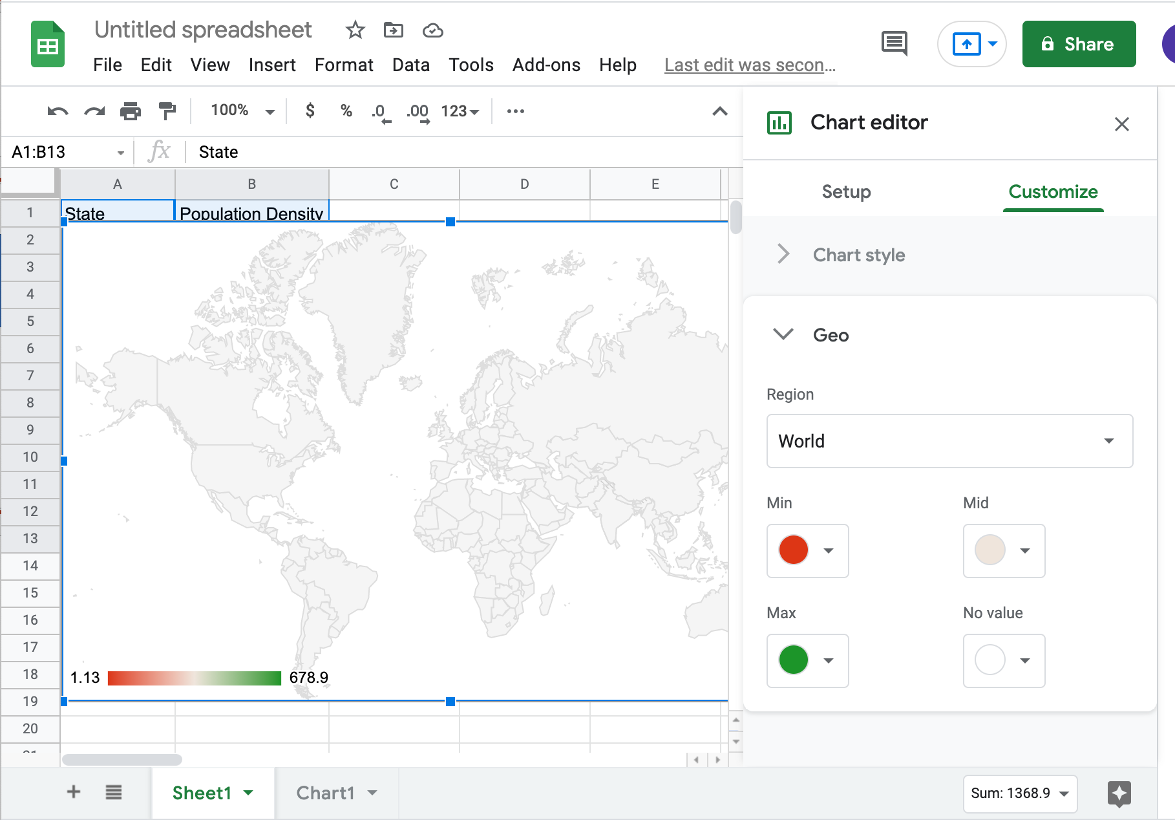
Step 5
Go to region and select USA
Select Region and scroll down to USA

Slide 7
Step 6
Select a colour and select 3 different shades.
Customise the colours on your map – select one colour and select different shades

Slide 8
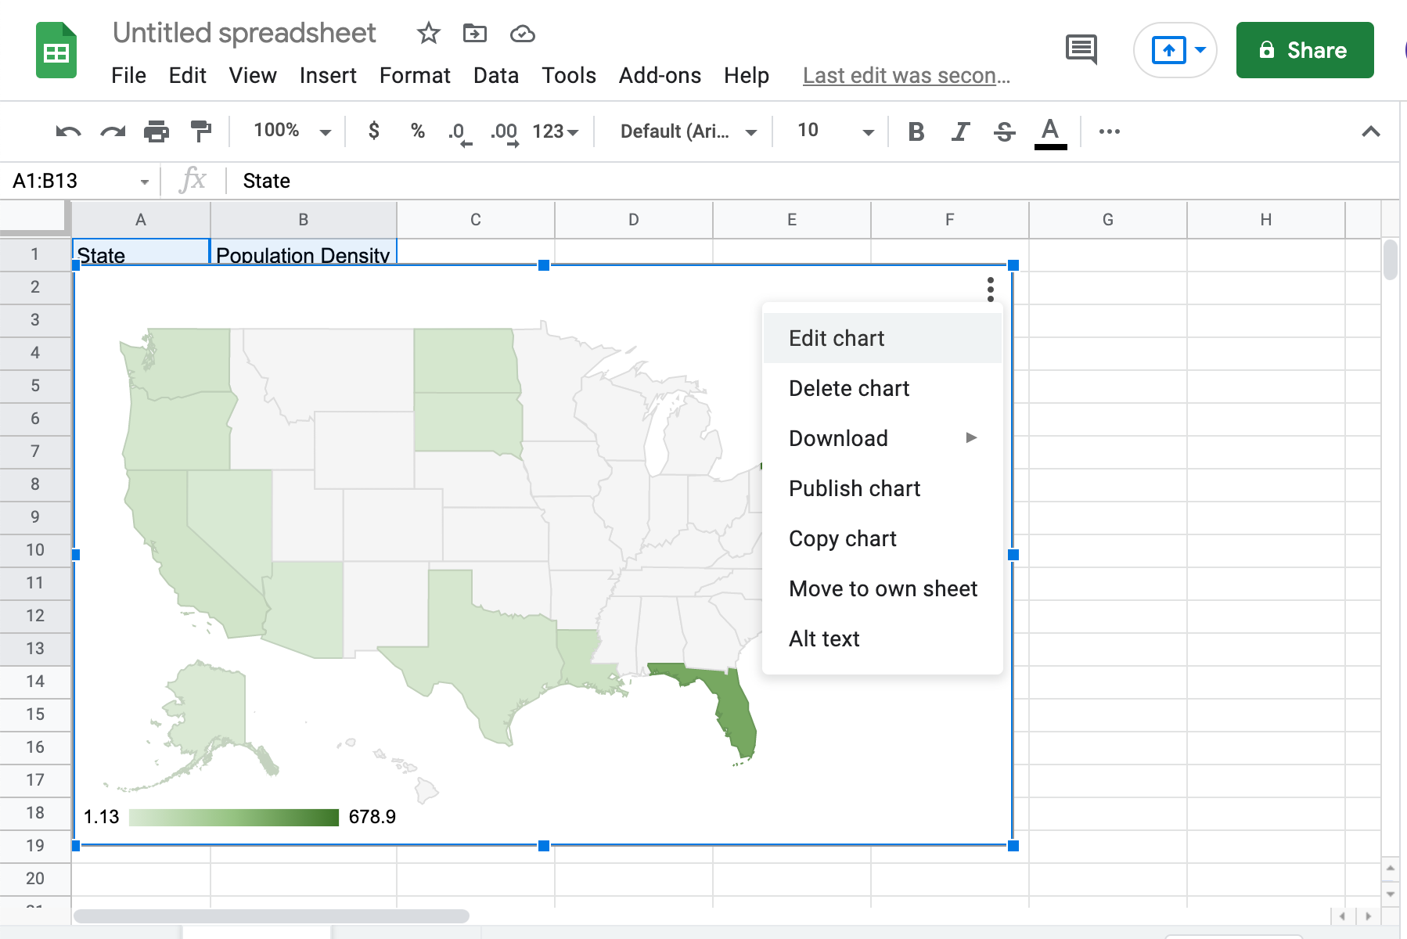
Step 7
Click on the 3 dots in the corner of your map and select download.

