Slide 1
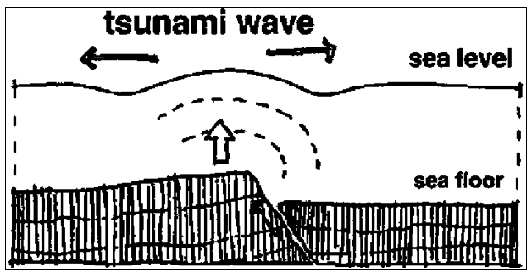
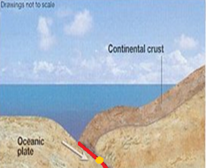
Task: How do tsunamis form?
Why: To understand that tectonic activity produces different hazards and to develop our understanding of why the 2011 Japanese was so deadly
1.Carefully examine the statements below. Put them in the order in which they occur to create a tsunami:
Sea movement causes Tsunami
Plate movement causes earthquake
Waves crash onto shore
Sea above earthquake forced upwards
Plates move towards each other
Tsunami waves spread quickly outwards
2 Make a larger, neater (better) coy of the diagram below. Use the material on this page to fully annotate the diagram in order to fully explain how tsunamis form. Remember to give the diagram a title, to use a ruler for arrows, to draw a frame around your diagram.
Taking it further: Instead of just one diagram you could draw a series of diagrams to the formation of a tsunami

