Slide 1
Activity: How has the Covid-19 pandemic affected GDP?

Slide 3
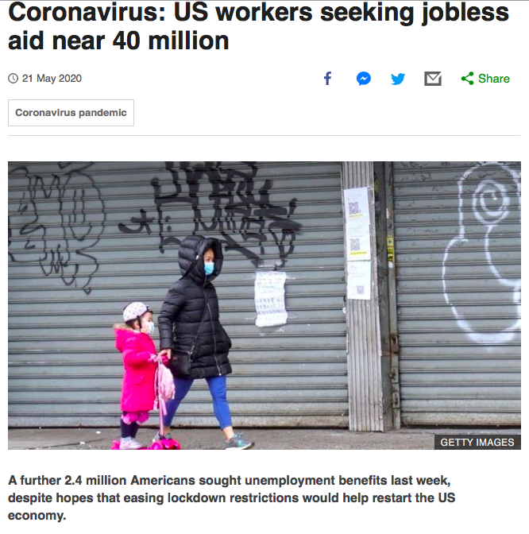
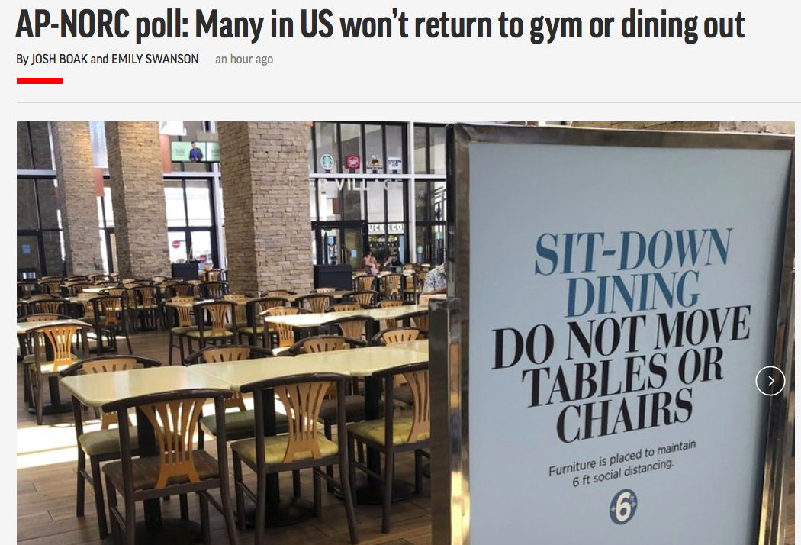
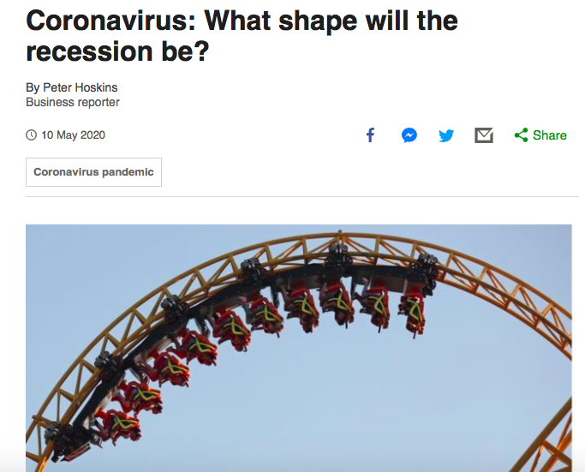
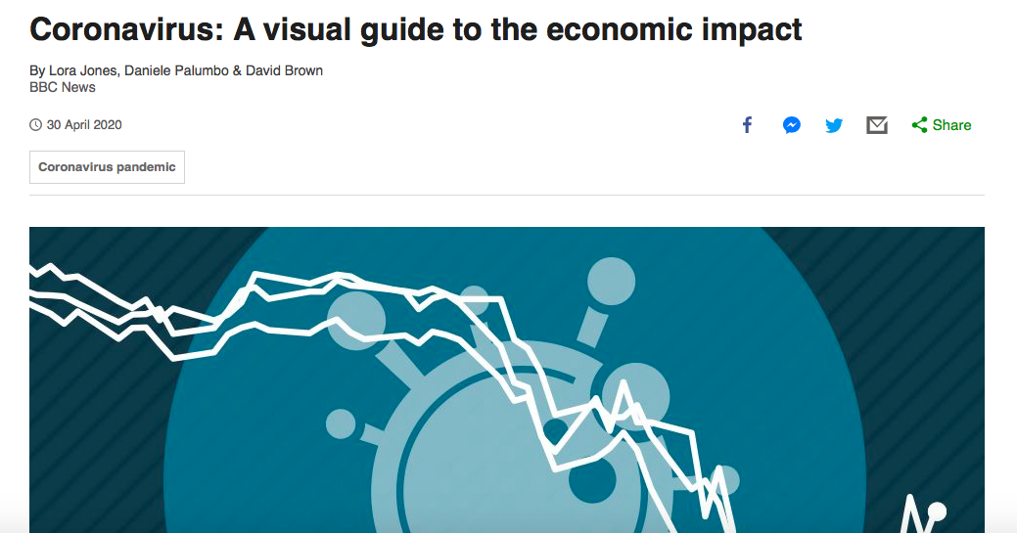
What sort of recovery will the US and global economy experience?
Use the following sources of data (HYPERLINKED ARTICLES) to consider the severity of the recession facing the USA. What does the Circular Flow of Income Model suggest about the length of the recession. Can you give your opinion as to whether you are expecting a ‘V’, ‘U’, ‘W’ or ’L’ shaped recession? You can jot down your ideas, remember to think about how each article relates to the CFI model.
Sources to help form your ideas:

Slide 4
Conclusion; write a brief conclusion about what sort of recession the USA will experience as a result of the pandemic (to make sense of the letters you will need to have read Data source E):
Evidence for ‘V-shaped’ | Evidence for ‘U-shaped’
Evidence for ‘W-shaped’ | Evidence for ‘L-shaped’

