Slide 1
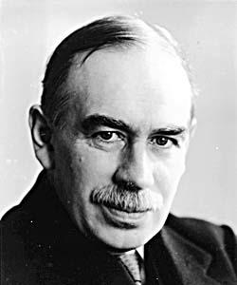
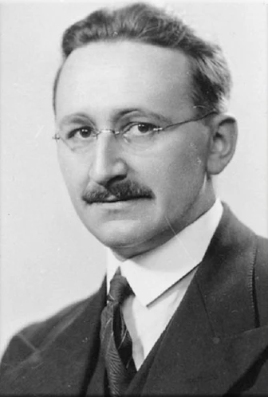
Keynesian
Model of the Macroeconomy
Neo-Classical
Keynesian economists do not separate Aggregate Supply into Short Run and Long Run
Keynesian economists believe the AS curve to be a horizontal line followed by a curve upward into a vertical line
Neo-Classical economists separate Aggregate Supply into Short Run (SRAS) and Long Run Aggregate Supply (LRAS)
The LR is where all prices are variable.
And the SR is where prices are roughly constant
Neo-Classicalists believe the LRAS curve to be vertical and the SRAS curve to be a positive correlation
AGREEMENT
Both agree on the shape of the AD curve
“In the long run we are all dead”
How far and why do Keynesian and Neo-classical economists disagree about the characteristics of the macroeconomy (growth, inflation and unemployment)?

Slide 2
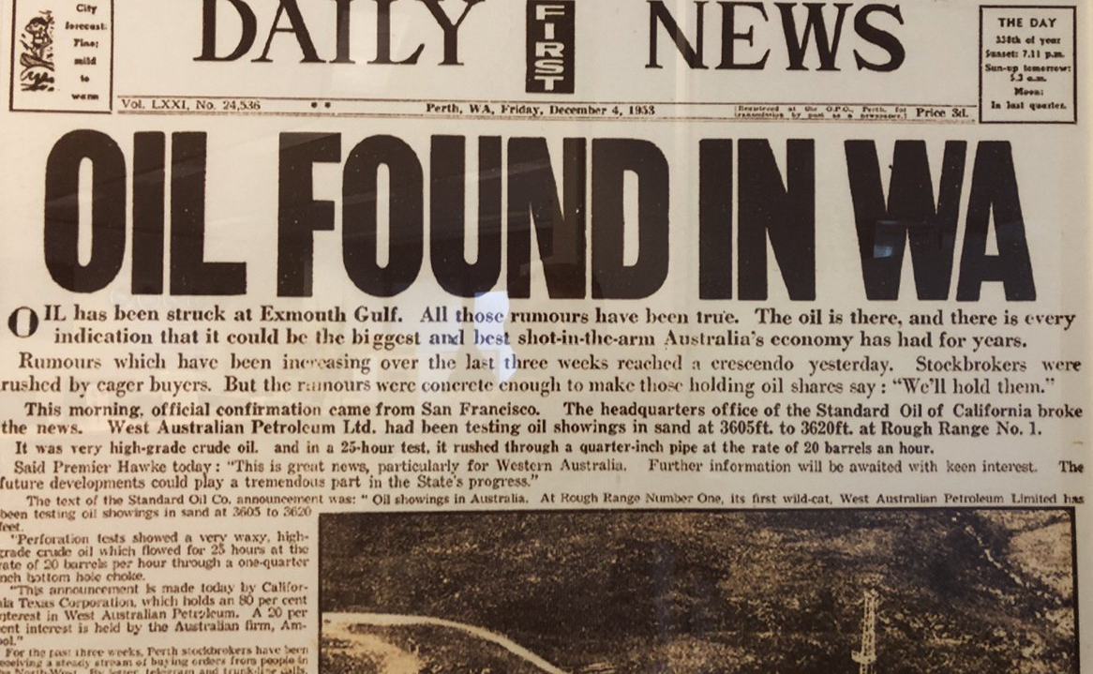
Keynesian
Growth
Neo-Classical
Keynesians believe that an increase in AD can result in higher real GDP if the economy is running below potential output
Keynesians believe that an economy can be below equilibrium in the long run
Neo-classicalists believe that an increase in AD will only result in inflation.
They believe that the only way to increase growth in an economy is to increase LRAS
AGREEMENT
AS must be increased to create a larger potential GDP
How far and why do Keynesian and Neo-classical economists disagree about the characteristics of the macroeconomy (growth, inflation and unemployment)?

Slide 3
Keynesian
Inflation
Neo-Classical
An increase in AD can lead to higher real GDP
Governments should run deficits during recessions to ensure minimal fall in AD
Governments should run a balanced budget in a boom as higher C and I will allow for higher government revenues and AD
An increase in AD will always lead to inflation in the long run
In the long run the economy will sort itself out, the less intervention from government the better.
AGREEMENTS
An increase in AD can close a deflationary gap
A decrease in AD can close an inflationary gap
“The market can remain irrational longer than you can remain solvent”
“Every government intervention [in the marketplace] creates unintended consequences, which lead to calls for further government interventions”- Von Mises
How far and why do Keynesian and Neo-classical economists disagree about the characteristics of the macroeconomy (growth, inflation and unemployment)?

Slide 4
Keynesian
Unemployment
Neo-Classical
The central idea of unemployment is still the microeconomic model of a labour surplus
However, this will result in different consequences for the Keynesian model than for the Neo-Classical
In the Keynesian model it does not result in deflation if the economy is not in equilibrium.
Keynesians would argue for governments to spend money on infrastructure projects to fix the demand deficient economy
Any fall in the rate of employment results in deflation
A similar fall in AD in both models will result in a larger fall in the price level in the neoclassical model
Neo-classicalists would advocate for abolishment of minimum wages in order to reduce unemployment
How far and why do Keynesian and Neo-classical economists disagree about the characteristics of the macroeconomy (growth, inflation and unemployment)?

