Slide 1
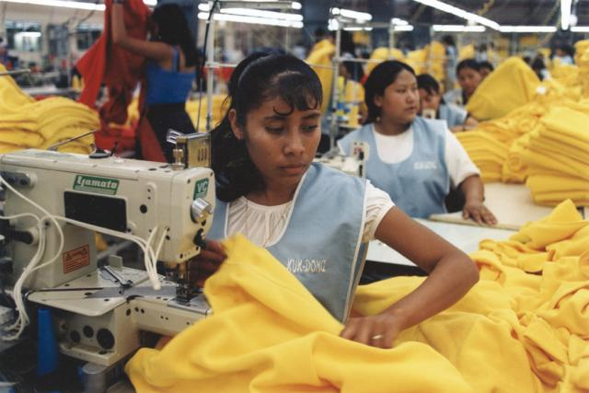
How fair is fashion?
To what extent has industrialization (development of factories) in Bangladesh brought more issues than benefits?
L.O : To understand the impacts of industralisation on developing countries such as Bangladesh
To understand the environmental, social and economic impacts of the fashion industy
To evaluate how production practices can be made more sustainable

Slide 2
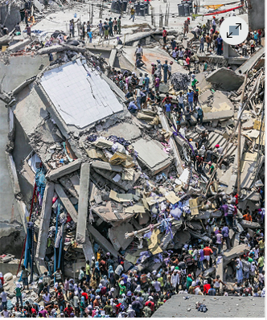
IDEAL analysis
I
Identify what can you see?
D
Describe the impacts this may have had
E
Explain- why may this have happened?
A
Apply- how does our desire for ‘fast fashion’ lead to this?
L
Link- How does this link to the topic of globalisation responsible consumption and production ?
Complete the IDEAL analysis on your sheet.

Slide 3
Fast Fashion – fast fashion: trendy clothes designed, created, and sold to consumers as quickly as possible at extremely low prices. New looks arrive in stores weekly or even daily, and they cost so little that many people can afford to fill their closets with new outfits multiple times each year—then toss them the minute they go out of style.

Slide 4
Key questions regarding fast fashion
What are the environmental concerns regarding fast fashion?
What are the social issues regarding fast fashion?
What are the economic issues?
To what extent has industrialization (development of factories) in Bangladesh brought more issues than benefits?

Slide 5
Thinking
Key Terms
It is important to remember that a country can pass through these stages at different times…
Pre-Industrial
Industrial
Post-Industrial
The period of time before a country goes through the industrial revolution
The time of an industrial revolution when a country’s economy relies heavily on manufacturing (making things)
The period of time following deindustrialisation when a country’s economy makes more money from the tertiary sector (services)

Slide 6
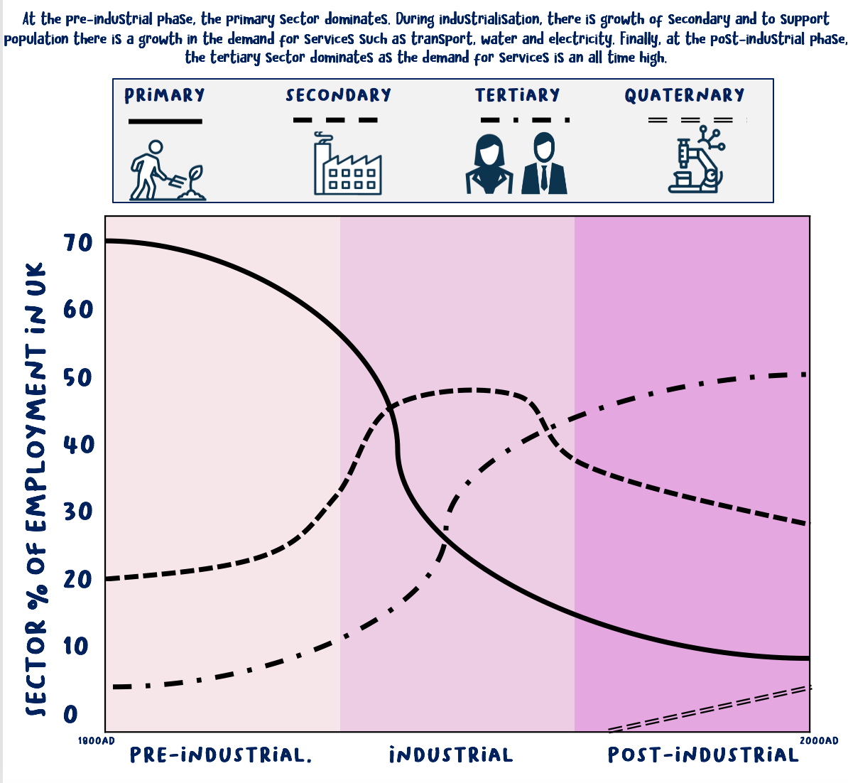
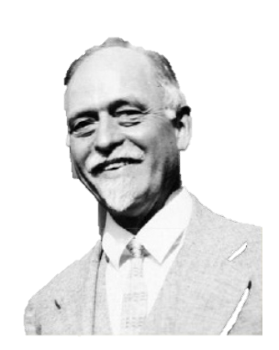
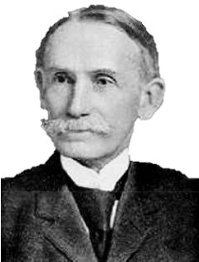
Realising
The Clark Fisher Model
The Clark-Fisher model shows changes in employment structure through time. The model plots the percentage of employment across the 4 sectors of the economy to show how a country transits through a pre-industrial, industrial and post-industrial era.
Irving Fisher was a professor of Mathematics at the University of Yale.
John Clark was a professor at Columbia University.

Slide 9
Information race
You are going to work with a partner to collect as much information as possible to be able to answer 14 questions about the information

Slide 10
Information race questions
What is the daily wage?
How many garments does the fast fashion industry churn our annually?
What are the worlds 2 biggest polluters?
In 1990 how many of American clothes were made in the USA?
What % of our clothes are now made in the USA?
How many garment workers are there globally?
What are the top 2 clothing producers?
What is the average weight of clothes an American throws away per year?
How many garments do Americans buy each year?
How many people were killed in the Rama plaza incident?
Since the rana plaza incident how many have been trained in safety procedures?
How much has the minimum wage increased to in some parts of China?
What is an issue of increasing wages and improving buildings?
How much water does it take to make one pair of jeans?

Slide 11
Information race answers
What is the daily wage? $3
How many garments does the fast fashion industry churn our annually? 150 billion
What are the worlds 2 biggest polluters? The oil industry and the fashion industry
In 1990 how many of American clothes were made in the USA? 50%
What % of our clothes are now made in the USA? 2%
How many garment workers are there globally? 75 million
What are the top 2 clothing producers? China and Bangladesh
What is the average weight of clothes an American throws away per year? 76 pounds
How many garments do Americans buy each year? 20 billion
How many people were killed in the Rama plaza incident? 1,100
Since the rana plaza incident how many have been trained in safety procedures? 2 million
How much has the minimum wage increased to in some parts of China? $312
What is an issue of increasing wages and improving buildings? The increased cost means that the factories can not afford to fill orders so the big manufacturers shift to cheaper locations abroad
How much water does it take to make one pair of jeans? 1,800 gallons of water

Slide 12
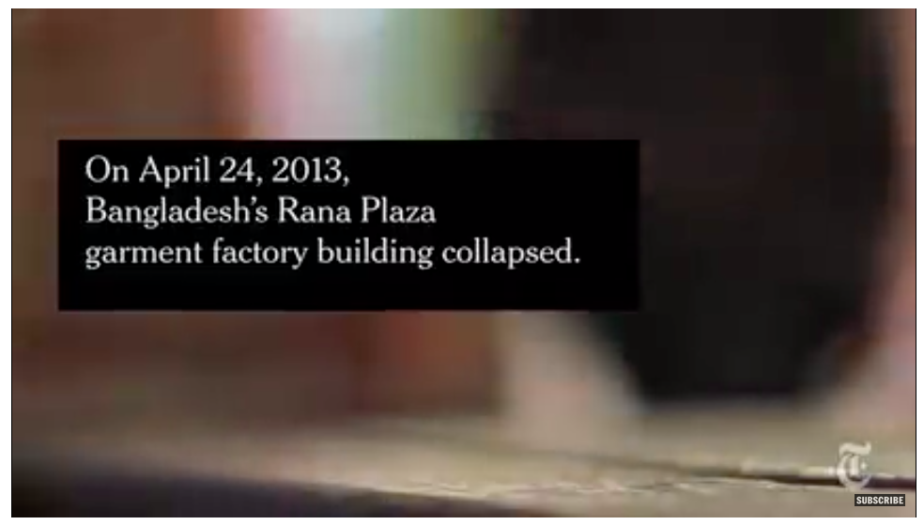
Bangladesh factory collapse toll passes 1,000
http://www.bbc.com/news/world-asia-22476774

Slide 13
What are the environmental concerns regarding fast fashion?
What are the social issues regarding fast fashion?
What are the economic issues?
To what extent has industrialization (development of factories) in Bangladesh brought more issues than benefits?

Slide 14
Watch the DVD: How fair is fashion? Case study Bangladesh
What are the advantages of the fashion industry for Bangladesh?
What are the disadvantages of the fashion industry for Bangladesh?
What are the solutions?

Slide 15
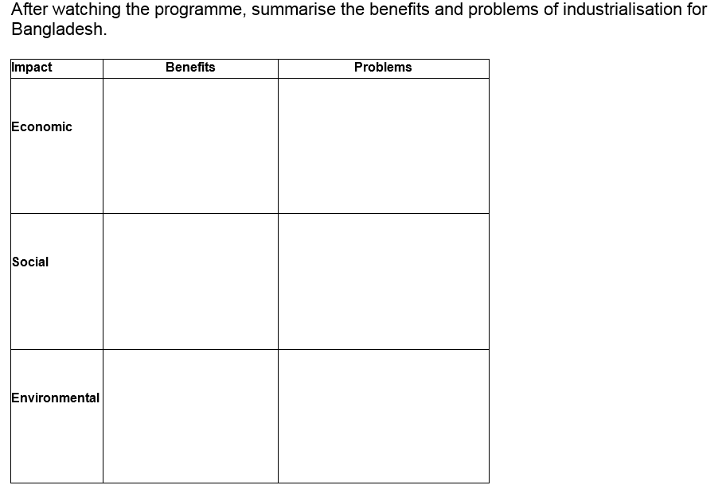
The benefits and problems of the textile industry for Bangladesh
Summary:
To what extent has industrialization (development of factories) in Bangladesh brought more issues than benefits?
Impact | Benefits | Problems
Economic
Social
Environmental
Use the padlet to help organize your answers

Slide 16
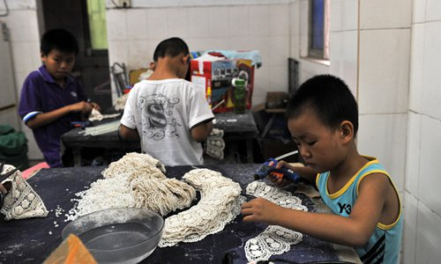
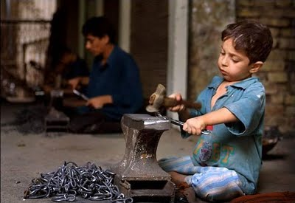
India’s sweatshop child workers
Task: As we watch the short clip, write the answers to the questions down.
Where does Stacey Dooley visit?
What is the average age of the children found working in the factories?
What caused Muhammed to run away from the factory?
https://www.youtube.com/watch?v=xGQceWoqVpA (from 25-30 mins)
Notes:
ANSWERS
A school set up by a local charity to meet some of the kids that have been rescued from factory work
9-12 years old
His adult factory boss worker beat him up

Slide 17
What drives child labour overseas?
Task: Match the pairs. Match each statement to its correct description by shading it the same colour. One has been done for you.
Employers lose money when, by law, they have to pay employees at weekends or during holidays | Legally allowed to pay women and girls less | There are organisations that exist to fight for better pay for workers (which turn costs firms money and reduces their profits). In some countries, trade unions are still illegal and workers have nobody to turn to in order to help them improve their pay and working conditions | Fewer health & safety rules
Little requirement to pay for medical insurance and sick pay | Employers must pay workers overtime (more money) if they work more than the agreed number of hours. | Special clothing or safety features in the workplace can cost employers a lot of money to buy and install, especially in dangerous industries, such as mining. | A lack of trade unions
It costs a firm money to keep paying wages to an injured worker at the same time as paying wages to his/her replacement | In countries where men and women have equal rights, it costs more to employ women. In countries where discrimination is allowed, women can be paid less and so firms save money. | Maximum number of working hours per week | No holiday pay/fewer days off

Slide 18
What drives child labour overseas?
ANSWERS
Employers lose money when, by law, they have to pay employees at weekends or during holidays | Legally allowed to pay women and girls less | These are organisations that exist to fight for better pay for workers (which turn costs firms money and reduces their profits). In some countries, trade unions are still illegal and workers have nobody to turn to in order to help them improve their pay and working conditions | Fewer health & safety rules
Little requirement to pay for medical insurance and sick pay | Employers must pay workers overtime (more money) if they work more than the agreed number of hours. | Special clothing or safety features in the workplace can cost employers a lot of money to buy and install, especially in dangerous industries, such as mining. | A lack of trade unions
It costs a firm money to keep paying wages to an injured worker at the same time as paying wages to his/her replacement | In countries where men and women have equal rights, it costs more to employ women. In countries where discrimination is allowed, women can be paid less and so firms save money. | Maximum number of working hours per week | No holiday pay/fewer days off

Slide 19
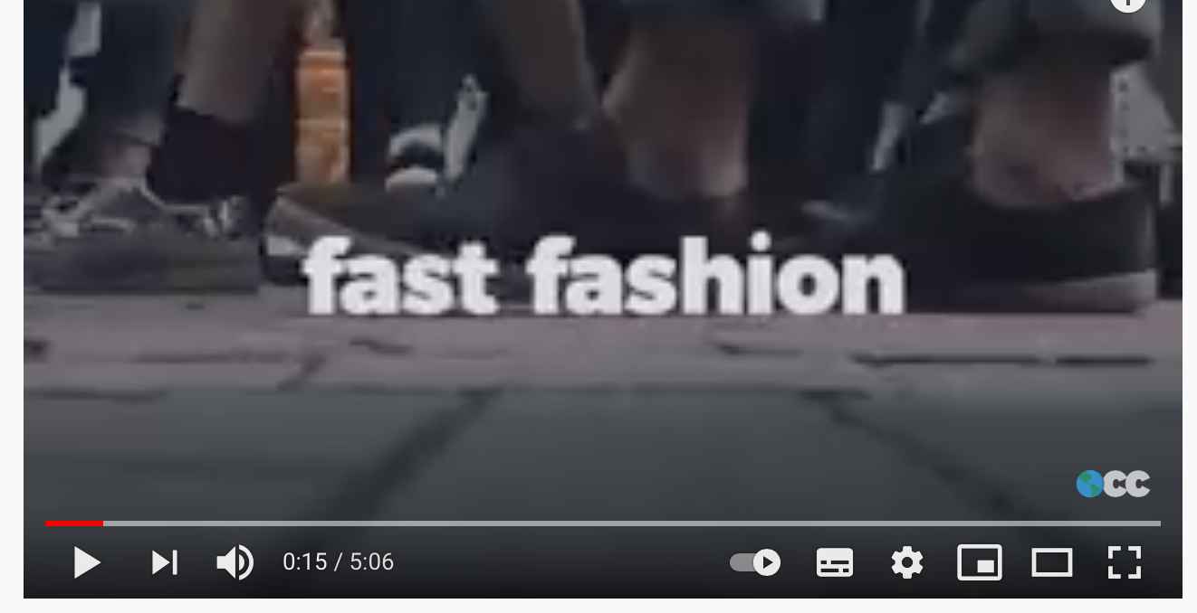
How is fashion destroying our environment?
Watch this video and list the ways in which fashion is having an environmental impact
https://www.youtube.com/watch?v=YOA0D0i5-fA&t=4s

Slide 20
Research: Conduct a survey into buying habits
Why: Plan, collect, record, organise, interpret and analyse qualitative and quantitative data and information about peer fashion consumption.
How could you collect this data?
How could you present this data- use qualitative and quantative information
From this information what conclusions can you conclusions draw about potential environmental and social impacts.

Slide 21
Choice of task: decide which group you will be in
Group 1 Meeting the trade unions! (Good for students with a liking for drama, acting, creative writing) Prepare a short play of about 5 minutes length to show the discussions between factory owners (3 people), factory workers like Jorna (3 people) and the Trade Union (2 people). | Group 2 Campaign! (Good for students with a liking for current affairs, politics, public speaking) Prepare a presentation – in role – of about 5 minutes length to show how team of Factory Inspectors (4 people) might report on the conditions they found in the factory when they met the owners (4 people). The factory is the one you have seen in the programme.
Group 3 Enquiry ! (Good for students with a liking for activity, finding out, face-to-face meeting with people) Design a questionnaire which you can ask the following groups of people about clothing, about factories in countries such as Bangladesh, and about Fair Trade. | Group 4 Researchers! (Good for quieter students with a liking for research!) You are a reporter from the USA. You are writing a magazine article for the National geographic magazine to explain the causes and impacts of clothing manufacturing in Bangladesh.

Slide 22
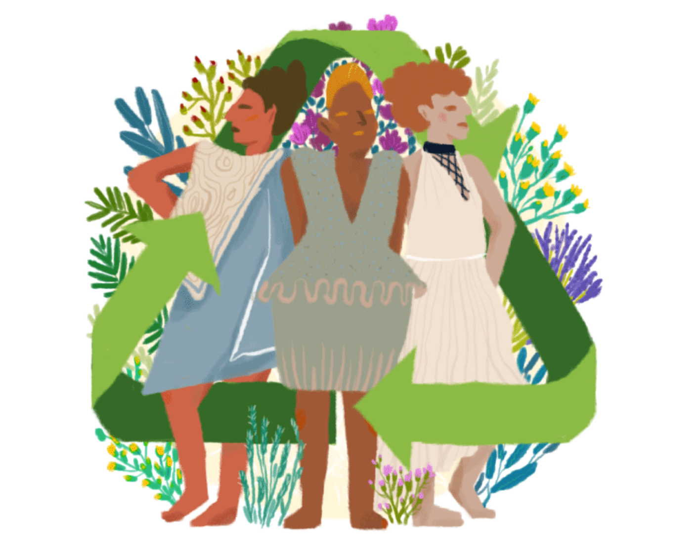
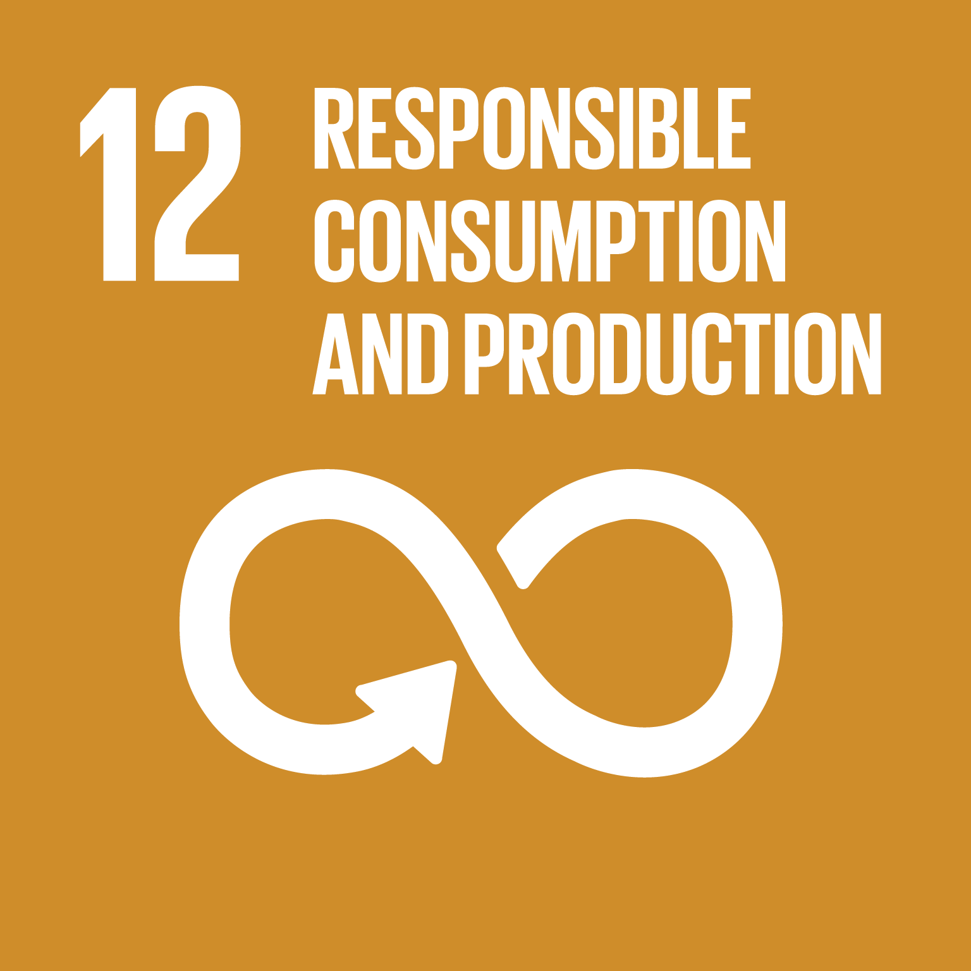
Can fashion be made more sustainable?
LO:
To evaluate the social and environmental costs of fashion
To look at ways in which fashion brands are becoming more sustainable

Slide 23
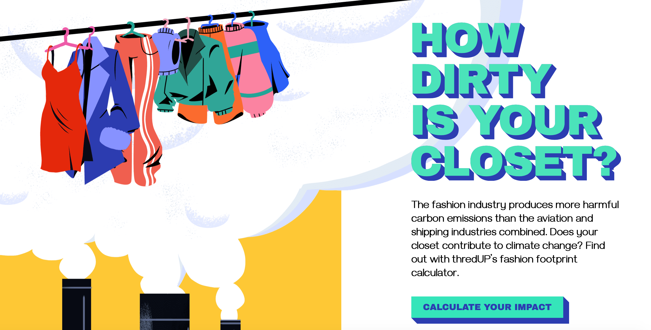
What is your fashion footprint?
https://www.thredup.com/fashionfootprint

Slide 24
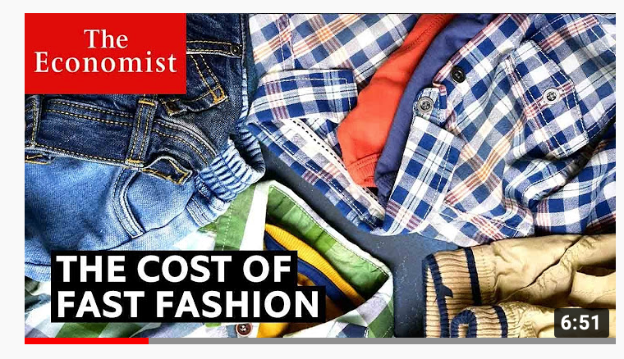
How are brands responding?
Watch this video and make notes on the different ways in which fashion companies are trying to be more sustainable
https://www.youtube.com/watch?v=tLfNUD0-8ts&t=88s

Slide 25
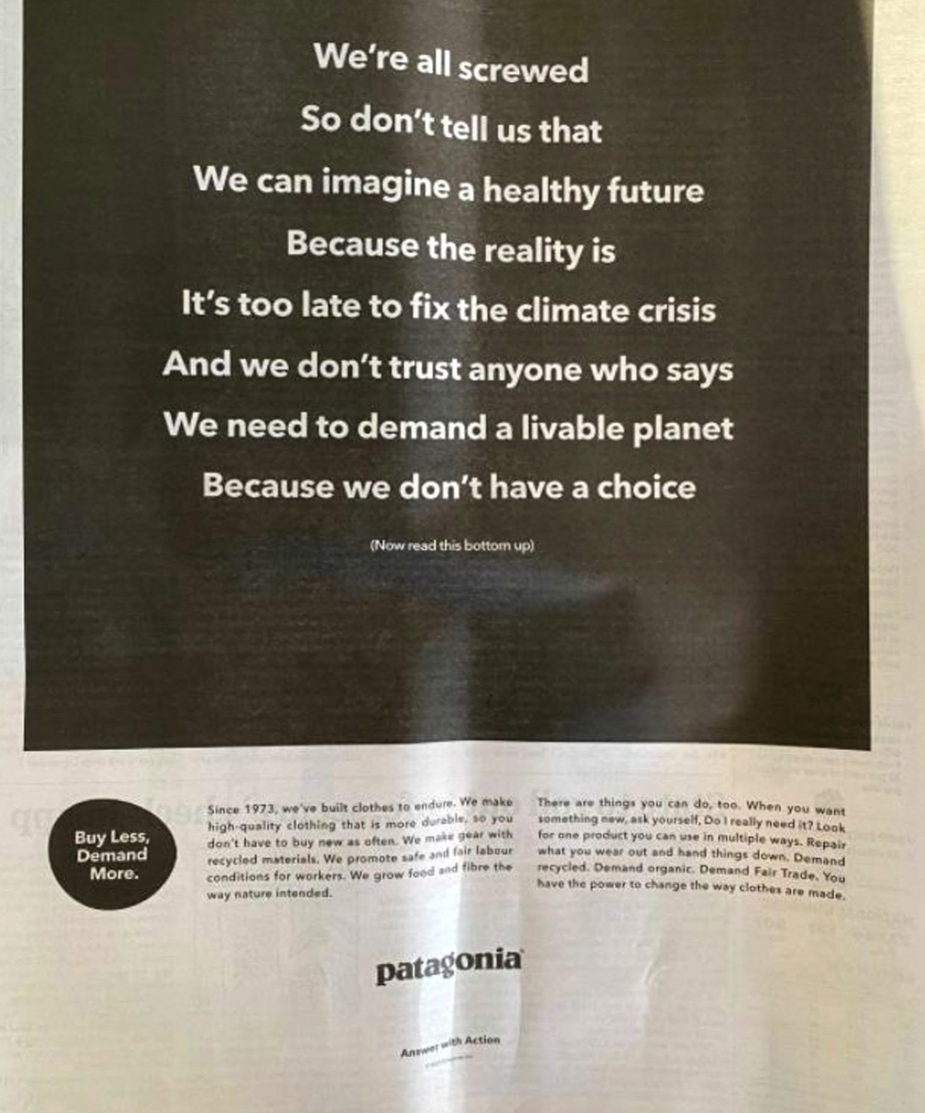
How are brands responding?
https://www.patagonia.com/our-footprint/

Slide 26
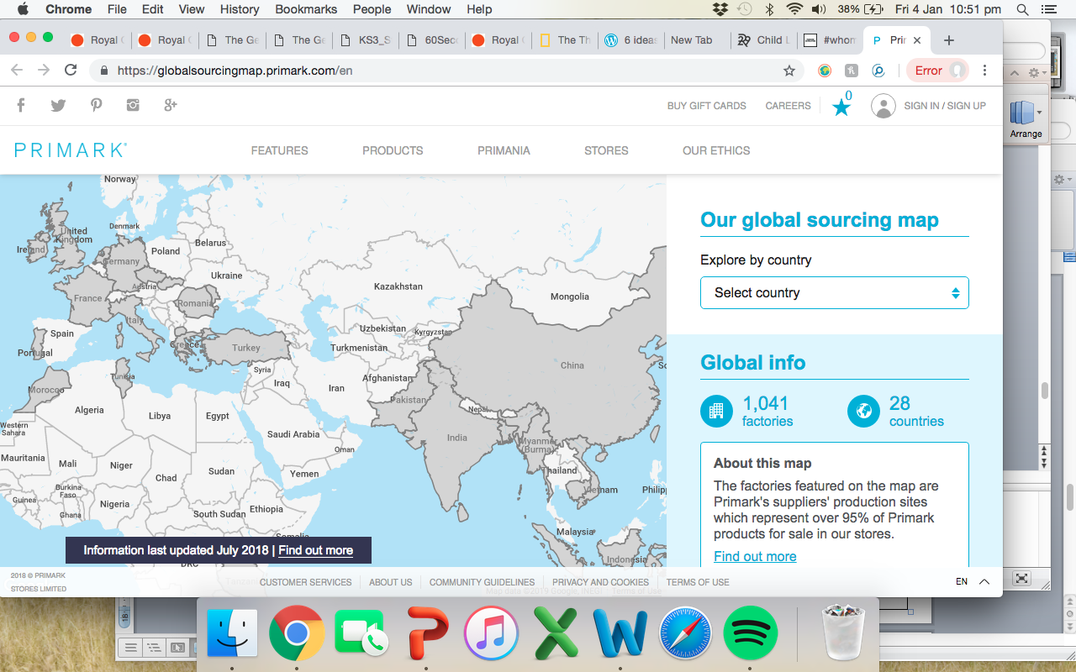
How are brands responding?
Primark now publish their factory locations on their website, including details of who works in each factory. Explore the link below!
https://globalsourcingmap.primark.com/en

Slide 27
How are brands responding?
Fashion Revolution published a report on the ‘Fashion Transparency Index 2018’. Some key findings:
“55 of the 150 brands (37%) included are publishing a list of their factories at the first tier, where clothes are typically cut, sewn and trimmed.”
Supplier lists have become a lot more detailed, including information such as factory street address, types of products they make and the number of workers.
Only one brand in the Fashion Transparency Index 2018, ASOS, discloses where they source raw materials. However, no brands were disclosing this information last year.
https://www.fashionrevolution.org/tag/whomademyclothes/

Slide 28
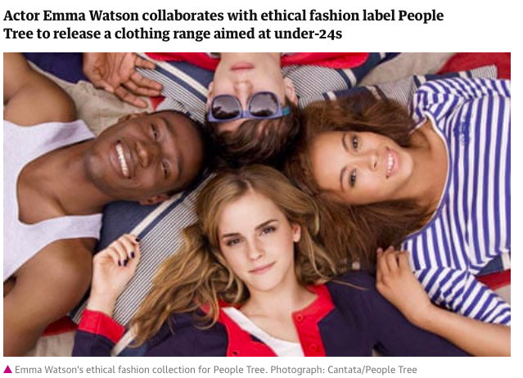
Solution: Fair trade fashion- People Tree
https://www.peopletree.co.uk
Guardian: Emma Watson launches ethical fashion range with People Tree
https://www.youtube.com/watch?v=VHLHphzxULg

Slide 29
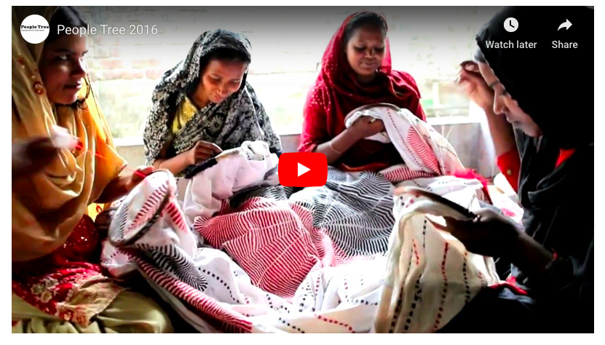

Slide 31
How can we promote responsible consumption?
Research two other ways that you can be a more responsible clothing consumer. You have a choice of how you present your findings. You may present your findings in any one of these three ways: As a poster, which must be a persuasive advert encouraging a more responsible fashion industry. As a piece of writing, which clearly explains the two methods you have found and how they help. As another creative piece (could be a piece of art/cartoon/song/rap/video – you can be as creative as you wish!) ​

Slide 32
Exam question
To what extent has industrialization (development of factories) in Bangladesh brought more issues than benefits?
Step 2: On one hand...
Step 3: On the other hand...
Below 4
You describe the advantages and disadvantages of globalisation
The advantages of industrialization
The disadvantages of industrialization
Because
Because
This means
Example
Example
Challenge
This means
Can you explain what conclusion you would reach?
Link
Marks 5-6
You explain the opportunities and challenges of globalisation
Point
Link
Point
7 marks
You fully evaluate the advantages and disadvantages of industralsiation and include specific case study detail
Literacy
Can you use these key terms:
Whereas
However
On the other hand

