Slide 1
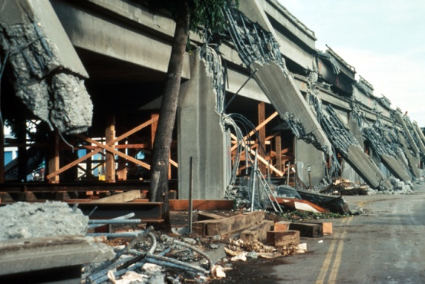
How does California prepare for Earthquake hazards?
LO:
To understand how natural hazards can be managed

Slide 2
Why does California need to prepare?
http://earthquake.usgs.gov/earthquakes/recenteqsus/

Slide 3
What is this device? How does it help manage the impact of an earthquake

Slide 4
Koso - The California Valve These valves are earthquake-sensitive gas shut-off valves. They are intended to close in the event of an earthquake to prevent gas flow into a structure where earthquake damage may have occurred. This will greatly reduce potential risk of explosion or fire due to loss of gas line integrity or uncontrolled flow of gas after a major earthquake.

Slide 5
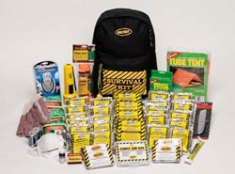
What is this product? How does it help manage the impact of an earthquake

Slide 6
Task: prepare a leaflet for new students and parents at the British International School of San Francisco to explain how they can survive in an earthquake
Success criteria:
Explanation of why the need to prepare for a quake in San Francisco
Before: How they can prepare themselves and their surroundings before the quake
During: how should they protect themselves during the quake?
After: How can they make sure themselves and area is safe after the quake?
OR:
Design an earthquake proof building:
You can use IT, modeling, drawings etc.
It must be annotated to explain the key features that make it earthquake ‘proof’.

Slide 7
http://quakequizsf.org/

