Slide 1
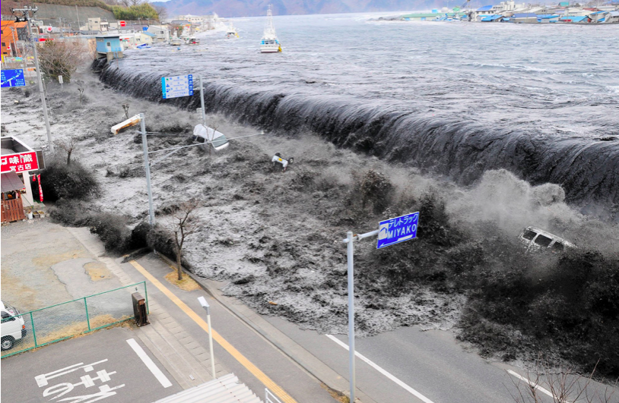
The formation of a tsunami
Geographical processes
What: How are tsunamis formed?
Why: To understand that tectonic activity produces different hazards and to develop our understanding of why the 2011 Japanese was so deadly
How: Use a range of resources to develop a sequence of how a tsunami was formed

Slide 2
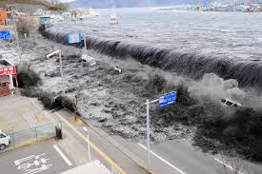
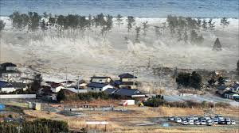
What is a tsunami?
A tsunami is a series of ocean waves that sends surges of water, sometimes reaching heights of over 100 feet (30.5m) onto land.
These walls of water can cause widespread destruction when they crash ashore.

Slide 3
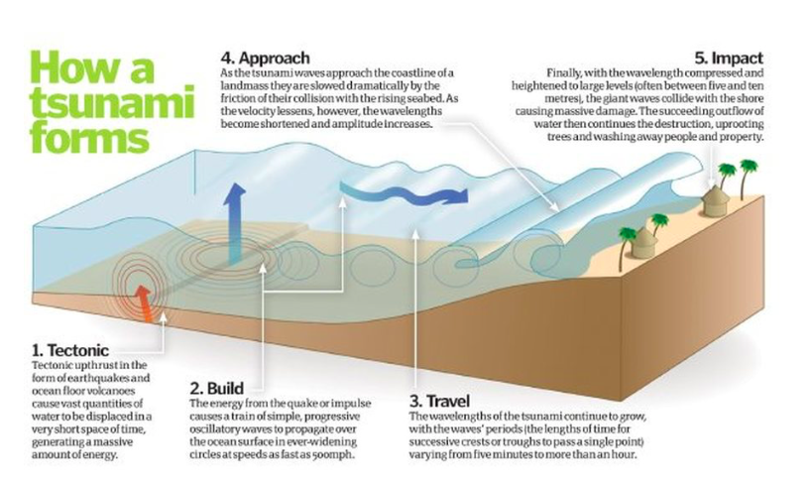

Slide 4
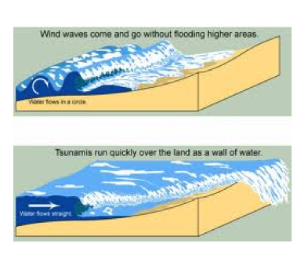
How are they different to normal waves or tidal waves?
Unlike a tidal wave, the waves of a tsunami move the entire depth of the ocean, from the surface of the water all the way down to the seabed.
They also hold a massive amount of energy.
80% of tsunamis occur in the ‘ring of fire’.

Slide 5
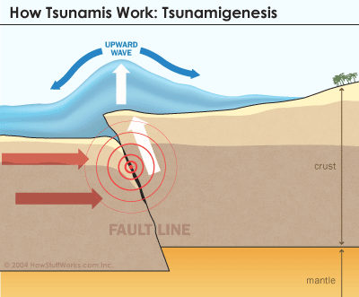
What causes a Tsunami?
Tsunamis are usually caused by large, undersea earthquakes at tectonic plate boundaries.
When the ocean floor at a plate boundary rises or falls suddenly, it displaces the water above it and launches the rolling waves that will become a tsunami.
Tsunamis may also be caused by underwater landslides or volcanic eruptions.
They may even be launched, as they frequently were in Earth’s ancient past, by the impact of a large meteorite plunging into an ocean.

Slide 6
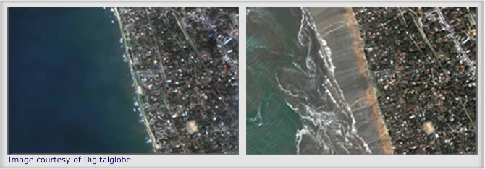
What happens when a tsunami reaches land?
A tsunami’s trough, the low point beneath the wave’s crest, often reaches shore first.
When it does, it produces a vacuum effect that sucks coastal water seaward and exposes the harbour and sea floors.
This is called the drawback. The main part of the wave typically hits shore 5-15 minutes later.

Slide 7
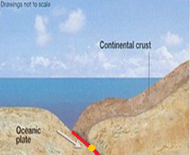
Task: How do tsunamis form?
Watch the videos on the weebly to help
1.Carefully examine the statements below. Put them in the order in which they occur to create a tsunami:
Sea movement causes Tsunami
Plate movement causes earthquake
Waves crash onto shore
Sea above earthquake forced upwards
Plates move towards each other
Tsunami waves spread quickly outwards
2 Make a larger, neater (better) coy of the diagram below. Use the material on this page to fully annotate the diagram in order to fully explain how tsunamis form. Remember to give the diagram a title, to use a ruler for arrows, to draw a frame around your diagram.
Taking it further: Instead of just one diagram you could draw a series of diagrams like the ones below to show to the formation of a tsunami

Slide 8
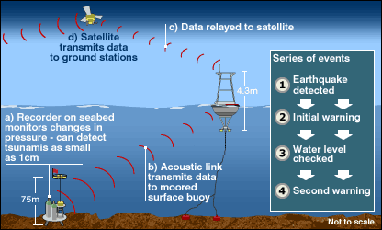
Warning Systems
Although tsunamis can be caused by a few events, most commonly they are caused by earthquakes.
Because scientists are now aware of this connection they have been able to conduct research and set up monitoring systems to help countries of oncoming tsunamis.

Slide 9
Plenary: How Geography lessons could save lives
Watch the video and see how Tilly Smith’s Geography lesson saved lives during the 2005 Indian Ocean tsunami

