Slide 1
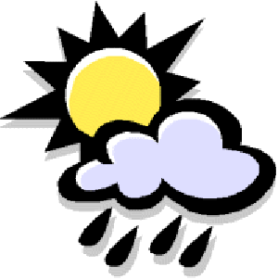
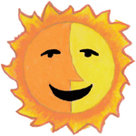
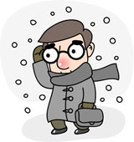
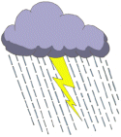
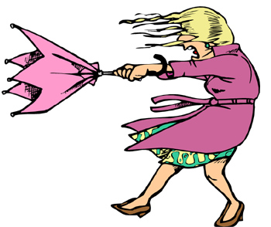
Weather and Climate
WHAT
How do you measure the weather?

Slide 2
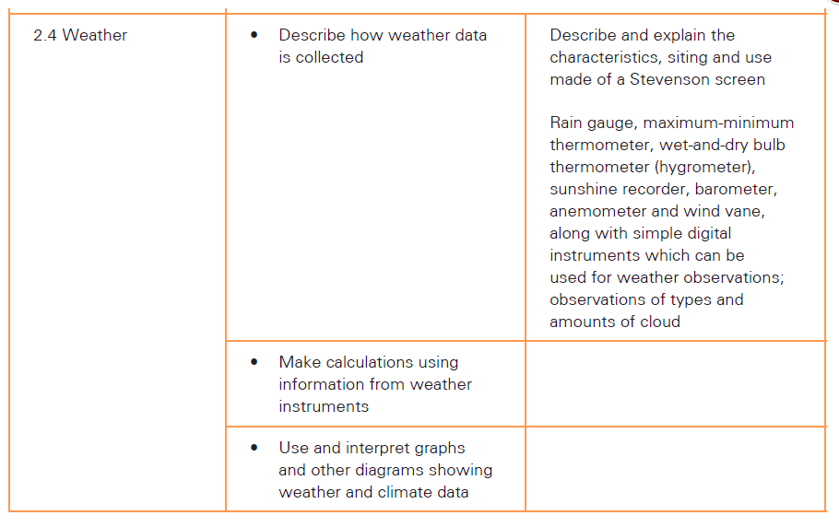

Slide 3
Weather and Climate
What do we mean by weather and climate?

Slide 4
Starter
Why is it important that we predict the weather?
http://www.youtube.com/watch?v=uqs1YXfdtGE&feature=player_embedded
https://www.youtube.com/watch?v=9yYHpceYlSU

Slide 5
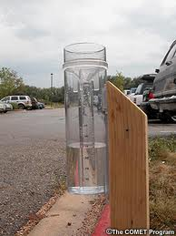
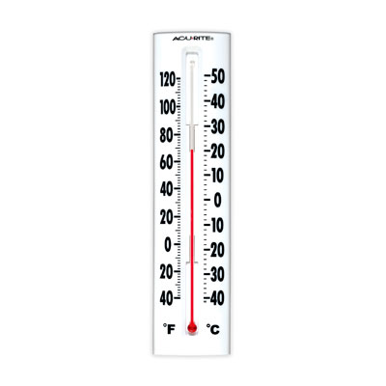
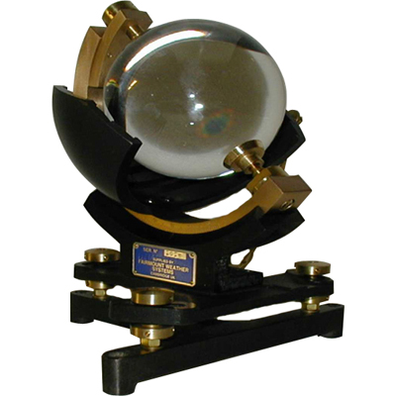
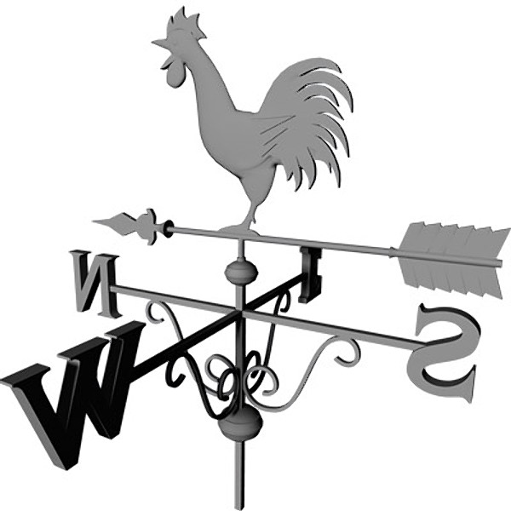
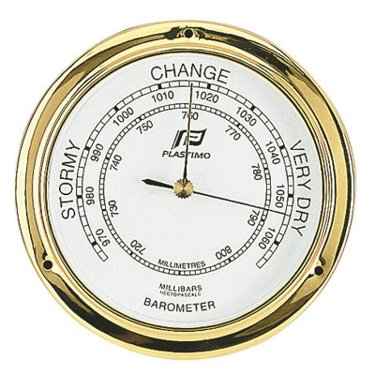
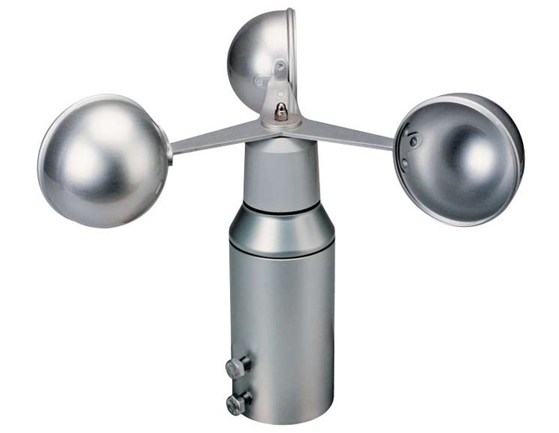
Measuring the weather: what do these instruments do?
A
B
C
D
E
F
Notes:
This is the starter activity. I asked pupils to write down the name and function for each of the instruments on the board. I didn’t give them the answers at this point but used this to gauge their prior knowledge. The answers are:
A = Rain Gauge, B = Thermometer, C = Sunshine Measurer, D = Wind/Weather Vane, E = Barometer, F = Aneometer

Slide 6
Lesson Information Screen
By the end of this lesson, I would like you to be able to name and explain how each of the pieces of equipment used to measure the weather shown below work:
rain gauge
sunshine measurer
maximum and minimum thermometer
anemometer and wind vane
Barometer
Stevnsenson screen
Keywords
WHAT
How do you measure the weather?
anemometer barometer
thermometer Stevenson screen
wind vane Beaufort scale

Slide 7
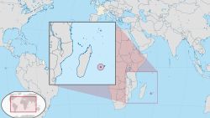
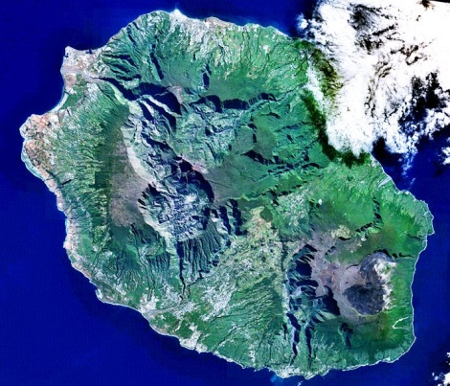

Rainfall Fact
The greatest amount of rain recorded worldwide in 24 hours was in La Reunion in the Indian Ocean, when 1825mm fell between 7th and 8th January 1966.

Slide 8
Instruments to research:
Maximum-minimum thermometer
Barometer
Wet-Dry bulb thermometer (hygrometer)
Anemometer
Wind Vane
Rain Gauge
Sunshine recorder
Stevenson's Screen (not really an instrument)
For each of these instruments you will need to explain to following:
What are they (include a photo/diagram)?
What weather do they measure?
What units or data do they give us?
How do they work?
Where should they be place for accuracy and why?

Slide 9
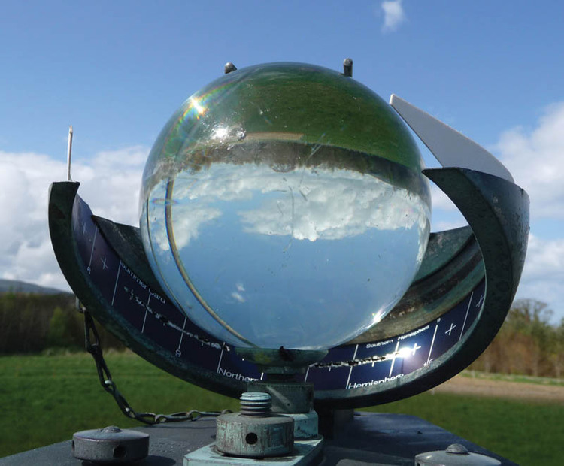
How much sunshine?
Notes:
Click on the picture to go to a 3D moveable picture of a Sunshine Measurer. I normally show pupils this picture and ask them to predict how they think it works.

Slide 10

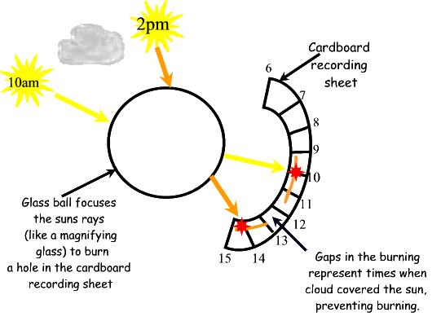
How a sunshine recorder works
Notes:
A good question to ask the pupils is why the glass has to be in the shape of a ball. It gives pupils a good opportunity to link this back to prior learning on Astronomy and the fact that the Sun appears to move across the sky during the day and so to collect the sunlight all day, it needs to be in the shape of a ball.

Slide 11
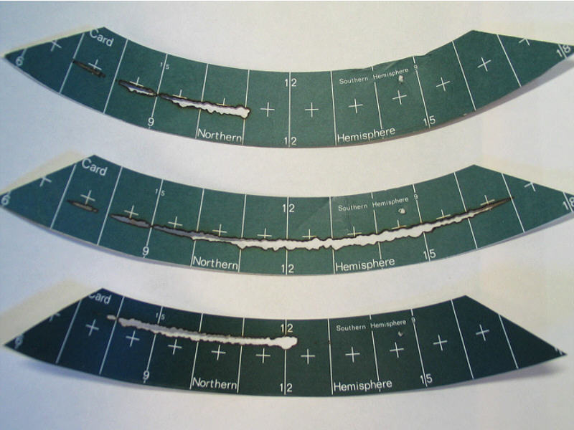
Skill: Analysing Results
Use the sunshine cards below to write a sunshine report for each day
Mon.
Tue.
Wed.
Notes:
This slide gives pupils a chance to demonstrate their data handling skills. I ask them to write down three ‘conclusions’ that they can make from looking at the results of this experiment. You could give them an example such as ‘The sunniest day was Tuesday’.

Slide 12
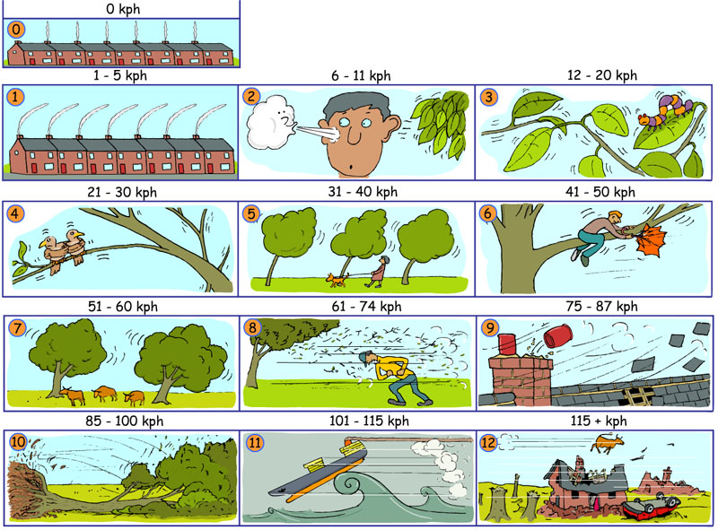
The Beaufort Scale
Can you write the descriptions for the Beaufort Scale?
Two examples have been done for you.
smoke rises vertically
trees uprooted
Notes:
I use this slide to introduce pupils to the Beaufort Scale. I ask them to write down 0 to 12 in rough and write in what they think will happen for each of the levels as shown by the picture. I tell pupils that the numerical speeds included here were only added at a later date and were not part of the original scale.

Slide 13
The Beaufort Scale
Beaufort Scale | Effects | Speed (kph)
0 | Smoke rises vertically | 0
1 | Smoke drifts | 1-5
2 | Wind felt on face, leaves rustle | 6-11
3 | Leaves and small twigs move | 12-20
4 | Small branches move | 21-30
5 | Small trees sway | 31-40
6 | Large branches sway, umbrella used with difficulty | 41-50
7 | Whole trees sway | 51-60
8 | Twigs break off trees, hard to walk into wind | 61-74
9 | Chimney pots and slates blow off | 75-87
10 | Trees uprooted | 85-100
11 | Rarely occurs inland | 101-115
12 | Disastrous, widespread damage | 115+
Notes:
This gives pupils a list of the written definitions for each level on the scale. This can lead to quite a good discussion on why this isn’t a very good system. For example – what is the difference between a twig and a small branch? When does a tree become a small tree rather than a whole tree? I explain that we have since added in the speeds to give a more accurate scientific description for each level.

Slide 14
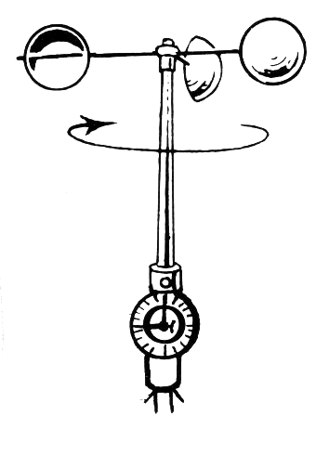
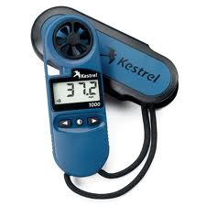
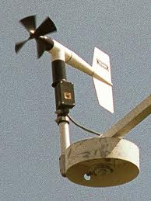
How fast is the wind?
An anemometer is an instrument used to measure how fast the wind is flowing.
Notes:
This is where you will need to explain to pupils that this instrument needs something that can spin and the amount of revolutions is counted to arrive at the speed of the wind.

Slide 15
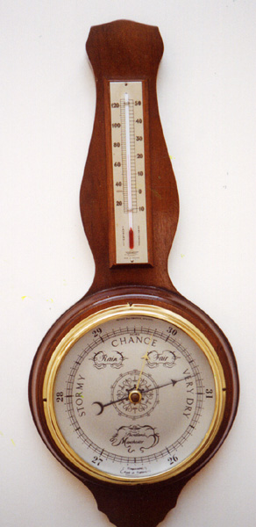
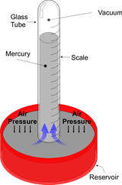
Barometer
Air pressure is the weight (force) of the air above pressing down on the Earth. It is measured using a Barometer.
There are two main types of Barometer:
Mercury
Aneroid
The unit of measurement for air pressure is kilopascals (kPa) or inches of mercury.

Slide 16
Mercury Barometer
A mercury barometer is a tube of mercury that is open at one end and placed in a dish of mercury.
How does it work?
The density of the air above the dish is constantly changing. The air above is pushing down on the mercury in the dish. As it pushes down more, the mercury is pushed further up the tube.

Slide 17
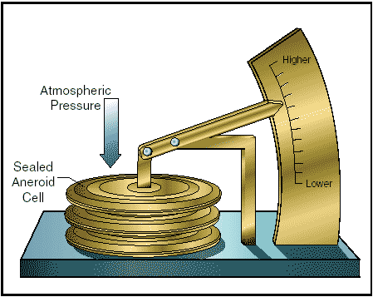
Aneroid Barometer
An aneroid barometer works by having a sealed box that can change shape. As the air pushes down on the box, it changes shape and moves the needle accordingly.
Notes:
Click on the picture to take you to a video about air pressure.

Slide 18
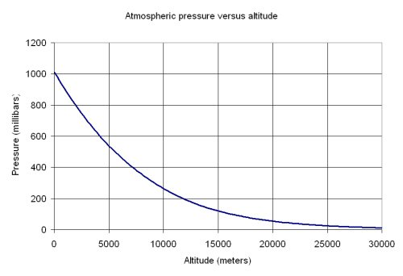
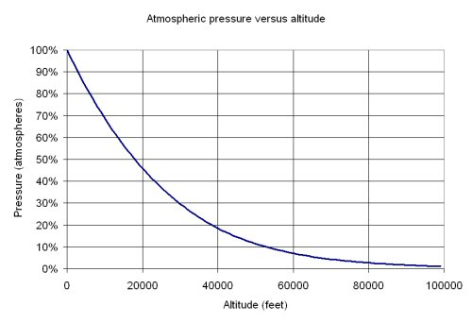
Questions on Pressure and Altitude
What is the atmospheric pressure at sea level?
At what altitude is the pressure 800 millibars?
At what altitude is the pressure 50% of that at sea level?
The capital city of Ethiopia, Addis Abeba, is amongst the highest in the World. It is 2300m (7725ft) above sea level. What is the air pressure at this level?
Roberto answered a question in class. He said that the air pressure at 3000m was about 30% of that at sea level. Can you explain his mistake?
Write a sentence that sums up the relationship between the variables altitude and pressure (Hint – try to use an er… er…. sentence).
Notes:
I would suggest that you will need to give pupils a copy of these graphs in front of them to use when answering these questions.

Slide 19
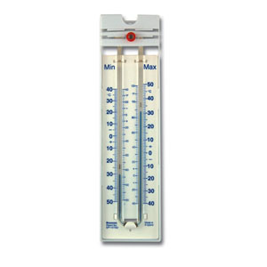
Maximum and Minimum Thermometer
A maximum and minimum thermometer is a temperature measuring device that is designed to show the highest and lowest temperatures reached.
It works by having a thermometer that has been turned into a U-Tube shape. At either end of the mercury is a small marker. This is pushed higher or lower up the tube by the contents of the tube.

Slide 20
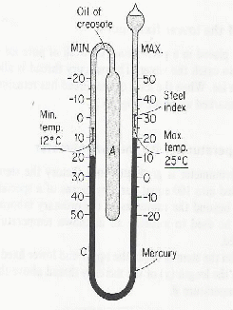
Maximum and Minimum Thermometer
The key science to remember when looking at how this works is that when things are warmer, they expand.
When the temperature is cold, the oil of creosote will contract and draw the liquid mercury up this side of the tube. This pushes the minimum marker upwards.
When the temperature is warm, the oil expands and pushes the marker up this side of the tube. It stays at the maximum.

Slide 21
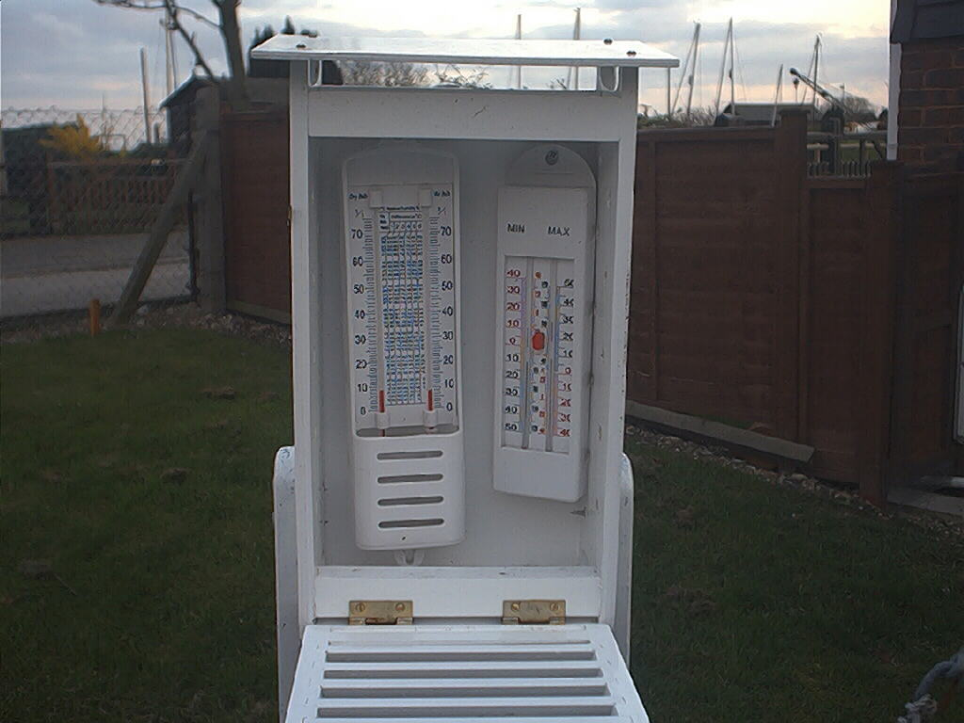
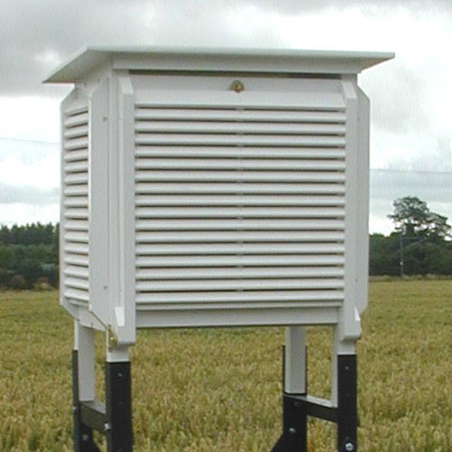
Stevenson Screen
A Stevenson Screen is used to house a maximum and minimum thermometer. It is designed to prevent the thermometers from giving a false reading.
Why is it painted white?
White is the best colour to reflect heat off of the box.
Why is it on stilts?
Being on stilts stops heat entering the box by conduction from the ground.
Why does it have slats on the side?
The slats on the side of the box allow the wind to flow through the box as this will give the correct air temperature.

Slide 22
Lesson Information Screen
By the end of this lesson, I would like you to be able to name and explain how each of the pieces of equipment used to measure the weather shown below work:
rain gauge
sunshine measurer
maximum and minimum thermometer
anemometer and wind vane
barometer
Keywords
WALT
How do you measure the weather?
anemometer barometer
thermometer Stevenson screen
wind vane Beaufort scale

