Slide 1
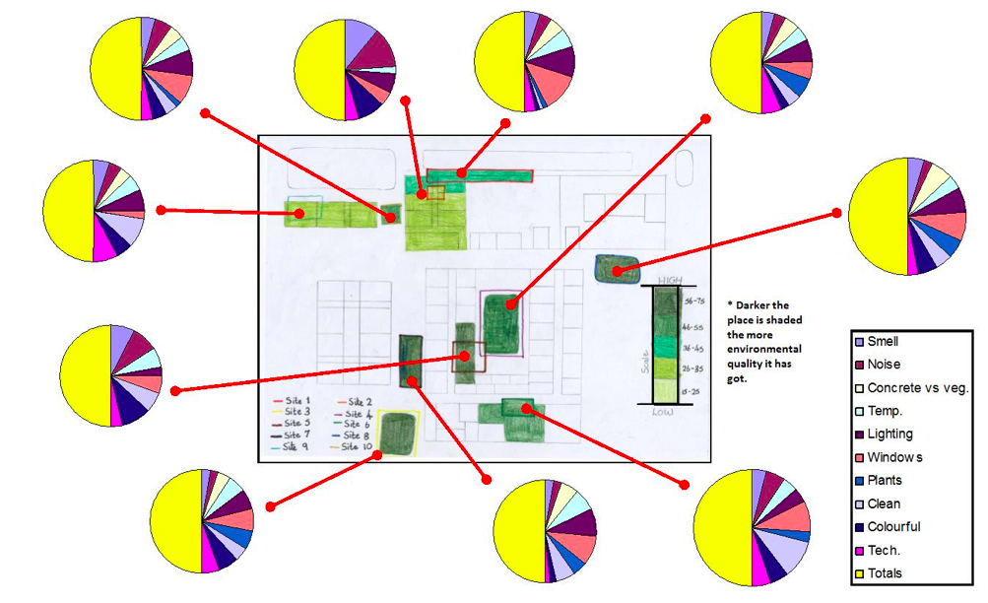
School microclimates enquiry
Data presentation
How do I display data?
Aim: To understand various appropriate ways to present data

Slide 2
How can we display data?

Slide 3
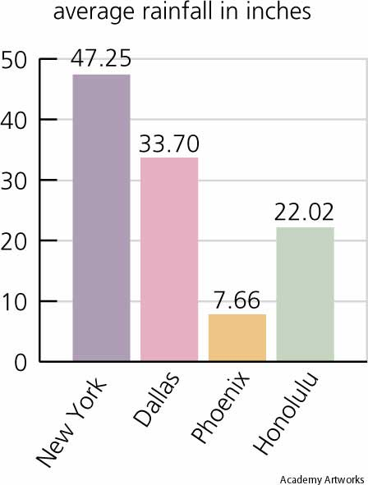

Slide 4
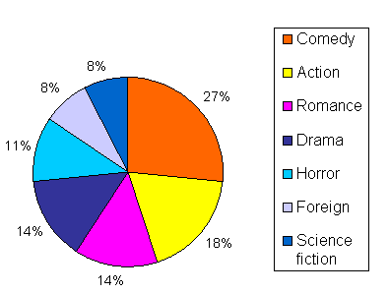
How to draw a pie cart
Add up all the numbers to come up with a total
Work out each data set as a percentage of the total
Multiply the percentage by 360 to get the degrees

Slide 5
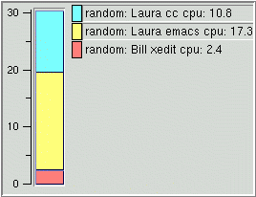
Divided bar chart
How to draw a divided bar chart
Add up all the numbers to come up with a total
Work out each data set as a percentage of the total
3. Draw your graph of the percentages

Slide 6
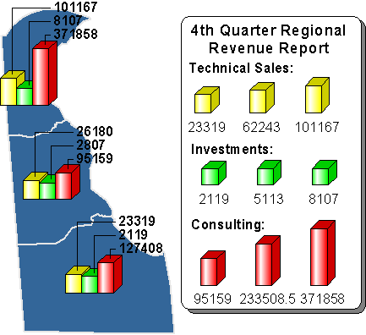
Located Bar graph
How to draw a located bar chart
1. Work out a scale like a normal bar chart.
2. Draw one bar next to each continent – use the same scale for each bar

Slide 7
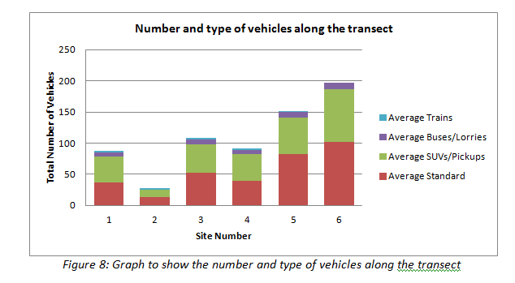

Slide 9
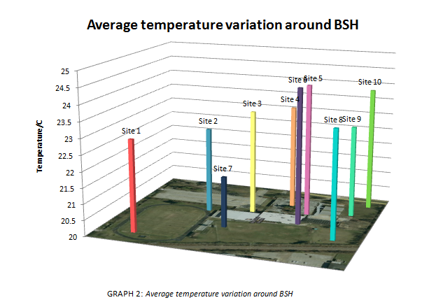

Slide 10
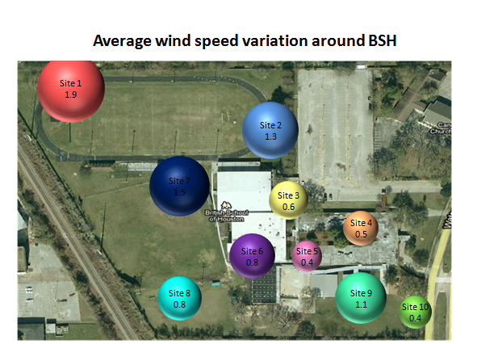

Slide 11
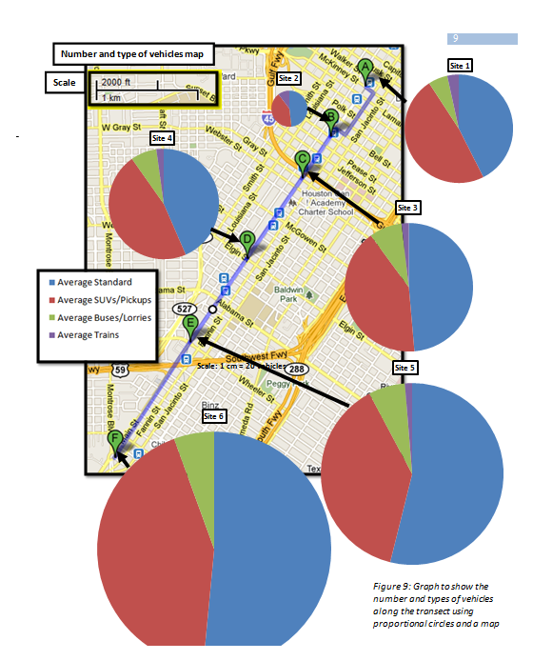

Slide 12
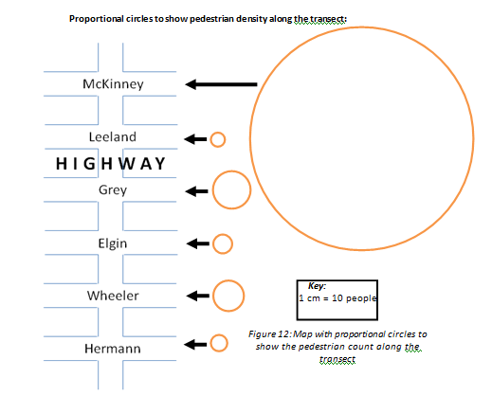

Slide 13
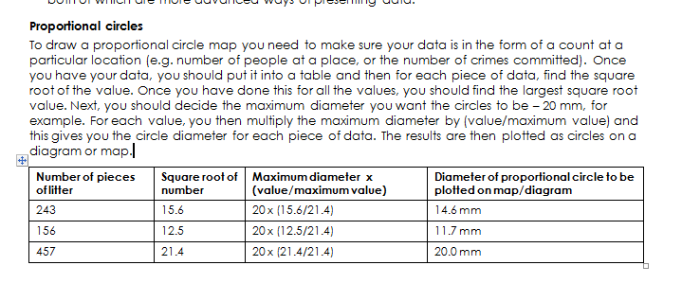

Slide 14
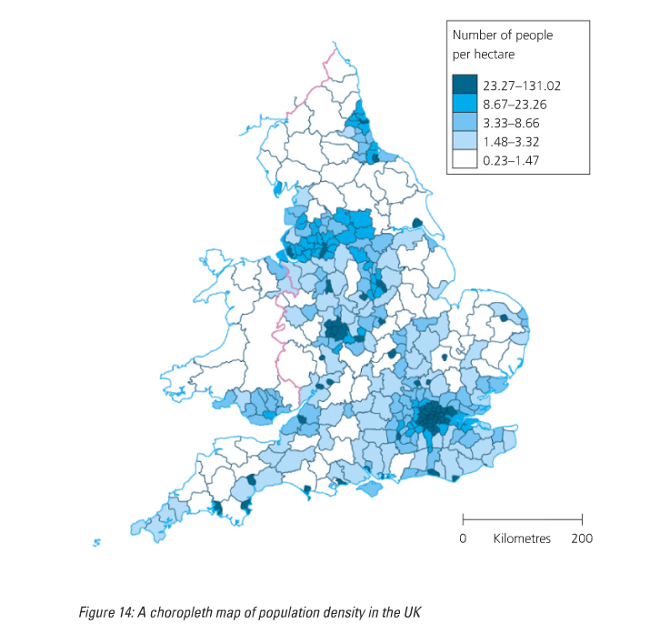

Slide 15
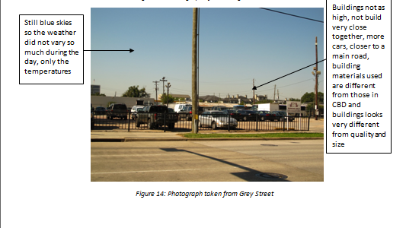
Annotated photos

Slide 16
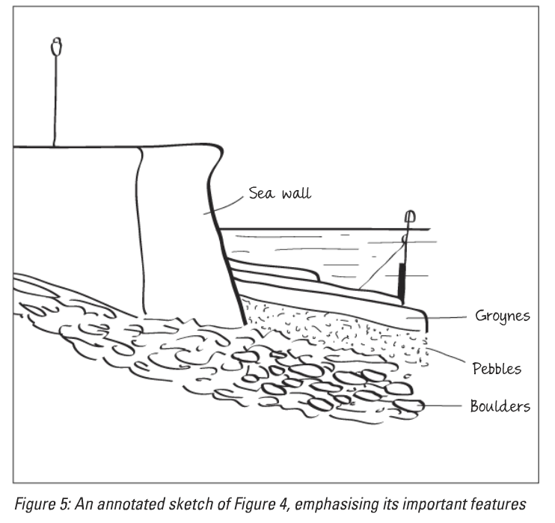

Slide 17
What makes successful data presentation?

Slide 18
Success criteria for data presentation
Varied (annotated photos, graphs, maps etc.)
Is the most appropriate method to show the results effectively
Shows how data varies spatially
Is clearly and neatly presented
Has clear titles, figure numbers, axis labelled etc.

