Slide 1
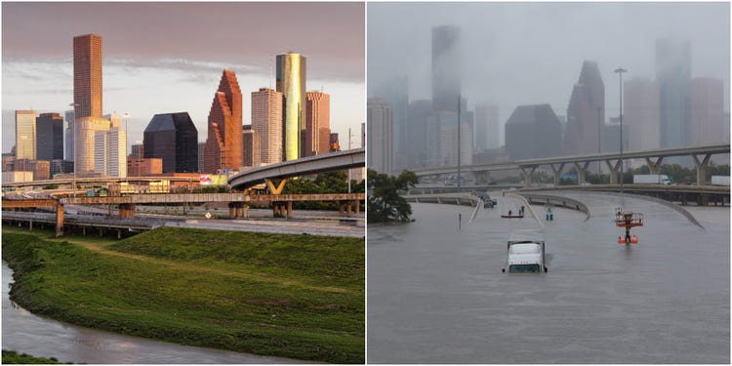
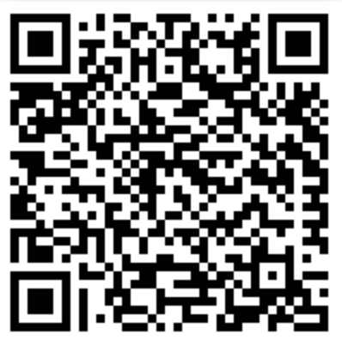
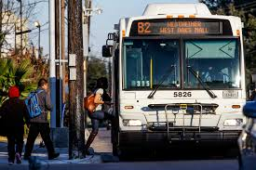
To start:
Skim read the article below and pick out at least 5 challenges that are faced in Houston.
Notes:
https://www.chron.com/opinion/editorials/article/Challenges-facing-the-city-of-Houston-5073189.php

Slide 2
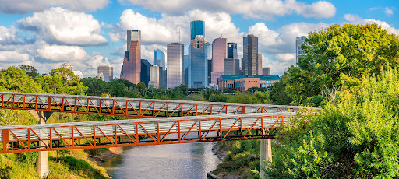
Sustainable Cities, Houston
What – Understand the possible strategies available to high income countries that can make urban living more sustainable.
Why – So that we can appreciate the varying options available to countries at higher levels of development.
How – By exploring a variety of sources based on the US city of Houston, an example of a city that is looking to become more sustainable.

Slide 3
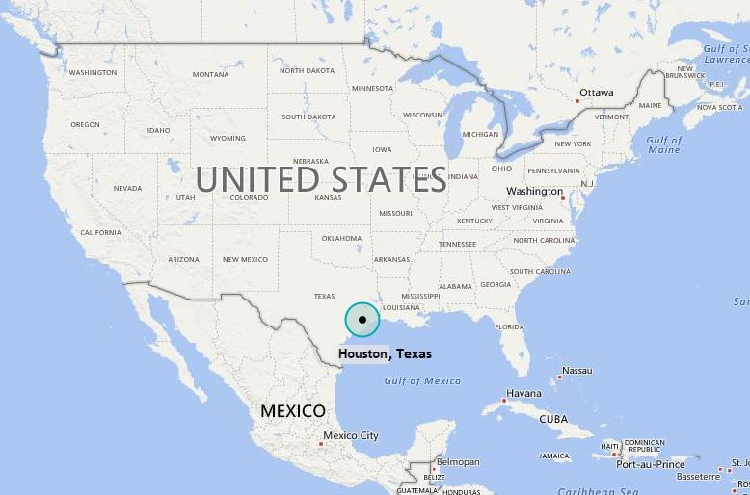
Challenge 1 – Houston’s Location
In your OneNote, describe the location of Houston. You can use Google Earth to help with this as well as the map below.
Make sure to include:
Global Location i.e. continent
National Location i.e. within the US
Compass directions
Location relative to other major cities in the US
Extra challenge:
Use the measuring tool on Google Earth to add the distance of Houston from other major US cities, and then from your home country (where applicable).

Slide 4
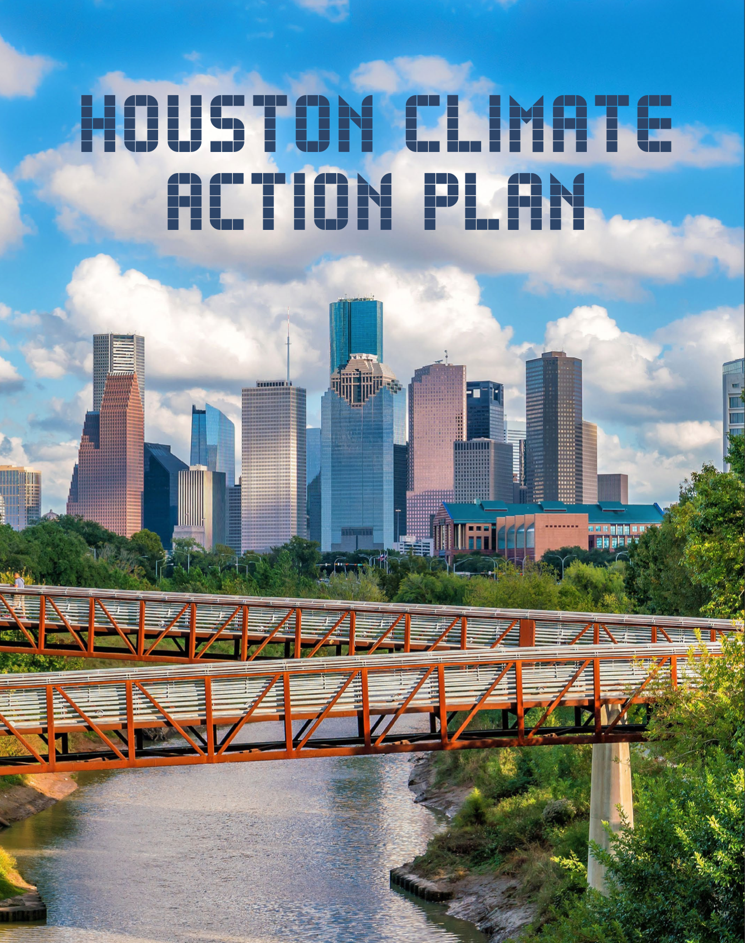
Challenge 2 – Houston’s Sustainability
Using the sources provided, create a piece of work that highlights Houston’s sustainable initiatives. The work should describe things that improve:
Waste disposal
Transport
Education
Health
Employment
Housing
This could be a made as a table, a spider diagram, a bullet point list. It is up to you.
Notes:
http://www.houstontx.gov/planhouston/index.html
http://www.greenhoustontx.gov/
https://www.centerforhoustonsfuture.org/our-vision

Slide 5
To start:
Copy this table into your OneNote and then colour code the Houston initiatives whether they are related to waste disposal, transport, education, health, employment or housing.
Changing government vehicles to electric by 2030 | Aiming to make Houston the global leader in carbon capture technology and energy innovation | Increase landfill gas capture and opportunities for waste conversion | 5 million MWh local solar per year by 2050 | The City of Houston's Brownfields Redevelopment Program mission is to revitalize core neighborhoods; catalyze sustainable economic growth; ensure a safe and clean environment; improve quality of life for Houston residents; and create thriving, livable neighborhoods in this world-class city.
Implement nature-based solutions that increase carbon storage. | Prepare future generations for highly skilled jobs in the energy transition by working with local higher education institutions | 4.6 million new native trees planted by 2030. | Implement integrated multi-modal transportation systems. | Zero traffic-related fatalities and serious injuries on Houston streets by 2030. 500 miles of high-comfort bike lanes by 2025.
Provide options to make affordable, workforce and mixed-income housing development more attractive to private investment. | Improve and promote Houston’s quality of life to attract and retain talented and creative workers and businesses. | Hire Houston Youth offers youth ages 16 to 24 internship and job opportunities in the public and private sectors throughout the Houston area. | Reduce residential waste 50% by 2040 | Ensure that affordable housing is connected to the community and its services.
Extra Challenge – Which initiative do you think will be the easiest / most difficult to implement. Explain why.
Notes:
https://www.youtube.com/watch?v=TaU1UH_3B5k

Slide 6
Challenge 3
Write a letter that will be sent off to the Mayor of Houston that celebrates the work that is being done to make Houston more sustainable and then gives some suggestions for ways in which things could be improved further.
You should praise things and recommend things linked to the 6 areas covered in Challenge 2.
See resources on Slide 6 to help with letter structure.

Slide 7
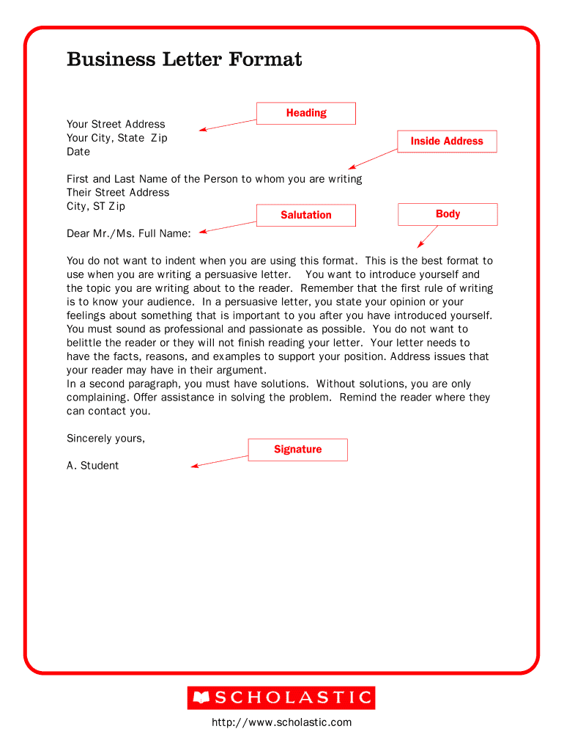

Slide 8
Challenge 4
Add your work to your Google Earth case study project.

Slide 9
Challenge 5 - Who do you think is involved in the urban development of Houston?
Look at the below groups and briefly summarise their role in Texas’ / Houston’s development. Include a definition of the group, the role that that might play in decision making, and then an example from within Texas / Houston.
Politicians:
Definition - https://dictionary.cambridge.org/us/dictionary/english/politician
Example - http://www.houstontx.gov/planning/
Industrialists:
Definition - https://www.merriam-webster.com/dictionary/industrialist
Example - https://www.outlookindia.com/newsscroll/industrialist-swraj-pauls-company-to-build-large-steel-pipe-mill-in-texas/2097903
Property developers:
Definition - https://dictionary.cambridge.org/us/dictionary/english/property-developer
Example - https://landtejas.com/about-us/our-history/
Planner:
Defintion - https://www.merriam-webster.com/dictionary/urban%20planner
Example - https://midtownhouston.com/affiliated-organizations/mmd/urban-planning/
Extra Challenge:
How would these groups be involved in managing the social, economic and environmental challenges in Houston?

Slide 10
Exam Practice:
Suggest 3 ways of making urban living more sustainable (6)

Slide 11
To Finish:
Which of the below areas do you think Houston will be able to make progress with quickly, and which do you think will be the most challenging?
Waste disposal
Transport
Education
Health
Employment
Housing
Give a short explanation for each.

