Slide 1
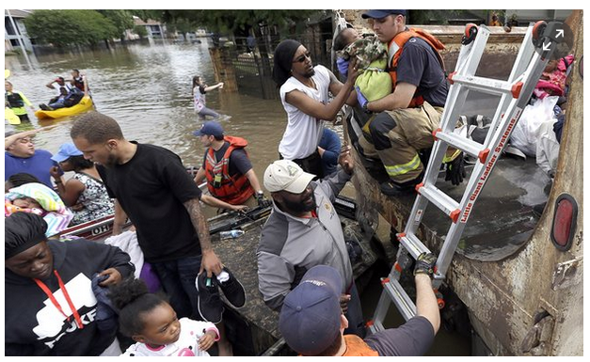
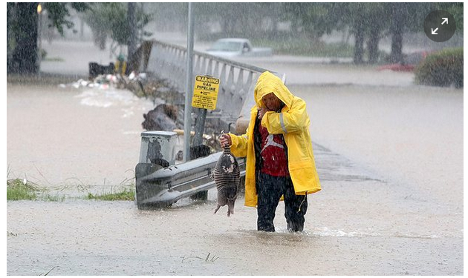
Houston Flood April 2016
LO: to link the information we have experienced over the past few days to our flooding case study
Cause, effect, management (hard and soft engineering)
Why: To consider how how human actions have an impact on the physical environment

Slide 2
Task 1: read the guardian article
Use 3 highlighters and highlight :
1 causes
2 effects
3 management
https://www.theguardian.com/us-news/2016/apr/19/houston-texas-state-of-emergency-deadly-floods
https://www.theguardian.com/environment/gallery/2016/apr/19/houston-floods-in-pictures

Slide 3
Physical causes
Extremely heavy rain: parts of the Houston area experienced 17 inches of rain in 24 hours
Houston has a humid subtropical climate type and thunderstorm activity is common, especially during the warmer months of the year.
13 bayous and creeks burst their banks on Monday 18th April.
Houston is located in a low-lying Gulf coast location. The flat land means that heavy rainfall tends to sit on the land rather than run-off. This means that it can take a long time for flood waters to subside.

Slide 4
Human causes
Houston is one of the fastest growing cities in the United States and has experienced a population explosion since the 1950s. It lacks planning controls and has sprawled uncontrollably outwards.
Much of the city is built on drained wetlands. Therefore the land is “meant to flood”, however, increasing urbanisation has reduced the natural capacity of the land to absorb rainwater.
Some new housing developments in Houston include adequate space for water to run-off, but not all. This suggests that tighter building regulations are needed to help reduce the future impacts of flooding.
Climatologists say that climate change has resulted in increased frequency of large rainfalls. The result this week was that sudden downpours overwhelmed infrastructure and in whole sections of the city.

Slide 5
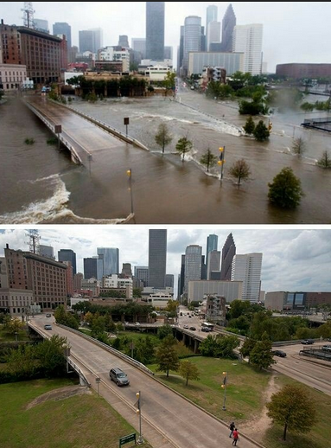
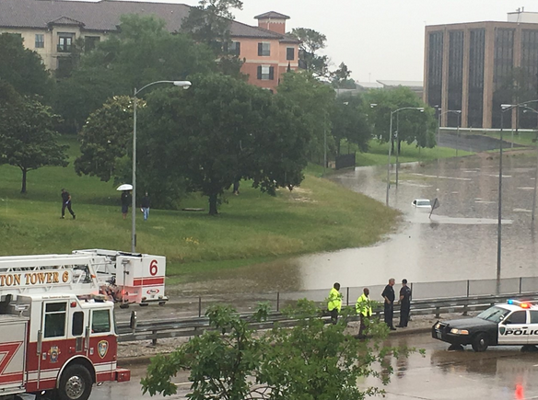
The effects of the floods
https://www.youtube.com/watch?v=gYYyBj4bCS8&sns=tw

Slide 6
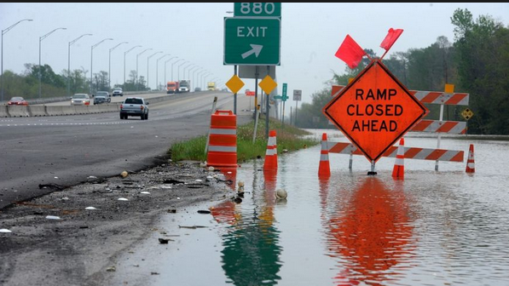
Impacts on people
Travel disruptions:
On Monday 18th April Bush Intercontinental Airport was forced to cancel 800 flights and there more than 150 delays.
Roads impassable, including many sections of freeways.

Slide 7
Impacts on people
1,000 homes had already been flooded, and city and Harris county authorities responded to more than 1,500 flooding emergencies.
Seven deaths inside submerged vehicles, including two in a car that drove around a barricade and into a flooded underpass.

Slide 8
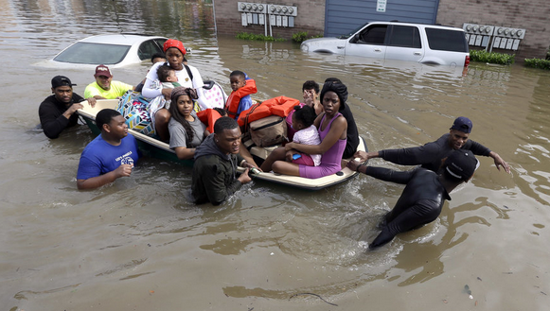
Impacts on people
In one neighborhood, Greenspoint, 1,000 people were evacuated Monday morning and transported to a mall.
One Greenspoint resident, Diamond Trueblood, said that she woke up overnight to the "loud sound of water coming through my walls."My stuff was literally floating," she said.

Slide 9
Impacts on people
Meyerland, located Sw of downtown Houston, was another neighborhood that was severely affected. The area borders a bayou and some homes had only just recently be restored after the Memorial Day 2015 floods.

Slide 10
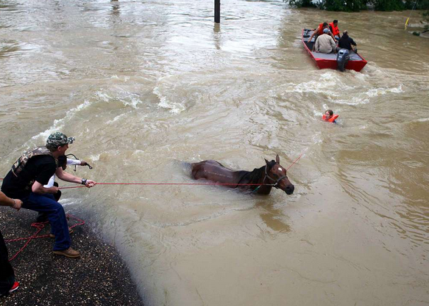
Environmental impacts
80 horses had to be rescued at Cypress Trails.

Slide 11
Prediction of flooding: Use of GIS
GIS: geographical information systems
Key word for paper 1 skills
GIS is when information is layer on maps to help research the local area

Slide 12
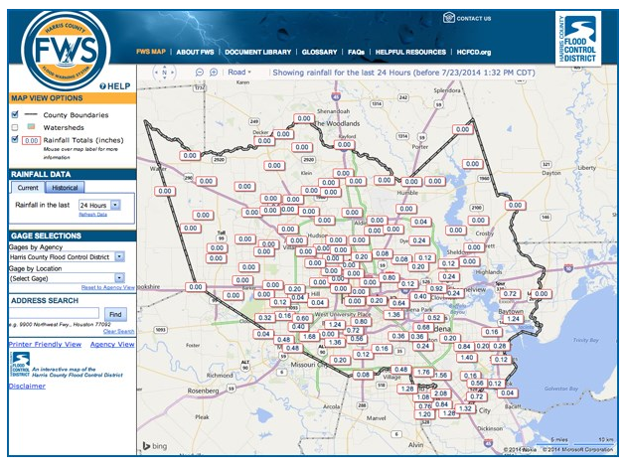
Prediction: Harris County Flood Warning System https://www.hcfcd.org/interactive-mapping-tools/harris-county-flood-warning-system/
The Harris County Flood Control District’s Flood Warning System measures rainfall amounts and monitors water levels in bayous and to inform you of dangerous weather conditions. The system relies on 133 gage stations strategically placed throughout Harris County bayous. The stations contain sensors that transmit valuable data during times of heavy rainfall and during tropical storms and hurricanes. Some gages also measure wind speed and direction, barometric pressure, air temperature, road temperature and humidity.

Slide 13
Prediction:
http://www.harriscountyfemt.org/
http://www.harriscountyfemt.org/Floodplains.aspx
Use GIS to map areas at risk from a 100 year flood and a 500 year flood
Can be used to determine insurance rates for certain areas of the city

Slide 14
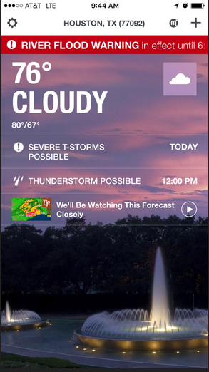
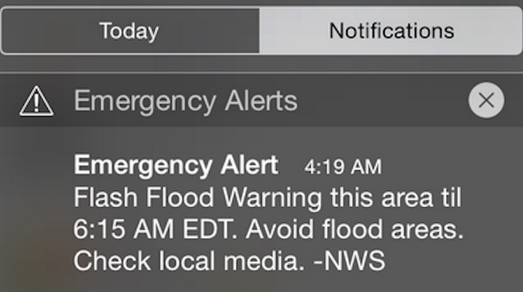
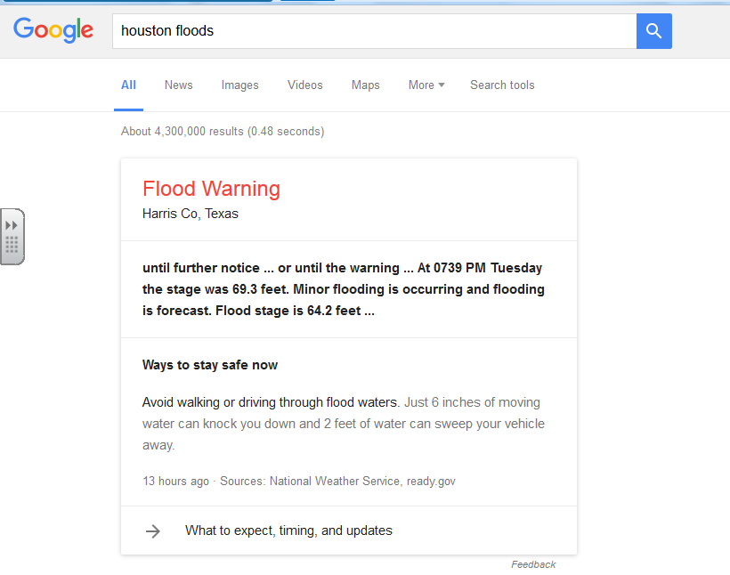
Use of technology to warn population

Slide 15
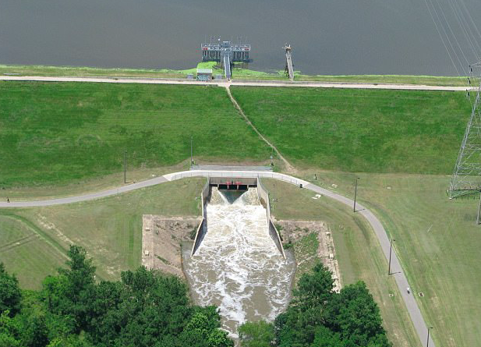
Hard engineering
The Addicks Reservoir and Addicks Dam in conjunction with the Barker Reservoir prevent downstream flooding of Buffalo Bayou in the City of Houston.
Major reservoirs built in the 1940s helped alleviate some of problems, but a population explosion and urban sprawl since then enveloped the reservoirs.
2016- Dams ‘Extremely high risk’ …The “extremely high risk” classification is in conjunction with the dams’ close proximity to the population. After the dams’ ratings were first listed, the Army Corps immediately began to implement safety measures and received $75 million in funding for long-term repairs for the 70-year-old dams that had a 50-year life expectancy.
http://abcnews.go.com/US/extremely-high-risk-dams-concern-amid-historic-houston/story?id=38553007

Slide 16
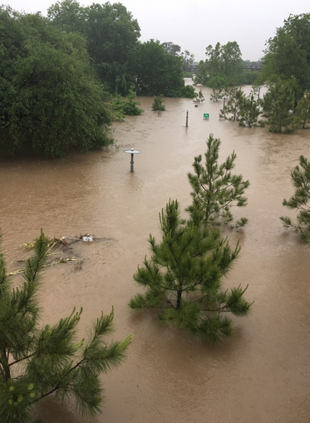
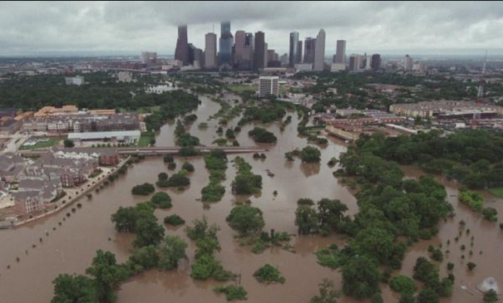
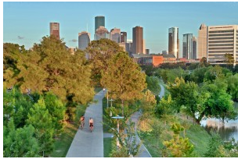
Buffalo Bayou redevelopment
This plan’s overarching goals and planning concepts are balancing conservation and development and creating projects that serve multiple purposes—recreation, flood management and ecosystem restoration.
Wash-lands: areas of limited development that are allowed to flood – soft engineering

Slide 17
Short term management for flood victims
Red cross- opened 12 shelters in the region
FEMA- federal emergency management agency
Handing out clothes, helping clean up houses etc

Slide 18
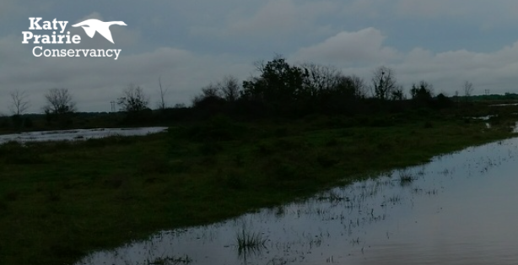
Soft engineering: Katy Prairie
The prairie-wetlands, ranches, creeks, and other green spaces on the prairie slow water heading downstream towards Houston, providing time for floodwaters to recede. As these prairie lands shrink, so does the ability to protect downstream citizens. This is why KPC is working with others to protect these lands. In addition, we are working with others on programs that will help alleviate future downstream flooding.
http://www.katyprairie.org/flooding/

Slide 19
Summary task: create a revision resource which compares the effects of the Bangladesh floods and Houston floods
Success criteria:
Use any type of revision resource- coogle, quizlet, kahoot
Include specific case study detail

Slide 20
Exam questions
Explain the causes of a specific flood you have studied (7)
Explain the human and environmental impacts of flooding (7)
Using examples explain how the risks of flooding can be reduced through planning and prediction (7)

