Slide 1
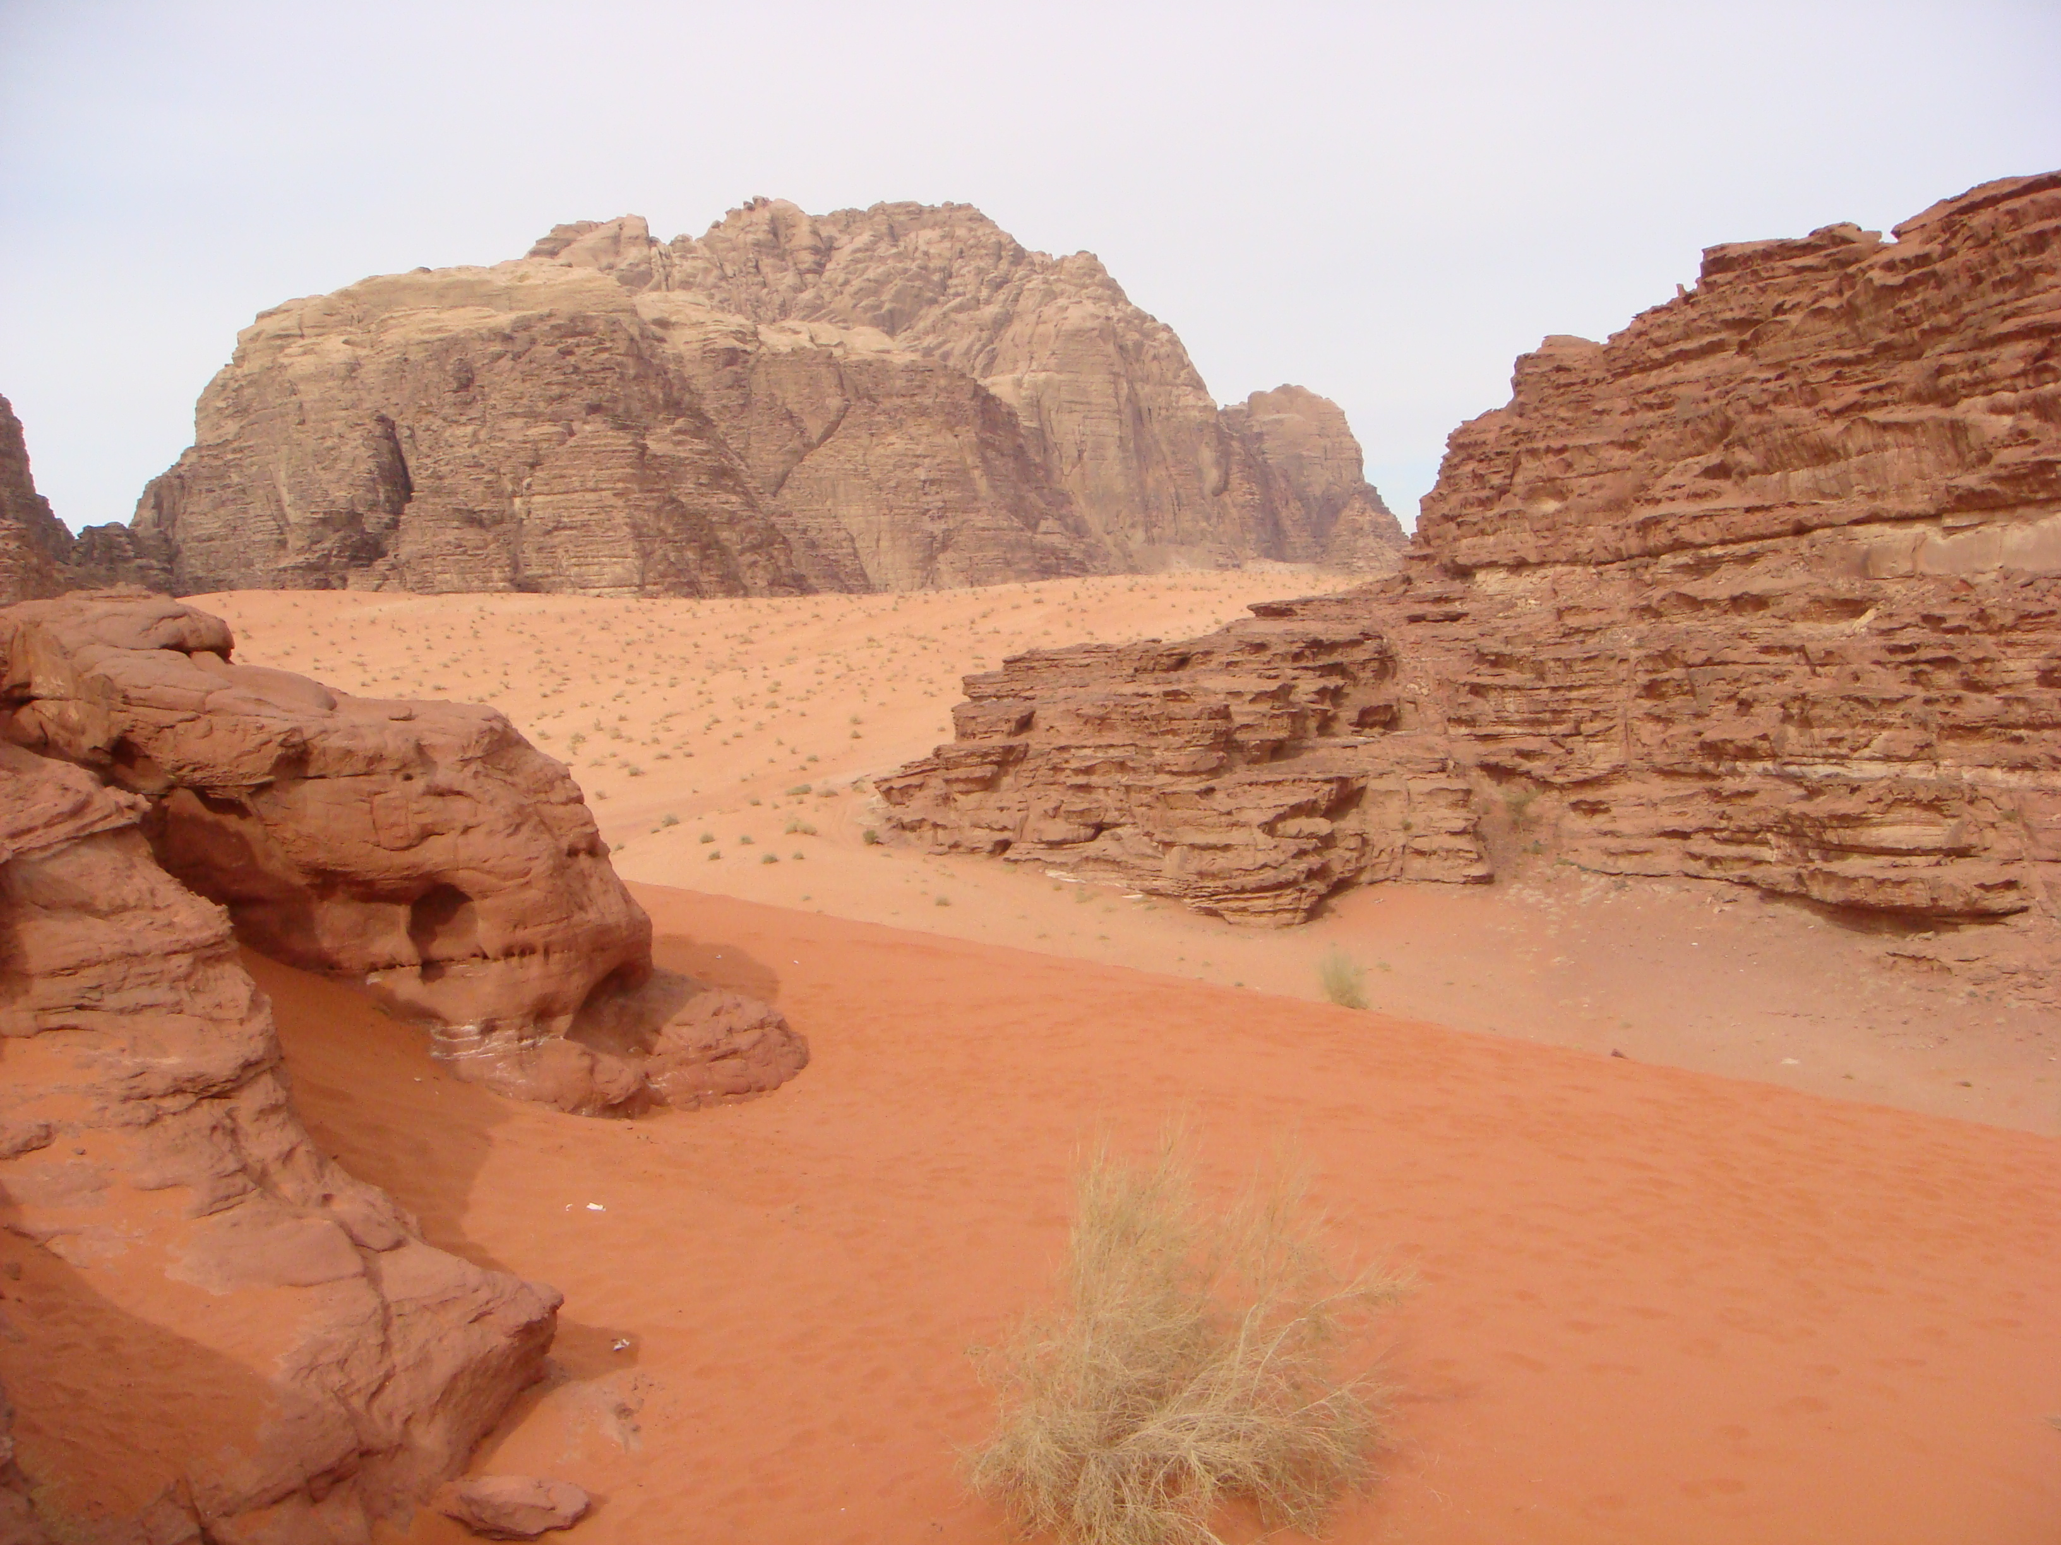
With your partner list the physical characteristics of the desert image.
Title: What is the hot desert ecosystem like?

Slide 2
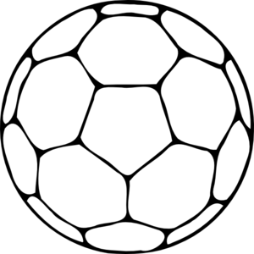
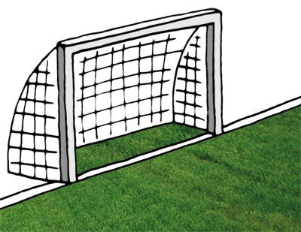
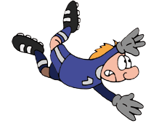
What is the hot desert ecosystem like?
To be able to explain the characteristics of hot desert environments. (Level 4-6)
To be able to make links between the characteristics of the hot desert environment. (Level 7)
To be able to describe the characteristics of the hot desert environment.
(Level 4 and below)
Lesson objectives;
To develop a greater understanding of the characteristics of the hot desert environment.
To develop a greater knowledge of the location, climate and soil types of hot features.

Slide 3
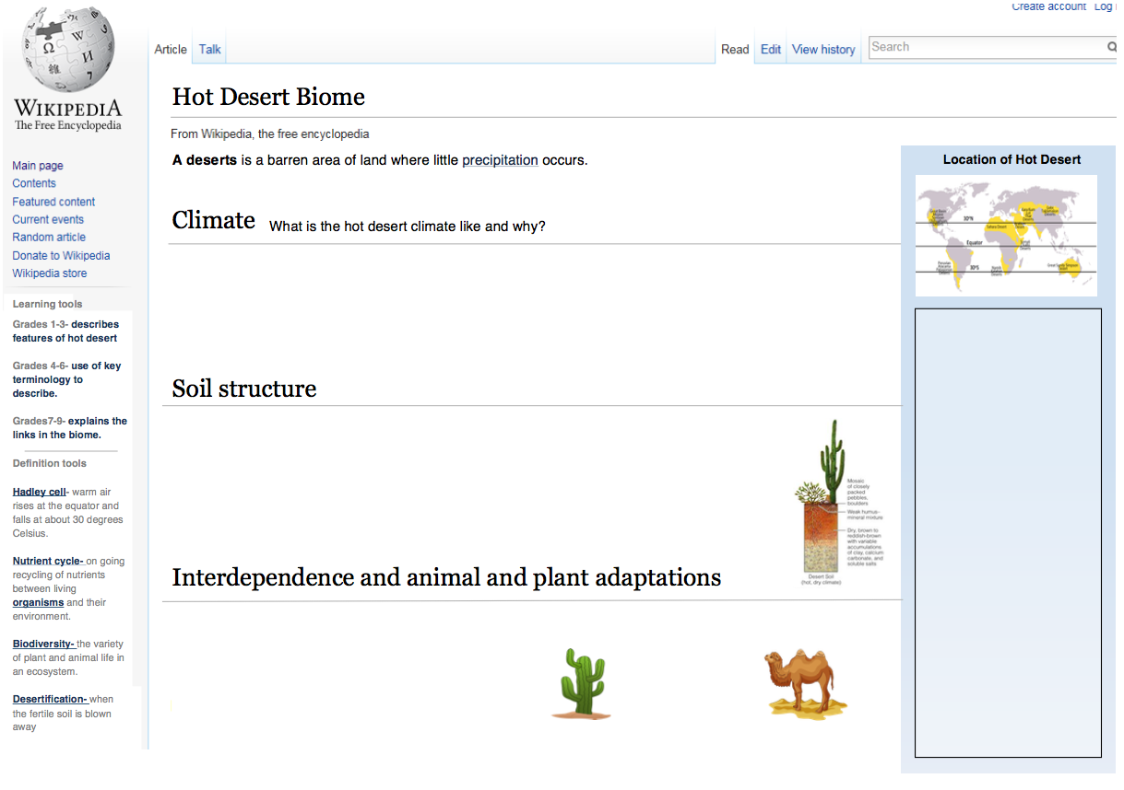
Where are the characteristics of the hot desert?
Task 1
Describe the location of the words hot deserts and give reasons for where they are located.
Task 2
Draw and describe the climate of the hot desert.
Task 3
Describe the features of the soil of the hot desert
Task 5
Annotate the cactus and camel to show how plants and animals are adapted to live in the desert.
Literacy
Extension
Can you use these key terms:
Biodiversity
Adaptation
Surface area
Can you summarise the factors that;
Could affect the
Could affect
Could affect the
In no more than 10 words summarise the rainforest.
Task 4
Describe how the abiotic and biotic parts of the hot desert are reliant on each other. Draw a food web of the hot desert ecosystem.

Slide 4
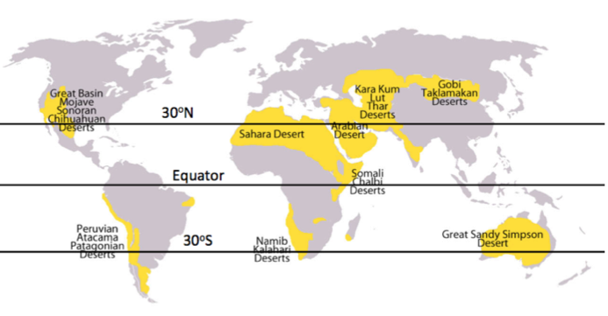
Where are the world’s hot deserts located?
The world’s hot deserts are found in subtropical areas between 20 and 30 north and south of the Equator. The Tropic of Cancer or the Tropic of Capricorn passes through most of the world’s hot desert regions. This climate is characterised by hot and dry sinking air.
The extremely arid conditions occur where less than 250 mm of rain fall annually. Large areas of the Earth’s land surface are covered by hot deserts, including the Australian, Thar, Arabian, Gobi and Kalahari deserts. Largest of all is the Sahara, which measures nine million square kilometers. Its towering sand dunes can reach 150 meters. Despite its extreme climate, the Sahara manages to support two million people at its edges and in towns along caravan trails. On the boarders of hot deserts are the world’s semi-arid areas, also called drylands or desert fringe areas. The Sahel is a long strip of semi arid drylands that borders part of the south of the Sahara. It includes parts of Sudan, Chad, Burkina Faso and Niger. Water can sometimes be obtained in deserts from aquifers, or rivers, like the Nile, which transport water from wet regions across much drier ones.

Slide 5
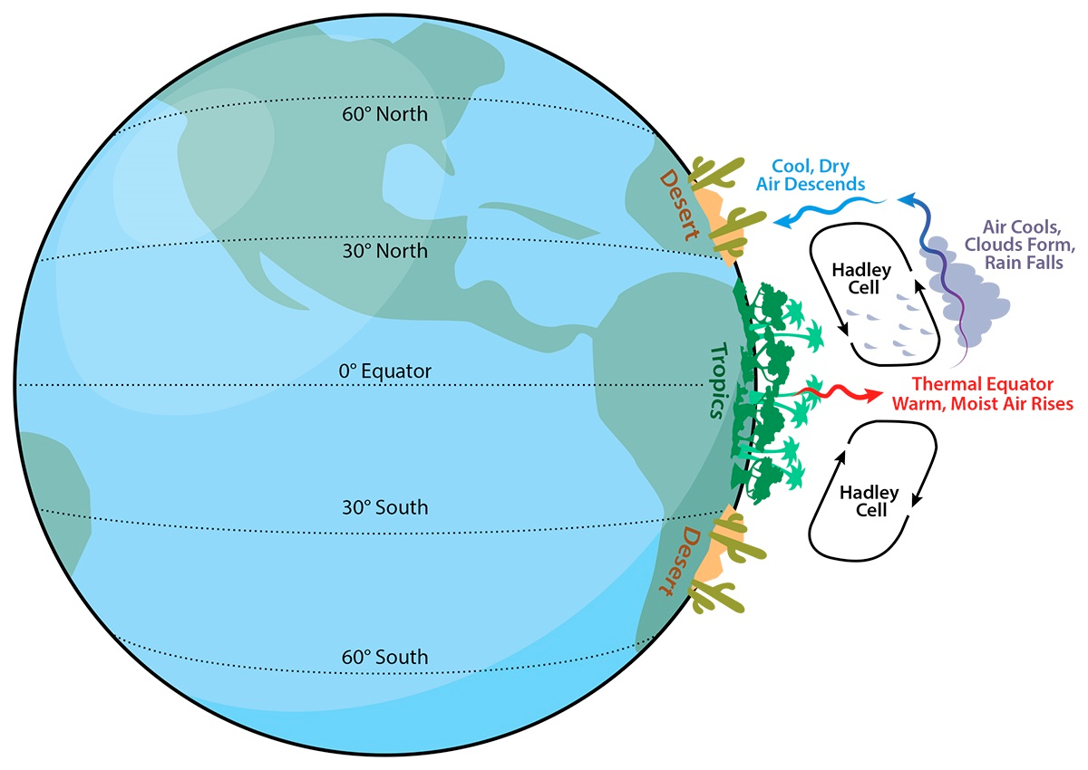
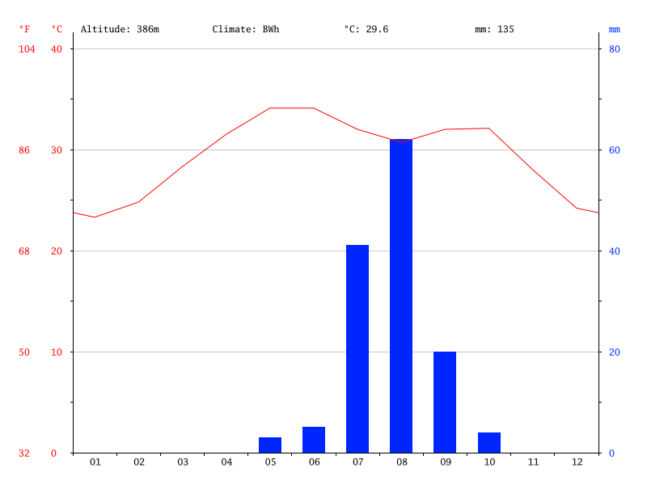
What is the climate of the hot desert?
Not only is annual precipitation low in hot desert environments , it is extremely unreliable too. Parts of Chile’s Atacama desert have not seen rain for 400 years; others just receive one millimeter per year! More typically hot desert regions experience around 100-200 millimeters of rainfall in most years.
Below shows the annual climate for Khartoum in Sudan. Between June and October Khartoum records on average six days with ten millimeters or more and 19 days with one millimeter or more of rainfall. Like other hot desert areas, rainfall can be unpredictable.
Another characteristic is the extreme range of temperatures often experienced in a single day. The cloudless skies that allow high levels of insulation in the daytime also permit rapid heat loss at night. This can bring a drastic fall in temperature, and occasionally sub-zero temperatures.

Slide 6
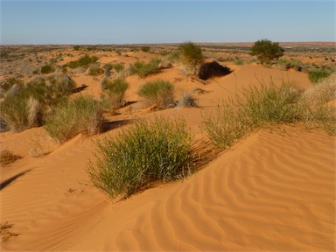
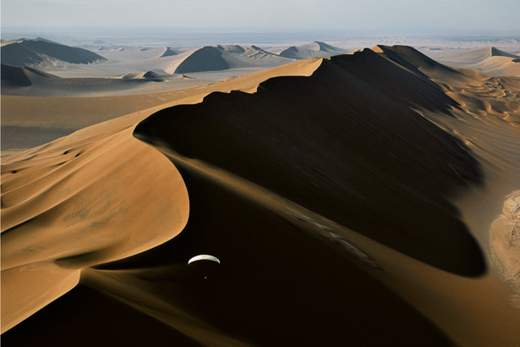
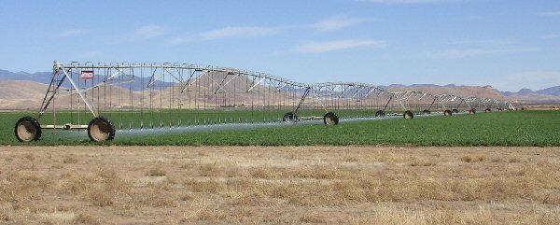
What is the soil of the hot desert like?
In hot climates, soil-forming processes are limited by the shortage of water and vegetation. Over time weathering creates deep deposits of sand and loose material. There may be little organic content due to the lack of vegetation growing there. These sandy rocky soils are typically around one meter deep, although in some places, wind action builds tall dunes where deeper soils can potentially develop. Sand dunes should not be classified as soils if there is no organic matter present there at all.
Desert with vegetation
Some desert soils are potentially very fertile because important nutrients for plant growth, such as calcium, have not been leached away over time. Once irrigated, the land can become highly productive for agriculture. Large desert regions of oil-rich Saudi Arabia and the southern states of the USA have benefited greatly from irrigation.
Desert with no vegetation
Desert soils tend to be sandy or stony, with little organic matter due to the general lack of leafy vegetation. They are dry but can soak up water rapidly after rainfall. Evaporation draws salts to the surface, often leaving a white powder on the ground.
Irrigation in the desert

Slide 7
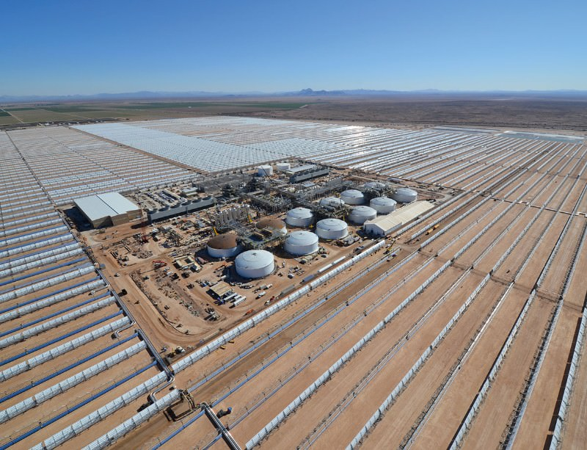
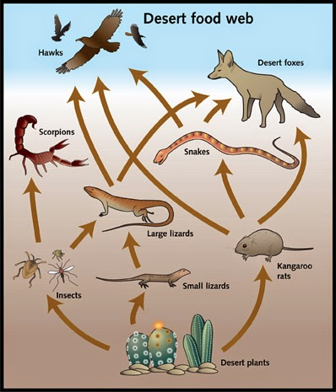
What interdependence exists in the hot desert?
The biotic and abiotic components of an ecosystem are interdependent. Living or biotic creatures play an important role in maintaining a healthy environment (the abiotic parts) and vise versa. Abiotic components of hot deserts include the soil, underlying rocks and water supplies.
The interdependency between different biotic and abiotic parts of hot deserts is shown by:
Links between different parts of the food web (animals eating plants that have gained nutrients from soils and water, for example).
The role that vegetation roots play in stabalising sandy soils in semi-arid areas at the edges of deserts. The plants stop the soil from being blown away by the wind. The destruction of the vegetation sometimes triggers desertification (the process where fertile land becomes desert).
Increasingly unsustainable human use of deserts threatens the interdependence between the physical environment and people.
The fragility of hot deserts is an important issue affecting biodiversity.

Slide 8
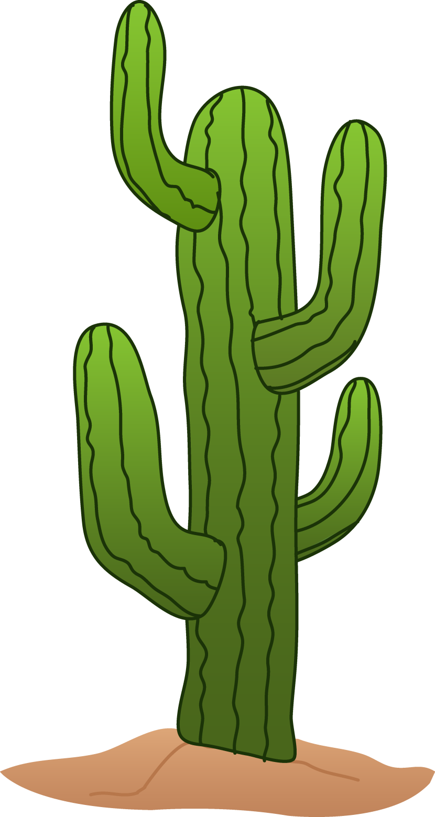
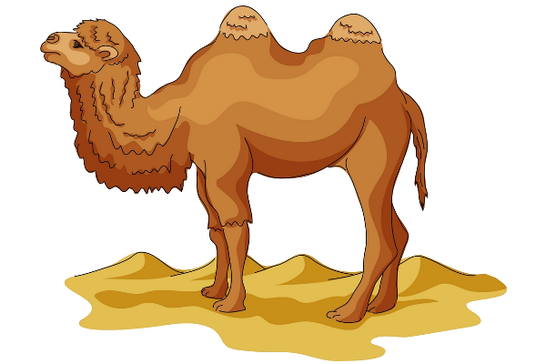
How are plants and animals adapted?
Deserts bloom suddenly after rainfall so to complete their life cycle quickly.
Thick fur on the top of their body to allow for shade.
Cacti’s spikes deter consumer species.
Plants that can survive in very dry conditions are called xerophytes.
Thing fur everywhere else to allow for heat loss.
A large area to volume ratio to maximise heat loss.
Spikes instead of leaves for a small surface area to minimise transpirations.
AKA succulents; they store water in their tissues (roots, stems, leaves or fruit)
Small, thick, waxy leaves and shed their leaves to reduce transpiration, to reduce water loss.
Slit like nostrils and two rows of eye lashes to keep the sand out.
Some animals are nocturnal so they can survive the heat.
Seeds can stay dormant for years, but can germinate quickly when it rains.
Some plants have taproots (7-10 meters deep) to reach ground water.
Able to go a long time without water by loosing little through urination and sweating.
Large flat feet to spread their weight on the sand.

Slide 9
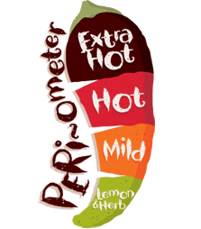
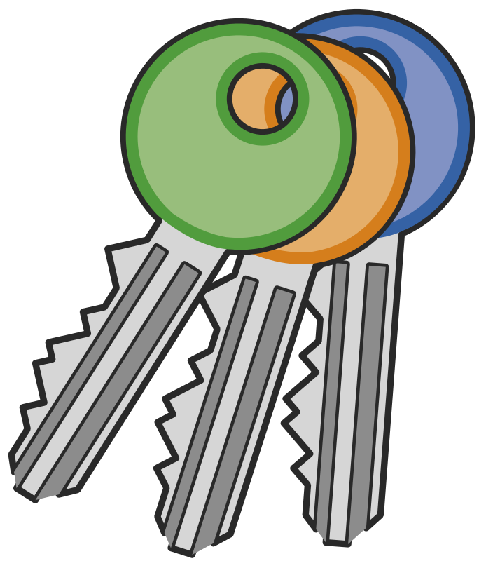
Exam questions…
Level 1
You demonstrate limited knowledge of hot deserts.
You demonstrate a limited ability to use key terms.
Level 2
You demonstrate a clear knowledge of hot deserts.
You are able to use some place specific detail.
You are able to use key terms correctly.
Explain the location of the world’s hot deserts.
(4 marks)
Describe the main characteristics of a hot desert soil.
(4 marks)
Describe the main characteristics of a hot desert ecosystem.
(6 marks)
Level 3
You demonstrate detailed knowledge of hot deserts.
You are able to use place specific detail thoroughly.
You are able to use key terms consistently correctly.
Advice
Use examples
Use key terminology
Make links between points
Use point, example, explain, link to structure your answer
Key words
Equator
Organic matter
Infertile
Hadley cell
Stony
Sand dune
Desertification

