Slide 1
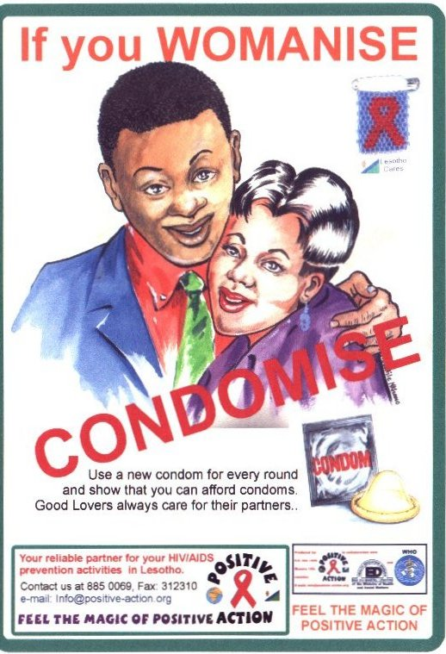
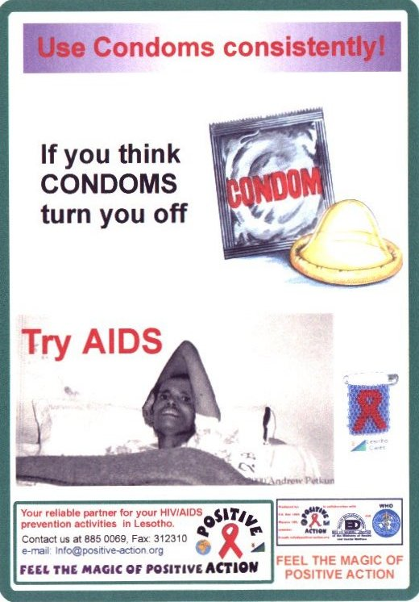
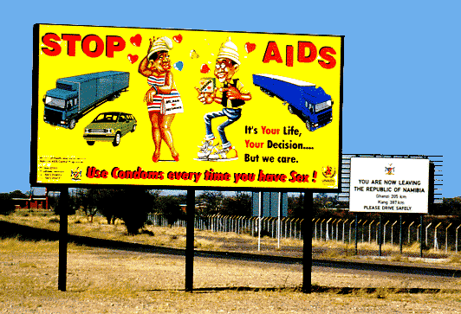
HIV/AIDS In Botswana

Slide 2
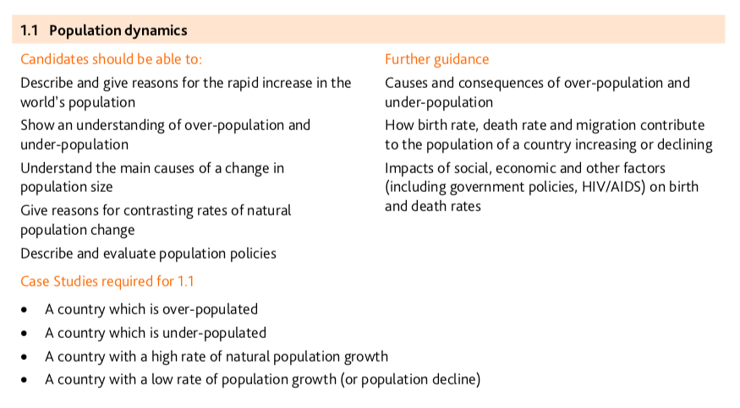

Slide 3
Learning objectives….
What: HIV and AIDs in Botswana
Why: Give reasons for contrasting rates of natural population change
How: Explain the impact of HIV/AIDs in a country (Botswana)
Consider how the impacts have changed the population structure

Slide 4
HIV/AIDS
What do you know now?
What is it?
What causes it?
How is it spread?
What are the effects?
How can it influence the population structure of a country (especially in areas with high infection rates?)

Slide 6
Explain, using a case study example, how incidences of AIDS can affect the future population structure of a country. (7)

Slide 7
What is it?
AIDS: acquired immune deficiency syndrome
HIV: Human immunodeficiency virus
AIDS is an incurable disease resulting from infection from the HIV virus.
It gradually destroys the body's defenses (immune system) opening them to opportunistic infections.
It was first describe in medical literature in 1981.

Slide 8
How is it spread?
Through the exchange of bodily fluids:
Unprotected sex (prostitutes can be more at risk as they have more partners)
Through use of contaminated needles
Through the transfusion of contaminated blood
From mother to child in the womb or through breast feeding

Slide 9
Where is Botswana?

Slide 10
Case study notes…..
What is the problem?
Why is there a problem?
Who is affected?
What is the solution?
How is this impacting population structure?
Figures etc….
Watch one of the 3 videos on HIV/AIDS in Botswana and answer the following questions….

Slide 12
Study the infographic carefully. Complete the following activities:
Comment on the distribution of the 15 most affected countries on earth. What pattern emerges? Make a note of the top 5.
Comment on the distribution of affected countries in the continent of Africa.
Comment on the situation in Europe and North America making reference to % figures living with HIV/AIDS.
What is the % figure for your home country?

Slide 13
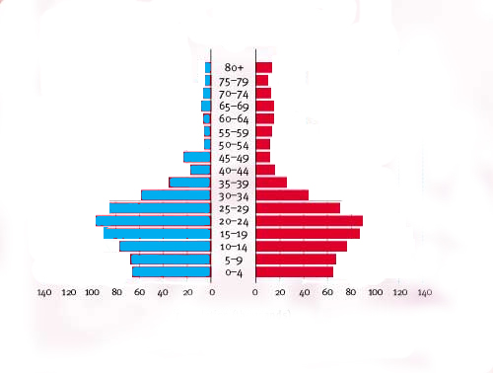
A Prediction of the Effects of Aids on Botswana’s Population in 2020
Life expectancy is lowered
The Population Chimney
Few adults survive past 40 years old
Deaths occur 8-10 years after infection
The pyramid narrows rapidly after 25 years old
Increased infant mortality
-poor child care of orphans
- Mother to child transmission of virus
Sexually active group 15-49 years old

Slide 14
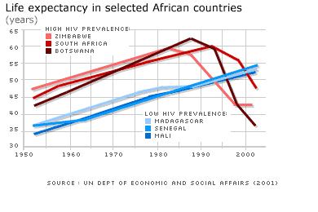
Life expectancy in Botswana fell as low as 37 yrs)

Slide 15
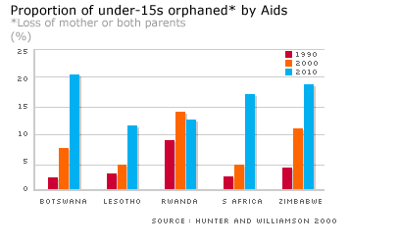

Slide 16
Case study: HIV/AIDS in Botswana
Botswana has the second highest HIV/AIDS prevalence rate (the percent of people living with the disease) in the world (37.3%), a much higher rate than the sub-Saharan African region overall.
As of the end of 2003, there were an estimated 350,000 people living with HIV/AIDS in Botswana, or more than a third of the country’s adult population.

Slide 17
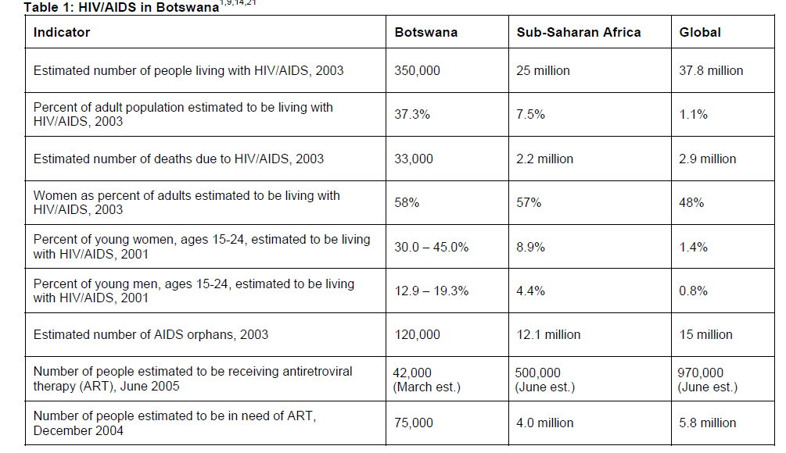

Slide 18
Task:
Watch one of the videos on the Weebly
Make notes on:
Why is there an issue?
Which groups of society are impacted?
What are the issues?
What are the solutions?
How may this issue be changing the population structure?
Ensure you take detailed notes (i.e. figures/ place names etc)

Slide 19
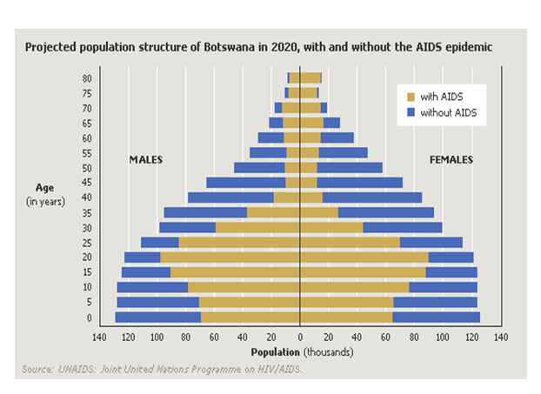
1. Describe the pattern shown on the population pyramid with AIDS (4)
2. Discuss what the implications of this situation may be (4)

Slide 20
The consequences of HIV/AIDS in Botswana
Life expectancy at birth in Botswana has fallen below 40 years in large part due to HIV/AIDS (60 in 1996 to 35 in 2007).
Increasing number of aids orphans.
Workforce declining.
Accepting government benefits and food rations is seen as humiliating
When parents die it is normal for grandparents or aunts to take over childcare- but many households already have too many children or are too proud to accept benefits.
Consequently children live in terrible conditions; underfed and having to fend for themselves.
http://www.youtube.com/watch?v=SYlFifXj48A&feature=player_embedded

Slide 21
Solutions to HIV/ AIDs
Prevention and care strategies for HIV
There is no cure for AIDS. However, a comprehensive package of prevention and care strategies can have a major impact on the burden and spread of HIV/AIDS.
Effective measures include:
Accessible, inexpensive condoms
Immediate treatment of other sexually transmitted infections (STIs)
Voluntary counselling and testing
Prevention of mother-to-child transmission
Promotion of harm reduction to reduce HIV infection in drug users
Sexual health education in school and beyond

Slide 22
Explain, using a case study example, how incidences of AIDS can affect the future population structure of a country. (7)
Use the textbook to add to your notes to help you answer this question

