Slide 1
The Opposition of Hitler
Charlie/CON

Slide 2
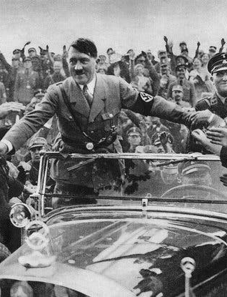
Hitlers Germany
Hitlers Germany was one of many ideologies. One of the most well known being that the ‘Perfect German’ was required to have blonde hair and blue eyes. With these restrictions came strong opposition.
In Hitlers Germany there was a range of different groups within Germany that did not agree with the policies that Hitler had in Germany. Many of these groups include The Catholic Church, The Communist Party, The Jewish Minority, The Military and a Part of the German Youth.

Slide 3
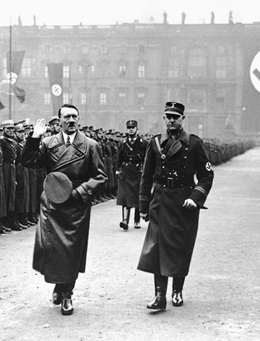
Who? KPD
One of the main opposition that Hitler faced was the KPD or the communist party. After the failing tactics of the Weimar republic many of the German people went to the extremist groups for solutions. This being the far right or the far left, the far left being the Communist party.
The Communist Party of Germany, generally abbreviated as KPO or KPD(O), was a Communist opposition organization established at the end of 1928 and maintained its existence until 1939 or 1940. After the rise of Adolf Hitler and the Nazi Party to power in January 1933, the KPO existed only as an illegal and underground organization.

Slide 4
Who? The Catholic Church
Catholic resistance to Nazi Germany was a component of German resistance of the Nazis and of resistance during WW2. The role of the Church during the Nazi years was always, and remains however, a matter of much contention. Many writers, echoing Klaus Scholder (a German historian), have concluded, "There was no Catholic resistance in Germany, there were only Catholics who resisted”.
An estimated one-third of German Catholic priests faced some form of reprisal from authorities and thousands of Catholic clergy and religious were sent to concentration camps. 400 Germans were among the 2,579 Catholic priests imprisoned in the clergy barracks at Dachau While the head German bishop generally avoided confronting the regime, other bishops such as Preysing, Frings and Galen developed a Catholic critique of aspects of Nazism.

Slide 5
Who? German Youth
White Rose, German anti-Nazi group formed in Munich in 1942. Unlike the conspirators of the July Plot (1944) or participants in such youth gangs as the Edelweiss Pirates, the members of the White Rose advocated nonviolent resistance as a means of opposing the Nazi regime. White Rose. Hans and Sophie Scholl, c. 1940. Scholls and other key members were trialed and the three were beheaded on February 22, 1943, many connected to the group through association were executed

Slide 6
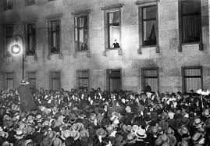
Who? The military
When Adolf Hitler rose to power as chancellor of Germany in 1933, he moved quickly to roll back these restrictions. He began developing German military aviation under the cloak of civilian production, and he worked with manufacturers to expand German military capacity.
Many of the soldiers of the army stepped forward as they were not happy with the way in which Hitler was running things. The army after a lot of negotiation and time came around and joined sides with Hitler, Hitler knew that to take control of other countries he would need the army and with the army being independent at the time it was hard to get them on Hitlers side.

Slide 7
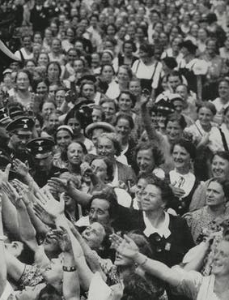
Who? German population
Obvcourse not every German in the Nazi regime believed in what Hitler was projecting to them. As a result of this many of the German population acted, examples of this include not saluting or attending any rallies that Hitler held.
This part of the German population was not very far lived as after long many of these people were converted to the Nazi regime or the were arrested by the Secret Police.
The Secret Police was a feared part of German life and lead to an increase in arrests, this was also the reason why people lost faith and turned against Hitler.

Slide 8
expansion? Kpd
The communist party was very widespread across Germany, as was explained previously the German population looked for extremist options to fulfill Germany’s needs and with the disliked Weimar Republic that did not seem an option to vote in a central party.
The communist party of Germany got many of the votes across Germany, making them a strong opposition for the NSDAP.

Slide 9
expansion? KPD
The maintenance of an extensive underground network required a major organizational effort.
The key posts within the Communist resistance were filled by paid party activists, who were supported by illegal subscriptions collected in factories and working-class areas.

Slide 10
reaction? Catholic Church
The catholic church was a national thing the catholic religion spread across the whole of Germany, with devote Catholics staying religious even with the new Nazi regime.
Efforts to "coordinate" religious life also followed the Nazi rise to power. Although the Concordat between the Vatican and the Third Reich in July 1933 regulated relations between the Reich and the Catholic church.

Slide 11
reaction? Catholic church
The Nazis went on to suppress Catholic groups and sought to defame the church through a series of show trials known as the priest trials.
The church played a role in the opposition to the killing of mentally or physically handicapped individuals ("euthanasia"). Moreover, individual clergymen sought to protect or help Jews.

Slide 12
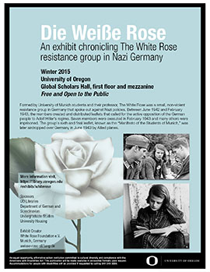
reaction? German youth
Opposition to the Nazi regime also arose among a very small number of German youth, some of whom resented mandatory membership in the Hitler Youth.
In Munich in 1942, university students formed the White Rose resistance group. Its leaders, Hans Scholl, his sister Sophie Scholl, and professor Kurt Huber were arrested and executed in 1943 for the distribution of anti-Nazi leaflets.
The leaders' leaflets got to many of the German university students, turning their opinions into anti Nazi.

Slide 13
Reaction? German youth
The group expanded into an organization of students in Hamburg, Freiburg, Berlin, and Vienna. At great risk, “White Rose” members transported and mailed mimeographed leaflets that denounced the regime.
In their attempt to stop the war effort, they advocated the sabotage of the armaments industry.

Slide 14
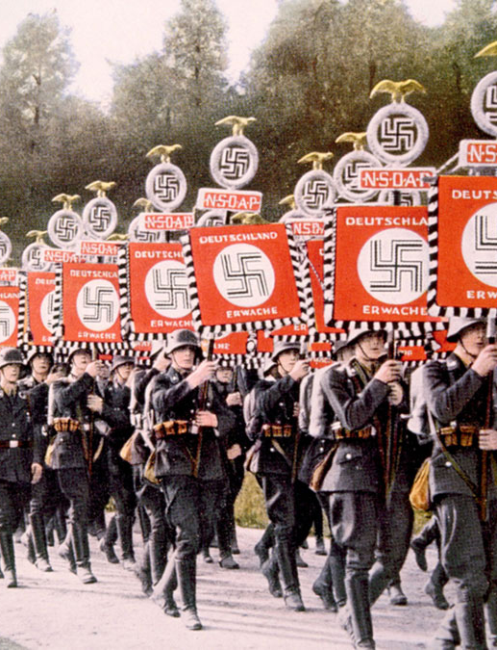
Reaction? military
A group that included conservative military officers and diplomats believed that Hitler's violent death should signal a general anti-Nazi revolt. Military officers attempted to assassinate Hitler on July 20, 1944, in his East Prussian headquarters at Rastenburg
Colonel Claus Schenk von Stauffenberg left a bomb in a briefcase near Hitler during a military briefing about the eastern front.

Slide 15
Reaction? military
Hitler survived the blast, the coup attempt failed, and Roland Freisler, chief justice of the People's Court in Berlin, presided over the trial of those implicated in the plot. Invariably, Freisler convicted the defendants. Most were executed at Berlin's Ploetzensee prison.

Slide 16
reaction? German population
The upper middle class opposed Hitler's policies.
Judges refused to administer 'Nazi' justice, such as the churchman. For example, Bishop Galen and Pastor Dietrich Bonhoeffer spoke out against Nazi policies.
Kiesau Circle was a group which met at the home of Helmut Von Moltke. Here, aristocrats, lawyers , SDP politicians discussed ways to remove Hitler from Power.
They were disbanded by the Gestapo in 1943, they held three meetings from 1942-43

Slide 17
The gestapo
A secret police force established in April 1933 by Goering.The gestapo relied on spies and informants to collect data
The gestapo operated without civil restraint. They were not subject to judicial appeal and had rights to subjugate civilians such as Jews, trade unionist, political clergy, left wing opposition to concentration camps and later death camps.
By the end of 1944 there were 32,000 personnel and departments ran by notorious members such as Heydrich, Himmler subordinates.
Over 150,000 informants throughout the country would report any anti-Nazi ‘feeling’ to the Gestapo.
However, The regime survived heavily on the compliance of the public to betray their colleagues and Neighbors rather than the atmosphere of terror.
For example Robert Gellately put forward the theory that surveillance was dependent on the reports provided by ordinary German people than a ubiquitous force of the Gestapo

Slide 18
The ss
The SS was Hitlers private army that was to control opposition, by infiltrating internal and external threats.
The SS controlled concentration camps and later death camps in which the people deemed inferior to the Nazi state would serve punishment.
When reports came out of the treatment of individuals in the camp it filtered its way to the general public. This increased over all fear and phycological weapon to control the population.
political opponents
criminals
gypsies
Jews
certain religious figures.

Slide 19
Treatment of the military
Knight of the long knives
Under Ernst Rohm the SA were gaining tremendous power and were seeking to take control of the military. Hitler could not let the military be overtaken by the SA and ordered for the dismantling of the organization.
On 30 June, the SS assassinated just under 100 of the SA’s leadership, including Röhm. Other opponents such as the ex-Chancellor General von Schleicher, were also murdered.
How did he use them to oppose others?
The military became Hitler's symbol for his society to some extent.
Flags, symbols and uniformed troops on the streets all created a clear impression of the power of the Nazi government.

Slide 20
Treatment to the population
Between 1933 and 1939, around 225,000 Germans were convicted of political crimes and a further 162,000 were placed in 'protective custody’.
In April 1933, the parliaments of the German states (Lander) were replaced by Nazi governors who could appoint and dismiss officials and judges
On 24 April 1934, People's Courts were established - anyone accused of treason was to be tried by the courts' Nazi judges
Gleichschaltung Laws
On 31 March 1933, the "First Gleichschaltung Law" dissolved Germany's state parliaments . New state governments were put in place with the same powers as the Reich government.
On 7 April, the "Second Gleichschaltung Law" put a Reich Governor in nearly complete control of each state.
In April the Law for the Re-establishment of the Professional Civil Service led to the dismissal of Jews and Nazi opponents from the Civil Service.
Propaganda
Goebbels made sure that Germans were fed Nazi ideology while organising for other ideas to be censored.
Radios were cheap to buy and would broadcast Nazi Party messages and speeches. Loudspeakers in public places blared out Nazi propaganda.
The 1936 Berlin Olympics was intended to showcase the superior athleticism of the Master Race.

Slide 21
Treatment to the Left
On 2 May 1933 trade unions were abolished and their leaders arrested. The German Labour Front was established in their place. This gave the Nazis control over workers.
On 14 July 1933 all political parties except the Nazi Party were banned - this removed the need for elections and created a one-party state
In 1935 the ‘Acts Hostile to the National Community’ allowed the Nazis to ‘legally’ persecute their opponents.

Slide 22
Treatment to the youth
Boys joined the Hitler Youth. From the age of six, boys took part in the Pimpfen. At ten they moved to the Deutsches Jungvolk before joining the Hitler Youth proper at 14. They were trained to become soldiers and indoctrinated with Nazi ideology.
Hitler believed in the ‘thousand-year Reich’ so in order to prolong their vision they emphasized on influencing and manipulating the youth in order to sustain their goals.
Girls became part of the Jungmädel at age ten before entering the Bund Deutscher Mädel at 14. They were taught to be mothers and wives.

