Slide 1
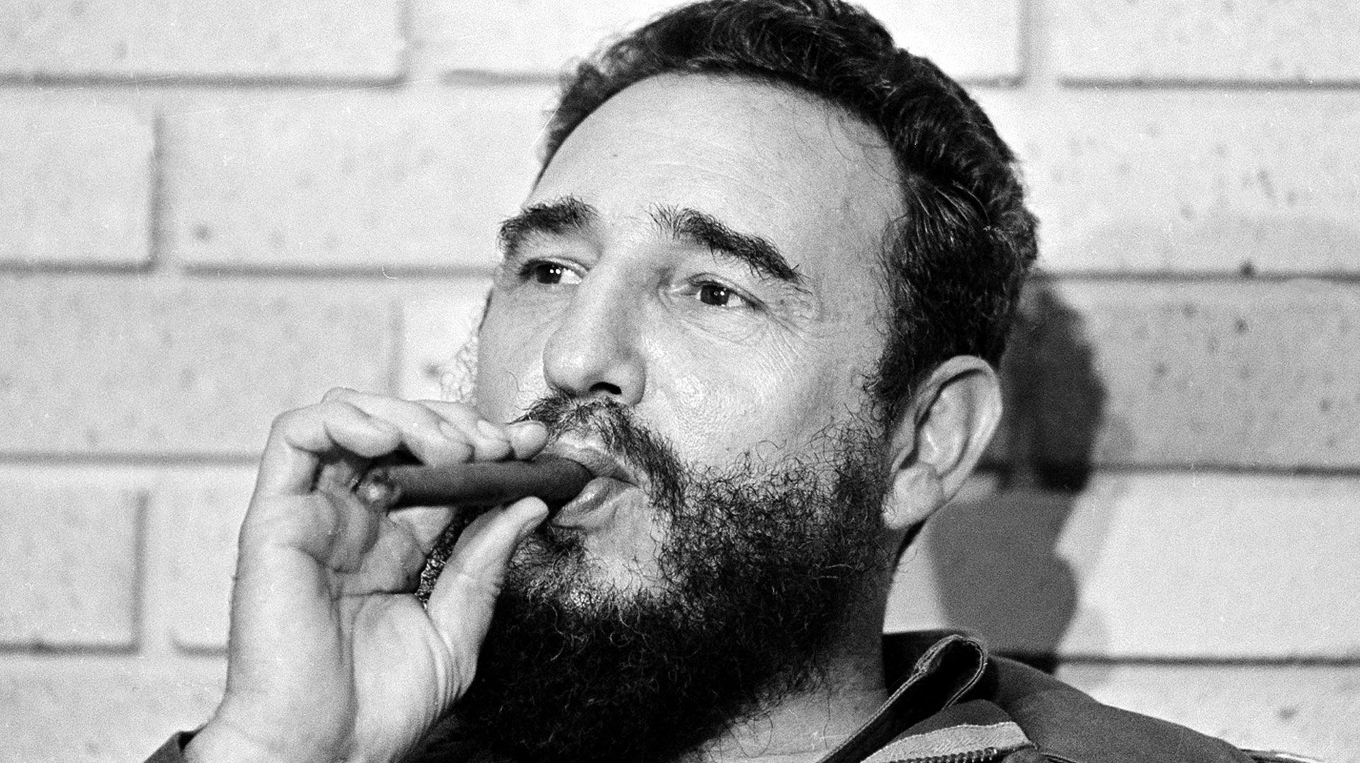
The opposition to Castro.
Who were they, extent of opposition and what was Castro’s response .

Slide 2
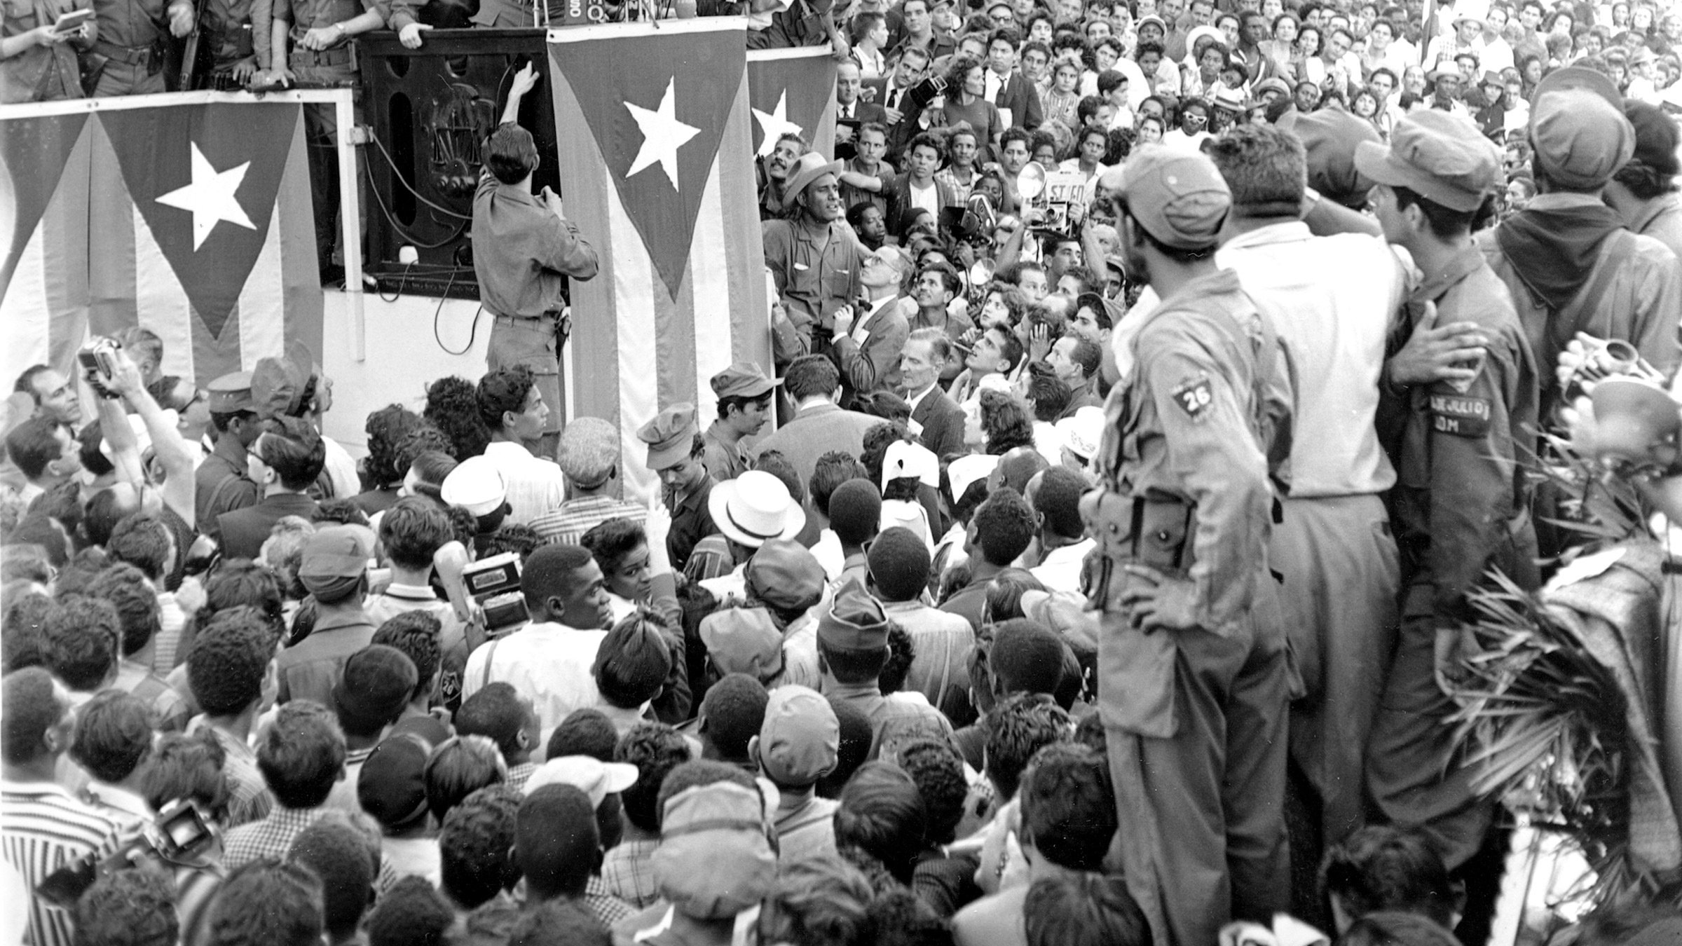
The theory of Castro’s Cuba.
For Castro socialism was mainly a strategy for a nationalist project of modernization, based on state control of the economy, prioritizing production over consumption and hostility to US imperialism.
Castro came to believe his revolutionary program of reforms required central political and economic control–not private enterprise or even a mixed economy.

Slide 3
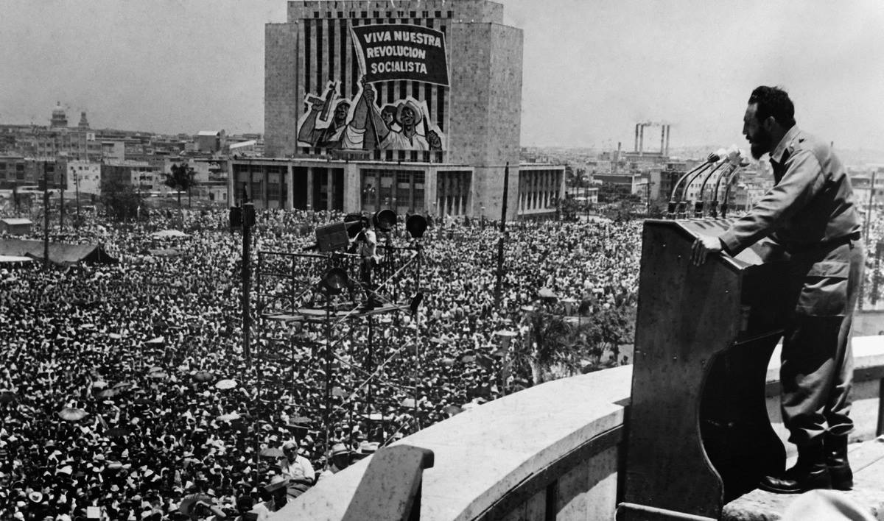
Castro’s Regime Over Cuba.
Cuba has had a socialist political system since 1959 based on the one-party rule, he’s regime over Cuba was seen as an authoritarian state where the liberty to private business and property was seen as wrongful and as a crime, thus, in Cuba, Castro had promoted the idea of collectivizing in his regime over the state.
This is why we view Fidel Castro as one of the 20th centauries most infamous dictators who had ruled Cuba as the sole leader for five decades with notorious methods of treatment of opposition.

Slide 4
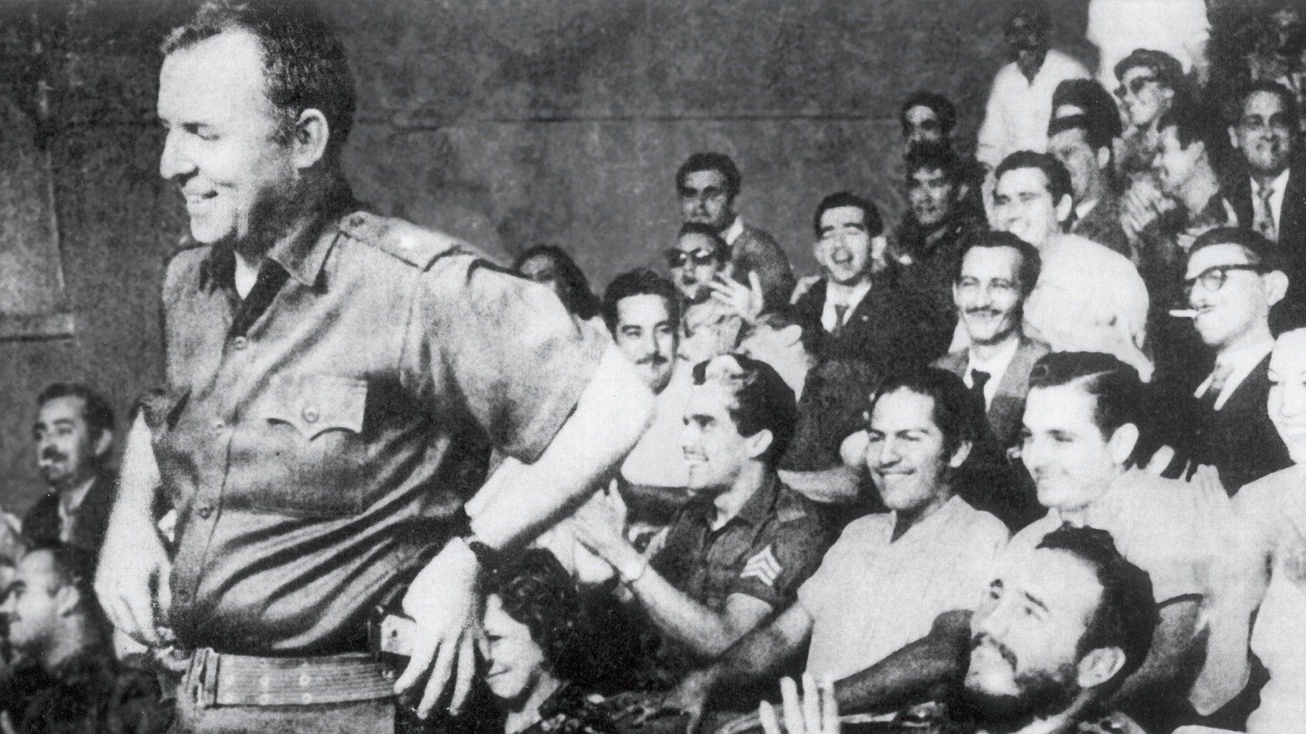
Castro’s aims and policies.
He promised agrarian reform, rent reduction, industrial development and modernization, expansion of education and health care and to take back public utilities from US companies.
Castro and a large proportion of its people shared the conviction that the government had a mission to help Cuba improve and serve its people. Redistribution of income as well as healthcare and education benefitted people on lower incomes was the idea of the regime established under Castro and promoted domestically.

Slide 5
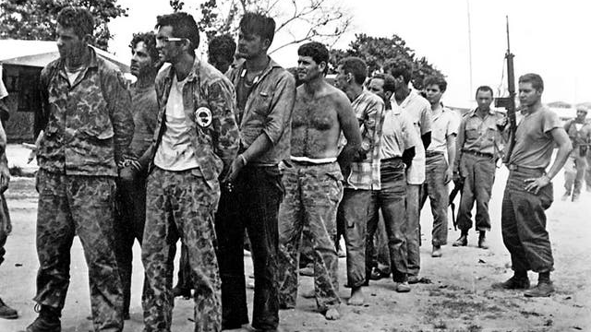
Why did opposition rise in Castro’s Cuba?
The combination of failed economic policies, increasing authoritarianism and a growing sense of disappointment with the way the revolution was working in practice led to the growth of opposition. Those who had regarded Castro’s 26 July Movement as a movement for liberation now began to have doubts.
The worldwide adulation among liberals for the Cuban leaders served to make it additionally troubling to the idealists in Cuba when they realized that the admiration felt by outsiders for Castro’s revolution was based on a misunderstanding of the actual situation. Unfulfilled hopes were, therefore, an important element in the formation of opposition. The same idealism that had motivated support for Castro now aroused opposition to him.

Slide 6
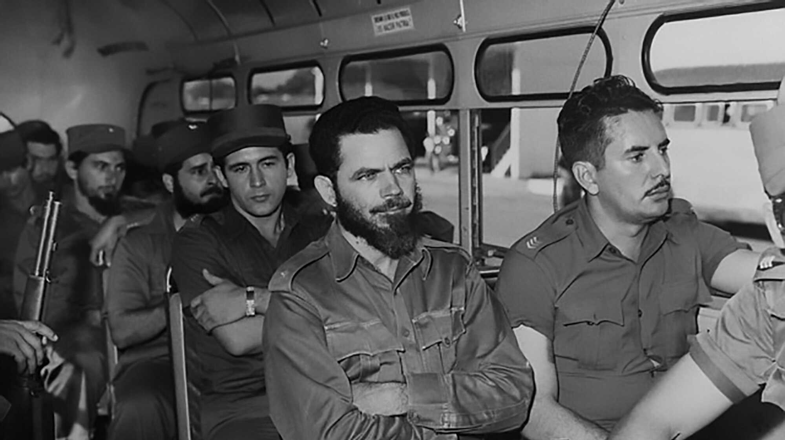
Who opposed Castro and why?
Landowners who had been forced off their land
Industrialists who had had their factories taken over by the state
Peasants who felt aggrieved at having been forced into collectivization
Pro-Americans who had been forced to break their commercial and financial links with the USA
Those badly affected by the failure of Castro’s economic diversity programme
Those who were offended by the ineffectiveness with which Castro’s government operated
Those who considered that the political constraints and repression imposed by the regime were unjustified by any of the internal or external threats supposedly facing Cuba

Slide 7
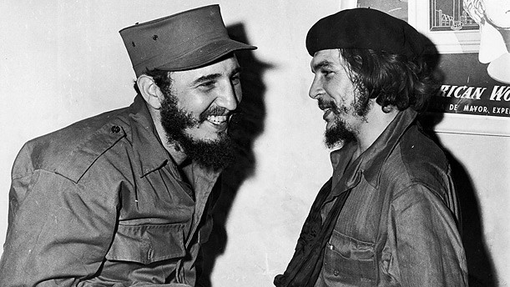
More opposition.
Writers and artists whose works were subjected to government censorship
Editors and journalists who objected to the curtailment of their press freedoms
Academics who resented the government’s encroachment on university freedoms
The trade unions, which had lost their independence
Professional bodies and associations, such as those representing businessmen, solicitors and teachers, who were angered at their being brought under state control

Slide 8
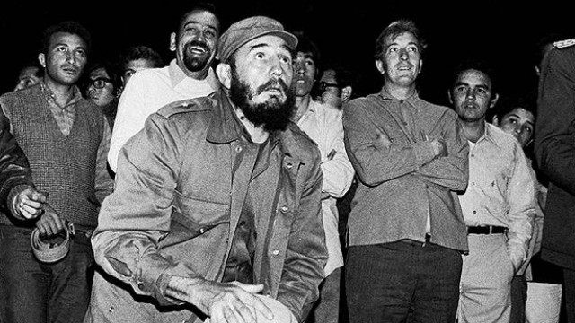
The array of opposition in Cuba.
Those who were dismayed by the way Cuba’s revolutionary government became centered in the person of Fidel Castro himself; such personalizing of authority undermined the notion of the 1959 revolution as a movement of the people
Those among Castro’s former supporters who were disturbed by his insistence on fighting wars abroad on behalf of liberation movements in such far-off countries as Angola, Zaire (later renamed the Congo) and Ethiopia, as well as closer to home in Latin America; they found his preoccupation with anti-imperialist campaigns merely drew attention to his failure at home to extend to his own people the rights that Cuban soldiers were fighting and dying for elsewhere

Slide 9
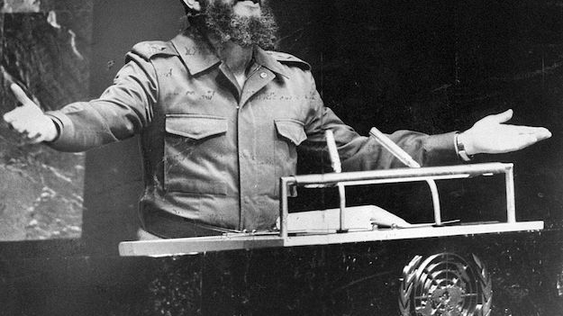
Opposition from the foreign states.
By 1968, 350,000 Cubans, nearly 5 percent of the population, had left the island. Most went to the United States where many of them formed cells planning to return to reclaim Cuba by force should the opportunity arise.
Those who had fled the island they knew their days of privileged living were over or because they simply felt they could not live in the repressive society Castro was creating
The United States was the biggest opposing foreign state of Cuba’s formation and leadership, the famous statistic of 638 assassination attempts on Castro is just one indicator, so is the Bay of Pigs.

Slide 10
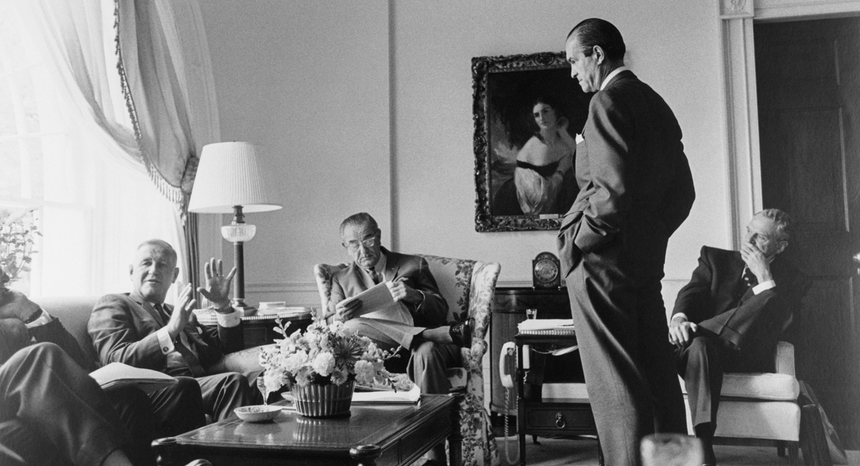
Opposition from exiled Cubans.
Castro’s notorious method of dealing with Cuban who had opposed his regime was to exile them, most of those exiles had gone to the United States and formed cells opposing Castro with the support of US agencies and had sought to form opposition against the regime with hopes of returning one day, the most famous example of opposition from Cubans abroad was their plan of the Bay of Pigs. But it wasn’t just intervention in Cuba, but also harsh protests and speeches done by the opposition abroad to rise awareness and gain support.

Slide 11
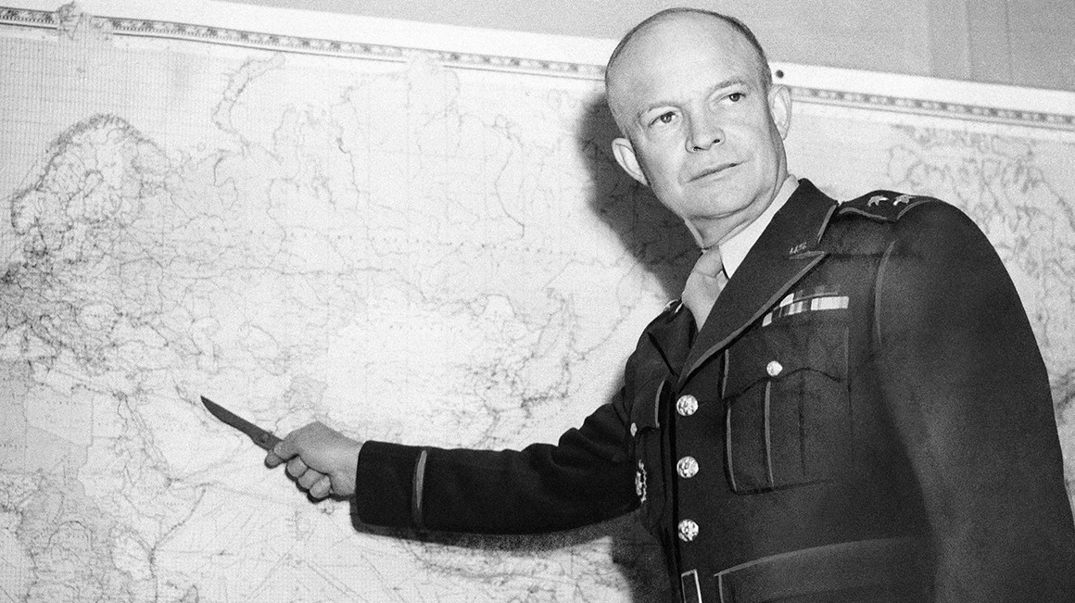
The opposition intervenes, Bay of Pigs, 1961.
Early in 1960, Eisenhower authorized a covert CIA program for using Guatemala as a training base for Cuban émigrés in preparation for a future attack on Castro’s Cuba. The hope was that this would provoke a popular rising that would topple the regime.
The attack was launched in April 1961 soon after Kennedy, the incoming president, who had earlier been a Castro admirer, had given it his approval. It proved as a fabulous fiasco. The invaders failed to receive the support they had expected from either the local Cubans or, more critically, the USA, and were killed or captured as soon as they landed. Forewarned of the attack, Castro’s forces were waiting for them. It was obviously a military disaster for the USA, but an even greater diplomatic and political one. The failed attempt to overthrow Castro’s regime was seen a huge victory for both Cuba and the USSR who had grown increasingly close.

Slide 12
The Ochoa Affair, 1989
In June 1989, Cuba experienced its most serious internal opposition crisis since 1959. Four senior military and intelligence figures- including General Arnaldo Ochoa- and several others were arrested on charges of corruption and drug smuggling. They were tried by military tribunals. Four, including Ochoa, were condemned to death and executed on July 13: others received prison sentences ranging from 20 to 30 years.
There is speculation that Ochoa and the others who favored Gorbachev-style reforms, were planning a coup. The crisis caused serious divisions in Cuba. However, the economic crisis of the Special period that soon followed brought about a new sense of unity.

Slide 13
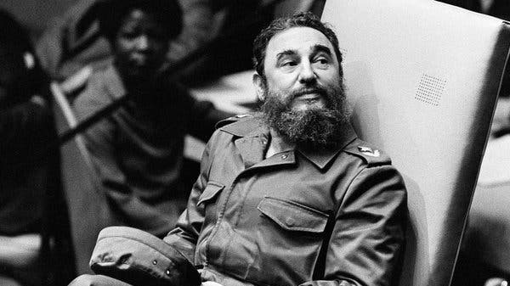
Black Spring
During the “Black Spring” in 2003, the regime imprisoned 75 dissidents, including 29 journalists. People such librarians, human rights activists, and democracy activists, on the basis that they were acting as agents of the United States by accepting aid from the US government.
Though these prisoners have since been released in the face of international pressure and by Amnesty international it stills shows Castro’s and Cuba's authoritarian regime and little liberty of speech.

Slide 14
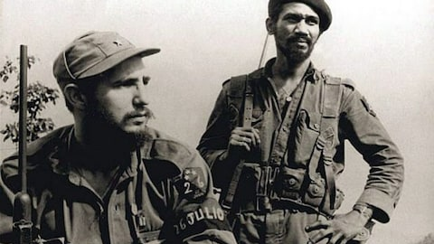
Aldana and the 1992 purge
However, during the “special period of time of peace” announced by Castro at the end of 1990, another reformist tendency emerged in the PCC and the Young communist party, where several members admired Gorbachev's policies. This opposition was led by Carlos Aldana and called for some limited political pluralism.
The collapse of the regimes of Eastern Europe and then the Soviet Union in the period of 1989-91 made Castro decide to move against this opposition, as well as other groups of reformists. In 1991, with the soviet union no longer a reliable ally against the USA, Castro created Rapid Response Brigades of volunteers to act against potential “fifth columnists”. These brigades often harassed oppositionist groups demanding political reform and the various organizations calling for human rights. In September 1992, Aldana was sacked from his party; and Castro, using his personal authority, began a purge of other reformists from the party.
To help diffuse this opposition, amendments to the constitution were made in 1992 to make Poder Popular more real. Despite the post-1991 economic suffering, these reforms were relatively successful, and Castro’s regime did not collapse the Soviet bloc states in Europe, as some had speculated would happen. In party, this was because most Cubans saw the revolution as their revolution - whatever its failings, it had also had real successes.

Slide 15
Castro's response to US Actions, 1992-96
The idea of a revolutionary Cuba under siege is part of the mythology of the revolution, and had led to mass mobilizations, revolutionary political offensives and popular militarization. In the 1990’s, moves against potential opponents were once again seen as increased threats from the USA. The Torricelli Act of 1992 and the Helm-Burton act of 1996, respectively, tightened US economic sanctions against Cuba and sought actively to “assist” in the creation of the USA’s form of democracy in Cuba. In March 1996, Castro acted against academics in the center for the study of America. They did not lose their jobs, but they were moved to different posts.

Slide 16
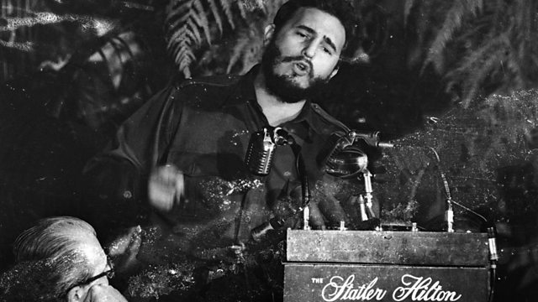
“Re-moralistion” and the Varela Project
By 1996, most of the economic measures of the special period had been stopped, then, in 2003, Castro decided on a partial return to anti-market centralization. This also involved the ‘re-moralisation’ of economic life. Associated with this were further moves against potential opponents, dissidents and human rights activists. The minister for economics and planning and the minister of finance, both of whom were closely connected to the liberalization of policies under the Special Period during 1993-96, were replaced by ministers favoring centralized political control of the economy and society.

Slide 17
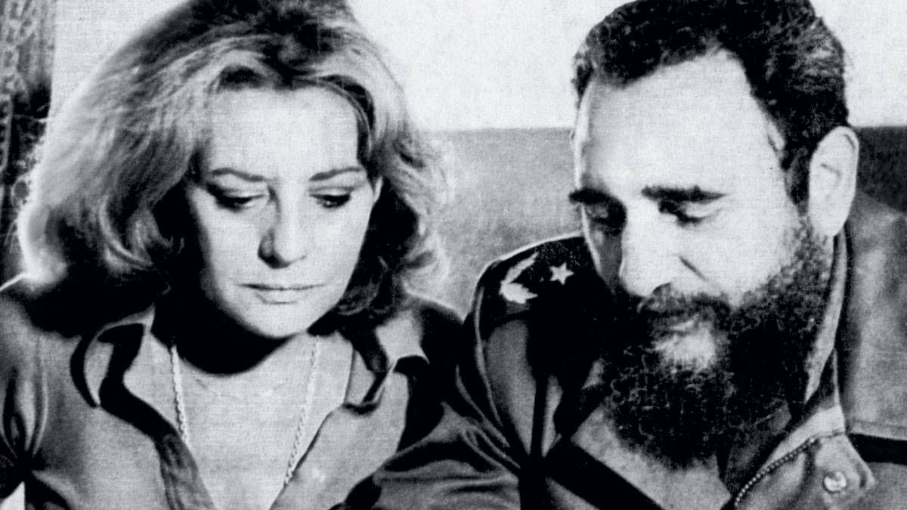
America and the Valera project
After the 2000 US presidential election, the USA stepped up its attempts to interfere in Cuba’s internal politics and President George W. Bush included Cuba in his new “axis of evil”. This led to renewed fears of an forthcoming US invasion. Castro then became concerned about the activities of members of the Varela project, who were campaigning for a law of democratic reform and more private enterprise. Castro’s government organized a counter-petition to amend the constitution to make the socialist nature of Cuban constitution unchangeable. This counter-petition included 8 million signatures - about 99% of the electorate. At the same time, the Cuban authorities began to harass members of the Varela Project. On 15 March 2003, 75 members were arrested, and many received long prison sentences, that event is known as the Black Spring.

Slide 18
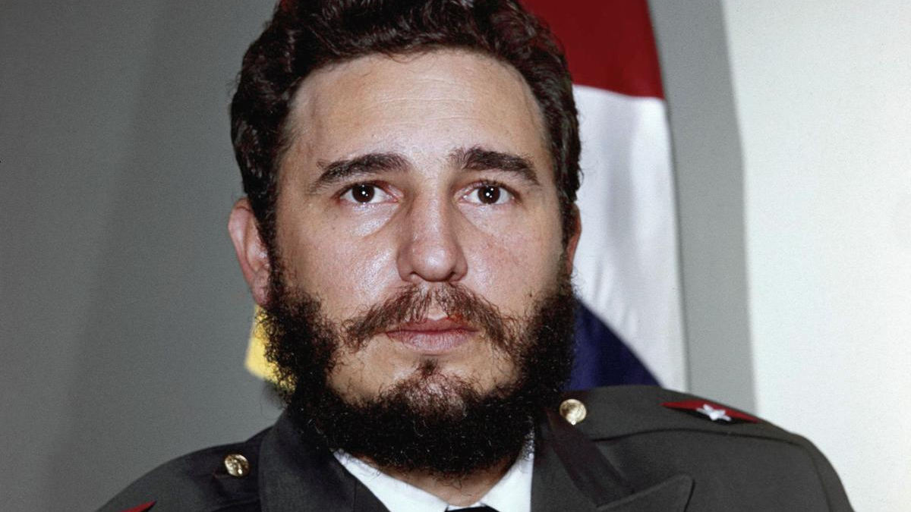
Opposition from the church
After Castro abolished celebrating Christmas in 1969 by stating that it interferes with the sugar harvests of Cuba. The church had quickly run to oppose the increasingly atheist state but were swiftly removed from the public eye by Castro’s orders to stop supporting the church and increased scrutiny of it.

Slide 19
Havana Riot, August 1994.
The Havana riot of August 1994 was one of the biggest demonstrations of resistance presented against Castro.
Caused by the build of tension from civil unrest since the 1980’s due to Castro forced emigrations alongside use of government violence against minorities and dissident, the opposition took up the streets of Havana to protest Castro’s regime.

Slide 20
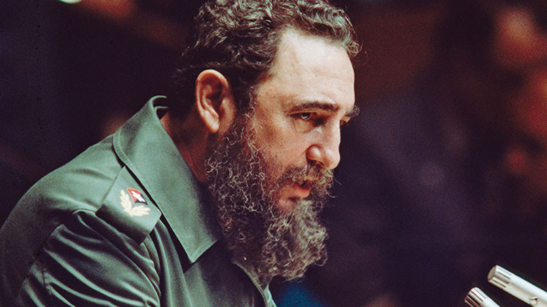
Brothers to the Rescue, 1996.
A famous groups of Cuban exiles, the brothers to the rescue, were an organization which had rescued refugees between Cuba and Florida.
Though tension between Castro and the group wasn’t stable as the organization went against Castor's regime and supported exiled emigrants it wasn’t until one of the groups planes was shot down by the Cuban Airforce which had then shown Castro’s response to opposition and increased tensions between the two.

Slide 21
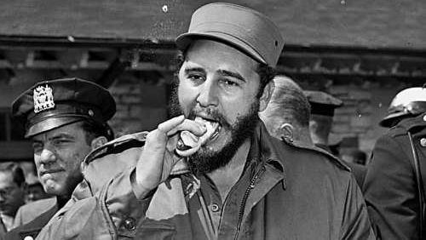
Unions in Cuba
The main mass organization is the Confederation of Cuban workers (CTC), which united all 19 unions and organized national congresses for workers to discuss issues. These are preceded by months of meetings of worker’s assemblies at local level. Castro and other leaders participate at times, to answer questions and to explain important issues. According to Saney, the worker’s assemblies have considerable input and say in their workplaces and in major national political decisions. By law, workers meet twice a year in their workplaces to discuss their company’s economic plans. They can reject management proposals, decide production norms and rates, and any new proposals are subject to ratification. Though they work closely with the PCC, they are independent of the government, which must consult the unions on all labor matters.
Unions were a major threat and opposition to Castro as they had accumulated a formidable force of people who if they weren’t satisfied with Castro’s policies relating their working conditions or wages were able to presents their concerns and voice their opinions publicly, having more liberty than the average Cuban.

Slide 22
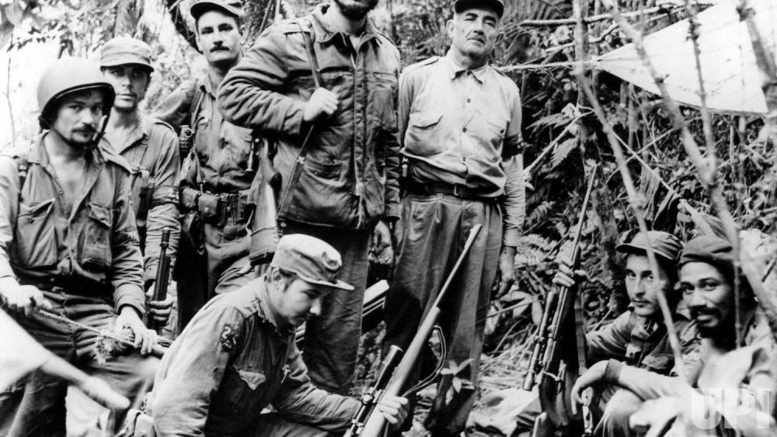
The PCC
The PCC attempts to integrate citizens by “promoting the development of a socialist consciousness and society” by trying to persuade people to put society’s needs above those of the individual. While Hobart, Spalding and others see the influence of the PCC as suffocating, according to Peter Roman the party does not meddle in the operation of people’s power. Though it does “screen” those selected as candidates, Carolle Bengelsdorf argues that Cuban citizens exercise significant political sovereignty.
About 1.5 million Cubans (15% of the population) belong to the PCC and its youth body, the union of Young Communists (UJC). Massive nationwide discussions - open - to both party and non- party people - take place before the party congresses.

Slide 23
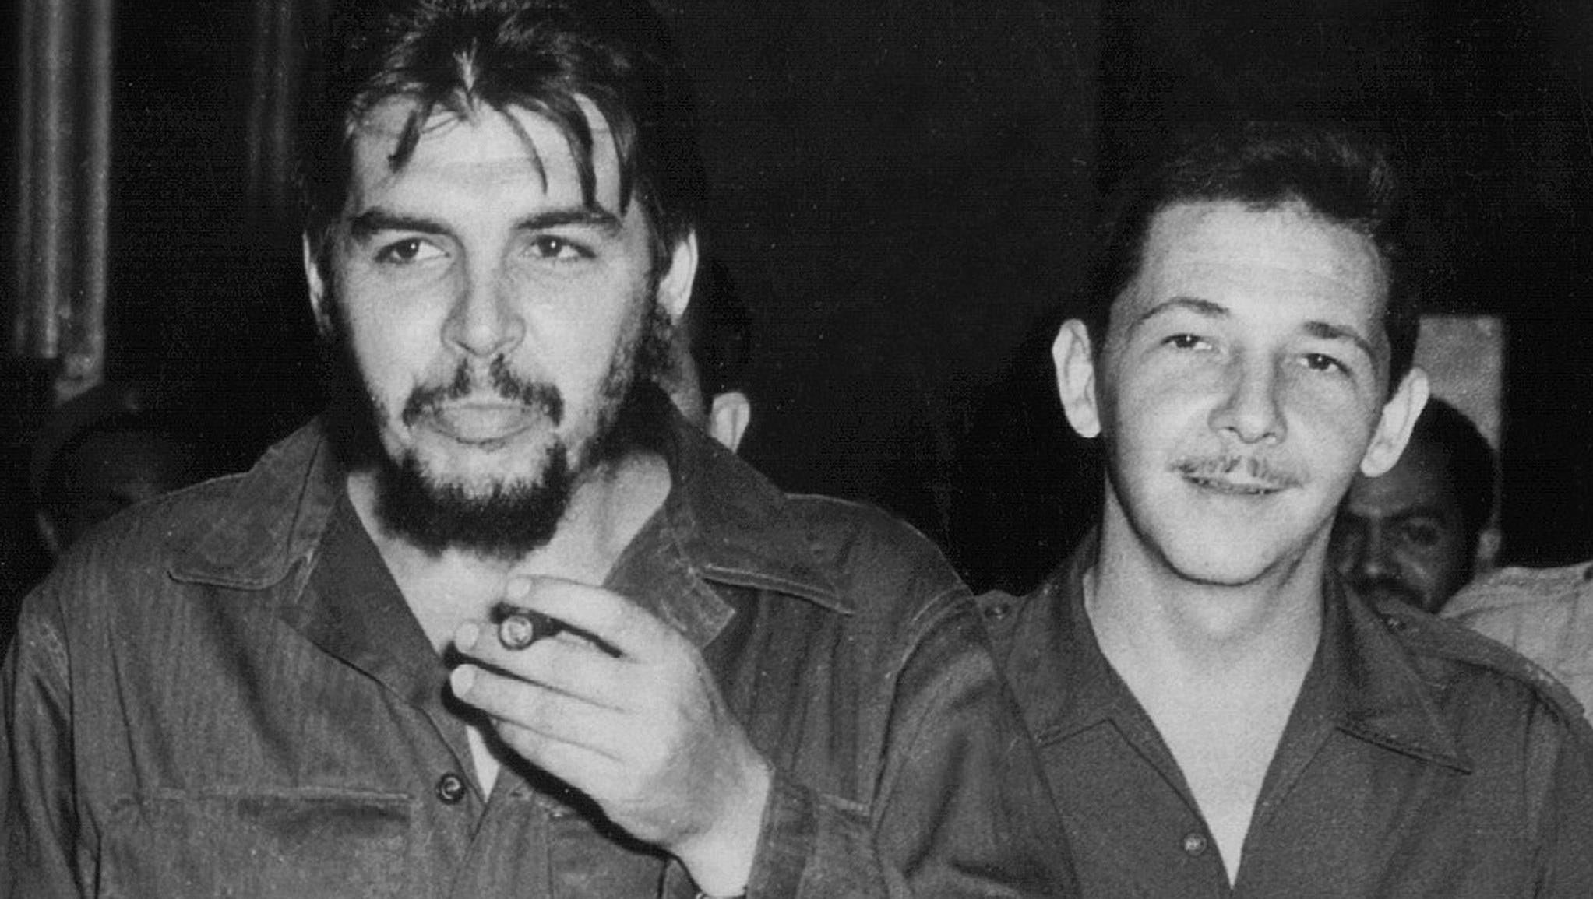
Weakness of the Opposition
Although the opposition groups looked to be a large and formidable array, they were never as serious a threat as appearance suggested. It was only the US-backed émigrés who represented real resistance, and when they did openly challenge Castro, as at the Bay of Pigs, they were decisively beaten.

Slide 24
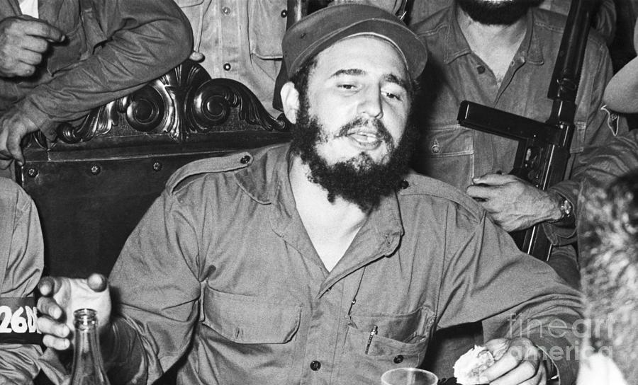
Weak Opposition
Opposition was never a united, organized body and the disaffected groups were unable to concert their efforts, even had they ever seriously planned to challenge Castro.
Castro’s status as the embodiment of Cuban aspirations meant that opposition to him seemed unpatriotic and so rarely gathered popular support.
The firmness with which Castro dealt with challenges rendered it a hazardous venture to try to oppose him.
Cuba’s close-knit society made it easy to monitor opposition movements through eavesdropping and surveillance. The DGI, an organization which operated under Fidel Castro’s direct control, was a highly effective means of detecting his enemies in Cuba and outside.

Slide 25
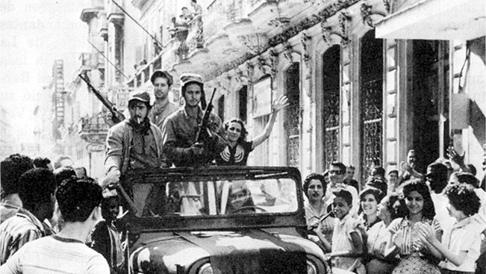
Treatment of Opposition.
Fidel Castro came to power with the Cuban Revolution of 1959. By the end of 1960, according to Paul H. Lewis in Authoritarian Regimes in Latin America, all opposition newspapers had been closed and all radio and television stations were in state control. Lewis states that moderate teachers and professors were purged, about 20,000 dissidents were held and tortured in prisons
Occasionally, however, in order to reduce political tension, Castro would allow large numbers of Cubans to leave. One such moment occurred in 1980 when 10,000 people, reacting against food rationing, besieged Cuba’s Peruvian embassy appealing for asylum. But Castro always accompanied such occasions with vast propaganda displays of support for himself and the regime. His intention was to show that the overwhelming mass of the population backed the revolution, contrasting with the relatively tiny number of selfish individuals who refused to stay and continue the struggle to achieve Cuba’s destiny. 'Let them depart in shame’ was his dismissive reference. During Castro’s rule, thousands of Cubans were incarcerated in abysmal prisons, thousands more were harassed, and intimidated, and entire generations were denied basic political freedoms.

Slide 26
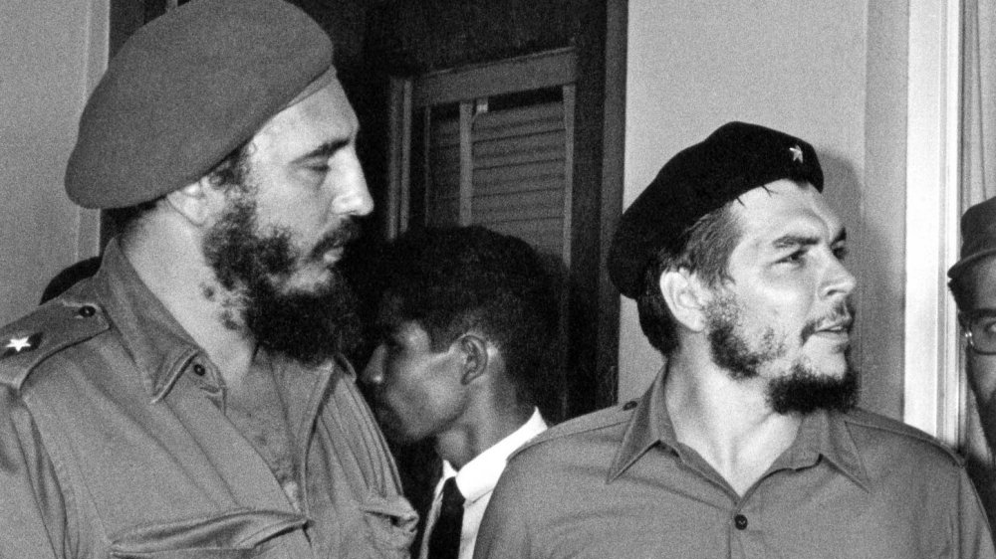
Castro’s treatment of Opposition.
The denial of fundamental freedoms throughout Castro’s decades in power was unrelenting, and marked by periods of heightened repression, such as the 2003 crackdown on 75 human rights defenders, journalists, trade unionists, and other critics of the government. Accused of being “mercenaries” of the United States government, the individuals were summarily tried in closed hearings. Many served years in inhumane prisons, where they were subjected to extended solitary confinement and beatings and denied basic medical care for serious ailments. More than 50 of the remaining prisoners were released after Fidel Castro handed over power to his brother, most on the condition that they accept exile to Spain.
Lastly, countless tactics developed by Castro during he’s regime including surveillance, beatings, arbitrary detention, and public acts of repudiation – are still used by the Cuban government.

