Slide 1
WARNING
Don’t try this at home!
Stress Reduction Kit
BANG HEAD HERE
Directions:
Place kit on a FIRM surface
Follow directions in circle of kit
Repeat step 2 if necessary, or until unconscious
If unconscious, cease stress reduction activity

Slide 2


Working together
Helping your child with revision

Slide 3
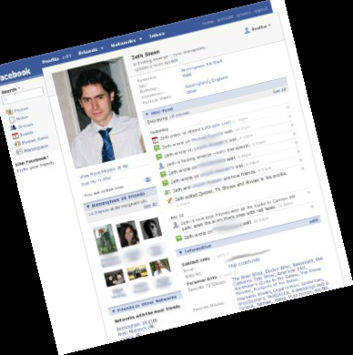
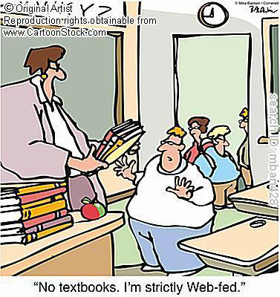

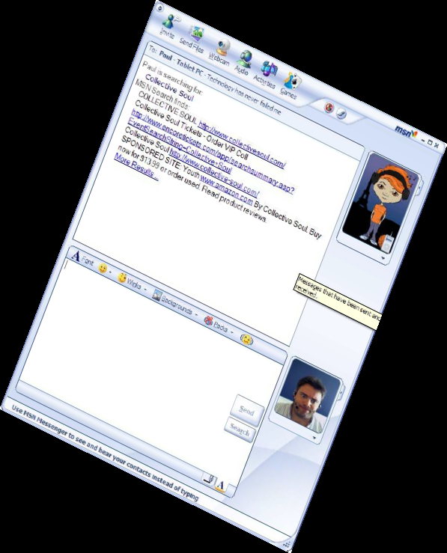
Things have changed….

Slide 4
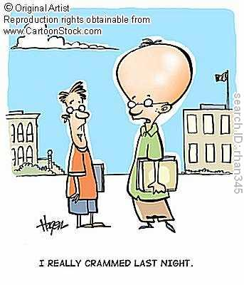
Revision is NOT....
Cramming the night before;
Just copying notes out;
Just reading a text book;
Just surfing the internet;
Phoning a friend for advice;
Just watching channels on TV.

Slide 5
What is Revision?
Actively going back over work on an ongoing basis to:
  Remind you of things you might have forgotten
  Make links to other learning so you have the bigger picture
  To reinforce your learning - so it stays remembered
  To show you what you don’t know
  Check that you have understood everything

Slide 6
What is Revision?
  Structured
  Regular
  Active
  Varied
  Bite size
  Supported
  USEFUL

Slide 7

Why encourage your child to revise?
It can reduce panic – gives them control and confidence

Slide 8
Why encourage your child to revise?
It means exams reflect what they can do, not what they didn’t bother to do – show what you know!
It can help them to identify problem areas.

Slide 9
Should I help with revision?
Research and experience shows that children whose parents take the opportunity to be frequently interested in their child’s learning make most progress.
Revision should be used to embed the learning beyond the classroom. It can provide the opportunity for learners to reflect on their understanding and extend skills and knowledge in a particular area.

Slide 10
You will also get to know your child’s particular strengths and difficulties and find out what they are studying.
Helping your children with their work is not the same as doing it for them; discussing their work with them strengthens their understanding.

Slide 11
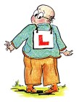
Where should students revise?
How should students revise?
How often should students revise?

Slide 12
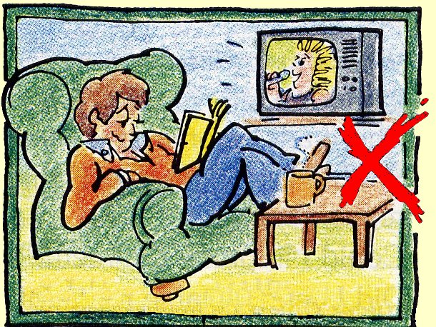
Where should students revise?

Slide 13
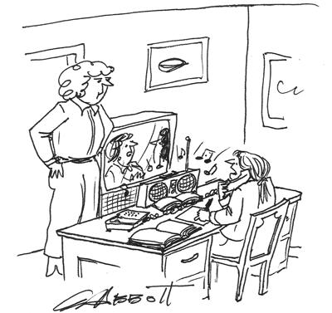
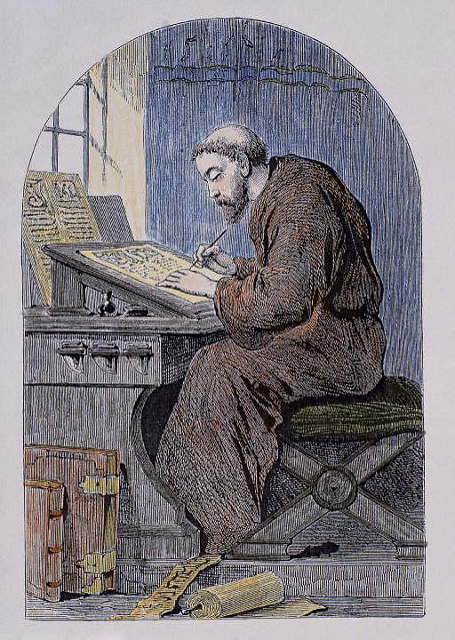
There is a balance that is needed to create the right learning environment at home

Slide 14
What does your child need?
A space that belongs to them for the duration of the studying period
Quiet background music IF they think it helps
Lots and lots of lined paper
Pens, pencils, colours and highlighters
Post it notes
Cue cards
Paper folders per subject

Slide 15
TV and other distractions must be minimised.
If they don’t have anything to do (quizzes, booklets, worksheets) they need to ask their teachers.
They must be honest with THEMSELVES. Students need to encouraged to have an achievable routine.

Slide 16
Organisation is essential
If they spend the first 20 minutes of every session looking for their notes to revise, just think what time has been wasted
Need an organised space to keep things together
Agreed places where they can put information and revision aids around the house

Slide 17
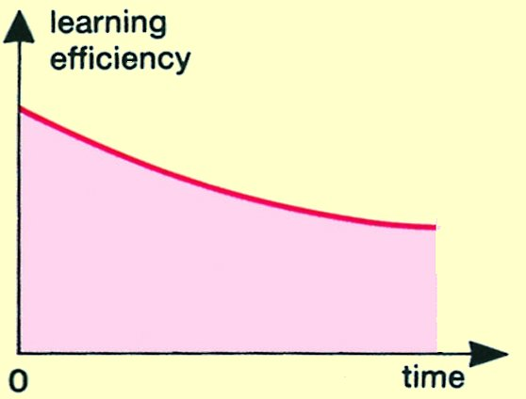
How should you revise?
If you just sit down to revise, without a definite finishing time, then your learning efficiency falls lower and lower,like this:

Slide 18
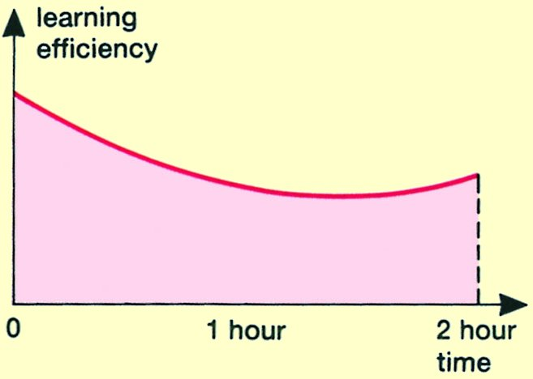
How can you improve this?
If you decide at the beginning how long you will work for, with a clock, then as your brain knows the end is coming, the graph rises towards the end

Slide 19
How can you improve this even more?
If you break up a 2 hour session, into 4 shorter sessions, each of about 25 minutes, with a short planned break between them, then it is even better.
Compare the next 2 graphs:

Slide 20
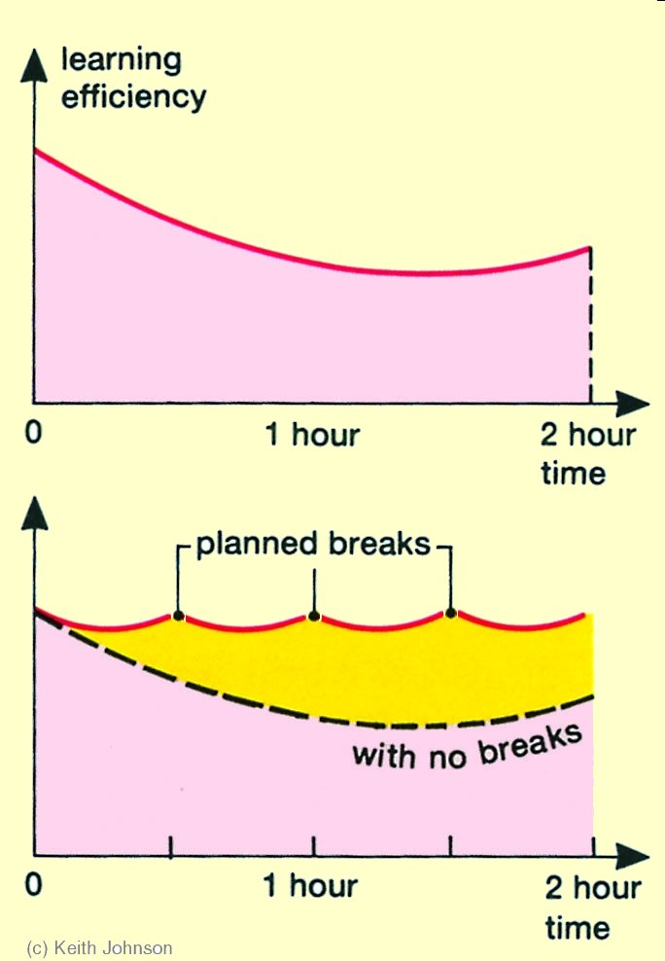
One solid session
4 shorter sessions
The yellow area shows the improvement.

Slide 21
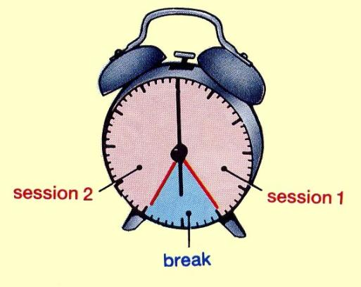

Slide 22
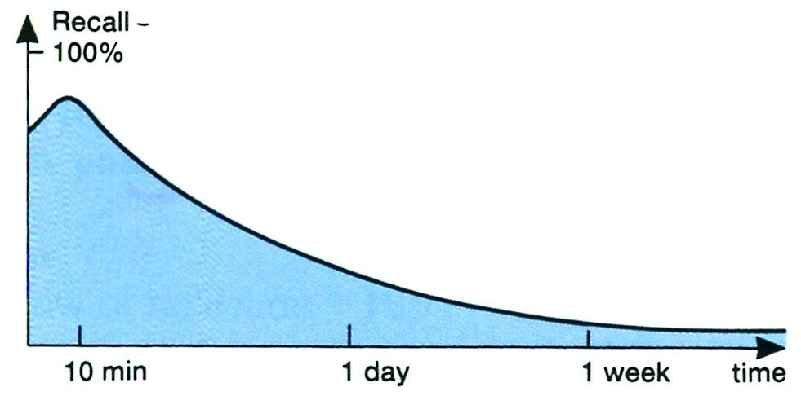
How often should you revise?
Look at the graph below. It shows how much your brain can recall later.
It rises for about 10 minutes …and then falls.

Slide 23
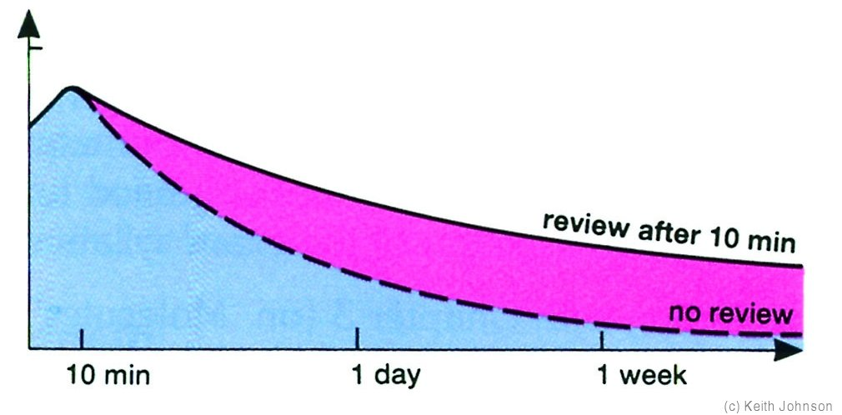
However,
if you quickly re-revise after 10 minutes, then it falls more slowly! This is good.

Slide 24
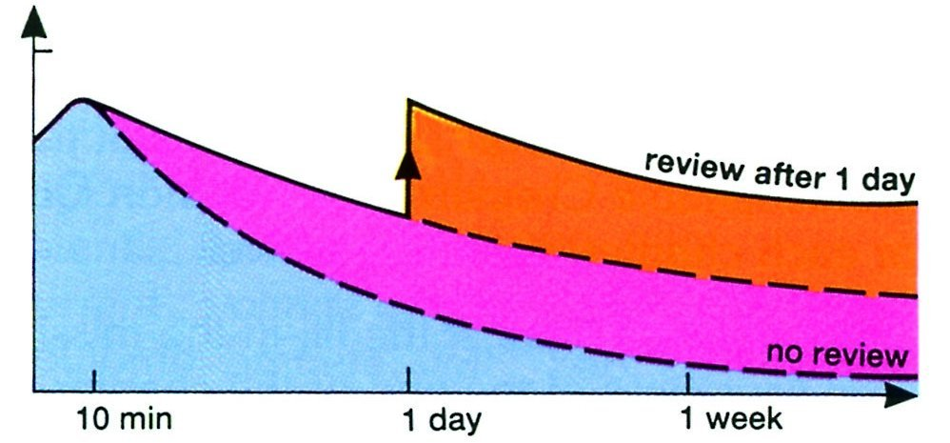
Even better,
if you quickly re-revise again, after 1 day, then it falls even more slowly!

Slide 25
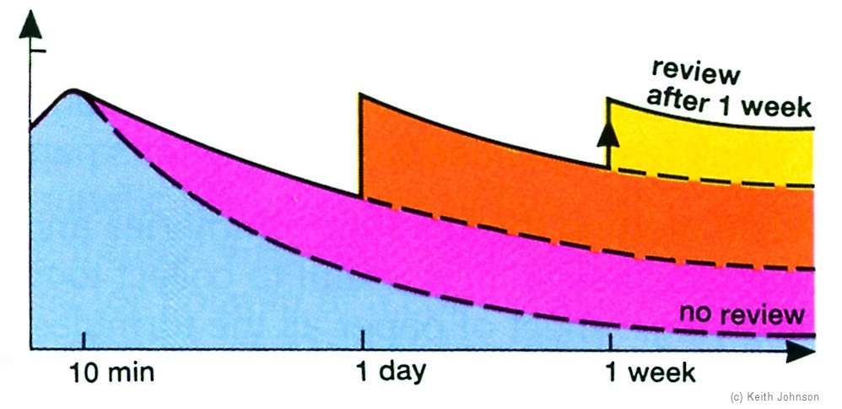
And even better still,
if you quickly re-revise again, after 1 week, then it falls even more slowly! Great!

Slide 26
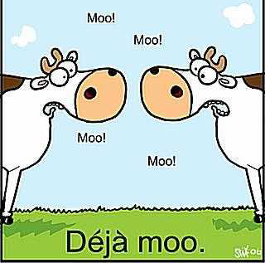
So the best intervals for ‘topping-up’, by reviewing or briefly re-revising are:
      10 minutes
      1 day
      1 week
      …and then 1 month.

Slide 27
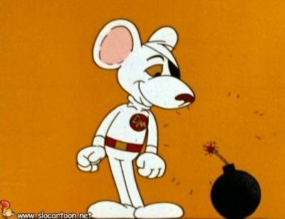
How do we manage the time left before the exams?
exams

Slide 28
MON | TUE | WED | THU | FRI | SAT | SUN
 | Clubs
Rest times.
Equivalent to one day in the weekend, and
one evening.
One box is 1 hour.
work
& rest

Slide 29
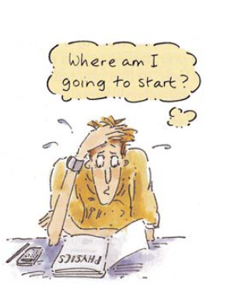
Happy revision needs....
exams

Slide 30
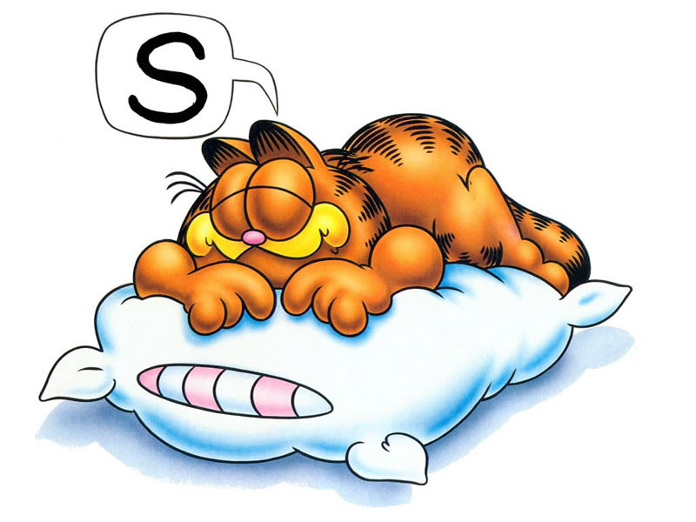

Slide 31



Slide 32

WATER

Slide 34
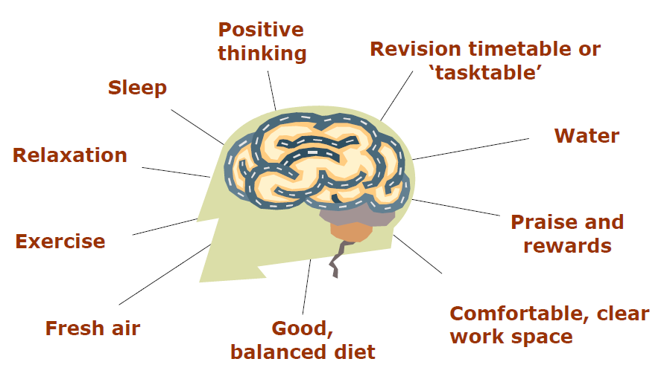
Keeping the Brain happy

Slide 35
How do I revise?
exams

Slide 36
Memory Board
Banana
Ball
Paint pot
Human body
Hammer
Teapot
REVISION
Brain
Notes:
36

Slide 37


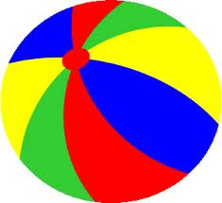

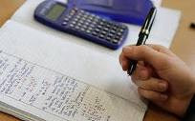
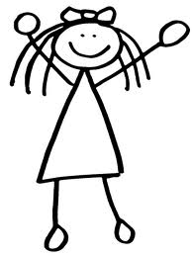
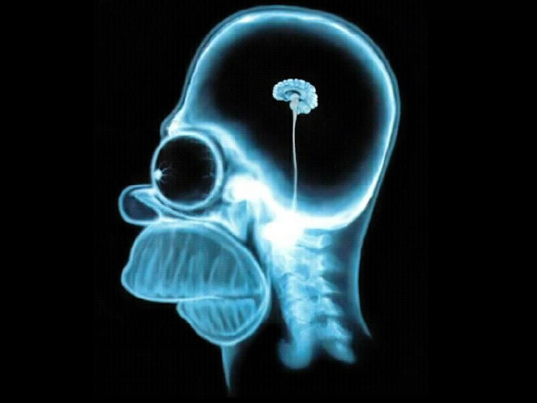

Notes:
37

Slide 39
How many did you remember?
Banana
Ball
Paint pot
Human body
Hammer
Teapot
REVISION
Brain
Notes:
39

Slide 40
Choose your first object, and use your imagination to create a memorable image for this in your mind. A boring old banana, for example, is no good. Imagine it huge, or gyrating, or blue. Or all three.
Now link this first item to the next. In this case it’s the ball. So perhaps your huge gyrating banana could sprout a hand and start bouncing the ball on the ground.
Now link the ball... to item 3, the paintpot. And make it memorable. So the ball could fly into the open paintpot with a giant splash which causes paint to fly everywhere... See the paint, hear the splash.

Slide 41
Continue linking each item to the next in a story. Just make sure that each link is really visual, unusual and memorable. Go wild – make it funny, surreal, even rude (ssh). Whatever works for you.
Rehearse the whole story in your mind a couple of times.
And off you go – you should be able to remember the whole list effortlessly. And even backwards... give it a try.

Slide 42
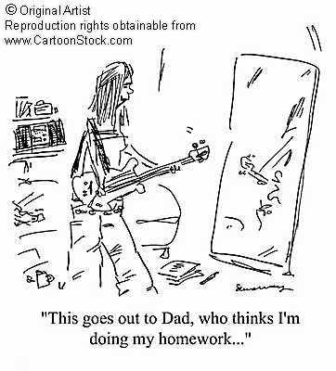
Associations
It is sometimes easier to remember things if we can make associations with things that we have an interest in
The child who loves drawing……turn the plot of an English Literature text into a cartoon;
The child who loves music…… set some key vocabulary to the tune of a favourite song.

Slide 43
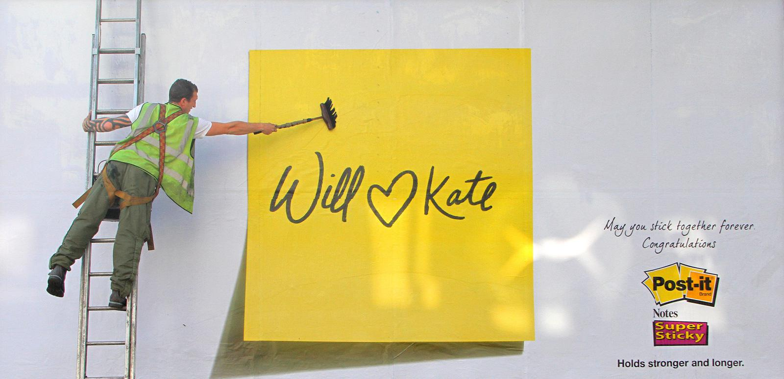
I LOVE REVISION

Slide 44
Pictures and Post-it-Notes
For visual learners creating a picture with the knowledge they are revising is an effective method
Pictures then can be used by displaying them around the house and on bedroom walls
Changing the pictures regularly is most effective

Slide 45
Mind maps
Start in the middle of the page
All words are key words representing information.
Use pictures and colours whenever possible
Each key word should have it’s own branch
Follow your thoughts- add ideas and facts by adding smaller branches.

Slide 46
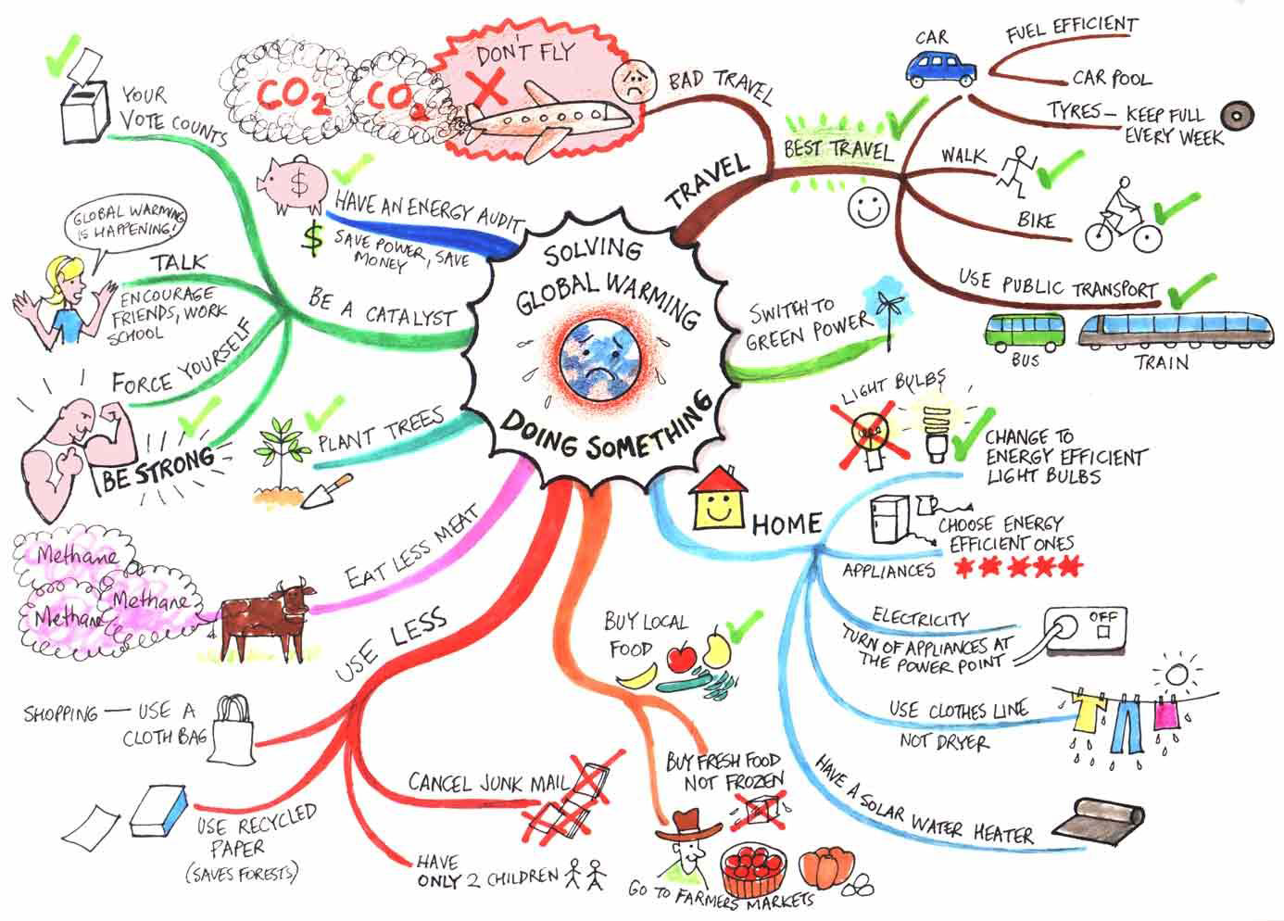

Slide 47
Cue Cards
Key words on small cards which students can carry with them
Good way to use up small amounts of time i.e. walking to school/ or on a journey
Good way of testing their learning.

Slide 48
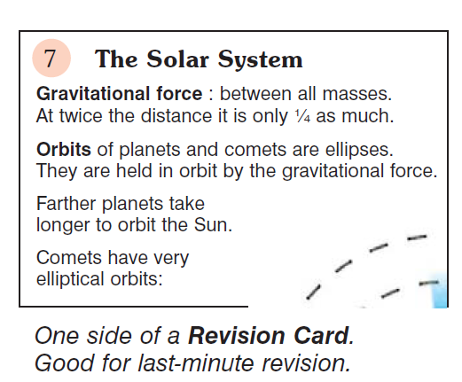

Slide 49

Folding Paper

Slide 50
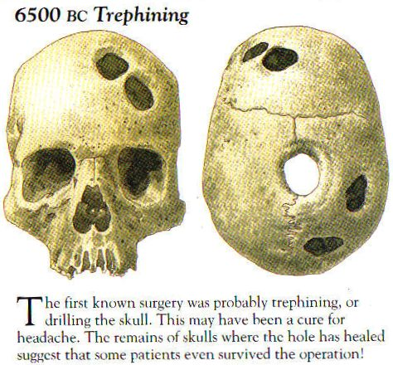

Another memory tool...
LABELLING AN IMPORTANT PICTURE
Periods which
are….
Treatments
Included…
A clear trend
Is that…
Symptoms
would have….
Public health
was…
One feature of medicine
were..

Slide 51

The Diamond 9
This is Damien Hirst’s Skull Diamond. He said:
"I wouldn't mind if it happened to my skull after my death."
Cost $20 milllion, valued now at $100 million

Slide 52
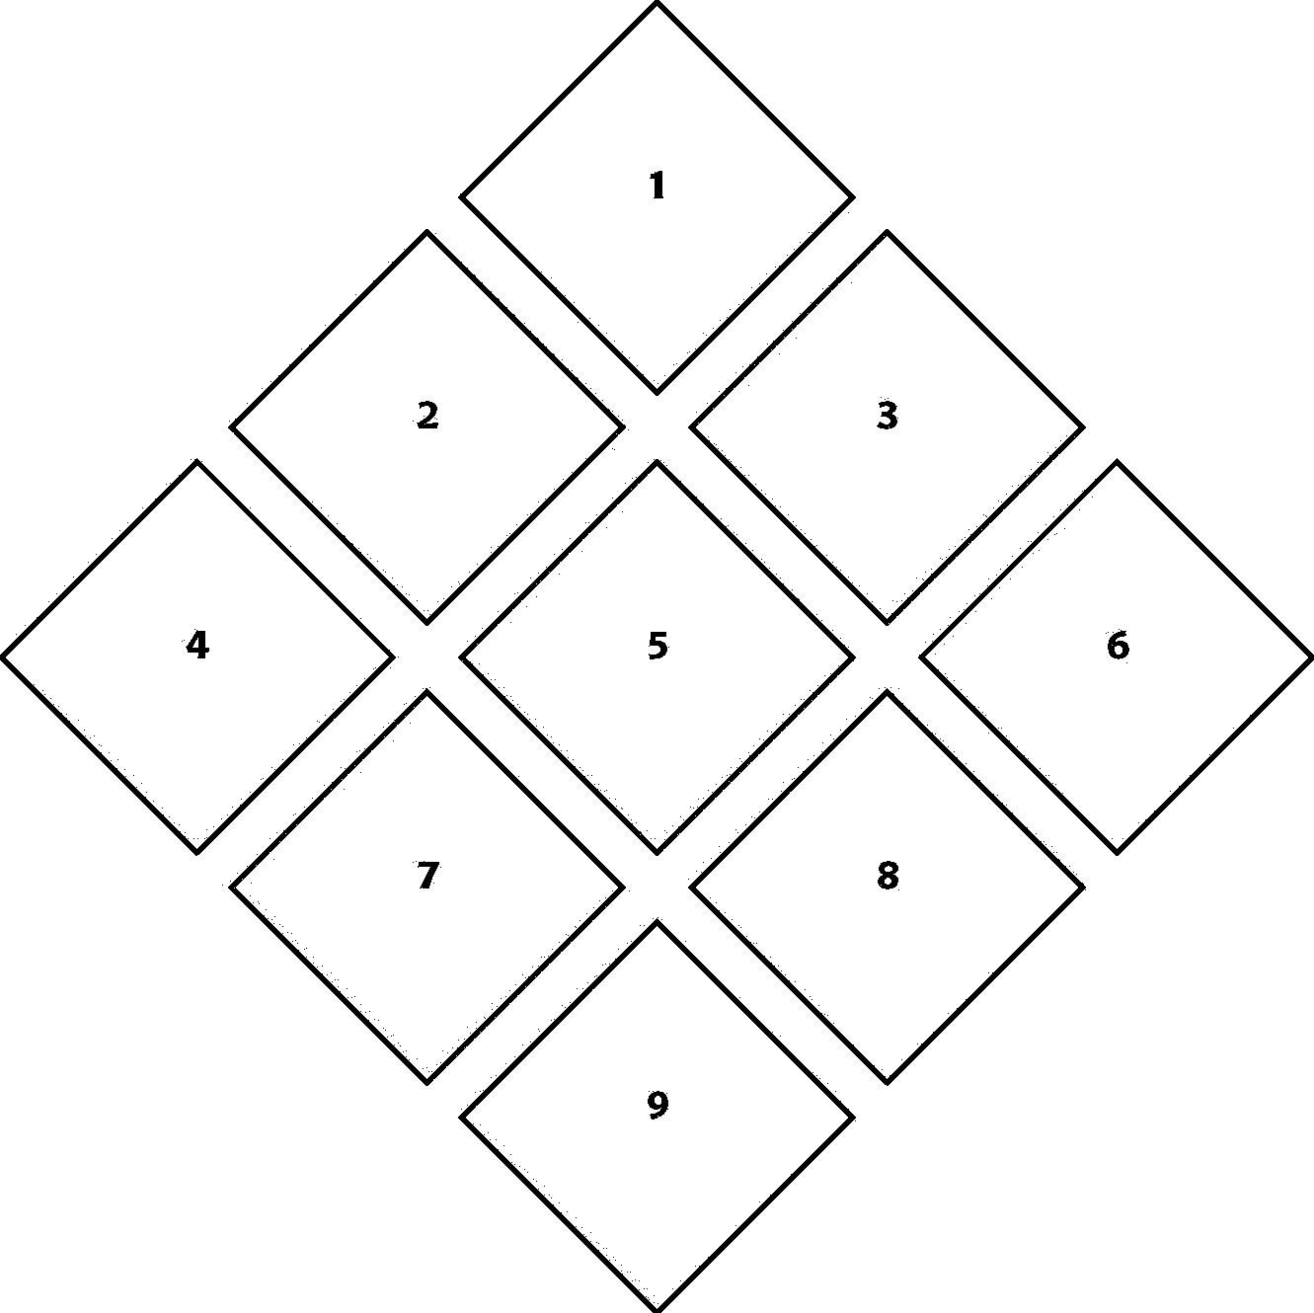
Most useful
1
3
2.
4
8
5
7
8
9
Least useful

Slide 53
Memory Cards
Take about 20 rectangles of paper / card
Write question on front, answer on back.
Scatter across table / floor – question side up.
Pick up one and try to answer.
Turn over to the answer - if right put it in a pile, if wrong put it back on the floor / table.
Repeat
This system will require you to answer questions you didn’t get right again. Therefore you will get more practice at what you don’t know

Slide 54
Memory Tennis
Choose a topic
Then take it in turns to give an idea / fact about the topic
The person who fails to give an answer within 5 seconds loses a point.

Slide 55
Act the story out…
Within subjects there are a number of areas which can be physically role played

Slide 56
It ain’t over til the fat lady sings…
How many of you can still sing “Old McDonald had a farm”
Use it for learning, it is really powerful
Other examples,
http://sing-smart.com/LyricsDetails.asp?SongCategoryID=4

Slide 57

E-learning

Slide 58
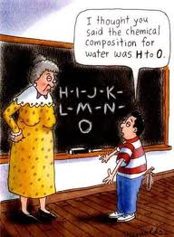
Let them be the teacher

Slide 59
Let them be the teacher
If you don’t know anything about what they need to know, ask them to teach you
We learn:
10% of what we read
20% of what we hear
30% of what we see
40% of what we see and hear
70% of what is discussed
95% of what we teach to someone else

Slide 60
Ask specific questions
What did you learn in French today?
 Look at a page in their exercise book and ask questions – How do you say ….my name is?

Slide 61
Revising in Different Ways
Visual
Posters
Cue cards
Mind maps
Power Points
Kinaesthetic
Mind maps
Note writing
Cue cards
Highlighting
Auditory
Dictaphone / mp3 recording
Listening to CD’s / mp3 files
Podcasts
Speaking out loud

Slide 62


Slide 63
Feedback
Past Paper Questions
ANNOTATE

Slide 64
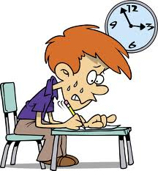
What is Revision?
  Structured
  Regular
  Active
  Varied
  Bite size
  Supported
  USEFUL

Slide 65
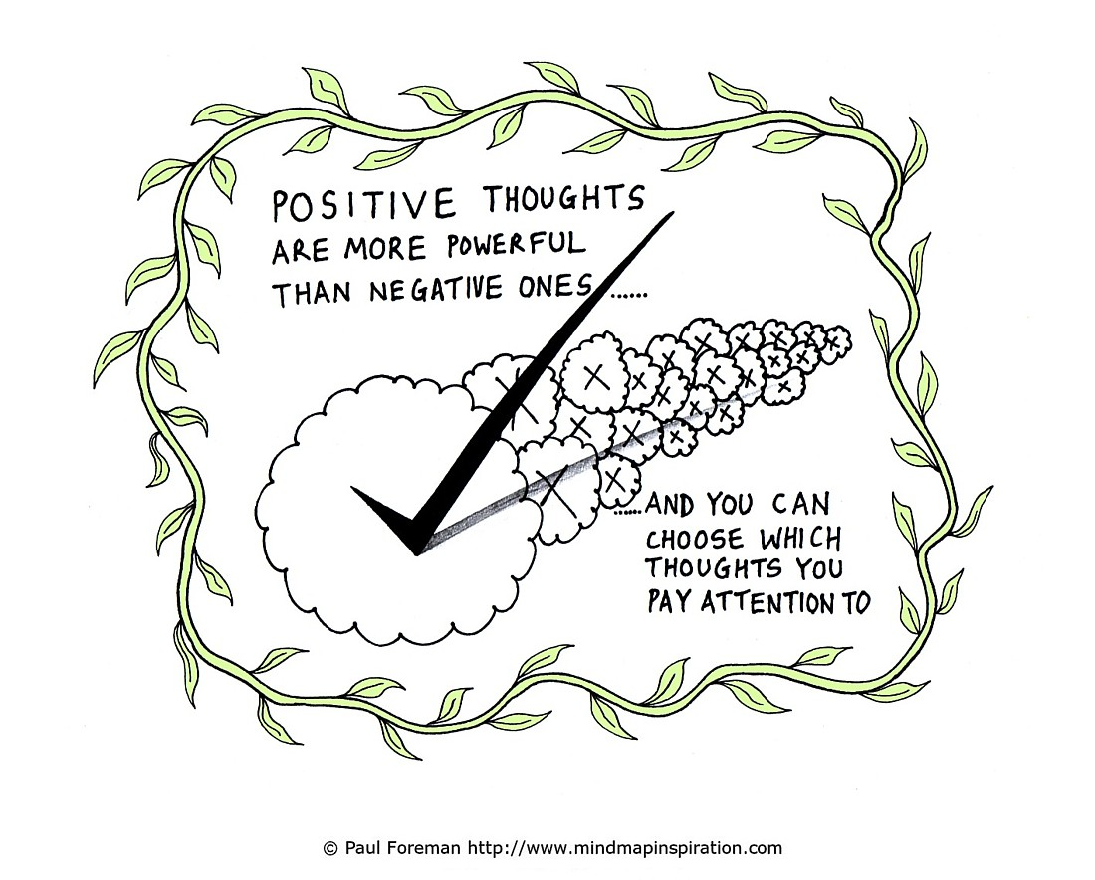
Managing Anxiety
Stress is healthy
Too much stress blocks the flow of oxygen to the brain and causes shut down
They can control their behaviour by controlling their thoughts.
Think positive things

Slide 66
Turning Stress into a Positive
Ted Talk:
http://www.ted.com/talks/kelly_mcgonigal_how_to_make_stress_your_friend.html?utm_content=awesm-publisher&utm_medium=on.ted.com-static&utm_campaign=&utm_source=direct-on.ted.com&awesm=on.ted.com_UpsideOfStress

Slide 67
Everyone gets stressed during exams but it's important not to let it get out of control
Difficulty getting to sleep or difficulty waking up in the morning
Constant tiredness
Forgetfulness
Unexplained aches and pains
Poor appetite
Loss of interest in activities
Increased anxiety and irritability
Increased heart rate
Migraines/headaches
Blurred vision
Dizziness

Slide 68

One suggestion
If upset, get your child to:
Write out for 5 minutes everything on their mind and leave it in book
Write both in the evening and morning, and when they are stressed

Slide 69

Help them to avoid comparing their abilities with their friends, such as “I've only read Macbeth 17 times“!
Everyone approaches revision in different ways, so just make sure they have a chosen method that works best for them. Make a realistic timetable. Stick to it.
Don’t forget,

Slide 70
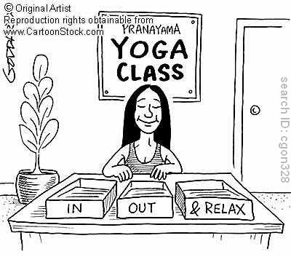
Panic is often triggered by hyperventilating (ie quick, shallow breaths). So help them recognise the signs, to sit back for a moment and control their breathing. Deep breath in and out through the nose. Counting to five each way.

Slide 71
Steer clear of any exam 'post-mortem'. It doesn't matter what they wrote for Question 3(b). It's too late to go back and change their answers, so it will just make you and them worry even more.
Ultimately, help them not to lose sight of the fact that there is life after exams. Things might seem intense right now, but it won't last forever

Slide 72
Ask the right questions
When is your exam?
What are you likely to be tested on?
What do you need to take on the day?
What strategies are helping you most?
You’ve been studying….What can you teach me?
What support do you need?

Slide 73
Top tips for on the day
Get up earlier than need to but follow the SAME routine
Eat breakfast
What they don’t know now – they don’t know
Don’t be late, or miss the bus!
Have the right equipment with them
Don’t have an argument. Deal with it later
Hug them: it releases endorphins

Slide 74
Stairway to Heaven
Revision space: Find a good place to work.
It should be quiet and uncluttered.
Revision timetable: Draw up a revision timetable –
it's crucial. It should cover subjects & allow you time off to relax.
10 steps
to success
Revision guides: Get a recommendation from your teacher as
to which are most useful and then make sure you use them
Questions and answers: Write out some questions and
answers to see how much you're actually remembering.
Listen in: Read your notes onto an ipod and then play
them walking down the street or whilst you're in bed.
Prompts: Put key words and phrases on sticky
notes around the house, so you'll see them often.
Seek help!: Don't go it alone. They say a problem shared is a problem
halved. So, get friends and family on board to help you revise.
Past papers: Make sure you get hold of some past papers,
they're a really good way of knowing what to expect in the exam.
Make notes: Don't just read through your class work, make notes.
One useful tip is to gradually condense your notes so they fit on the back of a postcard.
Relax: If you panic you're lost! The exams are going to happen so you might as well
give yourself the best chance of doing well by starting to revise early and keeping calm.

Slide 75
Useful Websites
http://www.bbc.co.uk/schools/parents/helping_with_exams/
http://www.eparenting.co.uk/education/revision_guide.shtml
http://www.youtube.com/watch?v=UThIcoyE1zk Revision Pig- if you’re tearing your hair out the revision pig is a five minute YouTube film which talks you through the revision process. It will not be everybody’s cup of tea but is quite amusing and factually accurate.

Slide 76
Useful Websites
http://www.guardian.co.uk/education/2008/feb/19/students.uk?INTCMP=SRCH (It’s old but still very useful)
http://www.youngminds.org.uk/parents/hot-tips-for-your-child/tips-on-managing-exam-stress-for-parents
http://www.bbc.co.uk/scotland/brainsmart/
Practical Guide to Revision Techniques (Practical Guides) [Paperback] by Simon Percival
How to Achieve 100% in a GCSE - Guide to GCSE Exam and Revision Technique [Paperback] by Robert Blakey

Slide 77
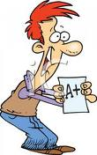

“Success only comes before work in a dictionary”

