Slide 1
Why did the Haiti 2010 Earthquake result in many more deaths than the Japanese Earthquake 2011?

Slide 2
Objectives
What: A comparison of two major earthquake events
How: Use a range of resources to investigate the causes, effects an management of two earthquake events
Why: To understand the factors that influence the severity of earthquake events
Final assessment: Essay- “Was the Haiti 2010 Earthquake a bigger disaster than the Japanese Earthquake of 2011?” Learner Profile Links - Empathy, knowledge, caring, inquirer

Slide 3
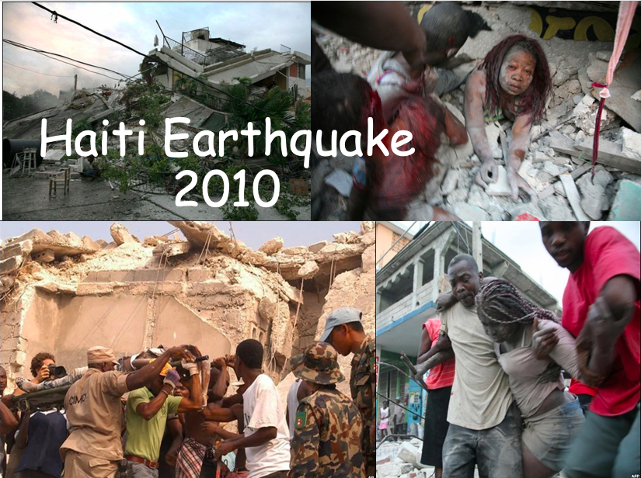
Stage 1 of enquiry: Learning about the cause and effects of the Haiti earthquake
Week 1

Slide 4
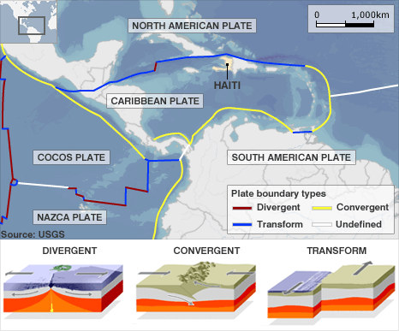
Where is Haiti?
Transform is another name for conservative plates
Why is Haiti at risk from earthquakes?

Slide 5
Task 1: Comparing the level of development between of Haiti and Japan
Development indicator | Haiti | Japan
GNI per capita (average income per person)
% of population who are internet users
Expected years of schooling
Extension: Can you explain why these factors may influence the effects of an earthquake?
Use this site to help to help you find the data
http://hdr.undp.org/en/countries

Slide 6
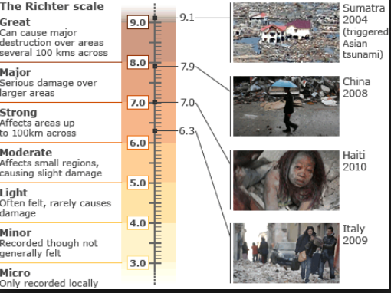
How are they measured: Richter scale

Slide 7
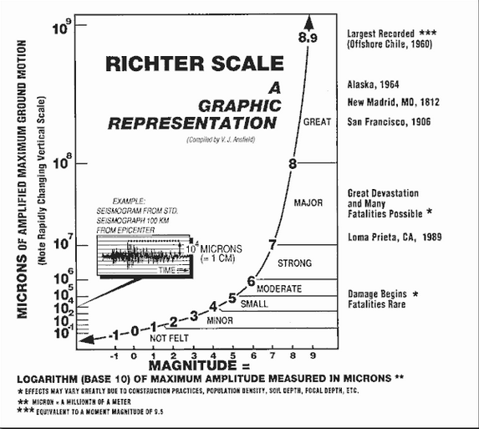

Slide 8
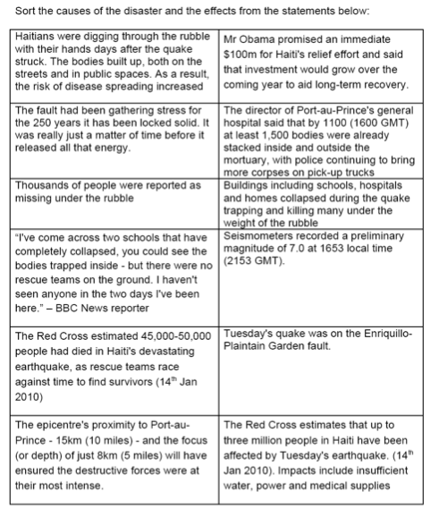
Task 2: Sort the information into facts that show the cause and those that show the effects of the earthquake.
Add this information onto the mind map you will create in task 3.

Slide 9
Task 3: Watch the video embedded on the weebly about the Haiti earthquake
Haiti earthquake
Causes
Responses
Were the effects so bad?
Effects
All watch:
Section 1- Immediate impacts
Section 2- Why was Haiti so badly affected?
While watching make notes about the case study a mind map like the one to the right
Success criteria for the mind map:
Ensure as many of the specific case study detail as possible
You could also try and make links between the different factors
Can you think of presenting your work in a variety of ways (colour/ words/ images etc)
Extension: You could also watch the rest of the video which explains how Haiti are trying to build long term resilience
There is also extra reading sources on the weebly which you could use to add to your mind map
Extension:
Also watch the rest of the video which explains how they are building resilience in Haiti

Slide 10
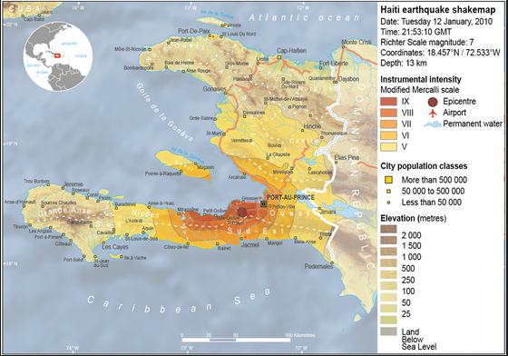
Plenary:Shake map Haiti
How could this map help to explain why the effects in Haiti were so bad?

Slide 11
Additional Resources Haiti, 2010
https://www.britannica.com/event/Haiti-earthquake-of-2010
https://en.wikipedia.org/wiki/2010_Haiti_earthquake
https://www.thegeographeronline.net/uploads/2/6/6/2/26629356/the_haiti_earthquake_2010_-_a_study_of_vulnerability.pdf
https://www.kerboodle.com/system/images/W1siZiIsIjIwMTQvMDcvMjQvMTUvMDEvMTMvMzk5L0dBNDY1LnBkZiJdXQ/GA465.pdf

Slide 12
Share your learning with your teacher:
By Monday 30th March share a copy of your mind map with your teacher- this could be a photo or a file upload.
Any questions or extra support needed- email your class teacher.
Next week: Your teacher will meet with you to discuss your learning about this case study and you will start learning about the 2011 Japanese tsunami to compare the effects

