Slide 1
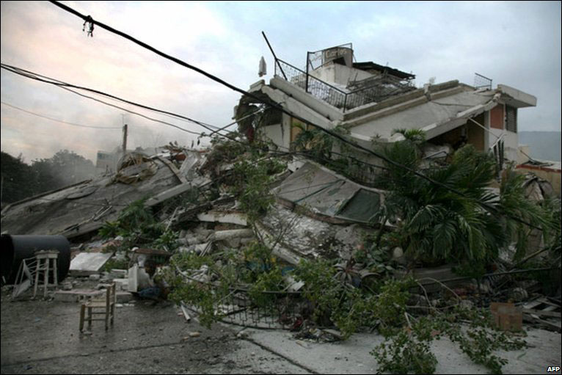
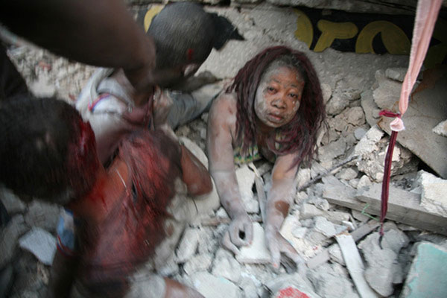
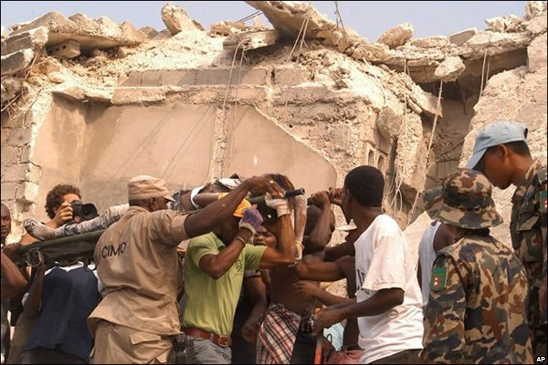
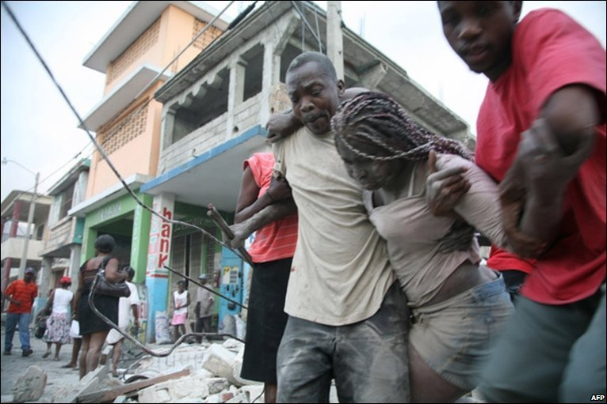
Haiti Earthquake 2010

Slide 2
Learning objectives:
To explain the cause of the Haiti earthquake
To explain the primary and secondary effects of the earthquake
To explain how prediction and management of earthquakes can be applied to an LEDC

Slide 3
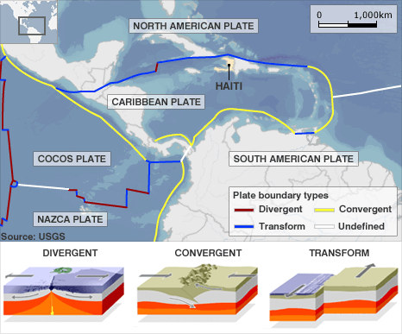
Where is Haiti?
Transform is another name for conservative plates
Why is Haiti at risk from earthquakes?

Slide 5
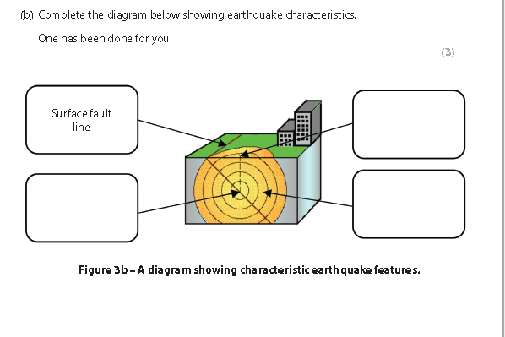

Slide 6
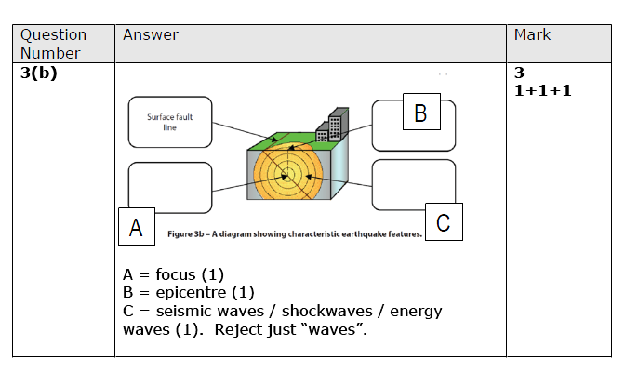
Answer

Slide 7
Measuring earthquakes
Richter scale
Mercalli scale
An open ended scale indicating the strength of an earthquake as measured by a seismograph.
A scale from I to XII, used to indicate the impact and effects of an earthquake.

Slide 8
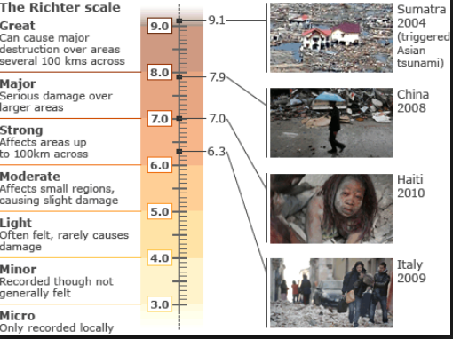
How are they measured: Richter scale

Slide 9
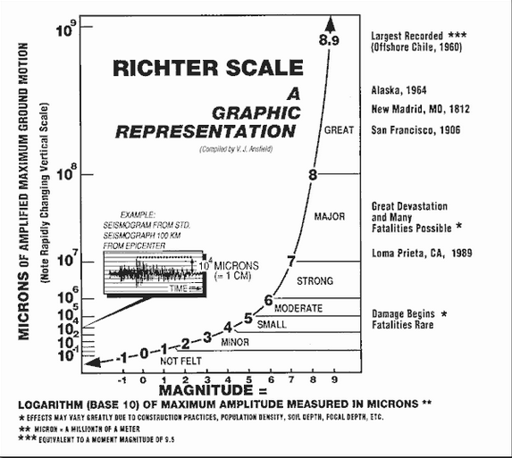

Slide 10
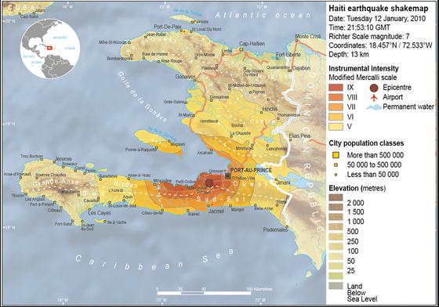
Shake map Haiti

Slide 11
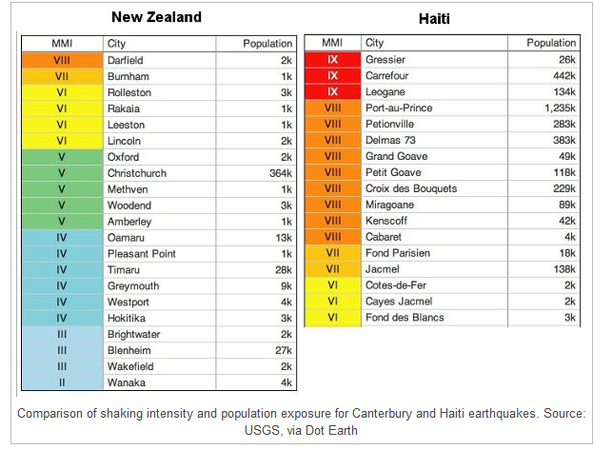
New Zealand v Haiti
Both 7 on Richter scale.
Suggest reasons why the damage (as shown by the Mercalli scale) varied (3).

Slide 12
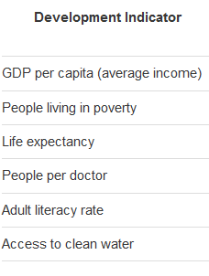
What type of country is Haiti?
Using information from the atlas find the information for each of these development indicators related to Haiti
How may this level of development impact the effects of an earthquake?

Slide 13
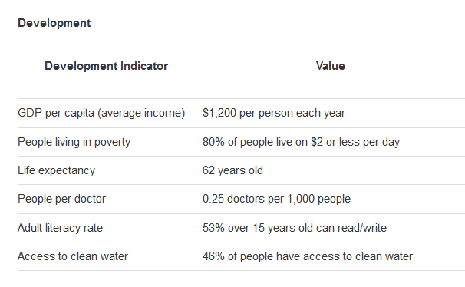

Slide 14
Watch the DVD…make notes on:
The cause
The effects: social, economic, environmental ( also political). Also primary and secondary
The short and long term management

Slide 15
Effects of the earthquake
These could be classified as:
Primary: effects that were caused directly by the earthquake
Secondary: effects that result from the primary effects
The impacts could also be divided into social, economic and environments (and political?)

Slide 16
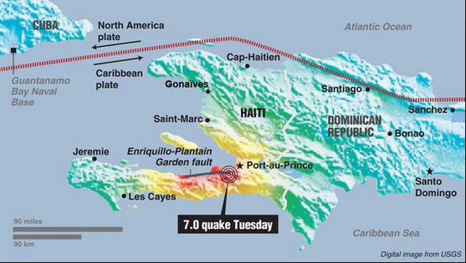
Explain the cause of a specific earthquake you have studied (6)

Slide 17
The cause of the Haiti earthquake
The earthquake was caused by the North American Plate sliding past the Caribbean Plate at a conservative plate margin (on a fault called the Enriquillo-Plantain Garden fault).
Both plates move in the same direction, but one moves faster than the other.
The pressure that was built up because of the friction between the 2 plates was eventually released causing a magnitude 7 earthquake on the Richter Scale.
The focus was shallow (5 miles) meaning that the effects were felt strongly at the epicenter. The epicenter was 16 miles west of Port-au-Prince (Haiti’s capital)
The earthquake struck at 16:53 (4:53pm) local time on Tuesday 12 January 2010.

Slide 18
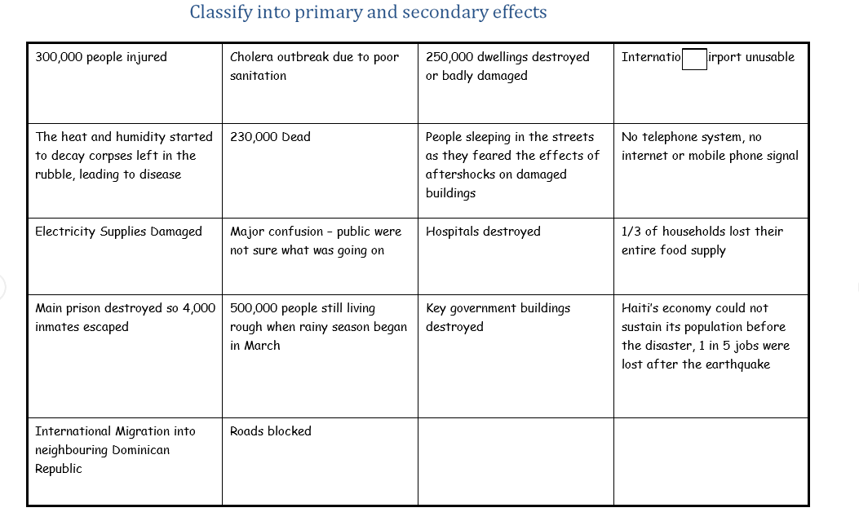

Slide 19
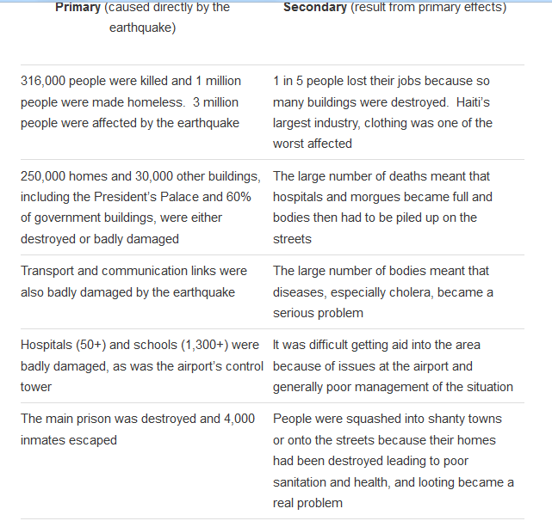
Impacts

Slide 20
Prediction and Preparation before the quake
Due to Haiti being one of the poorest countries in the world the Government had provided no help in constructing earthquake proof buildings.
80% of the buildings in Port au Prince were unplanned shanty style houses constructed from breeze block and thick heavy roofs to keep the heat out.
2007 report informed the Haitian government that the fault under Port au Prince would slip in the next 20 years and that it would be up to a 7.2 in size
Gov didn’t use info as they could not afford to make changes to city
2008 a story was run in Haiti newspaper, little interest by local people

Slide 21
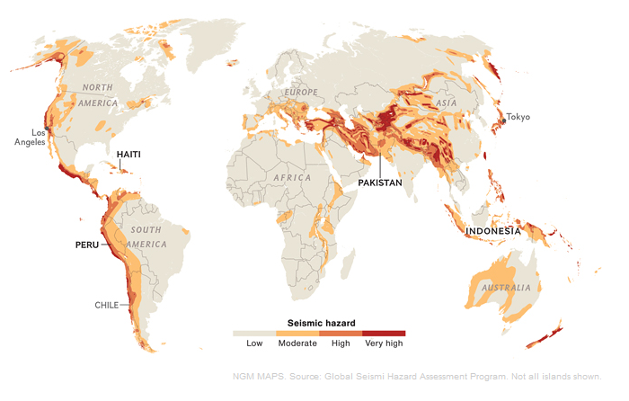
Most seismic (tectonic) hazards happen in LICs- prediction and prevention strategies are need here
Skills question:
Describe the distribution of seismic hazards globally (4)

Slide 22
Building earthquake proof houses in an LIC

Slide 23
Other exam questions
Explain using examples why Earthquakes in LEDC’s are more devastating than in MEDC’s
[6]
How can good preparation and management reduce death toll in earthquakes
[6]

Slide 24
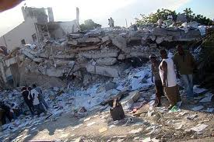
Haiti recap...

Slide 25
Question 1
Haiti is situated on what type of plate boundary?
Constructive
Conservative
Destructive

Slide 26
Answer
Haiti is situated on what type of plate boundary?
Constructive
Conservative
Destructive

Slide 27
Question 2
Which two tectonic plates are involved?
Caribbean and North American
Pacific and Indo-Australian
Eurasion and African

Slide 28
Answer
Which two tectonic plates are involved?
Caribbean and North American
Pacific and Indo-Australian
Eurasion and African

Slide 29
Question 3
When did the Haiti earthquake strike?
1st January 2010
12th January 2010
30th January 2010

Slide 30
Answer
When did the Haiti earthquake strike?
1st January 2010
12th January 2010
30th January 2010

Slide 31
Question 4
What magnitude was the Haiti earthquake?
4 on the Richter scale
6 on the Richter scale
7 on the Richter scale

Slide 32
Answer
What magnitude was the Haiti earthquake?
4 on the Richter scale
6 on the Richter scale
7 on the Richter scale

Slide 33
Question 5
How many aftershocks were recorded in total?
30
52
100

Slide 34
Answer
How many aftershocks were recorded in total?
30
52
100

Slide 35
Question 6
Approximately how many homes were damaged and need to be demolished?
1000
50,000
250,000

Slide 36
Answer
Approximately how many homes were damaged and need to be demolished?
1000
50,000
250,000

Slide 37
Question 7
Which country first provided aid to Haiti?
A. Dominican Republic
B. America
C. England

Slide 38
Answer
Which country first provided aid to Haiti?
Dominican Republic
B. America
C. England

Slide 39
Question 8
By July 2010, how much rubble was still left to be cleared in Haiti?
None
60%
98%

Slide 40
Answer
By July 2010, how much rubble was still left to be cleared in Haiti?
None
60%
98%

