Slide 1
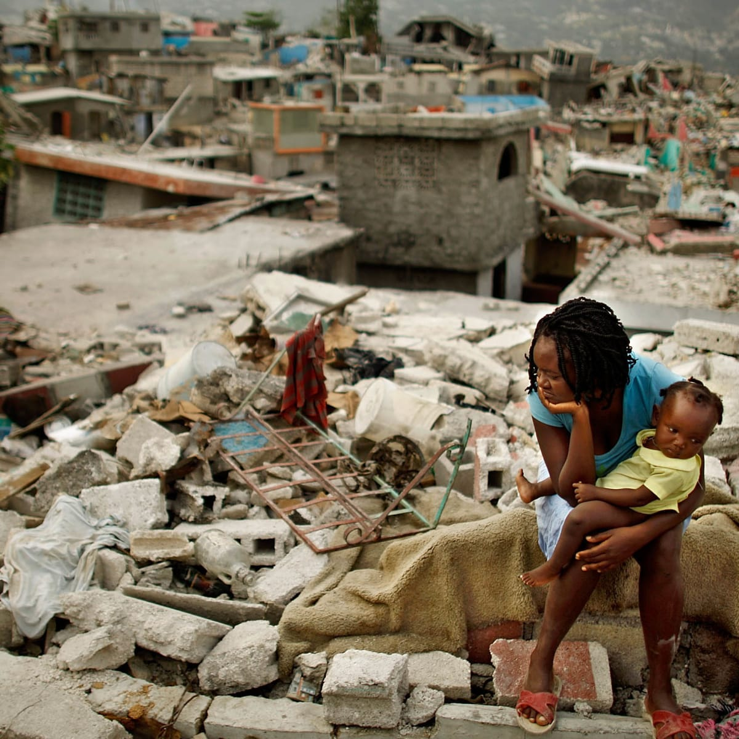
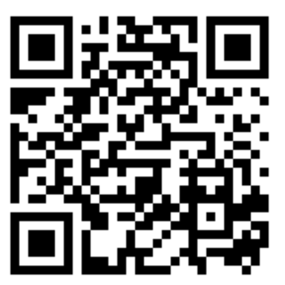
To start - Find out the information below about Haiti:
GDP Per Capita ($)
Life Expectancy
Adult Literacy Rate (%)
Infant Mortality Rate (out of 1000 live births)
Internet users (%)
Extra challenge – give reasons for these figures
https://hdr.undp.org/en/countries/profiles/HTI

Slide 2
Haiti Earthquake 2010 - Case Study
What – To be able to describe the short and long term impacts and responses of an earthquake in a developing country.
Why – So that we can appreciate the challenges faced by developing countries when looking to live with these hazards
How – By looking at a variety of sources and creating a visual case study presentation.

Slide 3
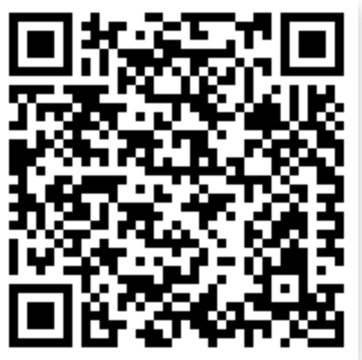
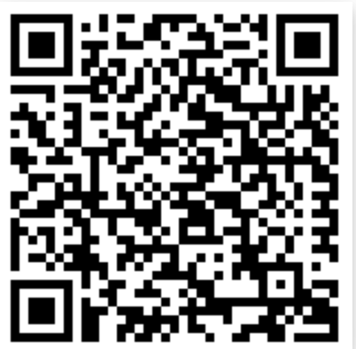
Challenge 1 – Short / Long Term Impacts and Responses
After watching the video, you should already have an idea of the short and long term impacts and responses.
You should now use the links below to get more specific case study information linked to impacts and responses. You should record this data as you like, as long as it ends up in your OneNote and on your Google Earth project.
Extra Challenge – Explain what you think is the biggest / smallest impact and why. Then, explain which of the responses you think would be less important if Haiti was a HIC.
Notes:
https://www.coolgeography.co.uk/GCSE/AQA/Restless%20Earth/Earthquakes/Haiti.htm
https://www.habitatforhumanity.org.uk/what-we-do/disaster-response/disaster-relief-in-haiti/
https://www.bbc.co.uk/bitesize/guides/zgmwv4j/revision/5

Slide 4
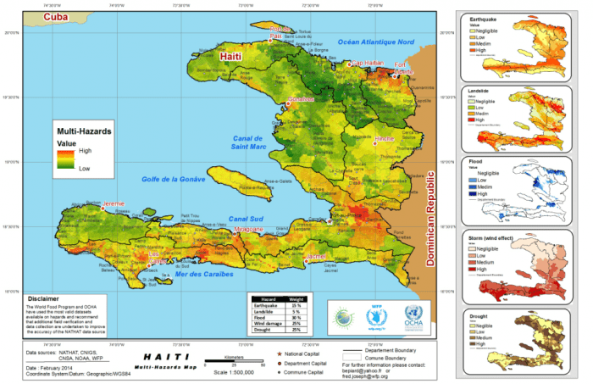
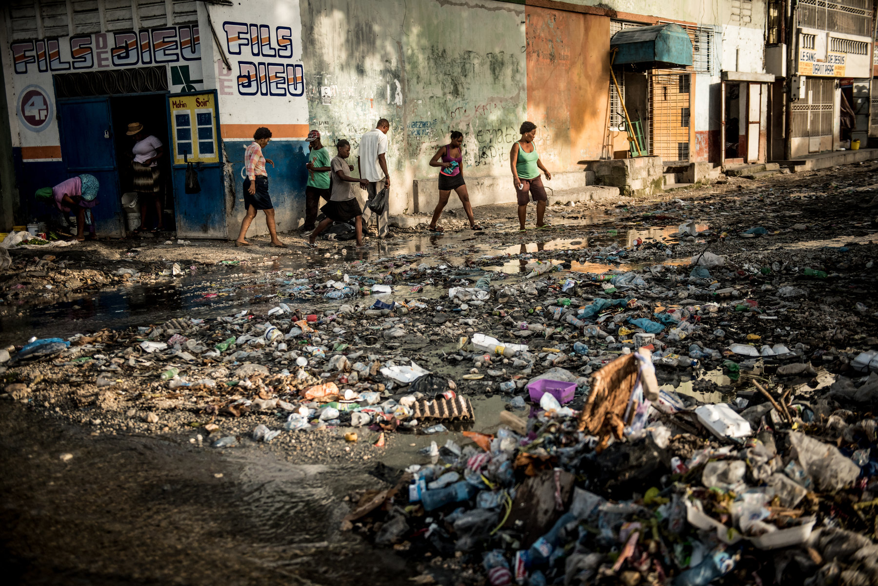
Challenge 2 - Why do you think Haiti is so vulnerable to earthquake hazards?
This response should consider:
Physical reasons (plate boundaries and topography)
Social reasons (education and poverty)
Economic reasons (lack of government resources)
This can be done as a mind map on your desk / paper / laptop, or as a piece of writing, or any other way that you feel appropriate.

Slide 5
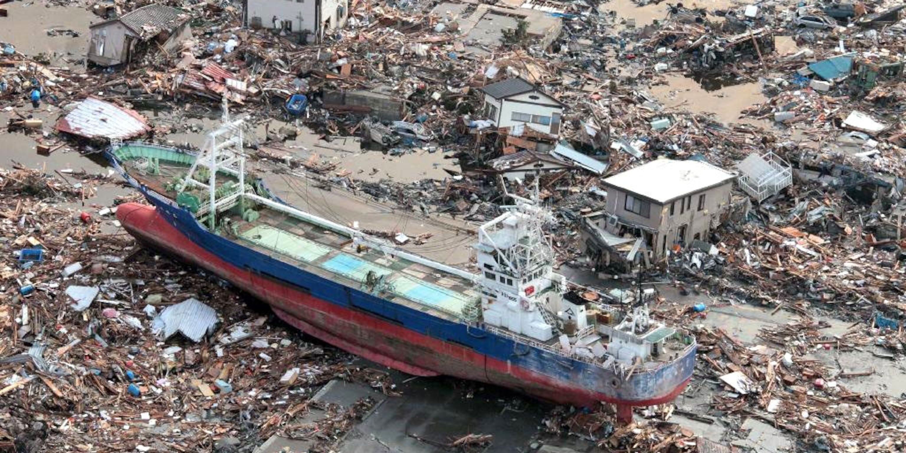
To Start: See, think, wonder

Slide 6
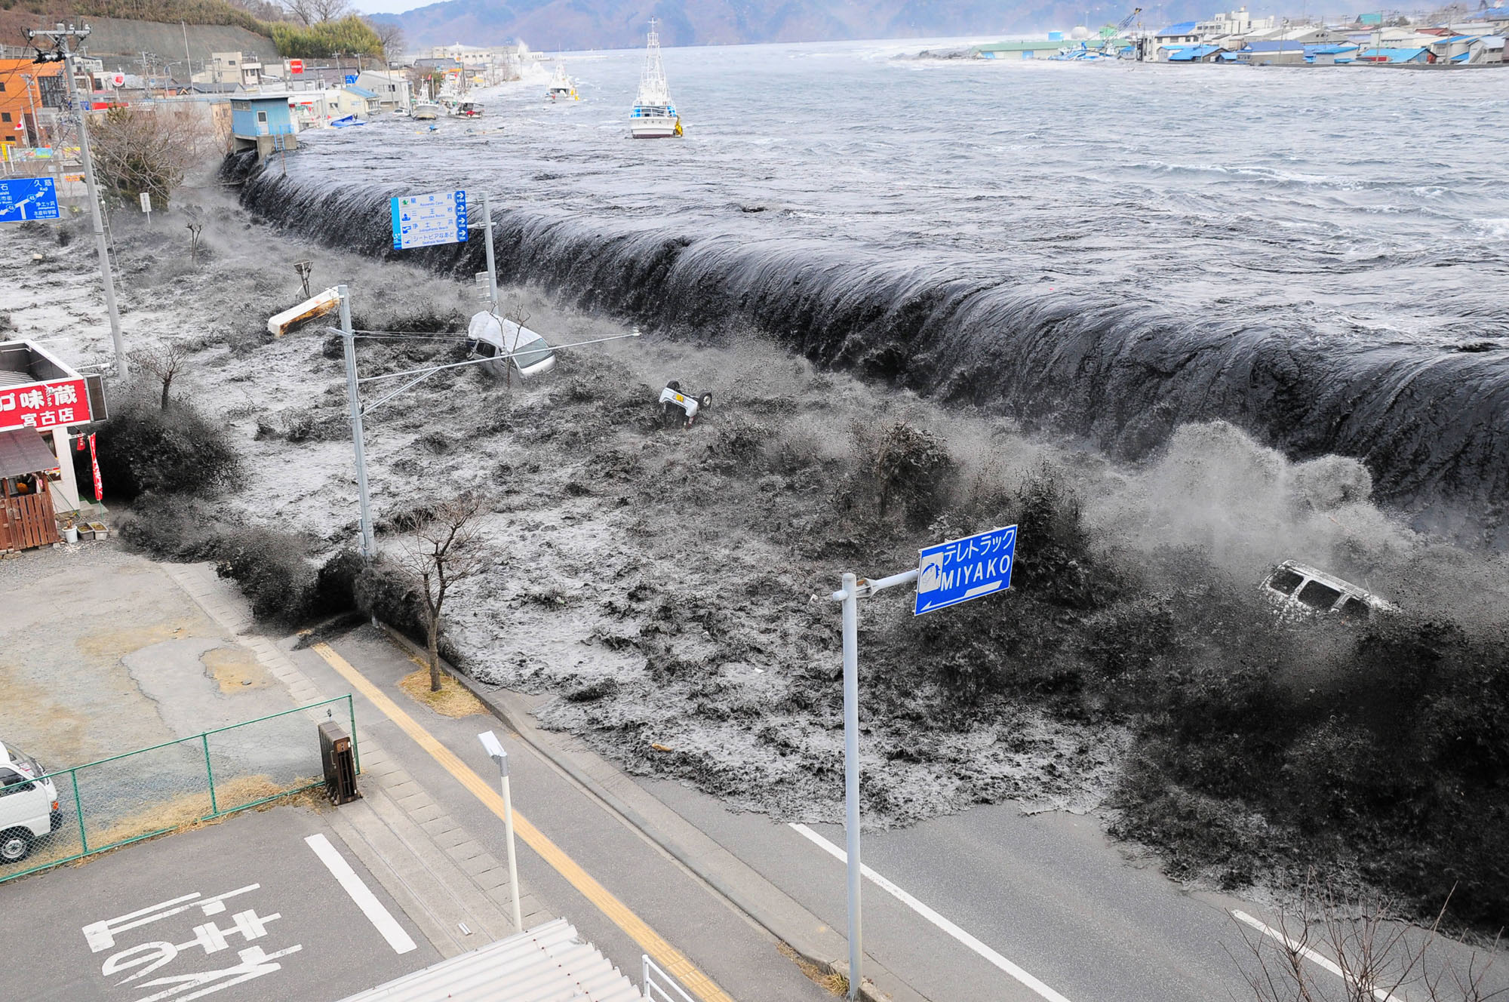
Challenge 1 - Find out the information below about Japan:
GDP Per Capita ($)
Life Expectancy
Adult Literacy Rate (%)
Infant Mortality Rate (out of 1000 live births)
Internet users (%)
Extra challenge – give reasons why these figures are different to Haiti
https://hdr.undp.org/en/countries/profiles/JPN

Slide 7
Japan Earthquake and Tsunami 2011 - Case Study
What – To be able to describe the short and long term impacts and responses of an earthquake in a developed country.
Why – So that we can appreciate the challenges faced by developed countries when looking to live with these hazards
How – By looking at a variety of sources and creating a visual case study presentation.

Slide 8
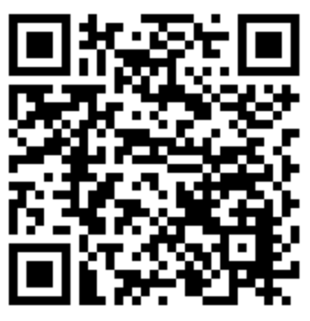
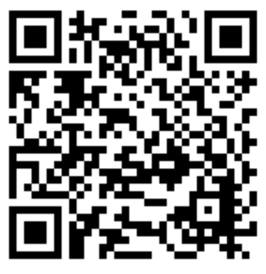
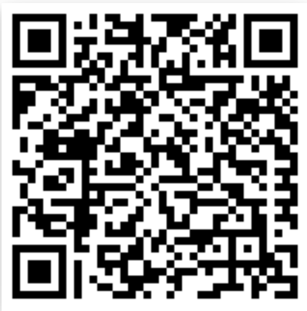
Challenge 1 – Short / Long Term Impacts and Responses
Use the links below to get more specific case study information linked to impacts and responses. You should record this data as you like, as long as it ends up in your OneNote and on your Google Earth project.
Extra Challenge – Explain what you think is the biggest / smallest impact and why. Then, explain which of the responses you think would be difficult for an less developed country to implement.
Notes:
https://www.internetgeography.net/japan-earthquake-2011/
https://www.bbc.co.uk/bitesize/guides/zg9h2nb/revision/6
https://www.worldvision.org/disaster-relief-news-stories/2011-japan-earthquake-and-tsunami-facts

Slide 9
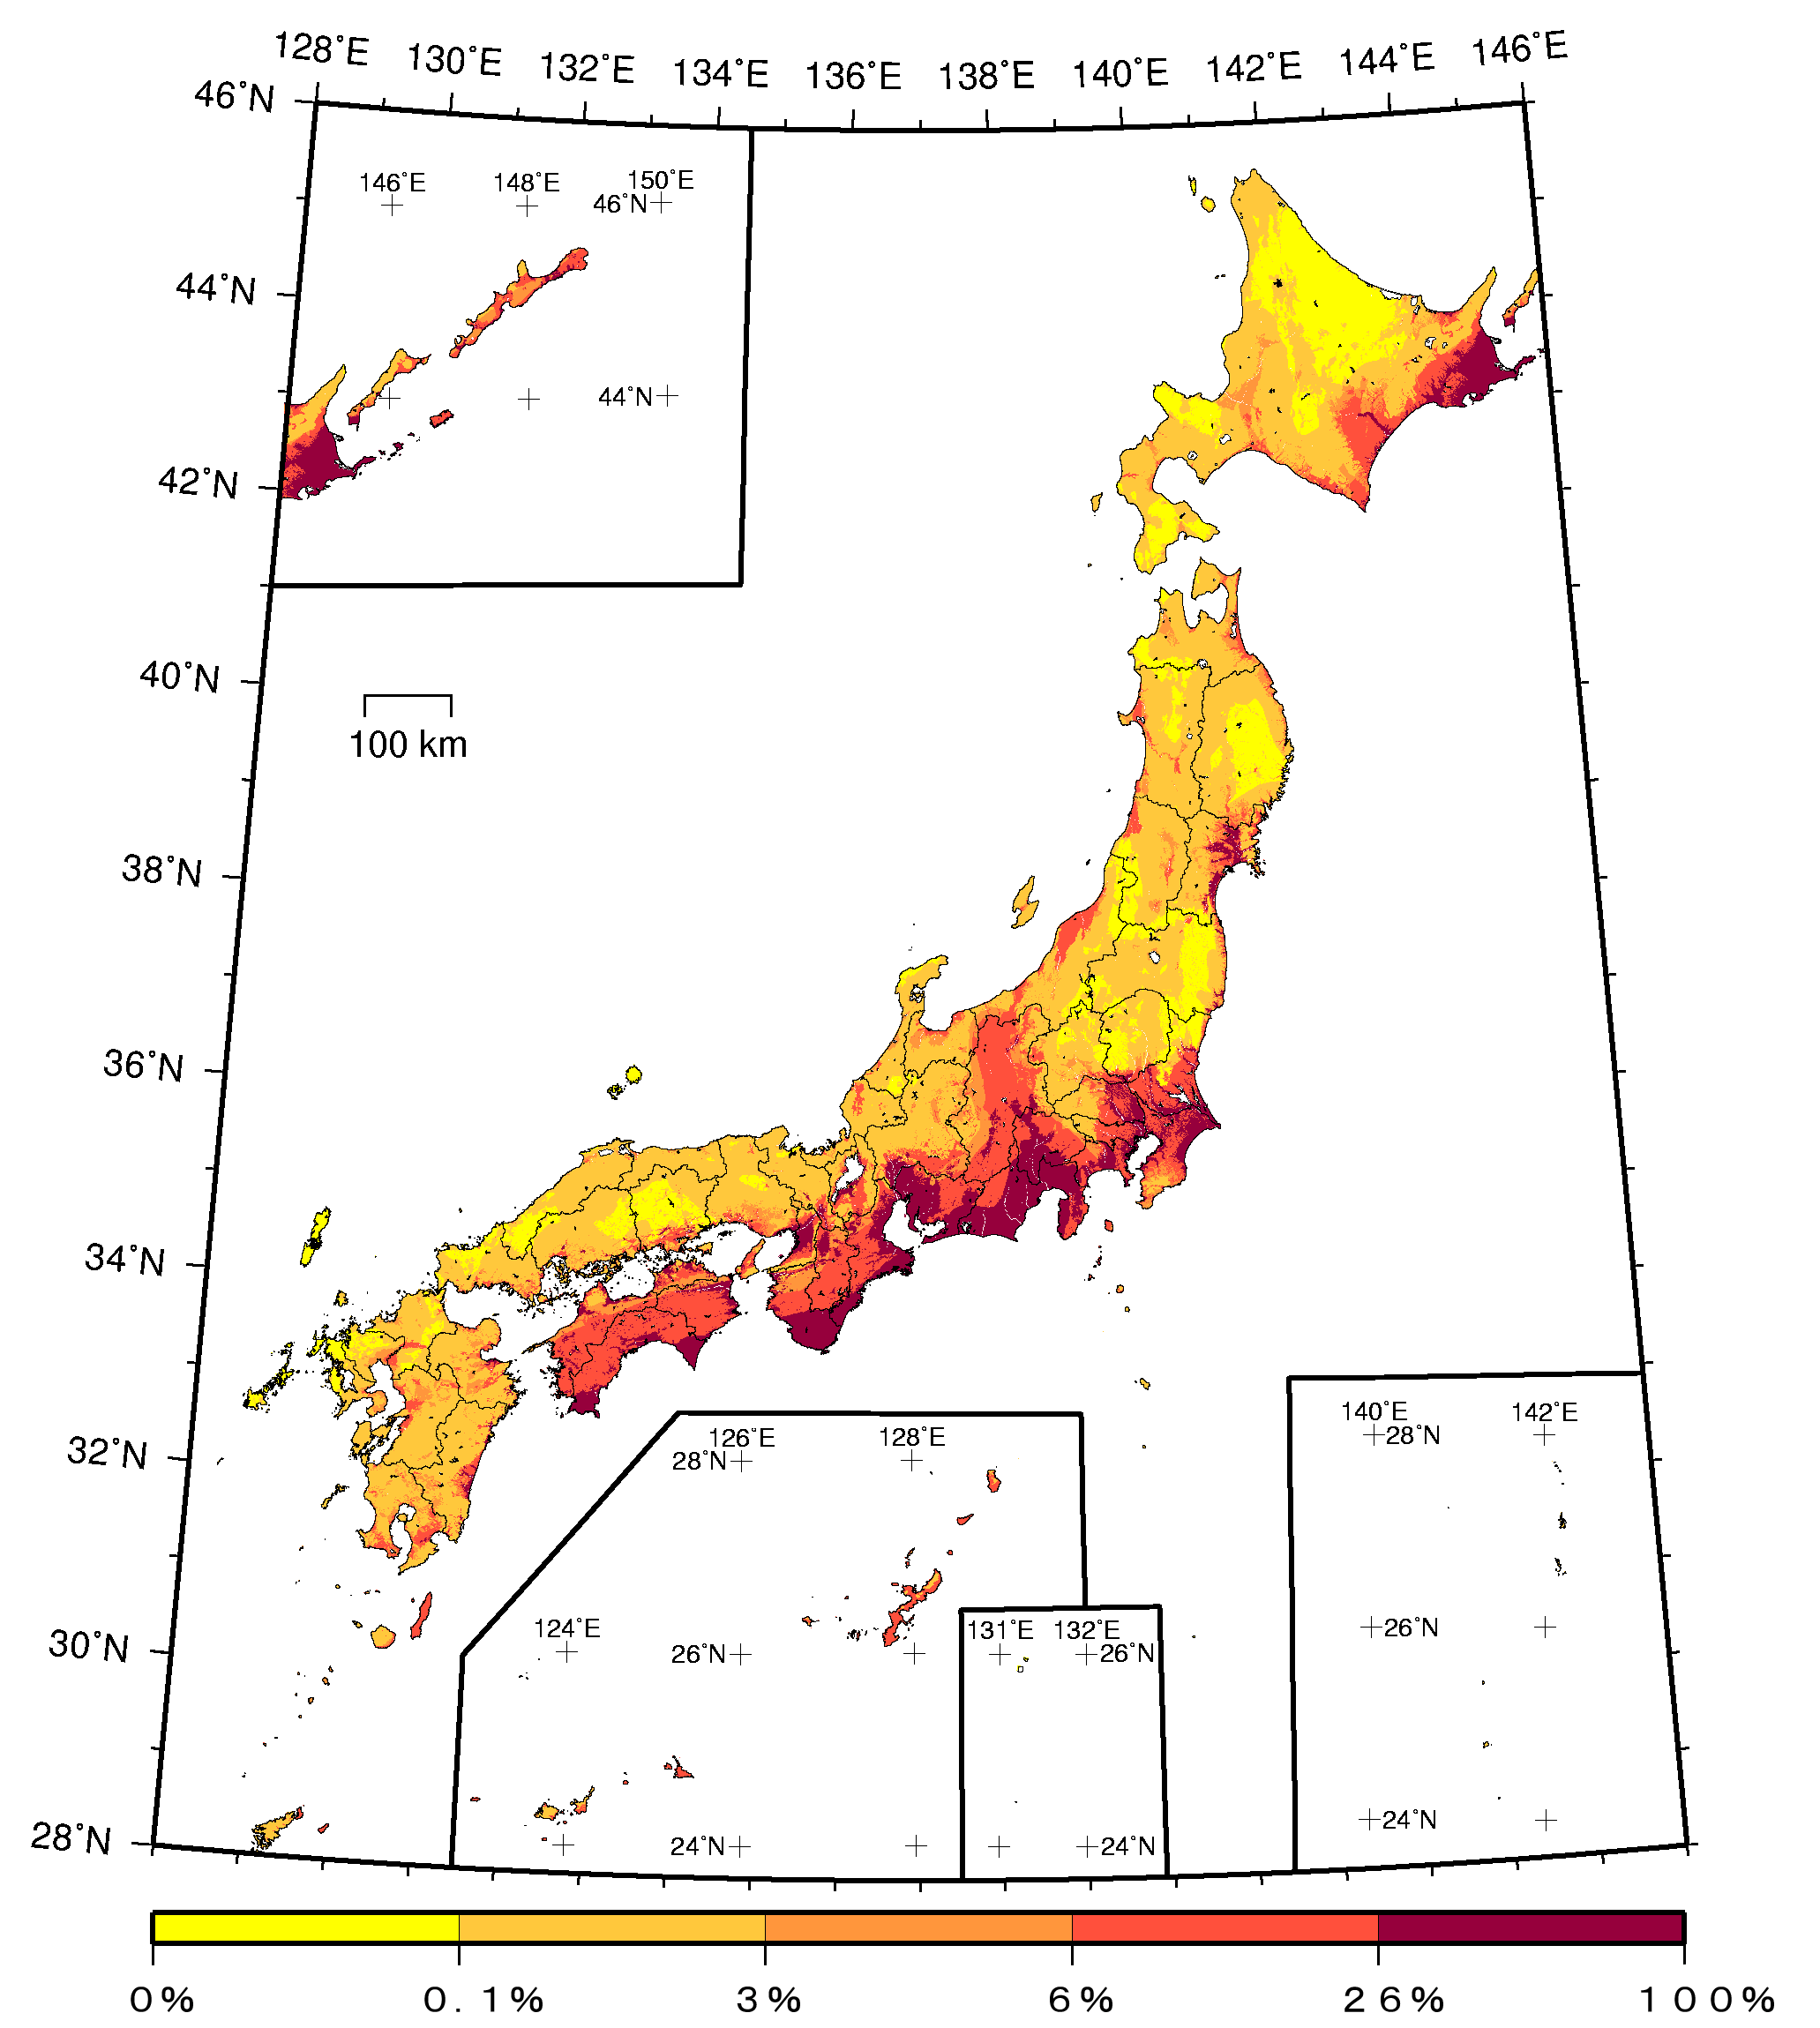
What do these two maps tell us about Haiti and Japan’s likelihood of experiencing natural hazards?
Why is Haiti more vulnerable than Japan?

Slide 10
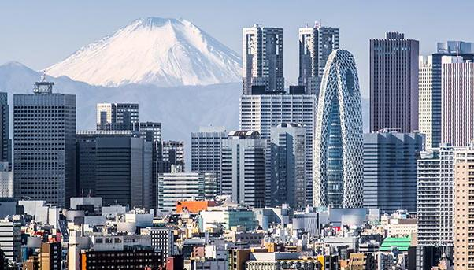
Challenge 2 - Why do you think Japan is less vulnerable than Haiti to earthquake hazards?
This piece of work should mention:
Social reasons (education and wealth)
Economic reasons (availability of government resources)
This can be done as a mind map on your desk / paper / laptop, or as a piece of writing, or any other way that you feel appropriate.

Slide 11
Challenge 3 – Specification Application
Look at a, b and c on the specification below. For each letter create a table that defines each of the measures, and then place them on a continuum which ranges from more likely to be used in Haiti to more likely to be used in Japan. Once you have placed them on a continuum, annotate it to explain why.
Make sure to use information that you found during your Haiti and Japan work.
Resources to help with definitions can be found on slide 12 and 13.
Likely in Haiti
Likely in Japan

Slide 12
Preparation for Earthquakes |  | Short term responses and relief |  | Longer term planning
Management | Description and ex. | Management | Description and ex. | Management | Description and ex.
Warning and evacuation |  | Emergency Aid |  | Risk Assessment
Remote Sensing |  | Shelter |  | Hazard Mapping
Geographical Information Services (GIS) |  | Supplies |  | Rebuilding Programmes
Building design

Slide 13
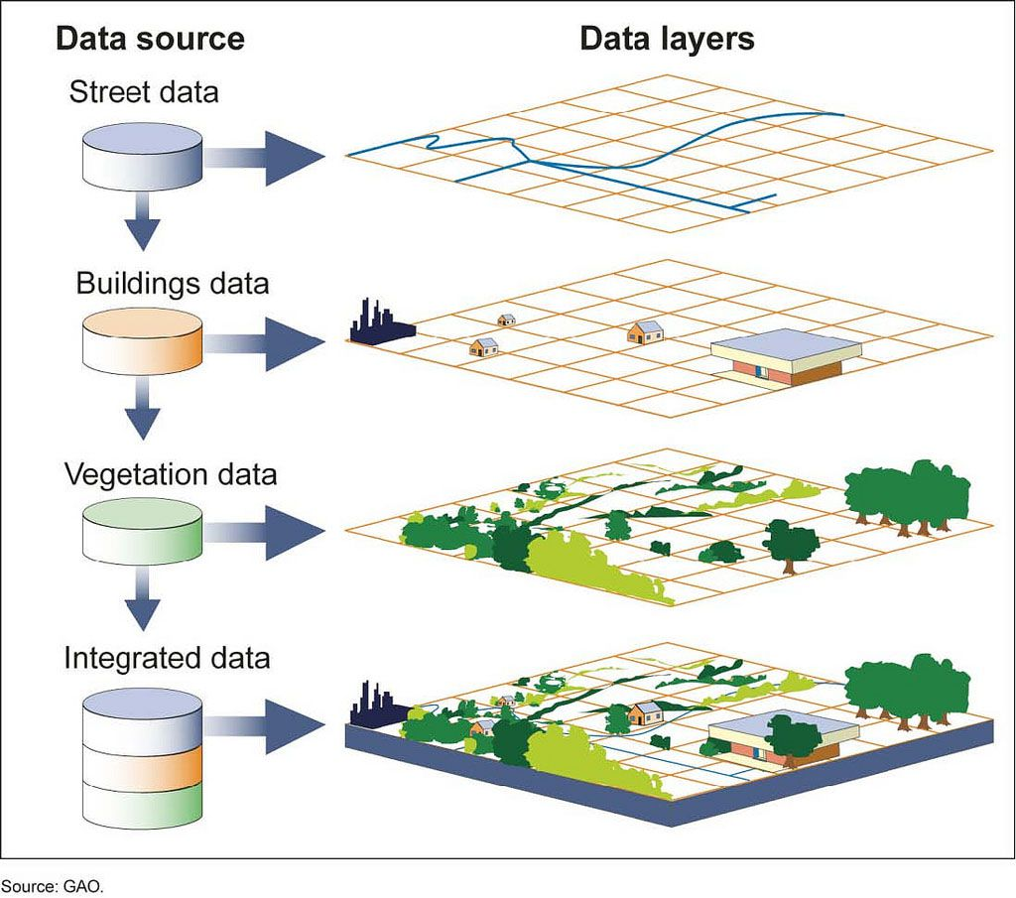
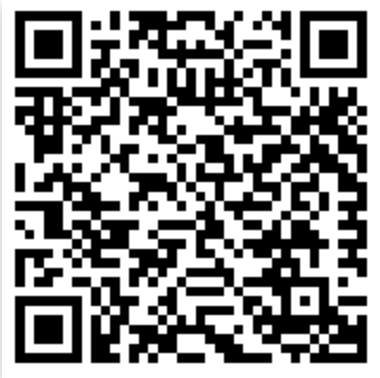
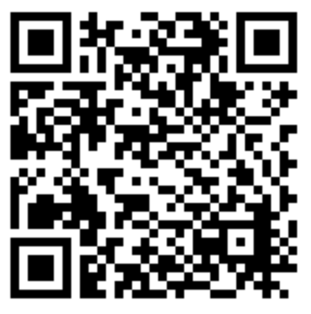
Geographic Information Systems (GIS)
Risk Assessment and Hazard Mapping
Notes:
https://oceanservice.noaa.gov/facts/remotesensing.html
https://www.nationalgeographic.org/encyclopedia/geographic-information-system-gis/
https://www.youtube.com/watch?v=6a3VwMj79DQ&t=100s
https://www.bigrentz.com/blog/earthquake-proof-buildings
https://www.preventionweb.net/files/29163_drmkn511.pdf

Slide 14
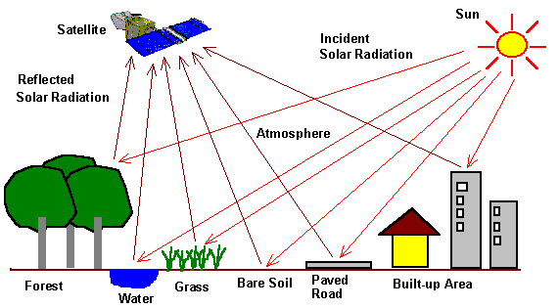
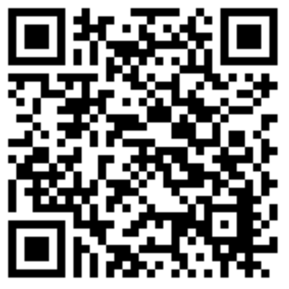
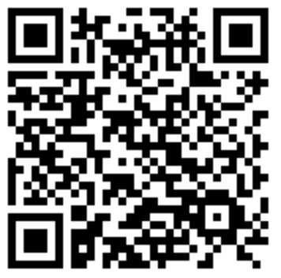
Remote Sensing
Building Design

Slide 15
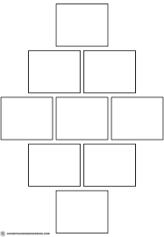
Challenge 4:
Rank the below management strategies in a diamond 9. The top of the diamond should be the thing that you think is the most useful strategy, the bottom should be what you think is the least. Annotate your diamond with justifications for the way you have ranked them.
Warning and evacuation
Building design
Remote sensing
Geographical Information Services (GIS)
Emergency aid
Shelter and supplies
Risk assessment
Hazard mapping
Rebuilding programmes

Slide 16
Challenge 5:
ArcGIS StoryMaps and ArcGIS Online Haiti and Japan

Slide 17
To finish:
In less than 150 words, explain which place you would feel least vulnerable to natural hazards in, Japan or Haiti.
All should use at least 3 of the management strategies covered, most will use the 2010 and 2011 earthquakes as supporting examples, some will justify their reasons through the use of social and economic factors.

