Slide 1
Should we build on brownfield sites or
greenfield sites?
Examine the positives and negatives of each type of development site.

Slide 2
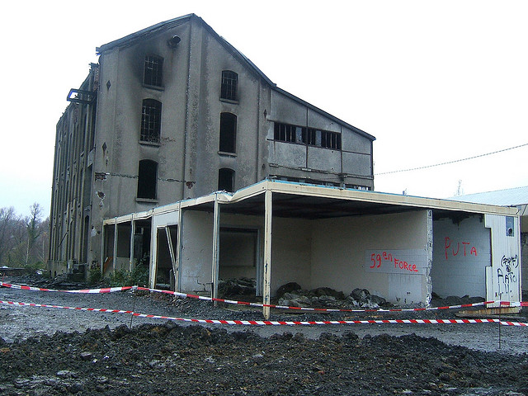
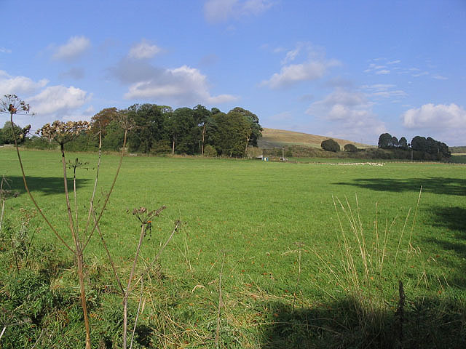
What are brownfield sites and
greenfield sites?
Try to define these terms ‘greenfield’
and ‘brownfield’
Brownfield site
Greenfield site
Notes:
©LHOON, 2008, flic.kr/p/5KZLub
©Walter Baxter, 2007, www.geograph.org.uk/photo/599846, CC BY-SA 2.0

Slide 3
What are brownfield sites and
greenfield sites?
Can you locate any ‘brownfield sites’ in your area?
Can you locate any ‘greenfield sites’ in your area?
Brownfield site
Greenfield site
Any area of land that has been previously developed, but is not currently in use.
Brownfield sites are almost always:
1. Found in urban areas
2. Abandoned or under-used land
3. Contaminated/polluted land
4. Varying in size
5. Often found near rail routes, rivers or roads.
Any area of land that has not had any previous type of development on it.
Greenfield sites are almost always found in suburban or rural areas.
Notes:
©LHOON, 2008, flic.kr/p/5KZLub
©Walter Baxter, 2007, www.geograph.org.uk/photo/599846, CC BY-SA 2.0

Slide 4
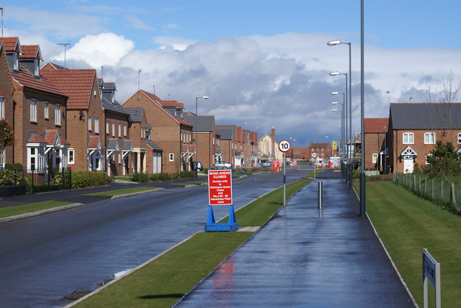
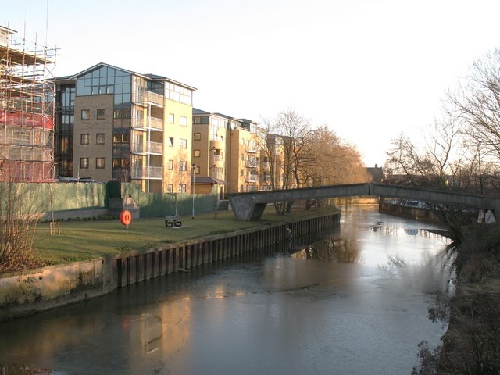
Thinking point.
Which housing was built on a brownfield site? Why?
B
Greenfield site
A
Thinking point.
Which housing was built
on a greenfield site? Why?
Brownfield site
Brownfield site
Notes:
©Colin Craig, 2009, www.geograph.org.uk/photo/1221938, CC BY-SA 2.0
©Gordon Hatton, 2009, www.geograph.org.uk/photo/1110867, CC BY-SA 2.0

Slide 5
Can you tell the difference in the sites?
Why? Why not?
B
Greenfield site
A
What clues are there?
Brownfield site
Brownfield site
Notes:
©Colin Craig, 2009, www.geograph.org.uk/photo/1221938, CC BY-SA 2.0
©Gordon Hatton, 2009, www.geograph.org.uk/photo/1110867, CC BY-SA 2.0

Slide 6
What are the benefits / challenge of using brownfield sites or greenfield sites for development?
Draw a table to show the benefits / challenges of developing brownfield or greenfield sites.
Brownfield sites | Greenfield sites
Copy the statements and sort into the correct column. Then highlight to show whether it is a positive or a negative

Slide 7
Look at the statements below…
1. Brownfield redevelopment eases pressure on Greenfield sites and is more sustainable – Its good to reuse land | 2. Greenfield sites are often on the edge of towns and cities and may have better access, have less congestion, be in a more pleasant environment and have more space to expand
3. House prices would increase in inner city areas as people are encouraged back into the area | 4. Infrastructure already exists in urban areas
5. Building on Greenfield sites ‘sucks’ out the core from towns as shops, etc. locate on the edge of towns/cities | 6. New employment opportunities if Brownfield sites are developed
7. New housing can lead to gentrification (old housing done up – area becomes more trendy and affluent) so the area will improve and statistics like crime rates will improve | 8. New sites are easier to build on as there is a fresh start, where remains of previous land-use do not need to be cleared, and is more attractive to retail parks, housing developers, etc
9. Providing public transport networks is easier in central areas where the population densities are high – investment is focused in central areas | 10. There may be an issue of contamination and making sites safe for development, given what the land may have been used for before
11. Towns and cities do not want their areas to decay – redevelopment results in more people coming to the area, which helps local businesses | 12. Using Greenfield sites is often not sustainable
13. Increased house prices due to inner city redevelopment might mean that local people cannot afford the houses, and the council will have the problem of providing for them | 14. In Greenfield sites new drainage, electricity, roads, etc would all have to be produced
15. Building on Greenfield sites may reduce traffic and congestion in cities | 16. Wildlife may suffer when Greenfield land is built on – may lose habitats, trees may have to be cut down, etc
17. Large family houses with gardens are more likely to be able to be built on Greenfield sites – often not enough space for this in Brownfield areas | 18. Redeveloping Brownfield sites can bring a ‘dead’ area back to life
19. Clearing rubbish from Brownfield areas is expensive | 20. People may protest to Greenfield developments

Slide 8
What are disadvantages of developing brownfield sites and greenfield sites??
Can you think of any disadvantages of developing brownfield or greenfield sites?
Brownfield site
Greenfield site
Expensive to clean up, therefore
unattractive to developers.
Encourages urban sprawl, as built in the greenbelt or beyond, so increases commuting and congestion.
Notes:
©LHOON, 2008, flic.kr/p/5KZLub
©Walter Baxter, 2007, www.geograph.org.uk/photo/599846, CC BY-SA 2.0

Slide 9
Challenge 3 – Silent Debate
Consider the two questions below, and then add comments to the questions around the room to agree or disagree with a previous comments made.
Do you think that the countryside should be protected at all costs, or should more be released for urban growth?
Should the development of brownfield sites be given priority over the development of greenfield sites? Give your reasons.

Slide 10
Should we build on brownfield sites or greenfield sites?
Thinking point
Give the opinions that might be held by each group of people.
Who would be in favour of using brownfield sites and who would be in favour of using greenfield sites?
Who would be against the use of brownfield sites and who would be against the use of greenfield sites?
Be ready to feedback with your justifications.
Groups of people:
Local council
Local residents
Building developer
Shop keeper
Farmer
Town planner
Environmentalist
Notes:
©LHOON, 2008, flic.kr/p/5KZLub

Slide 11
To finish…
What do you think the most important advantage is for:
a) Greenfield sites
b) Brownfield sites
Give reasons for your choices.
What do you think the most important disadvantage is for:
a) Greenfield sites
b) Brownfield sites
Give reasons for your choices.

