Slide 1
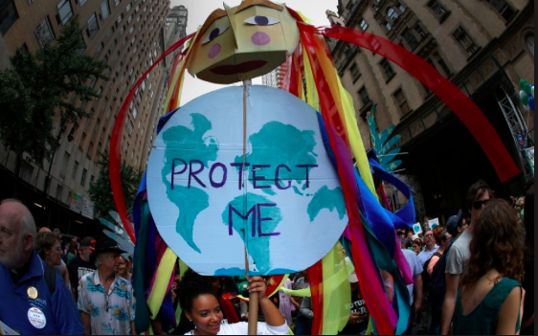
GOVERNMENT LED ADAPTATION AND MITIGATION STRATEGIES

Slide 2
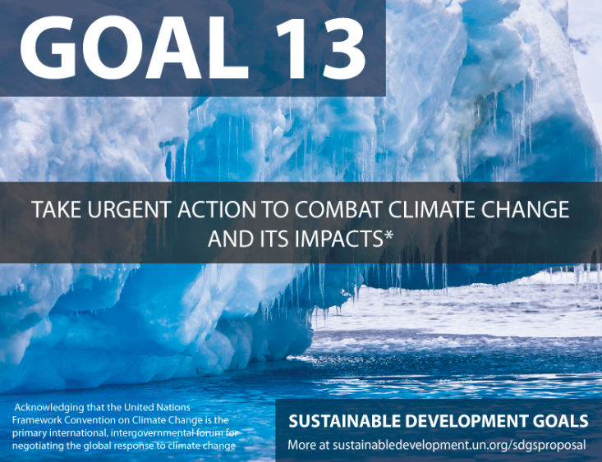
Subject guide:
Government-led adaptation and mitigation strategies for global climate change: global geopolitical efforts, recognizing that the source/s of greenhouse gas emissions may be spatially distant from the countries most impacted
carbon emissions offsetting and trading
technology, including geo-engineering

Slide 3
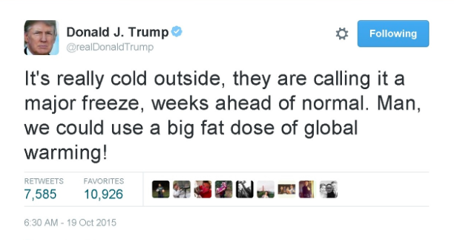

Slide 4
https://www.bbc.com/news/av/science-environment-51418310/climate-change-why-are-us-senators-wearing-this-symbol#

Slide 5
Government strategies for climate change
There are 3 broad ways in which governments can respond to the threat of climate change:
Do nothing
Act to reduce the severity or intensity of climate change by reducing the output of greenhouse gases and/or decreasing greenhouse stores. Mitigation.
3. Adjust to changes in the environment, for example by building coastal defences, rather than trying to stop climate change from happening. Adaption

Slide 7
Organise the following into ‘adaption’ and ‘mitigation’
Water and energy conservation
Insulate buildings
Health Programmes
Sustainable transportation, improved fuel efficiency
Renewable energy
Upgrades of buildings and infrastructure
Capture and use of landfill and digester gas
Carbon sinks and storage
Fish and shellfish
Training programmes and education
Change in land use, relocation
Energy conservation and efficiency
Green Infrastructure
Business community planning

Slide 9
Task: The climate change treaties
Geopolitics: politics, especially international relations, as influenced by geographical factors.

Slide 11
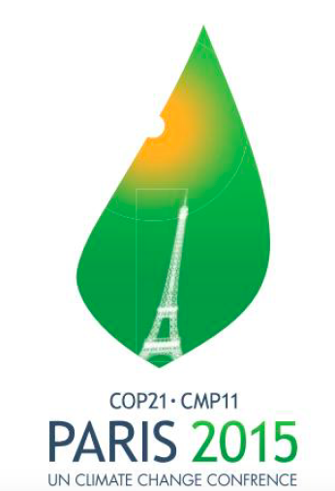

Slide 12
Task: The climate change treaties
Person 1 - The Kyoto Protocol 1997 Person 2 - The Paris Agreement 2015 Use the website below and your textbook to create revision resource which includes all of the following: 1 - Publicity photo from the event with leaders involved 2 - Objectives 3 - Who signed up? Who didn't? 4 - Successes & Failures (for the Paris agreement you should mention recent developments from Trump/USA)

Slide 13
Outline how international agreements can help to manage climate change (2).
International agreements mean that many countries around the world work together to reduce emissions, so that the concentration of CO₂ in the atmosphere doesn’t increase too much (1). Some international agreements such as Kyoto Protocol, require countries to cut emissions by a certain amount, so countries have to think about where their emissions are coming from and make changes to reduce them (1).

Slide 14
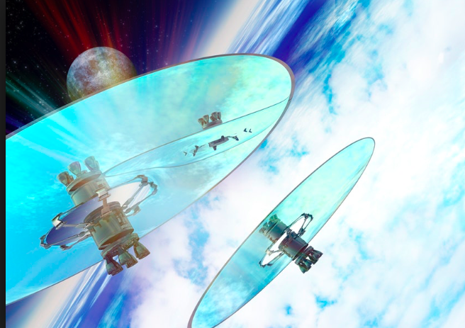
Technology including geo-engineering
Key word:
Geo-engineering: The deliberate, large-scale manipulation of the planetary environment in order to counteract anthropogenic climate change.

Slide 15
Synthesis: Mind Mapping Technology Solutions to Climate Change
Success criteria
Try to consider different technology solutions that you already know and mind map them
Identify examples of technologies that link to each heading
Draw synthesis lines between different factors where you see a connections

Slide 16
Watch the video and answer the following questions
What is geo-engineering?
What is the issue with carbon removal according to the Royal Society report?
How far are we away from clean and affordable carbon capture?
What is most likely with carbon storage?
How does solar radiation management work?
What would be the advantages of solar radiation management?
To what extent could solar radiation management create geo-political problems?
How clear is the link between solar radiation management and decreased rainfall in some regions of the world?
How do Nature Geoscience see the impact on rainfall?

Slide 19
How can we adapt agriculture in response to climate change?
Educating farmers in water-saving techniques
Introducing drought-resistant crops
Planting trees to provide shade for crops
Installing new, low water irrigation systems
Changing cropping patterns to preserve farmland
Task: Rank the 5 agricultural adaptation strategies according to how effective they will be at reducing demand for water.
Justify your choice for the most effective.

Slide 20
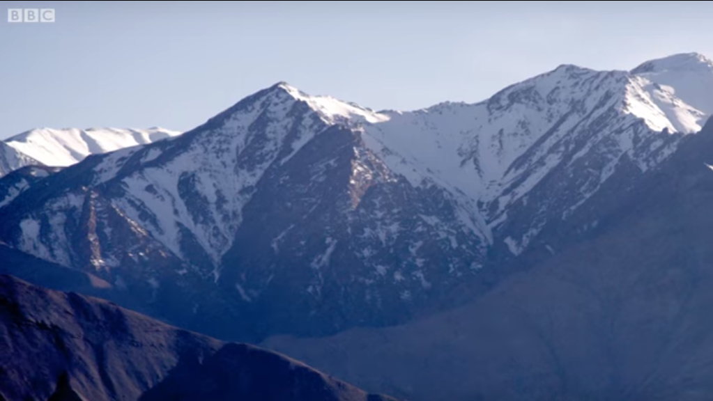
How is water supply managed in the Himalayas?
Task: Watch the following video and make notes on…
Why does water supply need to be managed in the Himalayas?
How is water supply being managed in the Himalayas?
Notes:
https://www.youtube.com/watch?v=kptgonELj00 (Link on picture)

Slide 21
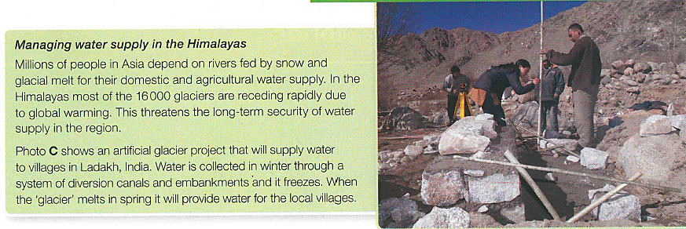
How is water supply managed in the Himalayas?
Task: How effective do you think the artificial glacier project will be? Why?
Think about:
What is the scale of the project?
What are the benefits?
What are the limitations (problems)?
Stretch & Challenge
How are we managing our water supply in response to climate change in the UK?

Slide 22
Sea level rise: Crisis in The Maldives
Restoration of coastal mangrove forests – the tangled roots trap sediment and offer protection from storm waves.
Construction of artificial islands up to 3m high so that people at risk can be relocated.
The entire population may need to be relocated to Sri Lanka or India.
Construction of sea walls – a 3m sea wall is being constructed around the capital, male with sandbags used elsewhere.
Building houses that are raised off the ground on stilts.
Task: Choose any 2 of the above strategies.
Explain how it will help the population of The Maldives
Evaluate its effectiveness. How much will it help? What are the issues?

Slide 24
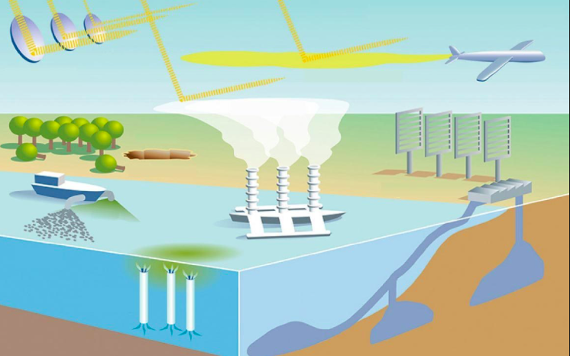

Slide 25
Examples of technological fixes:
Research at least 1 technology from each section of technologies that have been developed to combat the impacts of climate change.
1. The name of the approach
2. An outline of how the approach would work and which aspect of climate change it would tackle and how
3. The possible costs and benefits of the approach
4. Your considered opinion on the potential usefulness of the approach and of geoengineering in general as an approach to tackling climate change
5. Visuals which support what you say - this might include annotated photos, diagrams.
A. Carbon dioxide removal -Afforestation/ deforestation -Biochar -Geosequestration -Artificial trees - Desert Greening - Green buildings/ Algae covered buildings - GM crops -Ocean Fertilization B. Solar reflection -Micro-bubbles in sea water -Brightening clouds - Stratospheric aerosols/sulphur dioxide - Orbiting solar mirrors -Increasing albedo C. Reactive geo-engineering approaches -Sea walls (including the creation of coral seawalls in low lying atolls) - Raising land levels in areas threatened by sea level rise and floating islands

Slide 28
Concepts evaluation: Possibilities
How realistic are the technological fixes?
Will they be implemented in your lifetime? On which timescale?

Slide 29
Carbon offsetting
Mitigation strategy
Carbon offsetting is a way compensating for your emissions by funding an equivalent carbon dioxide saving elsewhere.
E.g. planting a tree after a flight
Use the materials in the weebly to answer the following questions:
What is carbon trading and what is carbon offsetting? What is the difference between them?
What are the possible benefits and problems of each?

Slide 30
Carbon offsetting
Watch the following animation, which introduces carbon offsetting and make notes under the following headings
Carbon Credits
Buyers
Sellers
Wider Benefits

Slide 31
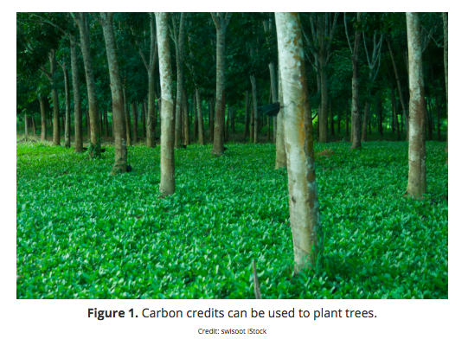
Kognity task
Read Kognity section: 2.3.6 Carbon emissions offset and trading
Define carbon offsetting, cap and trade and carbon offset
Make notes on examples of each scheme.

Slide 32
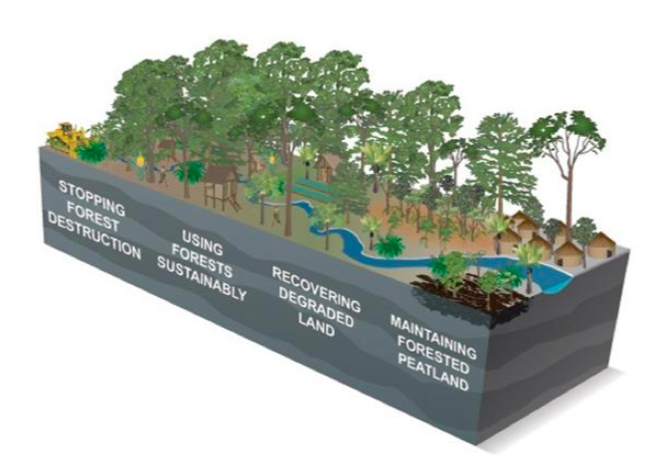
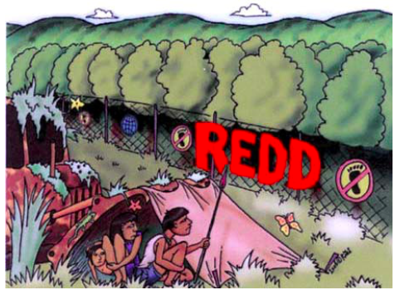
Reducing Emissions from from Deforestation and Forest Degradation (REED)
Processes and Possibilities - How does UN REDD Work?
Using the following links answer the following questions
How does the UN REDD Programme incentivize?
How is it funded?
How many national projects are involved and where are they located?
How do REDD projects impact indigenous groups?

Slide 33
The source/s of greenhouse gas emissions may be spatially distant from the countries most impacted
Using the graph would you evaluate the success of the international climate treaties you have studied? Identify the years in which Rio, Kyoto, Copenhagen and Paris occurred - can you see any transformations/changes in the graph of global emissions?

Slide 34
The source/s of greenhouse gas emissions may be spatially distant from the countries most impacted
b) Watch the video below carefully. It is an interview with the Nicaraguan negotiator at the Paris Climate talks. Why does he say that the targets set are unfair on countries like Nicaragua?
What points does he make about power?
To what extent do you agree with him? How would you advise world leaders to proceed?
https://www.youtube.com/watch?v=gbCBffIAdvU&t=183s

Slide 35
The source/s of greenhouse gas emissions may be spatially distant from the countries most impacted
c) Now read the article on the left.Summarise the seven points made in no more than 250 words.
Define social justice. To what extent is climate change an issue of social justice?

Slide 36
Example question
"Adaptation is more important than mitigation in terms of geopolitical efforts to cope with global climate change" Discuss the extent to which you agree with this statement " (10)

