Slide 1
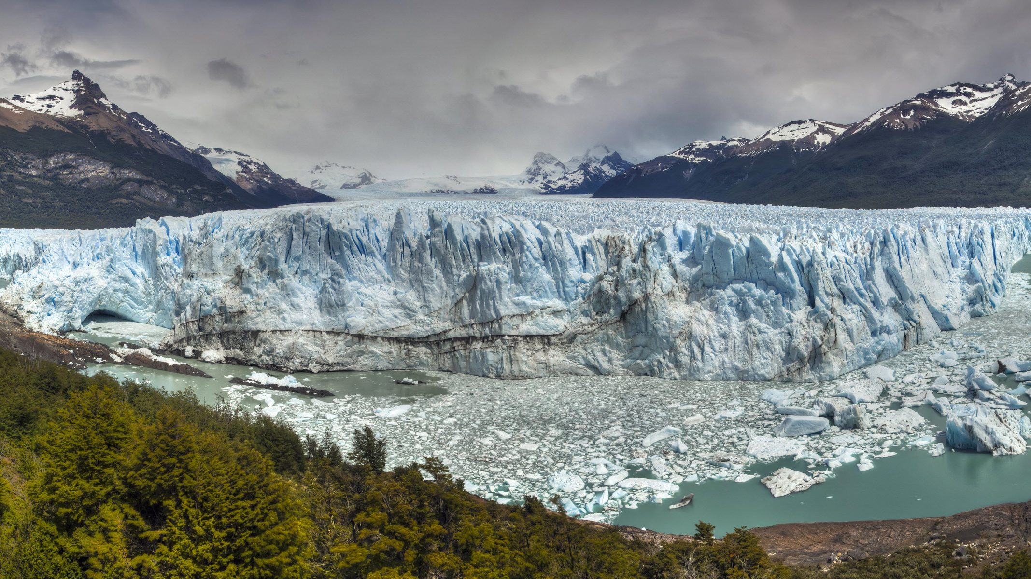
The Global Carbon Store
By TOM and LORCAN

Slide 2
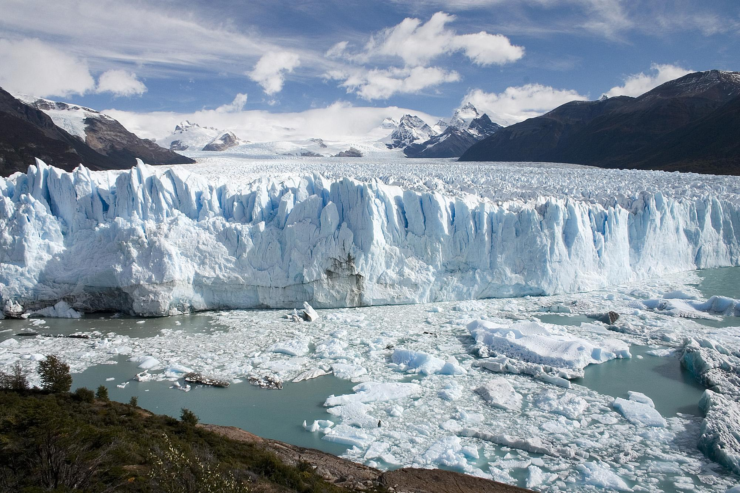
Ice
Periglacial areas have low temperatures and permafrost, which contains large stores of carbon accumulated over thousands of years
30-40% of global soil carbon is stored here
Low temps = lower decomposition rate; this has allowed large carbon stores to develop, e.g. dead organic matter
Contains 400-500 Gigatonnes of carbon stored as DOM, vs. 700-800 GT of atmospheric carbon
Beginning to thaw: will increase net primary productivity, as an increase of decomposition of DOM will occur
Increasing methane emissions: e.g. Siberia and central Canada: 25-40 megatonnes of methane are released annually
Global temperature increase of 4*c: possibility of 45-65% methane release increase

Slide 3
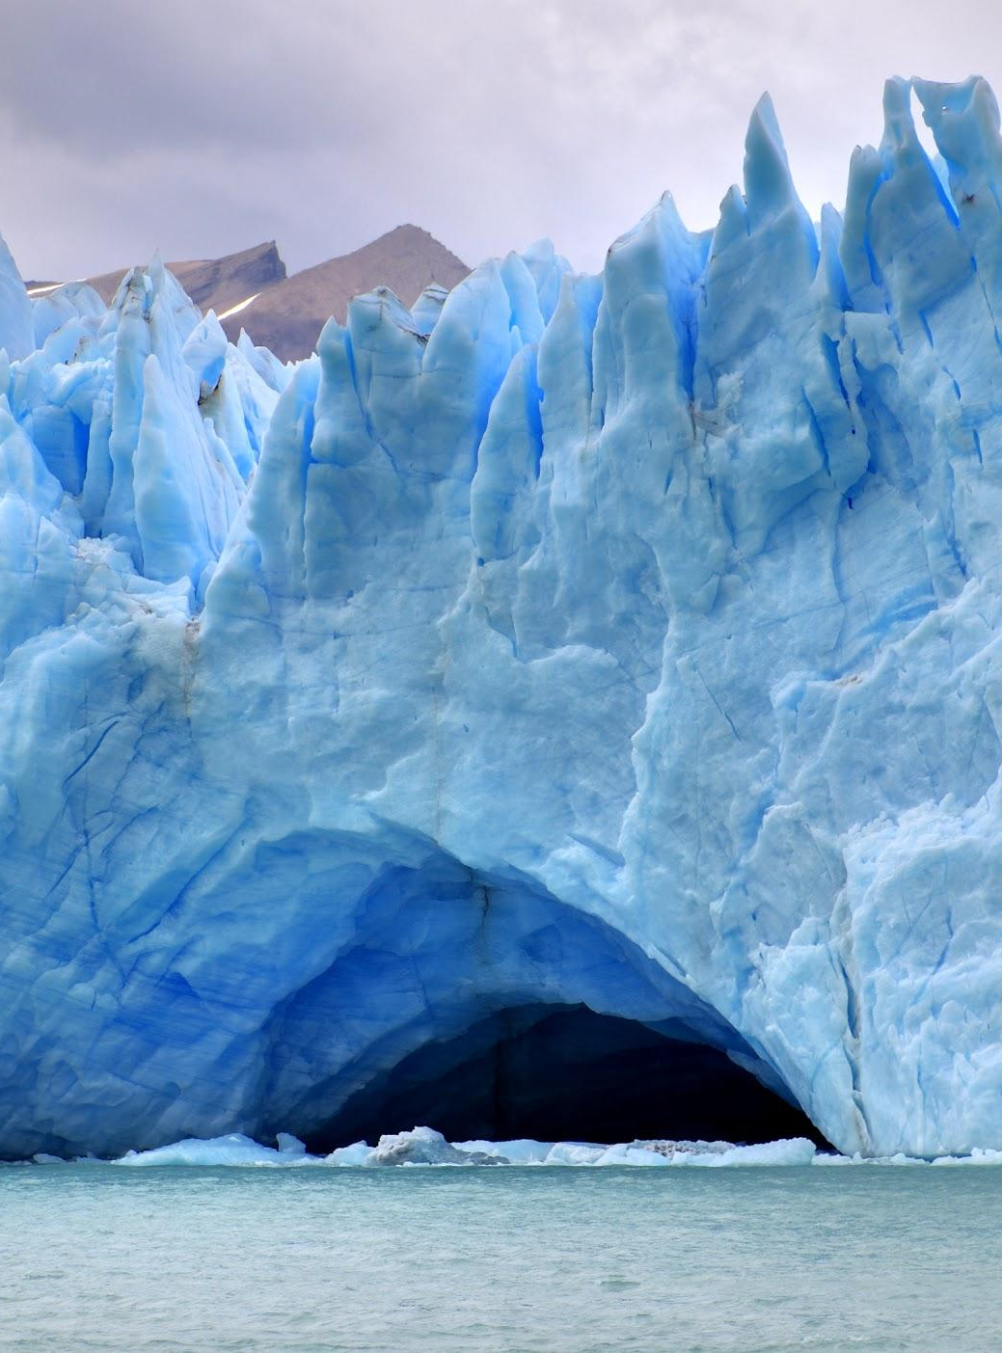
Processes:
Positive feedback mechanisms: decreased snow cover reduces albedo: more solar energy absorbed
Permafrost thawing: more soil exposed, and more carbon released - e.g. methane, which leads to enhanced greenhouse effect
10% permafrost thaw = enough methane released to increase global temperatures by 0.7*c

Slide 4
Oceans
The Oceans store 50 times more carbon than the atmosphere
The amount of carbon stored in the Oceans is increasing
30% of CO₂ released by humans has diffused into the oceans
CO₂ acidifies the water rosking harming marine life (it forms Carbonic acid)
Lobsters and other shelled animals shells are weakening
Since 1750 the Ocean’s pH has decreased by 0.1 (30% change)

Slide 5
Biosphere
Plants absorb 25 percent of the Carbon Dioxide released by humans
This combined with oxygen and Nitrogen to form organic carbon
Organic carbon is passed down the food chain and released by the animals
45% of the carbon stored in plants in in two areas: the Russian Taiga and Amazonia in South America
The amount of carbon held fluctuates based on the season due to changing rates of photosynthesis
Deforestation -- especially burning woodland releases 1.5 billion tonnes of stored carbon every year

