Slide 1
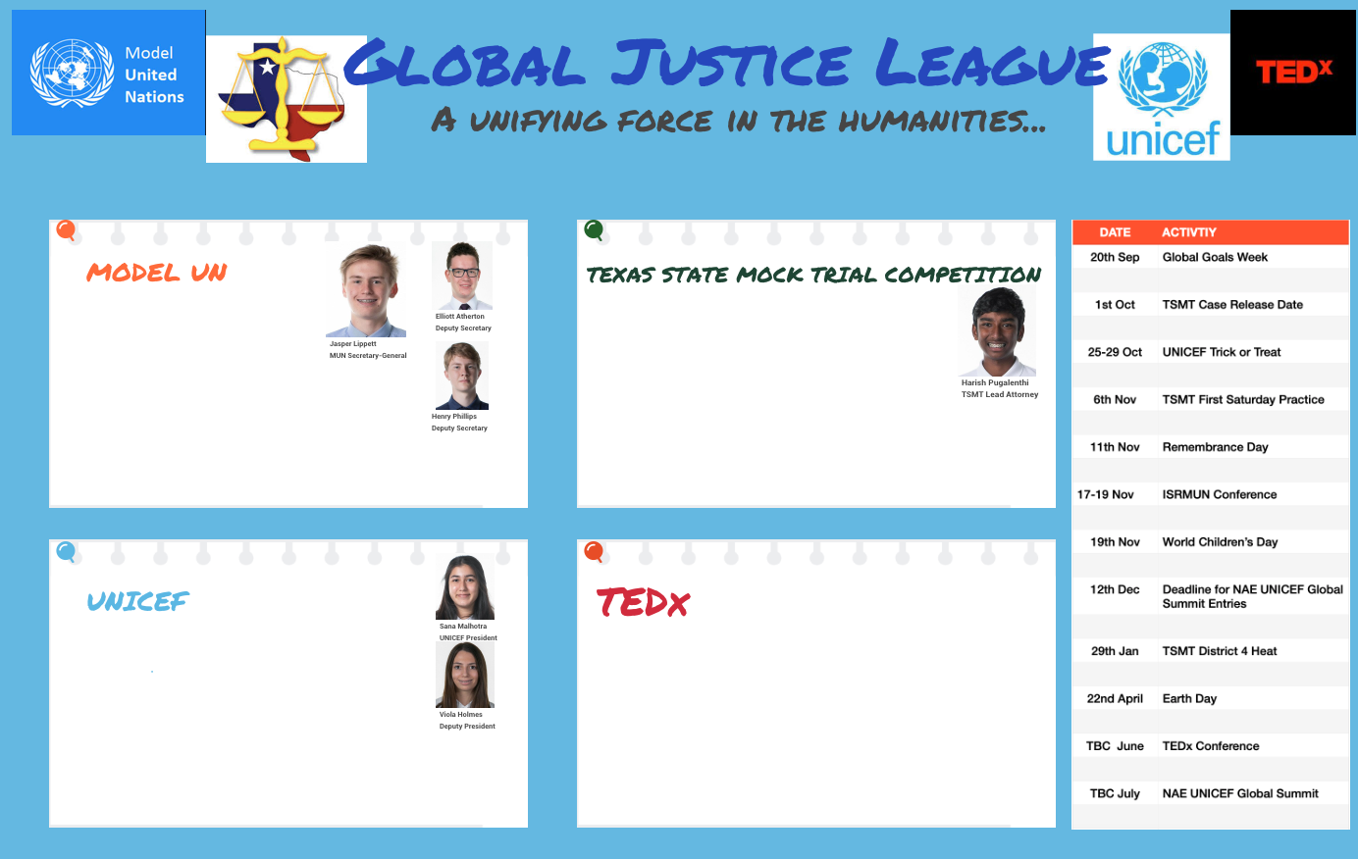
Humanities Enrichment
Advocacy skills
Team work skills
Public speaking
Collaboration skills
Global awareness
Research
Empathy skills
Advocacy skills
Global Awareness
Research
Organizational
Presentational

Slide 2
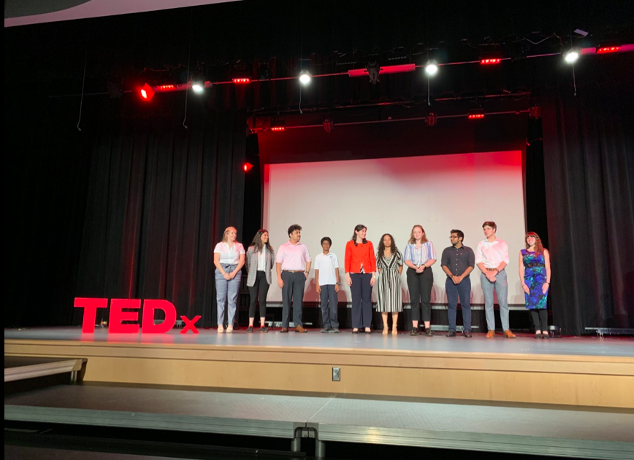
Humanities Enrichment

Slide 3
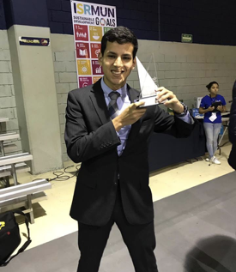
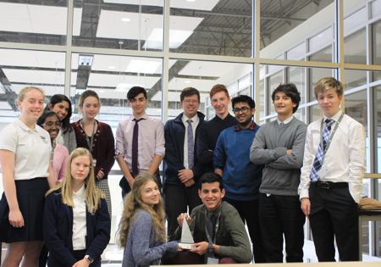
Humanities Enrichment
Date: 2021 November 17th-19th
Years 7-13

Slide 4
Humanities Enrichment
Model United Nations is an activity where you combine leadership, teamwork and critical thinking all into one.

Slide 5
Date: November 17th-19th
Years 7-13

Slide 6
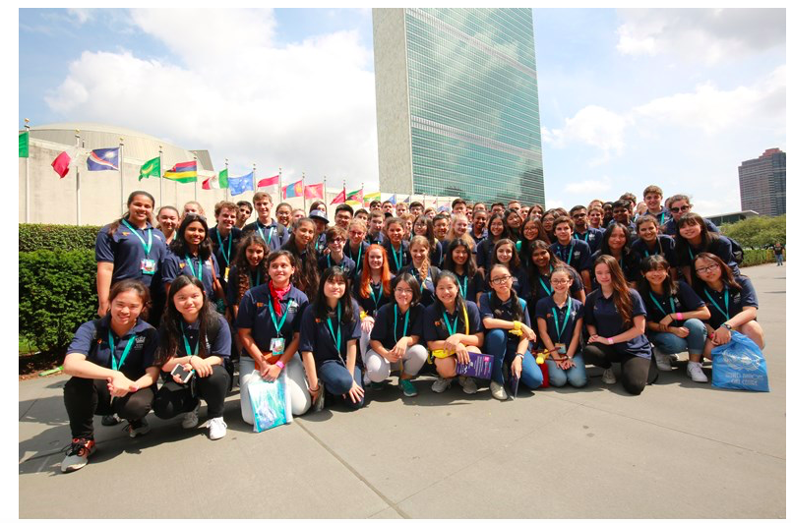
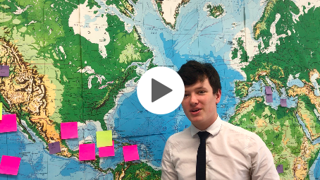
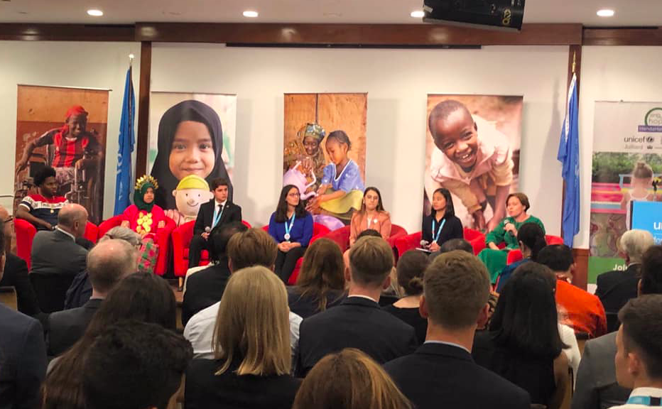
Humanities Enrichment
The NAE - UNICEF Student Summit
As part of Nord Anglia Education’s collaboration with UNICEF, student ambassadors from our schools around the world will visit New York in July to demonstrate how their schools are working to meet the United Nation’s Global Goals for Sustainable Development, including through the annual Global Challenge.

Slide 7
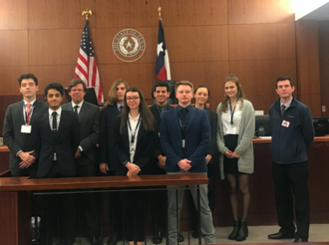
Humanities Enrichment

Slide 8
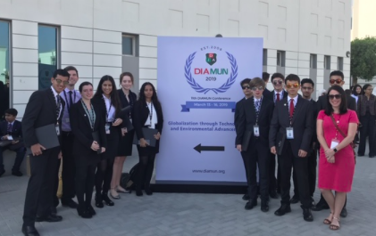
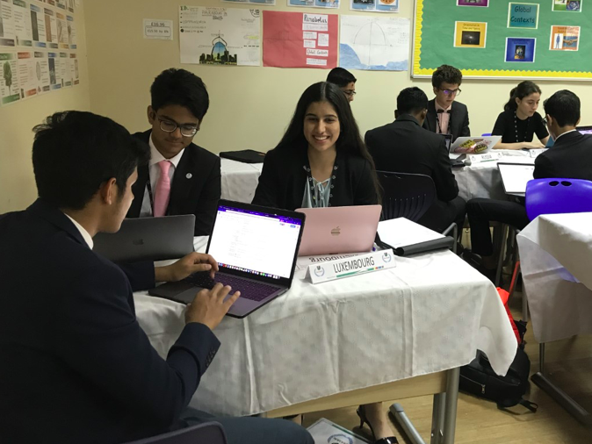
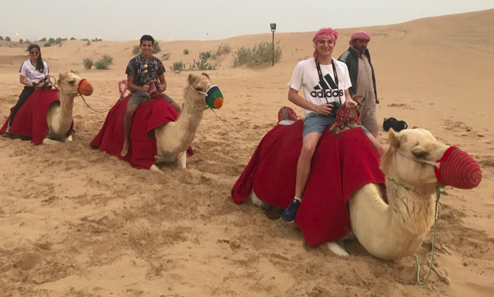
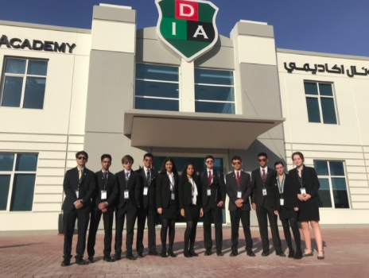
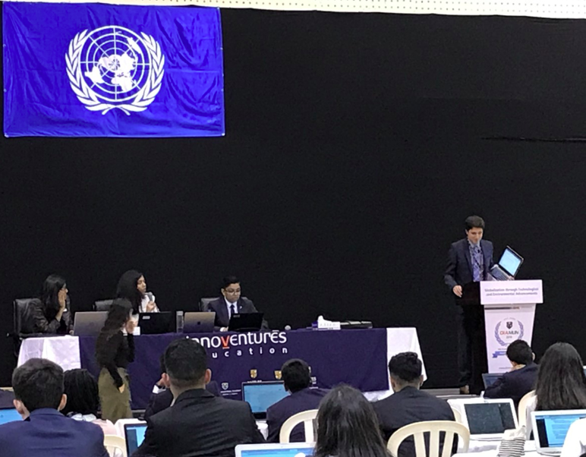
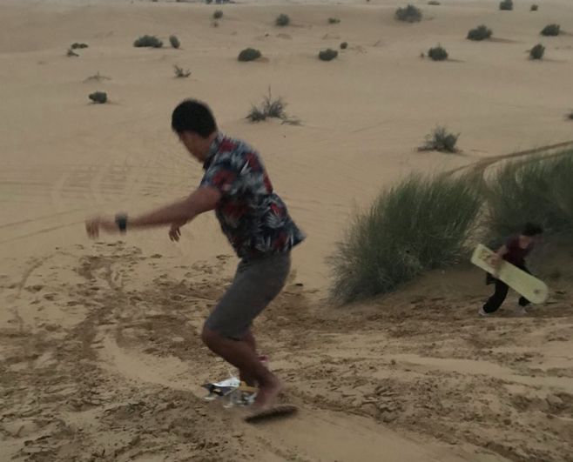
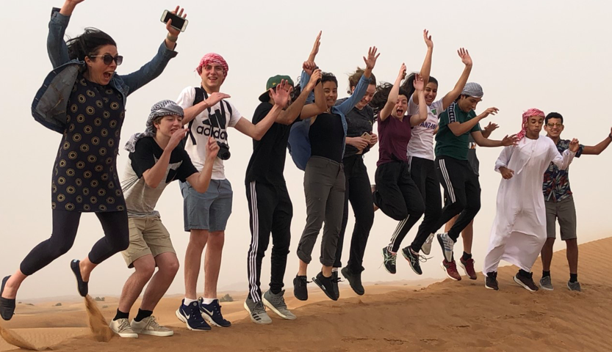
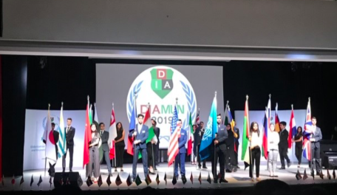
Humanities Enrichment

Slide 9
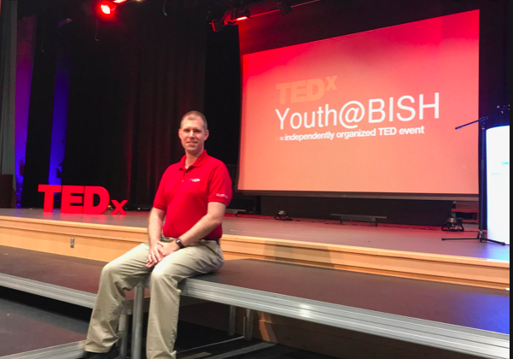
Humanities Enrichment
A TEDx event is a local gathering where live TED-like talks and performances are shared with the community. TEDx events are fully planned and coordinated independently, on a community-by-community basis.
https://www.ted.com/tedx/events/33669

Slide 10
Humanities Enrichment
2 Year iGCSE qualification in Global Citizenship (Year 10)
Possibility to complete in 1 Year

Slide 11
Humanities Enrichment
Advocacy skills
Team work skills
Public speaking
Collaboration skills
Global awareness
Research
Empathy skills
Advocacy skills
Global Awareness
Research
Organizational
Presentational

