Slide 1
What are the biggest problems in the world today?
On the post it notes list as many problems as you can think of people in the world face today. One issue per posit it. You have 4 minutes. When you have completed this stick them on the window.
How can you categorize them?

Slide 2
What: To understand the reasons behind the UN developing the global goals.
Why: To understand how we can all take action to create a better world in 2030
How: • Understand the aims of the Global Goals
• Promote the global goals • Synthesize information and declare a personal pledge to take action for the Global Goals.

Slide 3
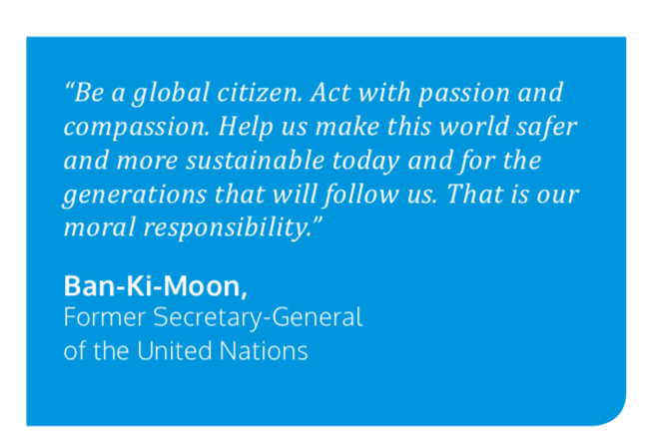

Slide 4
What are the Global Goals?
17 goals to reduce poverty by 2030
Why do you think we have these?
Do we need them?

Slide 5
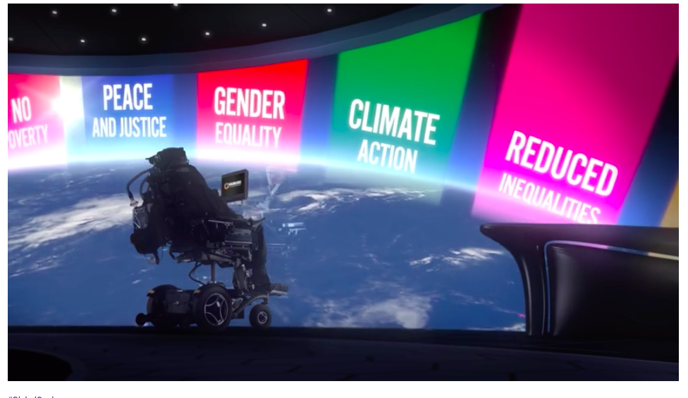
\

Slide 6
Memory game
List the 17 Global goals

Slide 8
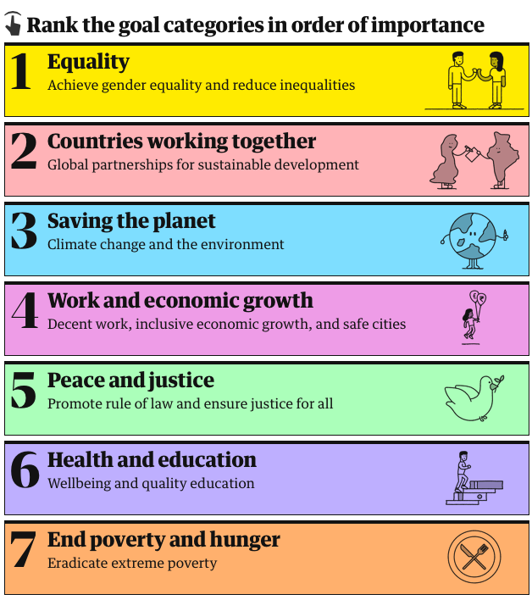
You can do this online here

Slide 9
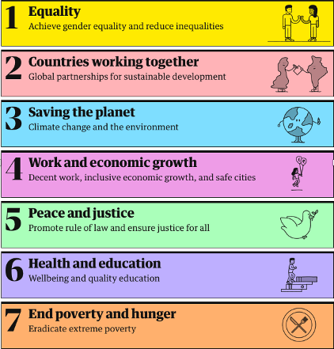
Goal Categories:
Related SDGs:
Goal 5 Gender Equality
Goal 10 Reduced Inequalities
Goal 17 Partnerships for the Goals
Goal 13 Climate Action
Goal 14 Life Below Water
Goal 15 Life on Land
Goal 8 Decent Work and Economic Growth
Goal 9 Industry, Innovation and Infrastructure Goal 11 Sustainable Cities & Communities
Goal 16 Peace, Justice and Strong Institutions
Goal 3 Good Health and Well-Being
Goal 4 Quality Education
Goal 6 Clean Water and Sanitation
Goal 1 No Poverty
Goal 2 Zero Hunger

Slide 10
Diamond 9
Display using a diamond, the order of importance of the goals. Your diamond should have take the following order;
1 (most important)
2 2 2 (3 goals in tied 2nd)
3 3 3 3 (4 goals in tied 3rd)
4 4 4 4 (4 goals in tied 4th)
5 5 5 (3 goals in tied 5th)
6 6 (2 least important goals)
Decide which goal you think is most important and justify with a paragraph.

Slide 11
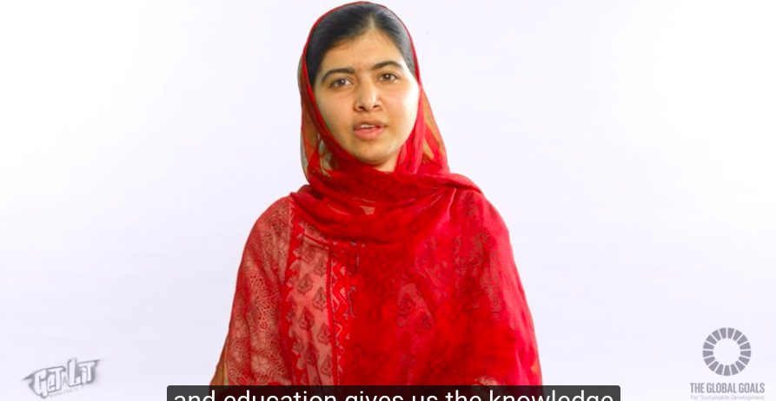
Promote the goals
Objective: Students are to complete their own Sustainable Development Goals School Campaign for 2015 - 2030
Create your own attractive display to promote the new goals around our school environment. You will be given a blank display as well as all the resources you need to create your display. You will need to include your own celebrity poster (you!) as well as a short piece of work on what has happened since 2000and what needs to happen by 2030. Think! * What is your colour scheme? * Come to an agreement on the text font and size to standardize all posters. * What quotes can you add to your piece of the display * You'll need to laminate the posters so that they last for the rest of the year.

Slide 12
SDGs and current events e.g. Covid 19
More here:
https://sustainabledevelopment.un.org/blog/covid19

Slide 13
Hot Air Balloon Debate - SDGs
You are going to have a 'hot air balloon' style debate. A hot-air balloon debate is a debate in which a number of speakers attempt to win the approval of an audience. The audience is invited to imagine that the speakers are flying in a hot-air balloon which is sinking and that someone must be thrown out if everyone is not to die.
Each speaker has to make the case why they should not be thrown out of the balloon to save the remainder.
In this case the debate is about which of the SGGs is the most important.
You will represent one of the SDGs. You will write an oral presentation explaining why your goal is the most important and therefore why it should be sorted out first.
Your presentation should complete the following sentences:
I am representing ...
My SDG is about ...
The reasons why this goal is so important are…
My SDG links has links with goals ? ? because….
The progress towards my goal so far is…
Work that needs to be done includes…
We will know that my SDG is complete when ...
My SDG should be dealt with first because ...
https://www.globalgoals.org

Slide 14
SDG resources
https://www.globalgoals.org
https://www.undp.org/content/undp/en/home/sustainable-development-goals.html
https://worldslargestlesson.globalgoals.org
How We Can Make the World a Better Place by 2030 | Michael Green | TED Talks
The global goals we’ve made progress on – and the ones we haven’t TED Talks
Sustainable development goals: all you need to know
https://www.theguardian.com/global-development/sustainable-development-goals
https://sustainabledevelopment.un.org/blog/covid19
https://www.jkgeography.com/sustainable-development-goals.html

Slide 15
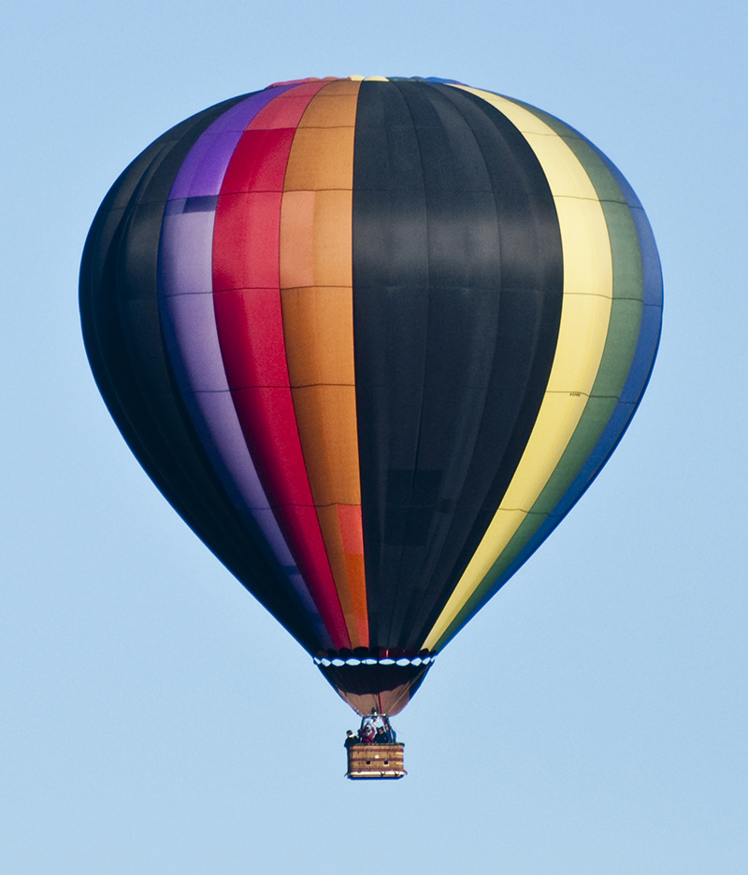
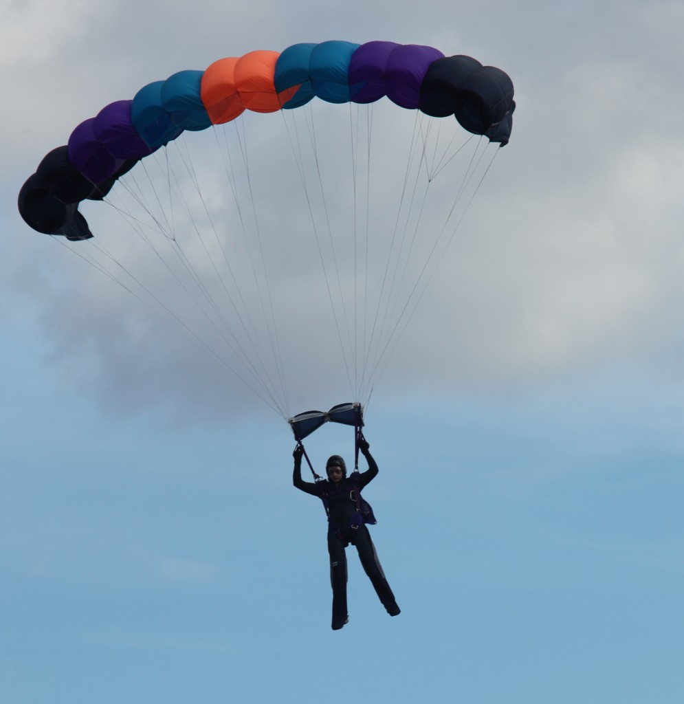
SDGs
The balloon debate
Could this be you?!

Slide 16
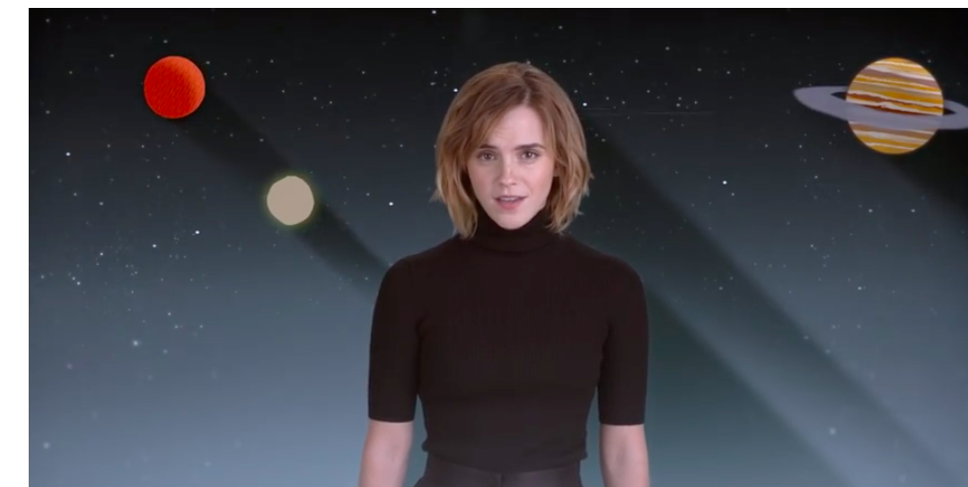
Turning Learning into Action: Reflection
How will we achieve this here?
What would individuals need to do or change to ensure that this happens?
What one thing could you do to help achieve the goals?

