Slide 1
What are the biggest problems in the world today?
On the post it notes list as many problems as you can think of people in the world face today. One issue per posit it. You have 4 minutes. When you have completed this stick them on the window.
How can you categorize them?

Slide 2
What: To understand the reasons behind the UN developing the global goals.
Why: To understand how we can all take action to create a better world in 2030
How: • Understand the aims of the Global Goals • Draw connections between the Global Goals and your own lives • Design your own vision of a Global Goals country • Synthesize information and declare a personal pledge to take action for the Global Goals.

Slide 4
What are the Global Goals?
17 goals to reduce poverty by 2030
Why do you think we have these?
Do we need them?

Slide 5
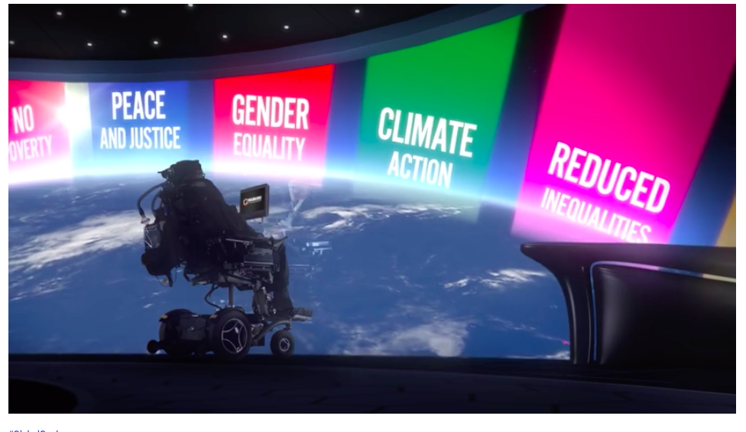
\

Slide 6
Memory game
List the 17 Global goals

Slide 8
Learning about the goals
Visit each station in groups (of 3 -4) to gather more information about the goals. You only have four minutes at each station! You will need to split the workload to ensure you manage your time effectively. Remember to fill out your prompt sheet to help you.
Whilst at a station, each group should write down at least one fact that surprises you. Also come up with a question at each station that you would like to find out more about and could be investigated in future lessons or at home.
Stations to visit:
Poverty, Health , Education, Safer world, Sustainability, Environment
The goals have been grouped together in themes.

Slide 9
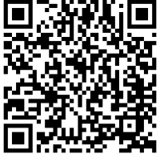
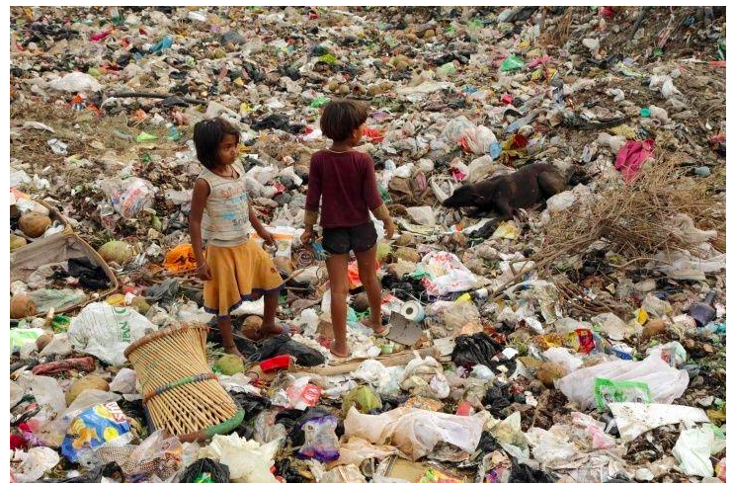
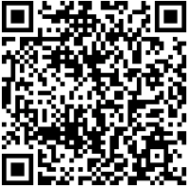
Poverty

Slide 10
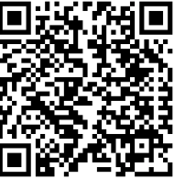
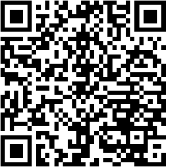
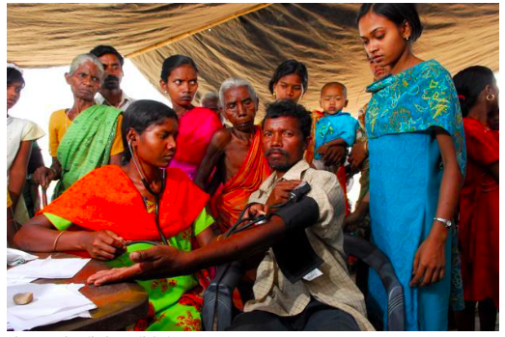
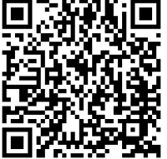
Health

Slide 11
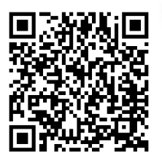
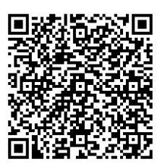
Education

Slide 12
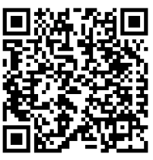
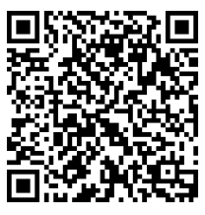
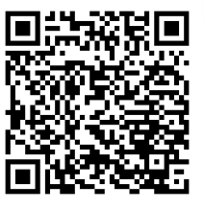
Safer world

Slide 13
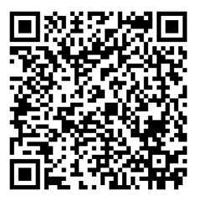
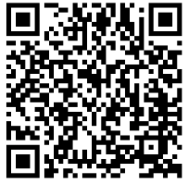
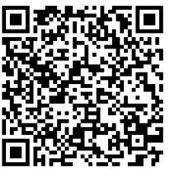
Sustainability

Slide 14
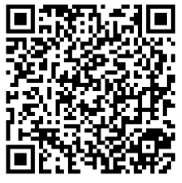
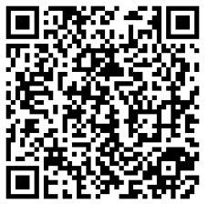
Environment

Slide 15
Test your knowledge….

Slide 16
Diamond 9
Display using a diamond, the order of importance of the goals. Your diamond should have take the following order;
1 (most important)
2 2 2 (3 goals in tied 2nd)
3 3 3 3 (4 goals in tied 3rd)
4 4 4 4 (4 goals in tied 4th)
5 5 5 (3 goals in tied 5th)
6 6 (2 least important goals)
Decide which goal you think is most important and justify with a paragraph.

Slide 17
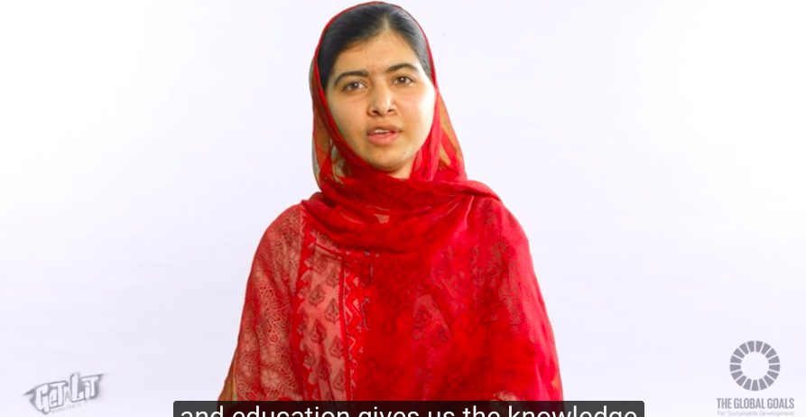
Promote the goals
Objective: Students are to complete their own Sustainable Development Goals School Campaign for 2015 - 2030
Create your own attractive display to promote the new goals around our school environment. You will be given a blank display as well as all the resources you need to create your display. You will need to include your own celebrity poster (you!) as well as a short piece of work on what has happened since 2000and what needs to happen by 2030. Think! * What is your colour scheme? * Come to an agreement on the text font and size to standardize all posters. * What quotes can you add to your piece of the display * You'll need to laminate the posters so that they last for the rest of the year.

Slide 18
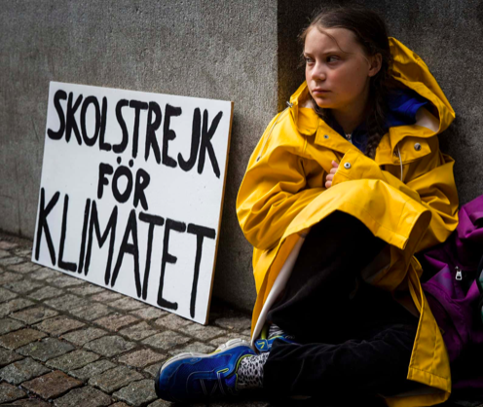

Slide 19
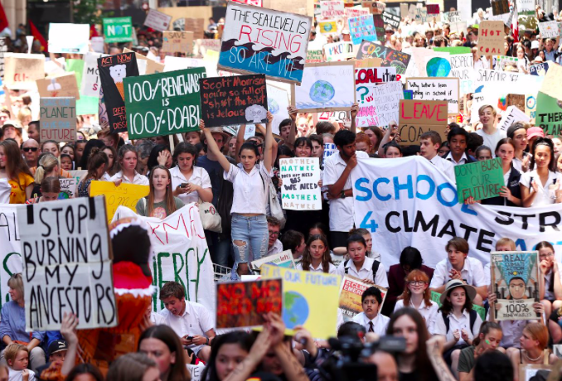
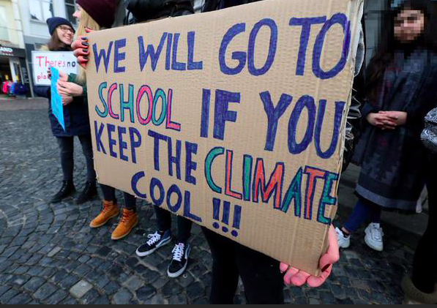

Slide 20
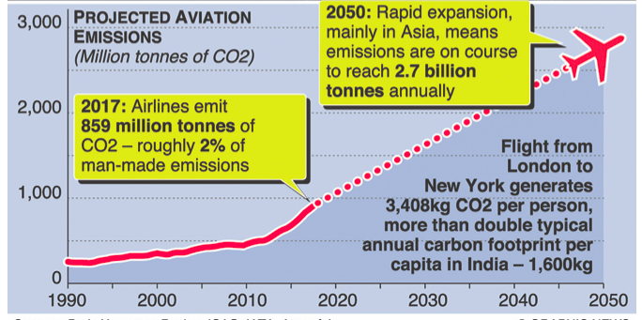
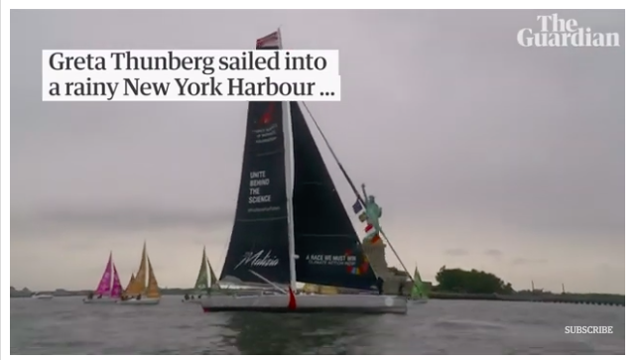

Slide 22
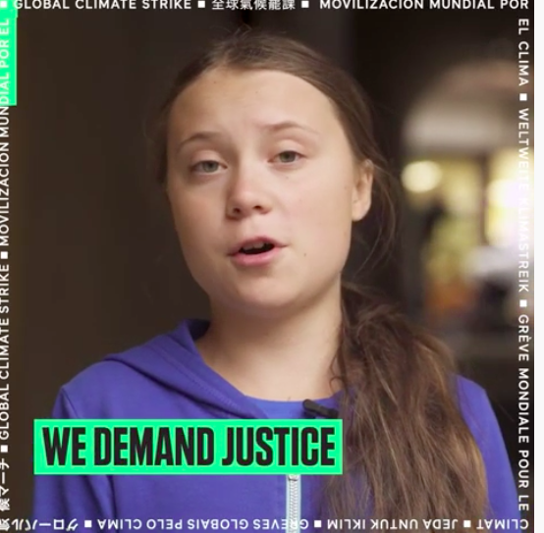
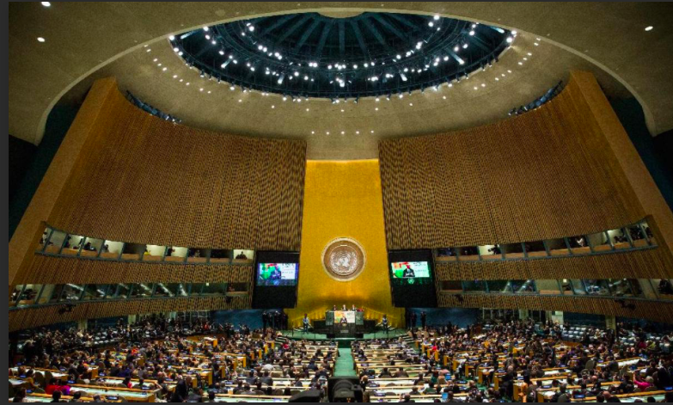

Slide 24
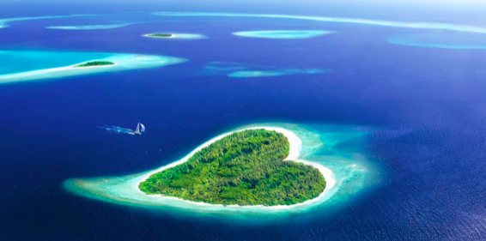
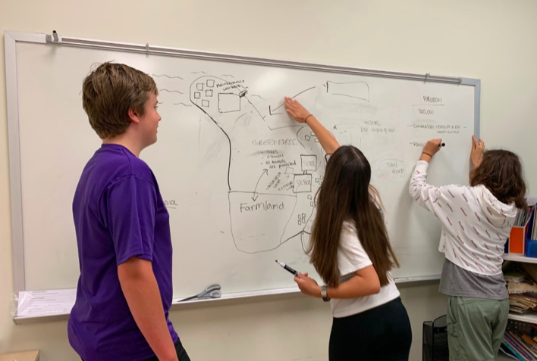
Love (the planet) Island
Design a Global Goals country
In groups of 3-4 draw your own vision of what a country would like in 2030 if the Goals are achieved.
-what facilities and infrastructures a country might need to look after its population, environment and natural resources? E.g schools, hospitals, water sources, waste management systems, safe roads.

Slide 25
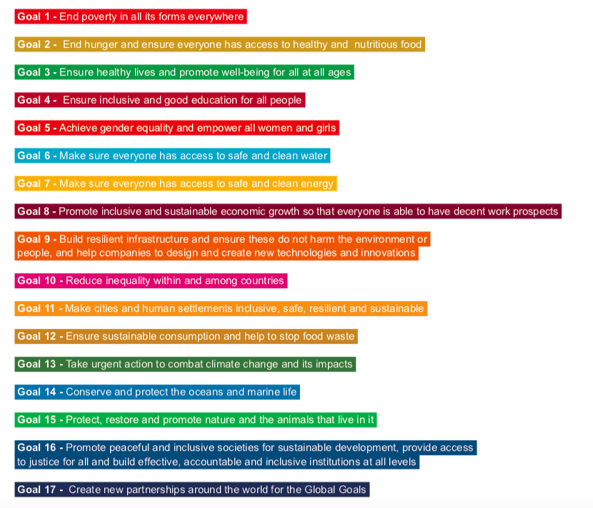
Love (the planet) island checklist
Include 8-10 of the goals
How will you provide water?
How will you provide food?
How will you provide energy?
How will you deal with the waste?
How will you provide education?
How will you create jobs?
How will you provide housing?
How will you provide transport?

Slide 26
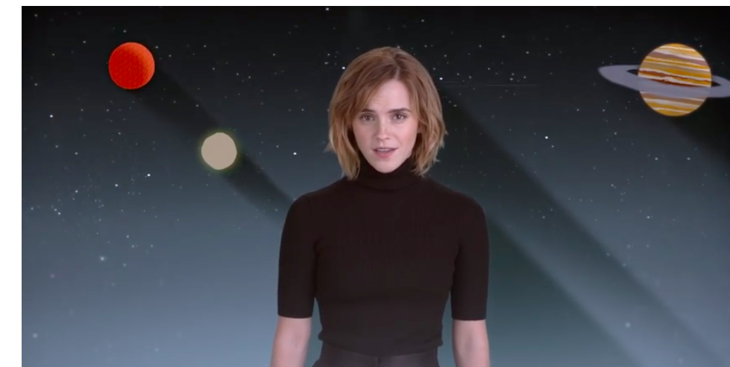
Turning Learning into Action: Reflection
How could the maps you have designed could become a reality in your own real country that you live?
How will we achieve this here?
What would individuals need to do or change to ensure that this happens?
What one thing could you do to help achieve the goals?

