Slide 1
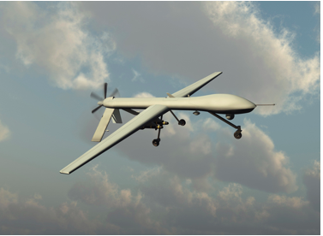
Geopolitical and economic risks

Slide 2
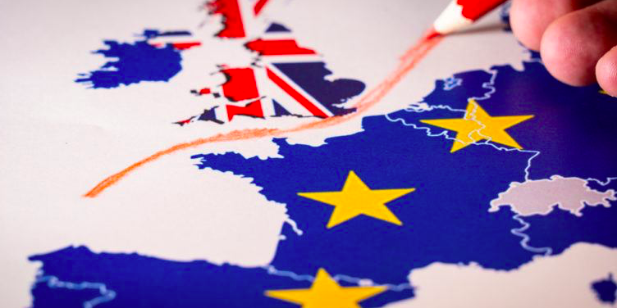
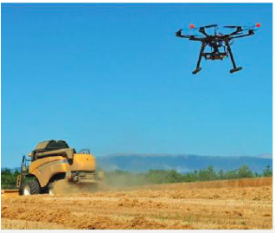
Why?
The advantages of globalization must be weighed against heightened possibilities of new geopolitical and economic risks

Slide 3
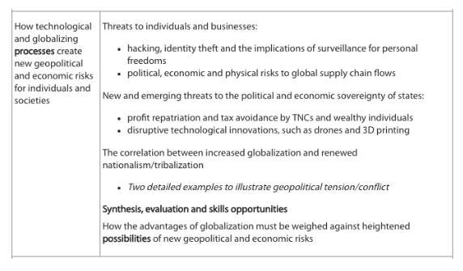

Slide 4
How:
To explore this we are going to examine:
the risk to individuals from hacking and identity theft
the role that TNCs and governments play in putting individuals under constant surveillance- case study facial recognition in China
Risks to supply chain flows- Case study the of supply chain disruption after Japan’s 2011 tsunami
the ability of individuals and companies to avoid paying tax by the use of tax havens
how cartels of TNCs and countries can control basic supplies of resources that we all use
how new developments in technology such as drones and 3D printers have the potential to put copyright, patents, trade secrets and trademarks beyond the control of any government
how drones can make individuals and states less secure through their military use
the growth of tribalisation as a reaction against the process of globalisation in many European countries and the USA.

Slide 5
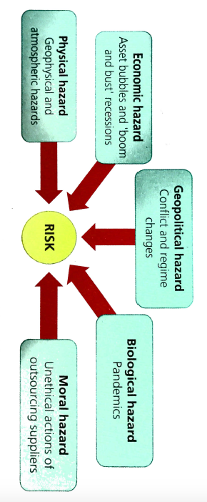
Risk
A real or perceived threat against any aspect of social or economic life.
Globalisation has meant that states, societies and businesses face an increasing number and range of hazard risks.

Slide 6
Threats to individuals and businesses
What: Hacking, identity theft and the implications of surveillance for personal freedoms
Political, economic and physical risks to global supply chain flows

Slide 7
Hacking and identity theft
Make notes from textbook p617-618 or kognity 6.1.1
Threats to individuals and businesses on hacking and identity theft

Slide 8
Examples of cyber attacks
Read: Cyberattacks have created an invisible but vast war zone
https://www.wired.co.uk/article/infoporn-cyberattacks-state-sponsored-hacking

Slide 9
Hacking threats

Slide 10
How easy is it to get Hacked?

Slide 11
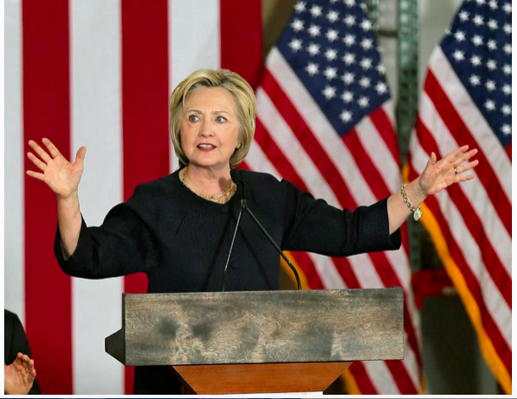
Hacking of Clinton emails
https://www.forbes.com/sites/paulroderickgregory/2016/06/15/what-russias-dnc-hack-tells-us-about-hillary-clintons-private-email-server/#51d9efa12a4b
According to Forbes, during the US 2016 presidential election it became evident that Russian hackers had been able to get into the email of the Democratic National Committee, but they had also managed to get into the private emails of Hillary Clinton. It would appear that they had access to her private emails since 2013 and particularly her correspondence with her trusted adviser Sidney Blumenthal. This is an example of how an important individual can have their email account hacked.

Slide 12
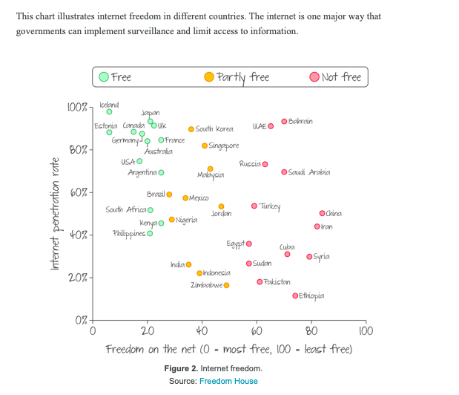
Surveillance
Read kognity: 6.1.1
Threats to individuals and businesses and/ or textbook page 619
And make notes on surveillance and government surveillance

Slide 13
Facial recognition technology in China
Watch The Economist video about the development of facial recognition technology in China.
What is it used for?
What are the benefits?
How is it a risk to personal freedom?
Synoptic link: Smart cities (Urban optional unit)

Slide 14
Managing risk…of global flows of data

Slide 15
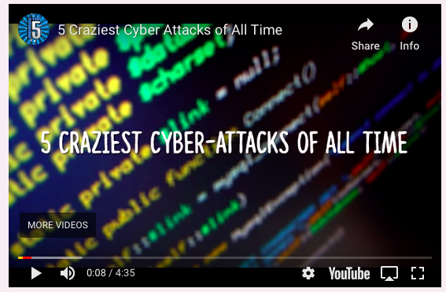
What ways can organizations and individuals attempt to protect themselves from cyber attacks?

Slide 17
Bitcoin
Bitcoin is a cyber currency that can be purchased online and used like any other currency.
Managing risk…of global flows of data
Use the textbook page or kognity 6.3.4
New technologies to help reduce risk and increase resilience
645-647 to
Explain why cybersecurity has become a major global issue
Explain what is trying to be combat the issue
Comment on why it is difficult to deal with

Slide 18
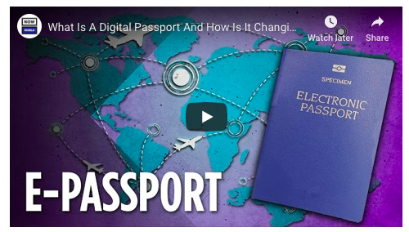
E- passports

Slide 20
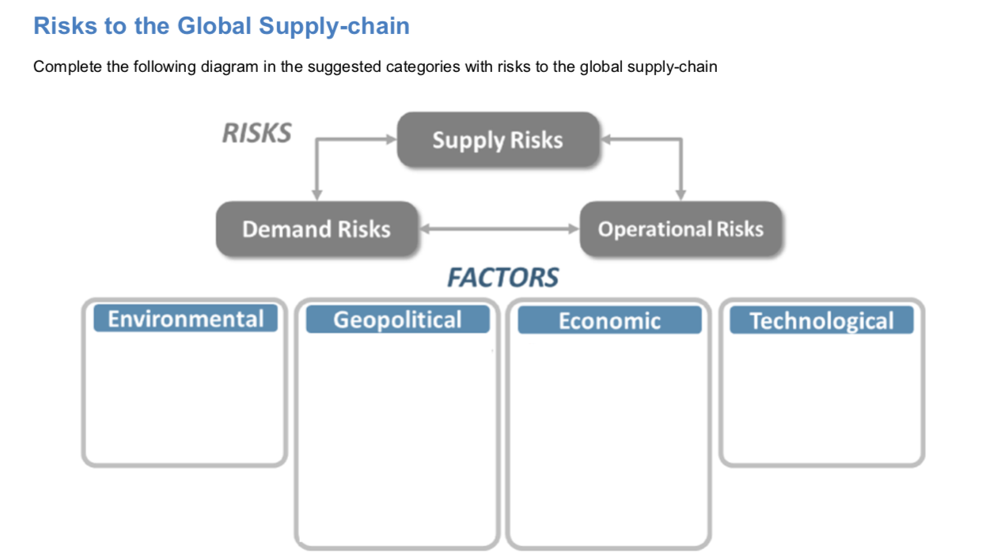
Risks to supply chain flows
Supply chain disruptions can be caused by economic, environmental, political or technological issues

Slide 21
Summary
Task: Read the embedded pdf on the Weebly and table 6.2 on the right to make notes on factors that may disrupt supply chains.

Slide 22
Think: what are the biggest risks according to this diagram

Slide 23
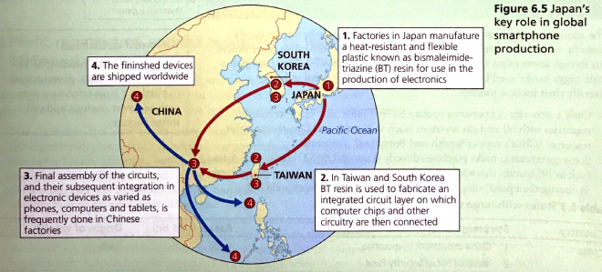
Case study:​​ Supply Chain disruption after Japanese tsunami
https://www.youtube.com/watch?v=1W0cZMtIfEQ
Watch the video and embedded textbook/ in thinking information on the Weebly
Which companies supply chains were impacted by the tsunami?

Slide 24
Example question
“Power struggles between places present the greatest threat to the ‘normal lives’ of individuals and businesses.” Discuss this statement. [16]

Slide 25
“Power struggles between places present the greatest threat to the ‘normal lives’ of individuals and businesses.” Discuss this statement. [16]
Threats from power struggles
Other threats to individuals/businesses
Hacking of businesses and the personal information of citizens by other nation states makes companies and individuals vulnerable e.g. theft of money from businesses, theft of personal data of individuals e.g. personal passwords, leaks of emails for high profile individuals e.g. Hilary Clinton/Sony executives. Make sure to use examples that show that these hacks are the result of power struggles between places.
Sanctions imposed on Russia disrupted the operations of US/EU oil companies in the country.
Terror attacks on holiday makers are the result of power struggles between terrorist groups and certain nation states e.g. the US./UK. These threaten the lives of ordinary people and harm tourist businesses within the countries hat experience attacks e.g. loss of tourism in Tunisia.
Individual liberty is threatened by state sponsored surveillance which is justified by threats posed by ‘bad actors’ e.g. terrorist groups.
War/conflict: Many countries have been attacked or undermined by rival powers since 1945. (many examples could be included here). Use of drones in conflict situations is controversial – 10% of deaths in drone attacks are civilians.
The use of sovereign wealth funds to purchase foreign assets. The goal of this is for other nation states to exert their influence and diversify their income sources. Critics view these sales as a loss of sovereignty.
Moral and ethical hazards due to the bad publicity that TNCs can receive. For example, Apple’s reputation was severely damaged by workers suicides in the Foxconn factories they use to manufacture their iphones.
Tax avoidance by TNCs e.g. Starbucks gives them a bad reputation and may lead to boycotts.
Individuals and businesses are threatened by ‘Black Swan’ events (rare events, that are difficult to predict and cause widespread disruption across the globe) – such as the earthquake and tsunami that struck Japan and or the Global Financial Crisis.
Physical threats e.g. the eruption of airlines due to the eruption of an Icelandic volcano grounded flights for weeks in 2010.
Businesses are threatened by changes in technology e.g. the emergence of Amazon has resulted in many closures of high street shops as people are doing their shopping online. 3D printing means that people will be able to produce products at home and will not need to buy them e.g. products with simple designs like hearing aids.

Slide 26
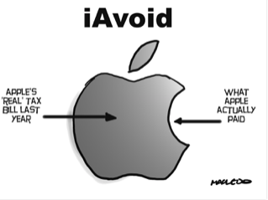
Economic threats to states
Why: The advantages of globalization must be weighed against heightened possibilities of new geopolitical and economic risks
New and emerging threats to the political and economic sovereignty of states:
profit repatriation and tax avoidance by TNCs and wealthy individuals

Slide 27
Threats to state sovereignty
The rational for retreating from globalisation is rooted, for some people, in the valid concern that actual political and/ or economic sovereignty has been/ or is being surrendered.
Political sovereignty: The freedom of a state to govern itself fully independent of any foreign power.
Economic sovereignty: The freedom of a state from any outside intervention in it’s markets and trading relationships

Slide 28
Profit repatriation and tax avoidance by wealthy TNCs and people
The taxes that TNCs pay in the states where they are domiciled play a vital role in providing governments much needed money for health, education ad welfare. Apple, which is head quartered in California paid the US government $6 billion in 2012.
Many use globalizing strategies to reduce their tax burden and increase payouts to shareholders instead.

Slide 29
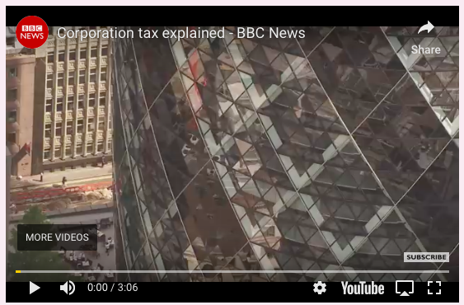
Tax Avoidance in the UK: Places, Processes, Spatial Interactions and Power
Watch the following video from the BBC on corporation tax avoidance in the UK. Make notes on
The amount of tax avoided
The reasons for it
Its impact on the UK

Slide 30
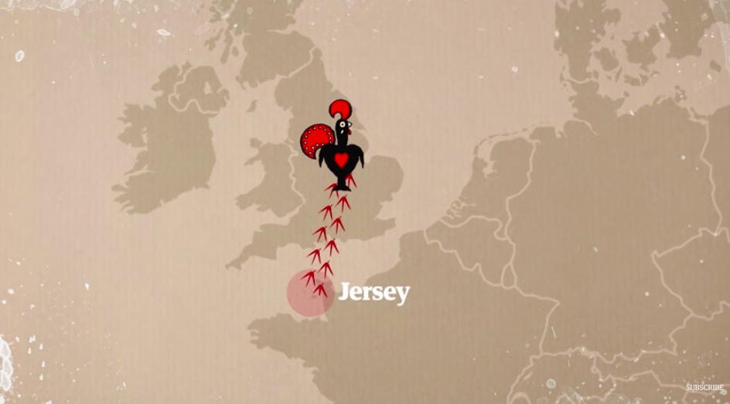
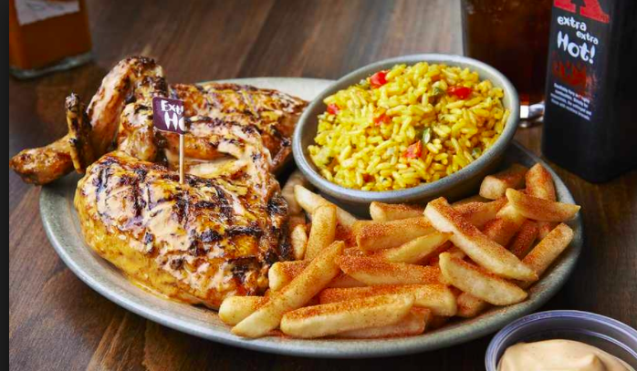
How does Nando's avoid paying tax in the UK?
Watch:
Read:
Nando's tax haven network exposed

Slide 31
Why did Apple pay such low taxes?
Why did Ireland not want the money back?

Slide 32
Managing risk- reshoring by TNCs
In an attempt to attract US companies to reshore, President Donald Trump wishes to cut corporate tax from 39.6% to 15%. He also wants to allow US companies not to be taxed on profits made overseas. This would be a great incentive for companies to return to the USA.

Slide 33
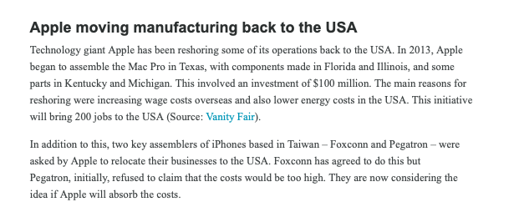
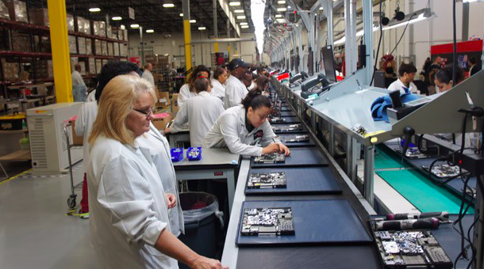
https://money.cnn.com/2017/05/03/technology/apple-tim-cook-advanced-manufacturing/index.html

Slide 34
Tax Avoidance by Wealthy Individuals- Processes and Power
Many wealthy people live in countries where there is a lower tax rate (i.e. Jenson Button lives in Monaco where there is zero tax rate
Pay someone to sort out taxes
Pay their spouse a small wage to claim 2 tax allowances
Start a small new company (in countries such as Switzerland there are tax breaks for start up companies)
Give to charity (In countries such as the USA tax donations are tax- deductible)

Slide 35
Tax havens
If companies or individuals have their wealth stored in a tax haven rather than the country where most of their operations are based, it means that the operations-based country receives less money and may not have enough money to pay for social services such as pensions and health care or education. Portugal, Italy and Greece have all been severely affected by corporations and individuals avoiding paying tax in their country.

Slide 36
1. Describe the pattern the map shows
2. Discuss the impacts of capital flight on the economies of countries

Slide 37
Exam question
Evaluate the threat posed to the political and economic sovereignty of states by profit repatriation and tax avoidance by TNCs. [12]

Slide 38
6.1.4 Technological threats to states

Slide 39
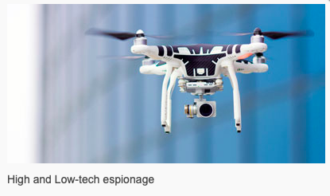
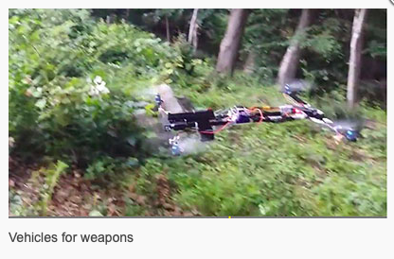
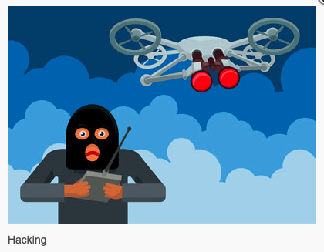
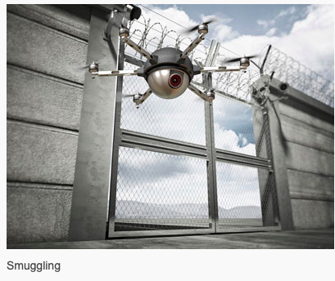
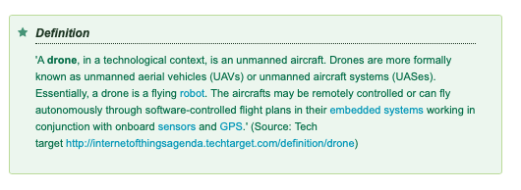
Drones as a Security Threat- Processes and Power

Slide 40
How drones can improve your lifestyle?
Watch:
Can Be used for surveillance in natural and man made disasters- i.e. survey damage, locate victims, help the police search for lost children and monitor large crowds
Make structural surveys of buildings
Monitor environmental conditions
Provide farmers with information

Slide 41
The benefits of drones
In Rwanda, the American startup Zipline has partnered with the government to launch the world’s first commercial drone delivery service, ferrying vital medical supplies to its far-flung hospitals by air.
Unicef is working with Rwanda and Malawi to help deliver needed medicines to remote regions. They have found that by using drones they can cut the delivery time of drugs to minutes instead of hours or days.

Slide 42
Different drone users

Slide 43
Internal threats to states- Drones in the USA
Make notes from kognity (6.1.4
Technological threats to states) on the internal threats from drones in the USA

Slide 44
External threats to states: the use of military drones
Make notes from kognity (6.1.4
Technological threats to states) on the use of military drones
Drones have been used by the US Air Force and the UK's Royal Air Force to carry out attacks on militants in Pakistan, Syria and Afghanistan.
Provide surveillance and intelligence gathering activities in areas that would be hostile for normal aircraft.
Can be used to listen to mobile telephone conversations, and to locate roadside bombs or devices on landing sites.
-Provide surveillance on local groups to see what the normal behaviour of the group is.
Drone attacks in Yemen mostly hit civilians
There have been concerns about the collateral damage, with many more innocent people being killed than just the intended targets. Some estimate that 80–90% of the victims are innocent civilians. One such strike in the remote region of North Waziristan in Pakistan killed 40 people – mostly civilians – in March 2011. It is believed that most of these people were people attending a tribal meeting. In an attack in December 2013 in Yemen, a wedding party who were driving to the feast in cars were attacked by four Hellfire missiles delivered from US drones, killing 12 people.

Slide 45
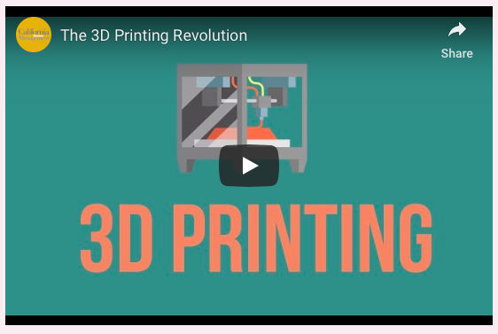
Technological threats to states- 3D Printing: The Third Industrial Revolution
3D printing has important implications for state sovereignty and the ability of governments to control what can pass across state borders. I.e. it is easier for a state to intercept an illegal shipment of guns than the blueprint to be emailed to a 3D printer.
This creates a technological disruption- physical commodity movements are being replaced with information exchanges which are harder to control.

Slide 47
Technological threats to states- 3D Printing: The Third Industrial Revolution
1. How is 3D printing likely to disrupt scale economies?
2. How is 3D printing likely to benefit smaller companies?
3. How will this change the global supply chain?
4. What sectors are currently benefiting from 3D printing?
5. What will be the wider societal changes brought about by 3D printing?
Using the embedded video and ‘In-thinking’ sheet, textbooks and infographic answer the questions to the left

Slide 48
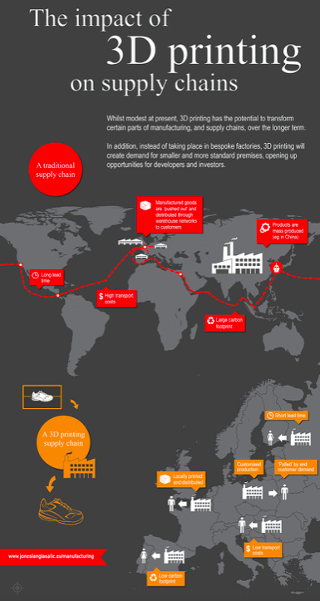
The Threats of 3D Printing on Economic Sovereignty
Study the infographic and describe the disruption 3D printing will have on the global supply chain and economic sovereignty
https://www.procurious.com/blog-content/2015/07/3d-printing-supply-chain-infographic.jpg

Slide 49
Geopolitical tension/ conflict

Slide 50
This is a process that has caused several countries around the world to start to look more inward.

Slide 51
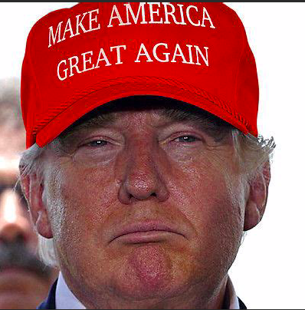
Example 1: ‘America first’
Donald Trump in his election manifesto kept referring back to the theme of 'America First' and making the USA a great power again by restoring coal mining and ensuring US companies kept their businesses in the USA. Associated with this policy has been an attempt to 'protect' American society by imposing strict immigration bans. These developments in the USA can represent a push back against globalisation.

Slide 52
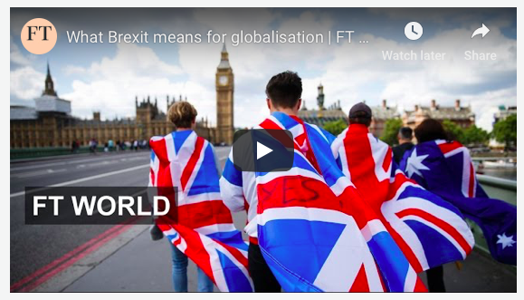
Example 2: Brexit
In the UK, a decision was made by referendum for the UK to leave the European Union (EU) (a process known as Brexit). The vote was supported by largely older English voters who wanted to reduce immigration and also not be governed by the EU's regulations. It was argued that Britain would do better economically if it severed its links with the EU.

Slide 54
Exam question
Examine the extent to which globalisation is responsible for increasing nationalism. [16 marks]

Slide 55
Exam question: Globalisation is now in retreat because of the risks it has created. Discuss this statement (16)

Slide 56
Exam question
Evaluate the success of strategies used to manage the negative impacts of globalisation on people and places. (16 marks)

