Slide 1
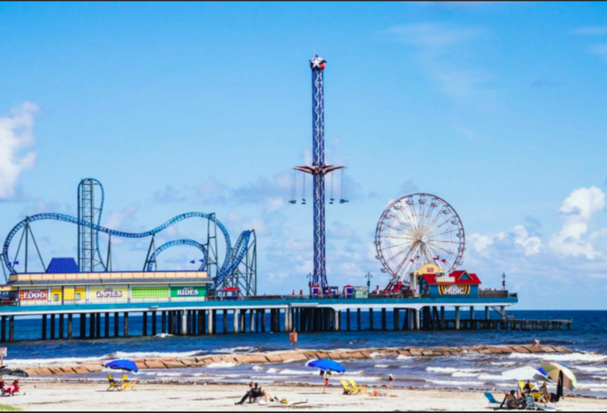
Geography coursework introduction

Slide 2
What: How to write the coursework introduction?
Why?: It is important to clearly set out the aims and the theory we are studying
How: By giving a clear overview of the theoretical and locational context of our study area

Slide 3
Markscheme

Slide 4
Checklist

Slide 5
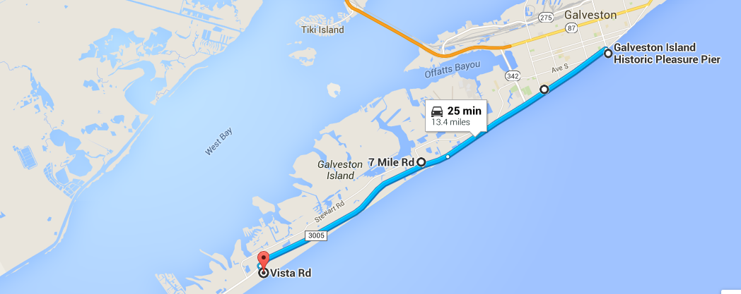
Location of study sites
Site 1: Pleasure pier
Site 2: conference Centre
Site 3: 7 Mile Road- Dellano RV park
Site 4: State Park

Slide 6
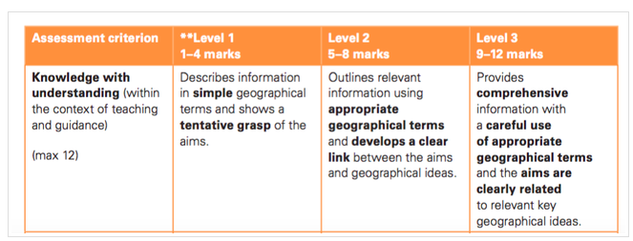
Peer assessment: Be the teacher
Read the 2 example introductions
What grade do you think they would get?
What have they done well?
Are there any things they could improve
What have you learnt from reading these introductions?

