Slide 1
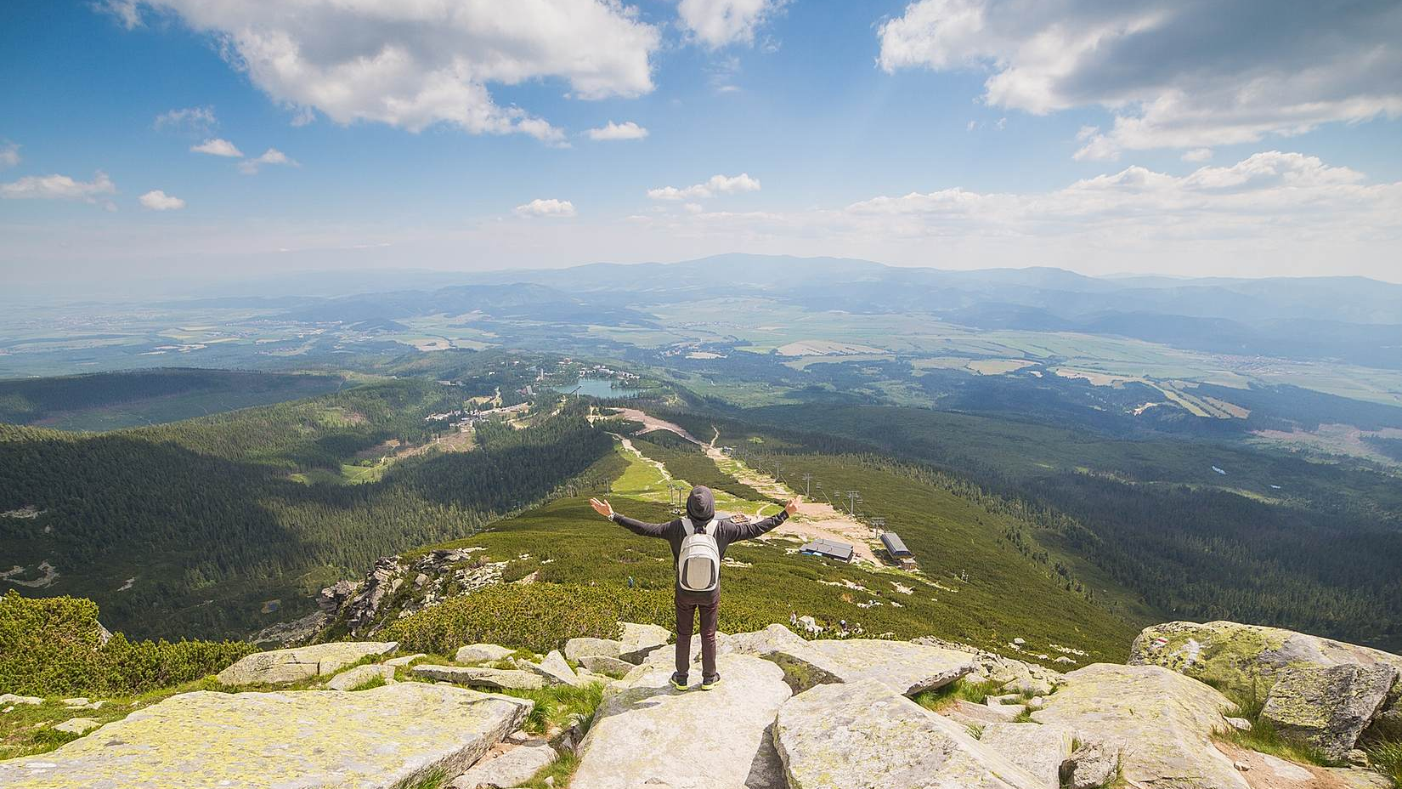
Why take IGCSE
GEOGRAPHY?

Slide 2
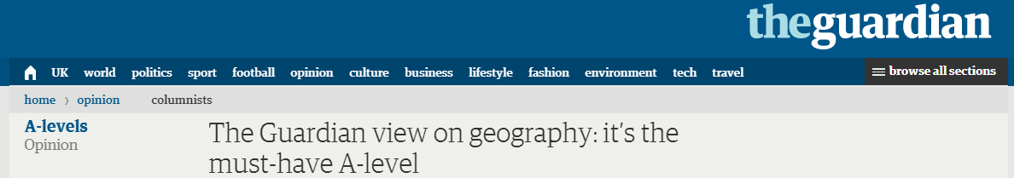
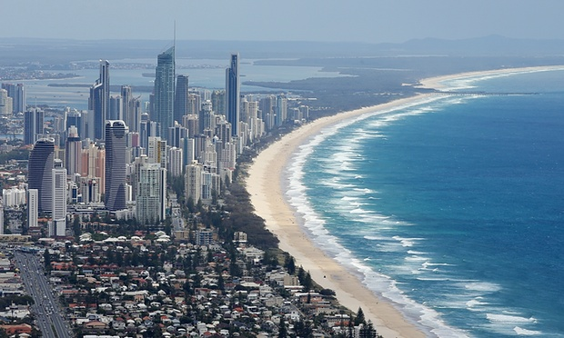
“Geography is all the rage.”
“Geography is a subject for our times.”
“Geography is soaring in popularity.”
Notes:
Geography is one of the most popular option choices at GCSE with over a third of pupils in England taking the subject. Geography is not only up-to-date and relevant, it is one of the most exciting, adventurous and valuable subjects to study at GCSE level. So important, in fact, that the Guardian newspaper in 2015 named Geography as a ‘must-have A-Level’ to help you make sense of the world.
Geography marries together the world of hard scientific fact and process, with human interaction and reaction, through skilful application. That is the strength. We don’t study for the sake of it, we problem solve. We don’t learn skills to sit in a room and stare at them, we go out and fix issues

Slide 3
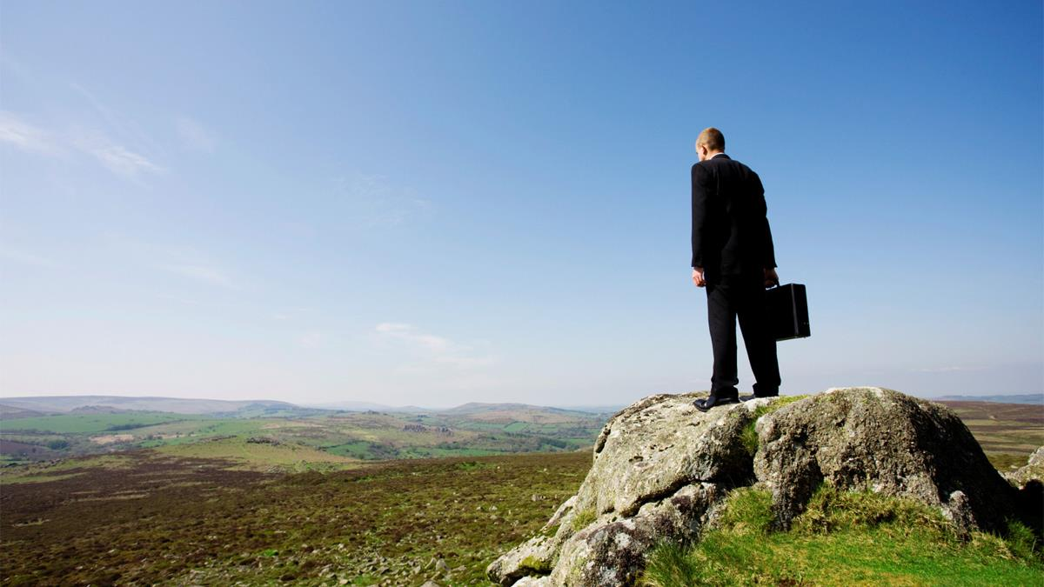


Slide 4

Unemployment rate 2013-2014:
Computer Science 11.4%, Physics 8.2%,
Biology 8.0%, Arts 7.9%, Maths 7.7%,
Chemistry 7.4%, Average unemployment 7.3%,
History 6.6%, Engineering 6.6%, English 6.6%,
Psychology 6.2%, Geography 5.8%
(six months after graduation)
Great job
PROSPECTS
Notes:
Data from Higher Education Careers Services Unit

Slide 5

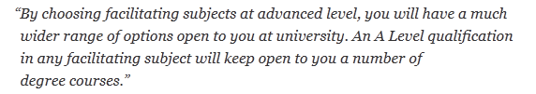
Geography
OPENS DOORS
Geography is a facilitating subject along with Physics, Chem­istry, Biology, Maths and Further Maths, English, History and Modern Lan­guages.
Notes:
“If you decide not to choose some of the facil­it­ating sub­jects at A Level, many degrees at com­pet­itive uni­ver­sities will not be open to you.”
Russell Group Universities – Informed Choices
LSE’s non-preferred subjects included: Art & Design, Business Studies, Drama, Media Studies, Law

Slide 6
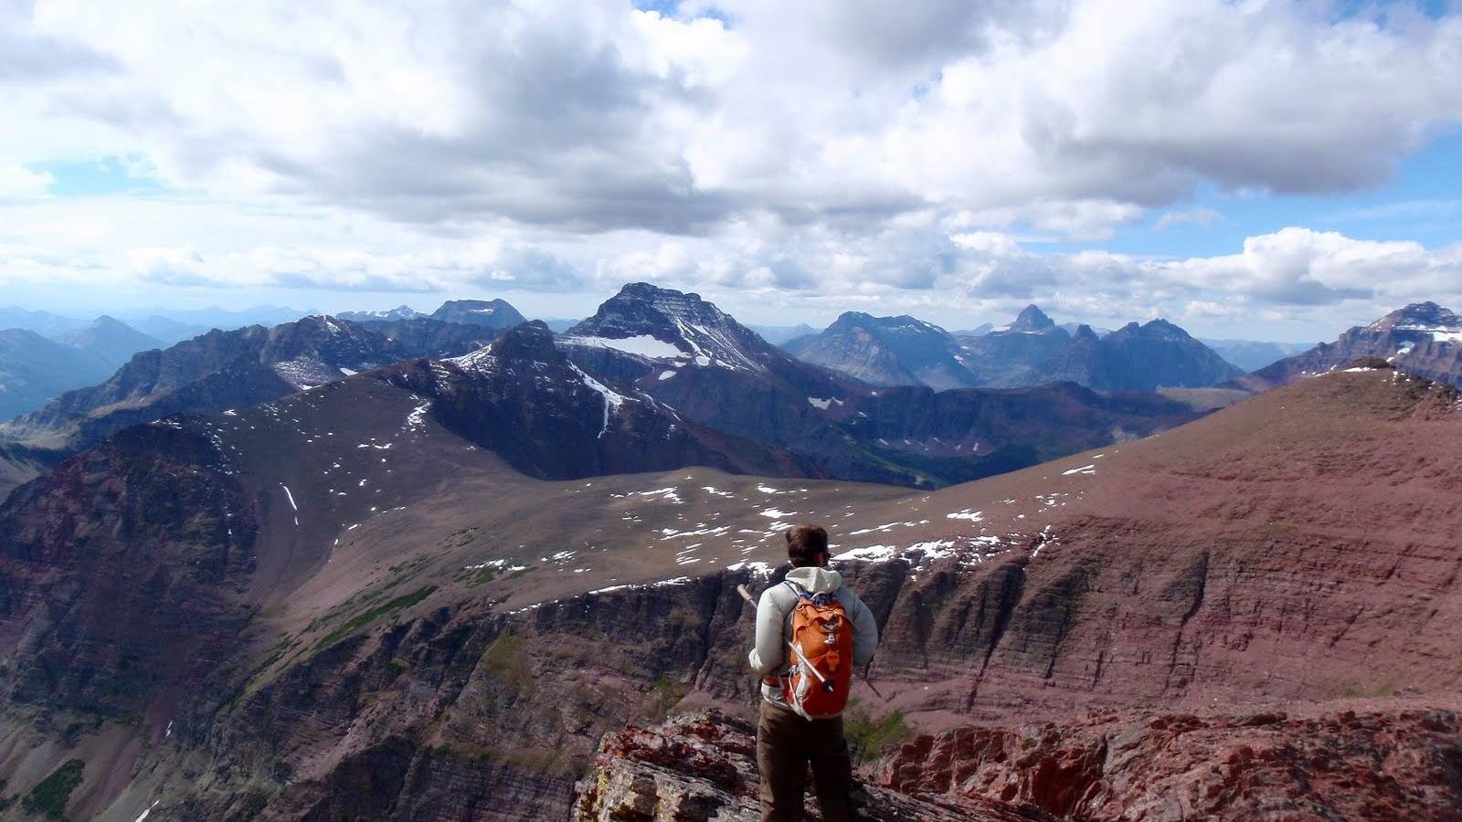
debating and arguing your point
fieldwork
map skills
modern computer based mapping
interpreting photos, cartoons, diagrams…
working with data
statistics
digital technologies
convincing others you are right
critical analysis
decision making
analysing articles
investigating issues in the real world
report writing
empathy
boosting your memory
problem solving
a wide variety of
SKILLS
Notes:
Such a wide variety of skills gained in Geography will be useful after school. These skills are highly sought after by Sixth Form Colleges, universities and employers.

Slide 7
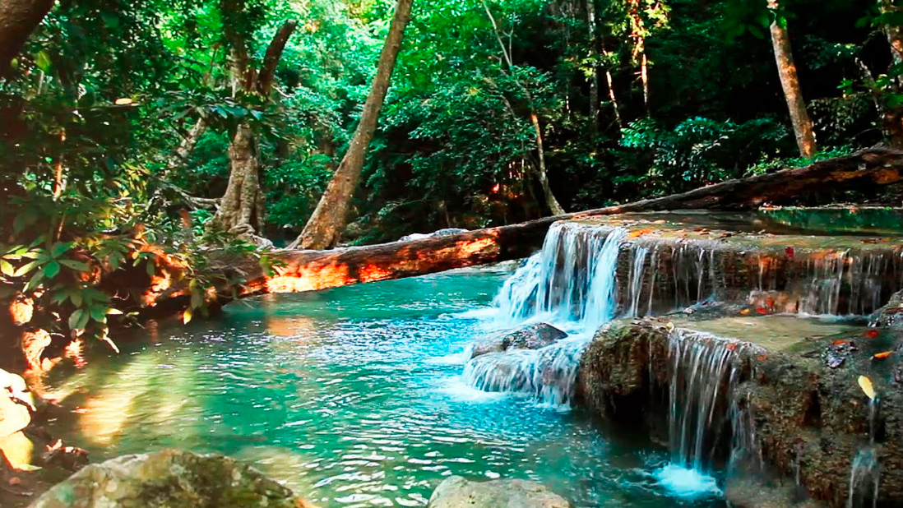
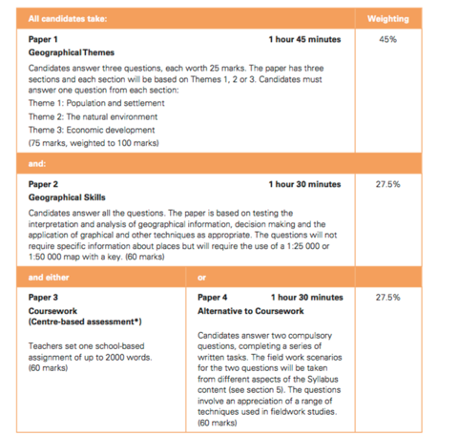
What do we study?

Slide 8
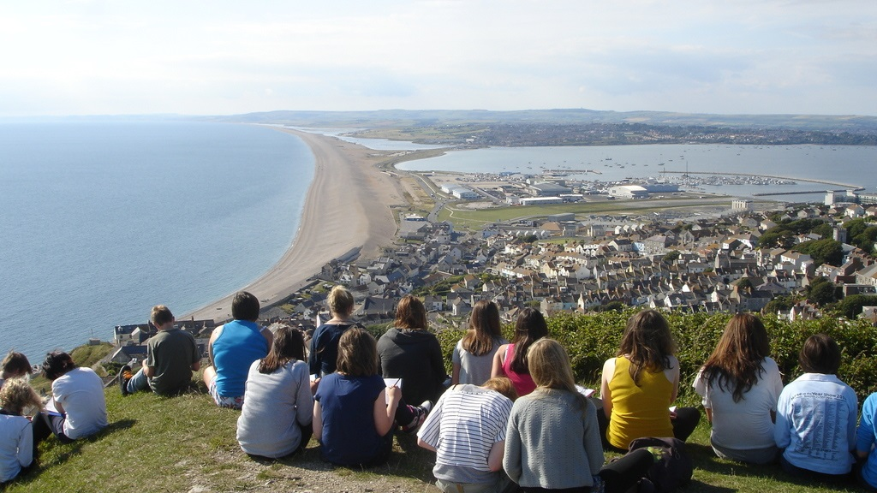
High quality
FIELDWORK

Slide 9
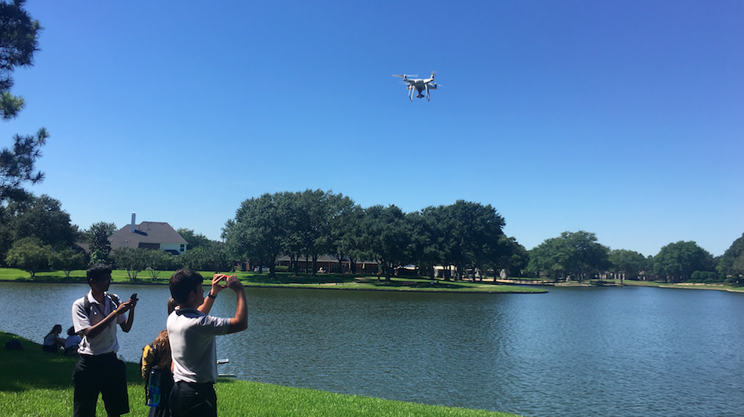
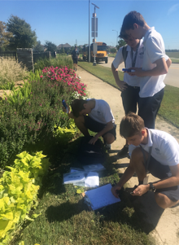
Fieldwork

Slide 11

Pupils who have studied Geography have gone on to work in the following sectors: law, science, medicine, business, environment, information technology, management, finance, banking, marketing, research, manufacturing, teaching, engineering and building, arts, design and media, town planning, working abroad and many (many) more…

Slide 12

Choose
YOUR FUTURE
GEOGRAPHY
Choose

