Slide 1
IB Objective: I can evaluate policies associated with managing population change, focusing on policies related to gender equality policies and anti-trafficking policies.

Slide 2
Class Objectives
What….
Gender equality:
What is it?
How is it measured?
Why do we need it?
How do we do it?
How effective are policies to tackle gender equality?
How….
Examine a range of resources including maps, newspaper articles, video clips etc to develop our understanding
Why….
To develop our understanding of why gender equality continues to be an important issue in today’s society and to appreciate how some countries are aiming to tackle gender equality

Slide 3
How gender equal is your community?

Slide 4
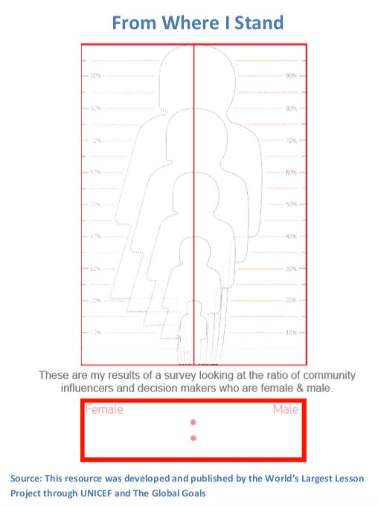
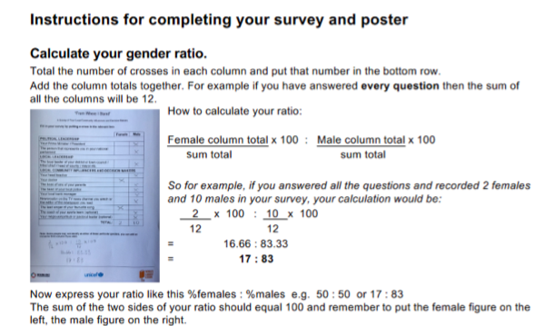

Slide 5
Explore the issues raised in this storyboard and the global goals handout. What does this tell you about the power and position of women globally?

Slide 6
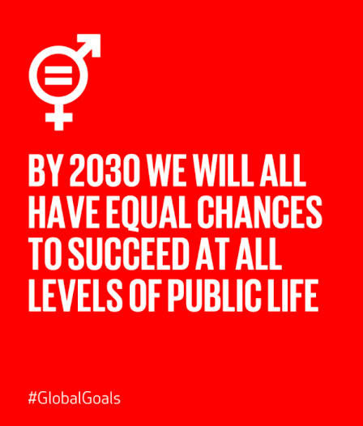
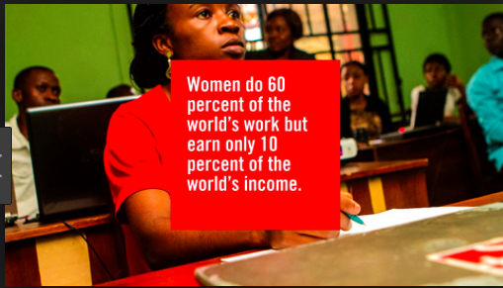
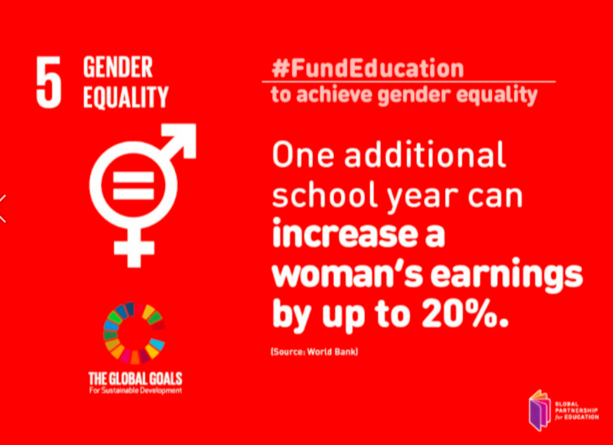
Read through the Global Goals handout and annotate your copy with your own comments and synthesis.

Slide 7
Why are gender equality policies needed?
https://www.girleffect.org

Slide 8
Why are gender equality policies needed?
https://www.youtube.com/watch?v=F-ZZeE7C7uM

Slide 9
Why are gender equality policies needed?
What does this article from The Guardian tell us about the economic need for gender equality? Do you think this reason is more or less important than the ethical/moral imperative?

Slide 10
The perception of a women’s work

Slide 11
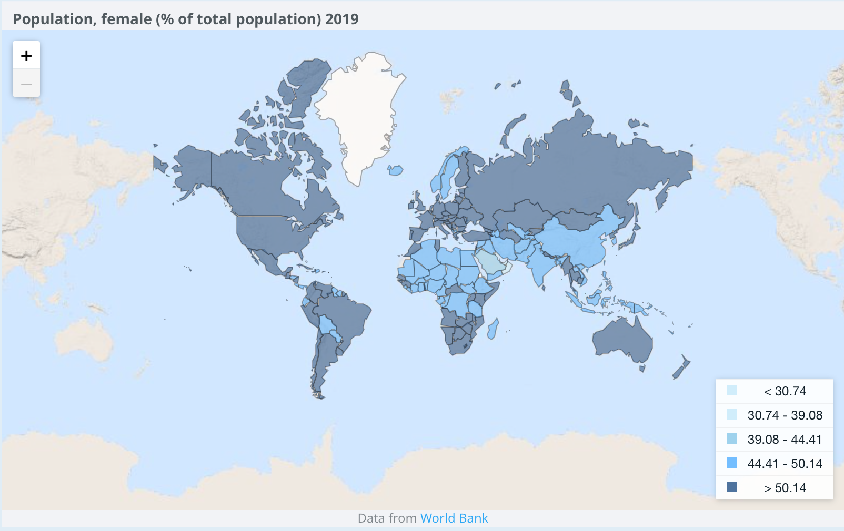
Preference for boys in China and India
Answer the following I.B. style practice questions: ​Referring to the map, state the % of the Chinese population that are female. (1)
Referring to the map, describe the global pattern of gender imbalance. (3)
Explain why a gender imbalance is present in China and India. (2+2)

Slide 12
Why are gender equality policies needed?
Study the map. Make sure you can explain what the data means.
What patterns are shown? Compare HICs with LICs?
Why is the education of girls important for both individual and personal development?

Slide 13
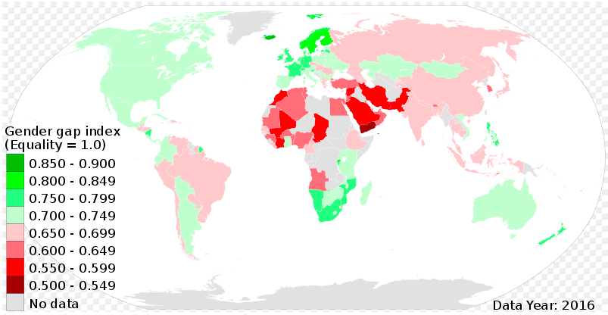
Global Gender Inequality Map 2016.
Study the map and describe the spatial distribution of gender inequality shown.
To what extent do these patterns match your expectations? Justify your answer.
Describe and try to explain the positions of Korea, Singapore, Japan, Rwanda, South Africa, Romania.

Slide 14
How can we measure gender equality?
Gender Inequality Index Study the diagram on the next slide which shows the dimensions of the gender equality index.
Briefly explain what you understand by each of the three main strands:
Health
Empowerment
Labour market
What other aspects could be included in a fuller/more detailed gender equality index?

Slide 16
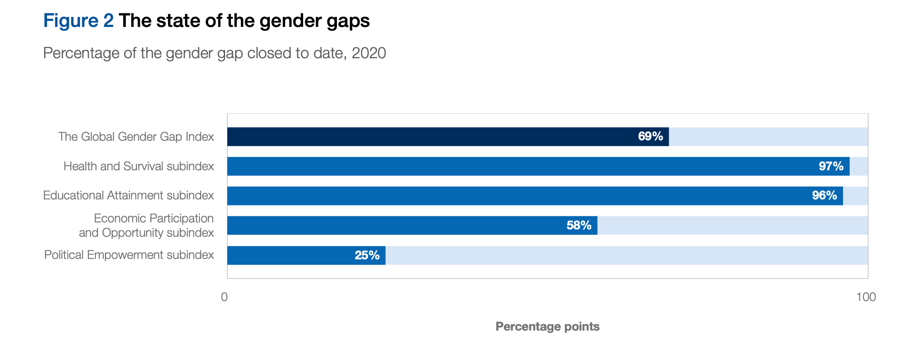
Global gender gap 2020
http://www3.weforum.org/docs/WEF_GGGR_2020.pdf
Look through the infographics: what questions could be asked about these

Slide 19
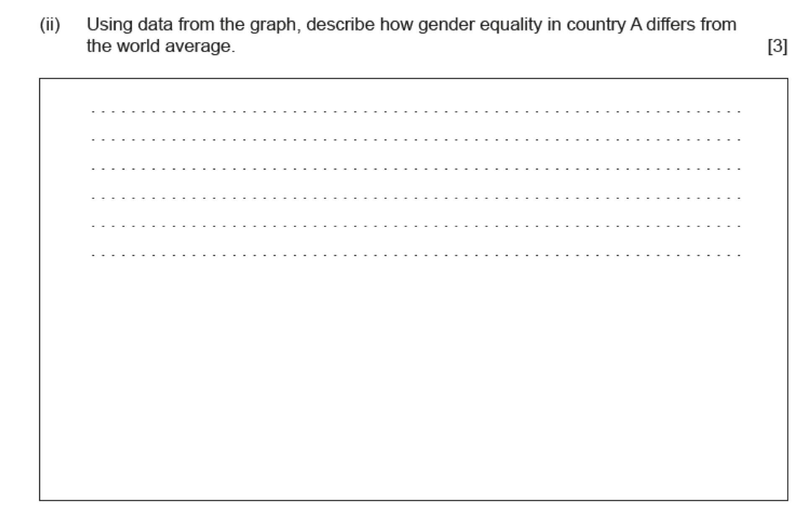
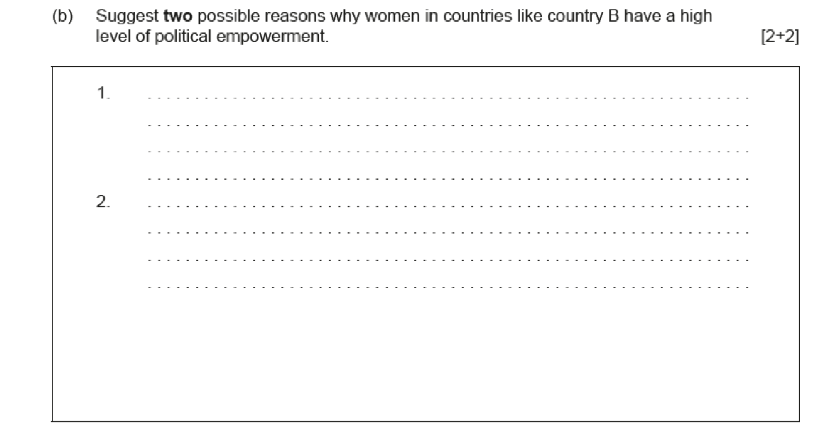
Example structured questions from November 2015

Slide 20
Men and gender equality
Look carefully at the resources here. Suggest three strong reasons why gender equality is in the interests of both men and women.

Slide 21
Men and gender equality
Look carefully at the resources here.
Suggest three strong reasons why gender equality is in the interests of both men and women.

Slide 22
You tube video links
https://www.youtube.com/watch?v=7n9IOH0NvyY
https://www.youtube.com/watch?v=p-iFl4qhBsE
https://www.youtube.com/watch?v=hg3umXU_qWc
https://www.youtube.com/watch?v=yj_47tRakRE
https://www.youtube.com/watch?time_continue=1&v=MfBkjRxfMks
https://www.youtube.com/watch?v=KecF3KASw6w

Slide 23
Gender inequality in India

Slide 24
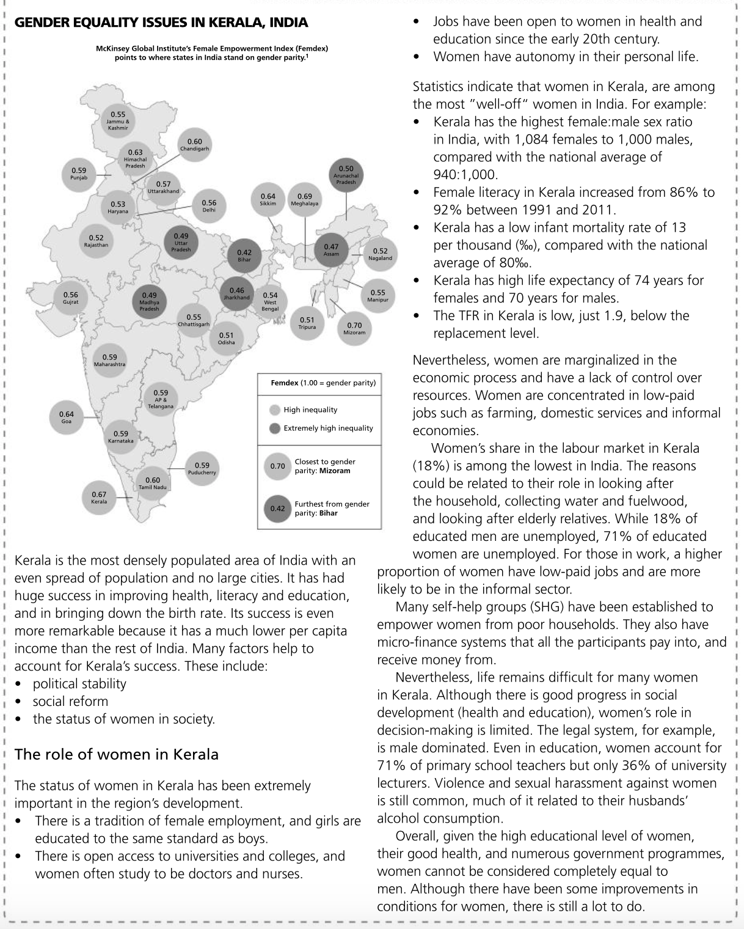
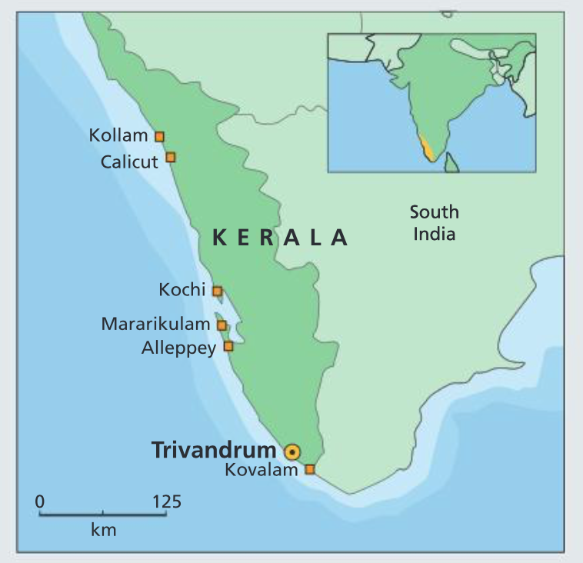
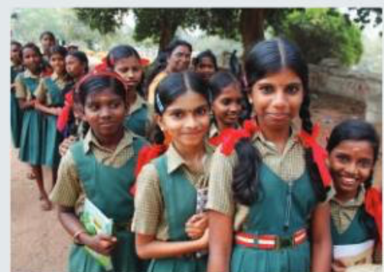
Case study: Gender equality in Kerala, India
Also read textbook 414-415

Slide 25
Gender inequality in Malawi
https://www.usaid.gov/malawi/fact-sheets/malawi-gender-equality-fact-sheet
https://africa.unwomen.org/en/where-we-are/eastern-and-southern-africa/malawi

Slide 26
Additional Case Study: Rwanda
Rwanda is the only country grouped as "Low Human Development" by the United Nations which has also been grouped among the most equal group of countries for gender equality. It ranks no 7 in the Gender Empowerment Index, just behind the Nordic countries, and actually has a higher proportion of girls enrolled in education than boys (97% compared to 95%). So, what factors have led to this level of gender equality in Rwanda? Study the resources below and divide the influences into:Gender policies
Other factors

Slide 27
So, what factors have led to this level of gender equality in Rwanda? Study the resources and divide the influences into:
Gender policies
Other factors

Slide 28
Use the video links to add greater depth and detail to your notes

Slide 29
Evaluation of gender equality in Rwanda
Rwanda tops the global league tables for the percentage of female parliamentarians. Fewer than 22% of MPs worldwide are women; in Rwanda, almost 64% are. Women have also outnumbered men as primary school teachers.
At secondary school, however, fewer than 28% of teachers are women (compared with 21% in 2000). In higher education, only 16% of teachers are women (compared with 10% in 1999 and 5% in 1990).

Slide 30
https://www.theguardian.com/global-development/2014/apr/07/rwanda-women-empowered-impoverished

Slide 31
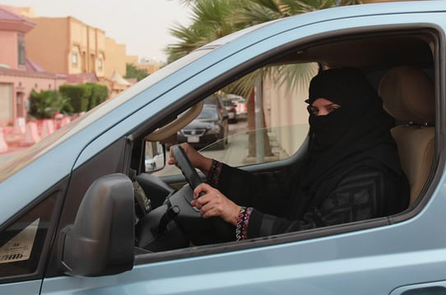
Gender policies Saudi Arabia: Allowing women to drive
https://www.youtube.com/watch?time_continue=6&v=q7Eajbi6N48
https://www.nytimes.com/2017/09/26/world/middleeast/saudi-arabia-women-drive.html
https://www.theguardian.com/world/2017/sep/26/saudi-arabias-king-issues-order-allowing-women-to-drive
Why was the ban lifted?
What impact will this have?

Slide 32
Click here to access the #GirlsCount campaign website

Slide 33
Exam style questions
Examine the view that gender inequalities are a major obstacle to development (10)
“Creating Gender equality is the most effective way of to reduce poverty and stimulate development”. Discuss this statement (10)
To what extent is gender equality the most effective way in reducing population growth (10)

