Slide 1
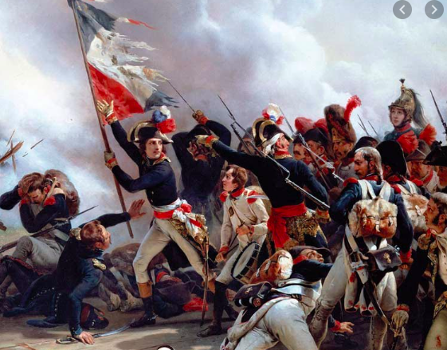
The French Revolution

Slide 2
‘Back2back’ opener
• Each of you will be given a picture. Don’t show your partner the picture you have been given. ▪ If you are the person with the “Middle Ages” diagram you should describe it to your partner, who should then draw it on the scrap paper provided as accurately as possible. ▪ The roles are then reversed: the person with the “1789” diagram describes their picture, and the other person will draws it in on their own scrap paper as accurately as possible. ▪ When finished the correct pictures will go on the board and there will be a mark scheme!

Slide 3
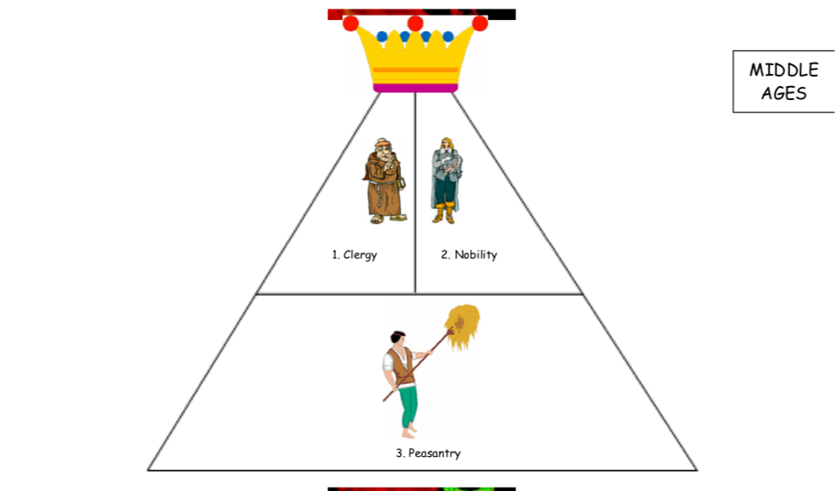

Slide 4
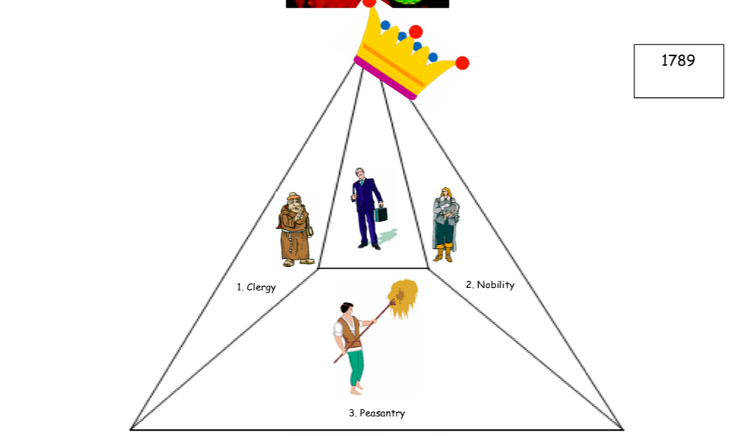

Slide 5
Mark scheme!
2 marks - if the crown is horizontal on one, slanted on the other (discuss – “what does this mean?”) 2 marks – if the inner triangle shape in the 1789 diagram is depicted clearly (discuss – “who is this new class of people?”)
2 marks – if the “nobility” picture clearly represents a noble; 2 marks – if the “peasantry” picture clearly represents a peasant; 2 marks – if the “clergy” picture clearly represents a churchman.

Slide 6
Writing task
• Use your two diagrams to (a) complete the gaps in the first paragraph and (b) write your own second paragraph. TIP: You can write your second paragraph as a series of bullet points. See how many you can come up with!
In the Middle Ages, France was ruled by the _________________. Underneath him were three groups known as the Three Estates. The first estate was the _________________and the second estate was the _________________. Neither of these groups had to pay any tax. The largest and poorest group in society was the _________________. This group had to pay all of the taxes.
By 1789, things had changed in a number of ways....

