Slide 1
FRENCH REVOLUTION
1789

Slide 2
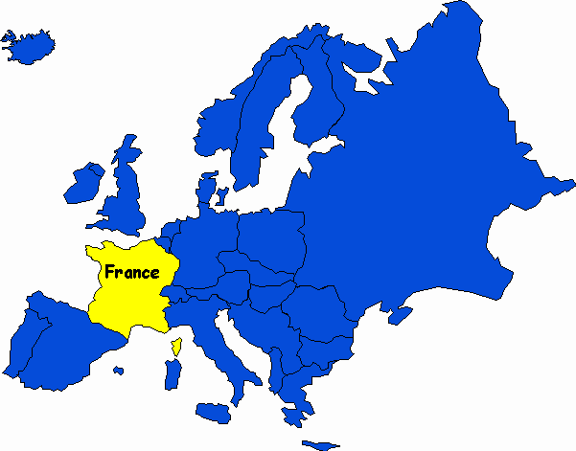
France

Slide 3
How France was governed
France was the birth place of the enlightenment
Writers such as Montesquieu, Rousseau and Voltaire inspired many people to rise up and rebel against governments and monarchy who ruled countries unfairly
France was ruled by an absolute monarchy. Louis XVI ruled with complete power in France
Only the Nobel's, Catholic church and king had any say in how the country was run - Ancien Régime

Slide 4
Bankrupt France
At this time The French King and government had run out of money. This was because
  France was involved in a lot of wars and these cost money
  Louis XVI and his wife Marie Antoinette had very expensive tastes and spent money on extravagant goods and built magnificent places and houses across France

Slide 5
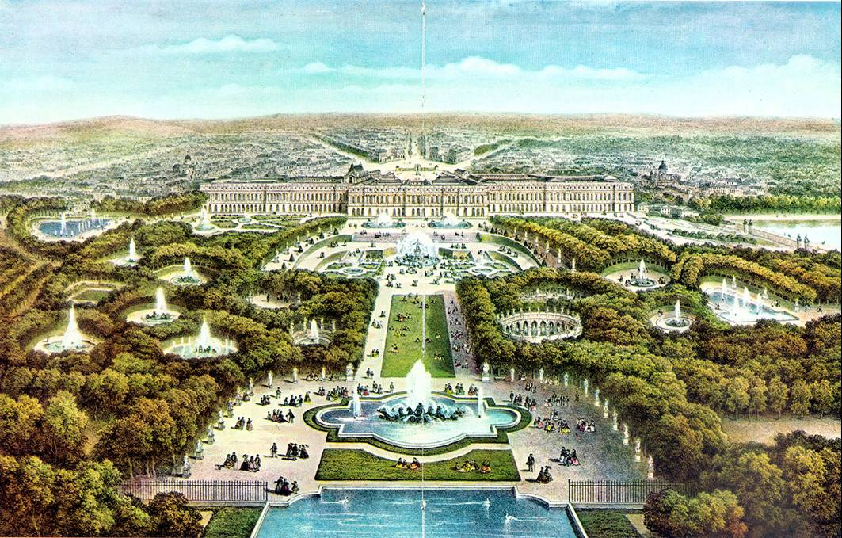
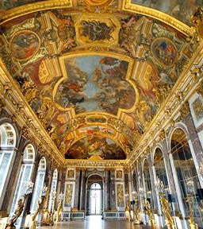
Versailles Palace

Slide 6
The Estates General
The French Parliament consisted of THREE ESTATES or groups
  First Estate – Catholic Church (paid NO TAX)
  Second Estate – Nobility (paid NO TAX)
  Third Estate – Everyone else (PAID TAX)

Slide 7
New taxes needed
In order to get more money for France Louis XVI needed to raise taxes
These new taxes were going to have to be paid by the THIRD ESTATE
In order to raise taxes, a vote had to be taken by the Estates General
Each estate had ONE vote, therefore the First and Second Estate out numbered the Third Estate 2 to 1!

Slide 8
THIRD ESTATE NOT HAPPY
The Third estate was not only made up of the peasants of France but also of wealthy business people, bankers, teachers, soldiers and artists
They were extremely unhappy with having to pay even more taxes

Slide 9
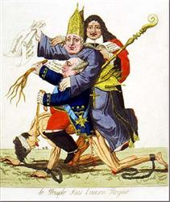
?

Slide 10
The National Assembly
With
  Americans gaining independence
  The ideas of the enlightenment writers
  the Third Estate decided not to accept the new tax increases and were determined to change the Ancien Regime and on the 20th June 1789 the Third Estate set up a new group called the National Assembly

Slide 11
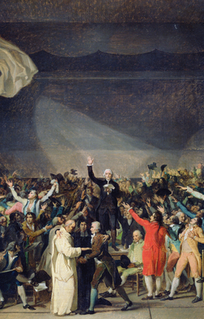
Tennis Court Oath
Louis XVI banned the National Assembly and ordered the army to close it down
The National Assembly then met at a Tennis Court and swore an oath:
They promised not to give up until the Louis XVI and the other two Estates agreed on a fairer taxation system and government
26th August 1789 – National Assembly passed the Declaration of the Rights of Man and of the Citizen.

Slide 12
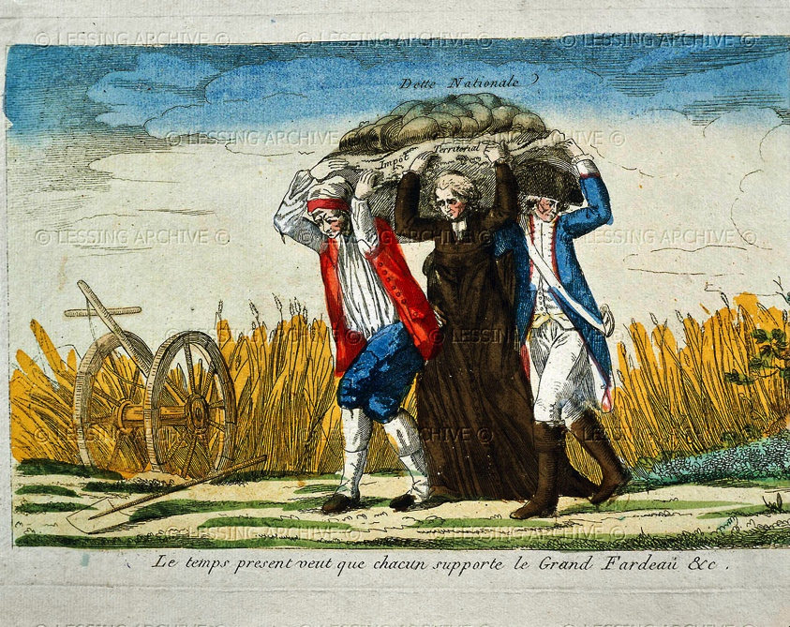
Source Question
French Revolution engraving; 1789
Questions
Who do you think the three people represent in this picture?
What do you think is the message of the picture?

Slide 13
A U-Turn
Louis XVI dramatically did a U-turn on the issue
He decided to discuss changes and reforms with the Third Estate and the National Assembly
This was a great victory for the National Assembly and many now believed that power and taxes would be shared more equally

Slide 14
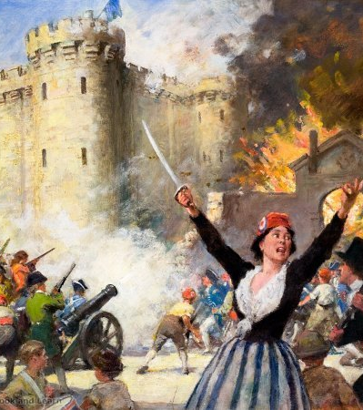
The Revolution begins
A rumour spread through Paris that Louis XVI was intending to use the extra soldiers he’d brought to Paris to break up the National Assembly and arrest its leaders

Slide 15
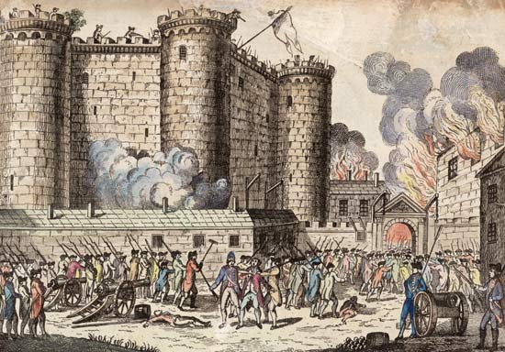
Storming the Bastille
14th July 1789 – The poor of Paris, sans culottes, rose up and stormed the Bastille. The Bastille was a huge prison in Paris and seen as a symbol of the cruelty of the king and the power of the First and Second Estates

Slide 16

French National Flag
The prison was taken easily as it was not that well protected
The new French flag was raised above the prison – Red and White the traditional French flag, the white was the colour of the monarchy and by placing it in the centre it was clearly showing how French people wanted France to be governed

Slide 17
The King and his wife is moved
The sans culottes did not trust the king and his wife. They went to Versailles and brought the king and his wife back to Paris where they could keep an eye on them both

Slide 18
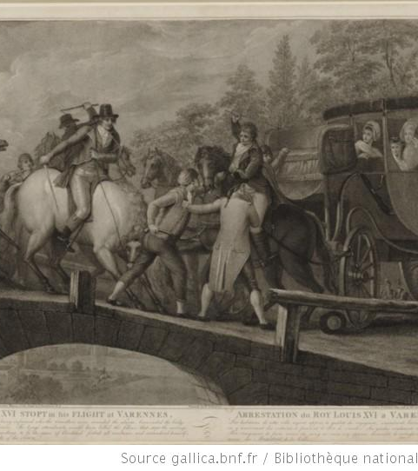
Flight to Varennes
In 1791 Louis had had enough and decided that he wanted to escape out of Paris
He headed for Holland where his wives brother ruled
However he was recognised in a town called Varennes and brought back to Paris

Slide 19
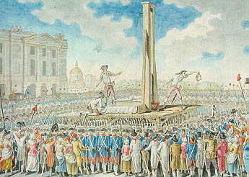
Execution of Louis XVI
Back in Paris Louis XVI was tried for treason, an extreme act against ones own country
It was believed that he was trying to escape to start a war against France
21st January 1793 Louis XVI was executed by guillotine

Slide 20
Shockwaves across Europe
The French Revolution terrified many other monarchies across Europe. They feared that a similar revolution could happen in their respective countries
These monarchs sent their troops to fight the French and crush their revolution
The French army succeeded in defending France against these attacks

Slide 21

The French Assembly
The French Assembly was divided between the Radicals and the Conservatives
Radicals: wanted speedy change (left wing)
Conservatives: wanted slower change (right wing)

Slide 22
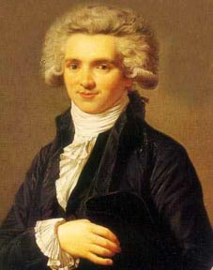
Left Wing versus Right Wing
Maximilien Robespierre was the leader of the Jacobins who led a revolt against the Assembly and seized power
They wanted change to happen quicker

Slide 23
Reign of Terror
France was fighting wars with other countries and also fighting within its own country against the revolution from those who supported the Catholic Church and the Royal Family
The Committee of Public Safety was set up to deal with these affairs
Robespierre believed that a Reign of Terror was needed in order to save the revolution from its enemies

Slide 24
What was it?
A Revolutionary Tribunal, (court) was set up to deal with these enemies – Nobles, priests, and political opponents
Laws of Suspects – listed those who were against the Revolution
People were encouraged to spy on each other
40,000 people were tried and executed before this court

Slide 25
Law of the Maximum
Robespierre wanted to keep the sans-culottes on side. To do so he passed the Law of the Maximum
  It set the maximum price a shopkeeper could charge for food
  Anyone who charged more was taken before the Revolutionary Tribunal

Slide 26
Successes
Robespierre, although cruel in his methods, actually saved the revolution in France
He raised a large army to defend France against Austria, Britain, Prussia (Germany), Holland and Spain
The internal revolt against the Revolution was put down savagely
By 1794 the Revolution had been saved

Slide 27
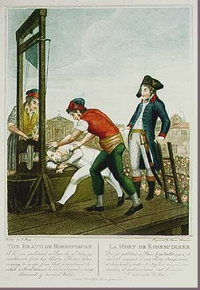
Execution of Robespierre
With the Revolution saved many of the moderate Jacobins wanted to end the Reign of Terror. However Robespierre did not want to stop.
27th July Robespierre was arrested and the next day guillotined.
France remains divided on whether Robespierre was a hero or not.
What do you think?

Slide 28
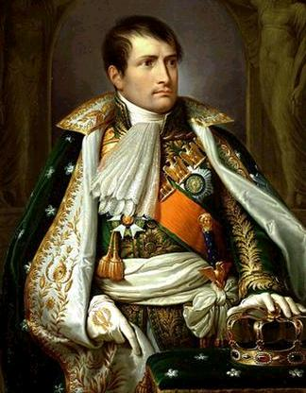
Napoleon Bonaparte

Slide 29
The Directory
Order was finally restored and a new government called the Directory was established in 1799
The Declaration of the Rights of Man and the Citizen was passed
In 1804, Napoleon Bonaparte became the emperor of France
He held ALL the power like Louis XVI had!
He continued to fight across Europe but was defeated badly by the Russians
By 1815 he was defeated at the battle of Waterloo and Louis XVI brother was appointed king!

Slide 30
Key Words
Louis XVI
Absolute Monarchy
Divine Right of Kings
The Enlightenment
Estates General
First Estate
Second Estate
Third Estate
Sans Culottes
National Assembly
Tennis Court Oath
Flight to Verennes
Maximilien Robespierre
Jacobins
Reign of Terror
Napoleon Bonaparte

