Slide 1
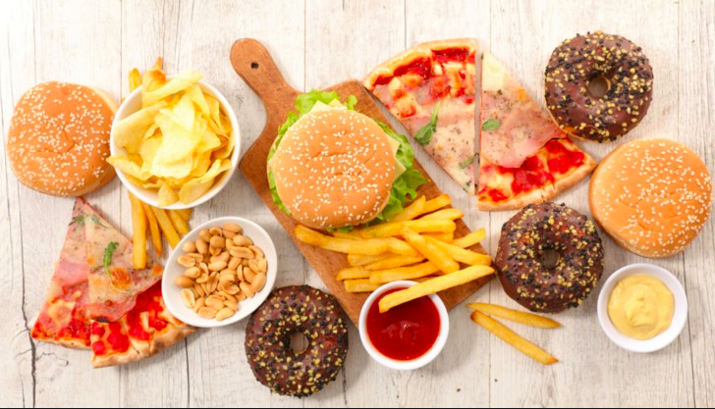
GLOBAL PATTERNS AND TRENDS IN THE AVAILABILITY AND CONSUMPTION OF LAND/FOOD
​Subject guide​ ​An overview of global patterns and trends in the availability and consumption of ​land/food, including changing diets in middle-income countries.

Slide 2
Global food production
To feed the growing population more food will have to be produced, either by using more land or through more intensive farming techniques. The problem is that as population numbers increase, the amount of space per capita is decreased and our cities and towns expand, often into prime agricultural land. That leaves the need for the intensification of farming which in many areas of the world leads to land degradation.

Slide 3
Has food production peaked?
What are the reasons the video to the left states that are the reasons for food peaking.

Slide 4
Global food production
LICs are under a great deal of pressure owing to their rapid population growth and the subsequent need to secure increasing amounts of food. They do not have the financial means to import food so they must increase production. This can lead to the use of more intense food production methods along with a high chance of land degradation. For example, within intensive farming methods:
The high use of fertilisers and pesticides can result in pollution of the land and surrounding ecosystems.
Irrigation can result in soil salinisation.
High crop production can result in soil nutrient deficiency, soil degradation and soil erosion.
Intensive farming can damage the very resources that countries most need.

Slide 5
Patterns….

Slide 6
Trends….
Use kognity: 3.1.7
Global food production
to help describe and explain the patterns and trends show on the figures on the last 2 slides.

Slide 7
Food consumption

Slide 8
Food consumption
Use the interactive graph on the weebly to describe the patterns and trends in food consumption

Slide 9
Food consumption
Keyword: Nutrient transition
A change in diet from staple carbohydrates towards meat, fish and proteins and dairy products. This typically happens when incomes rise from US$2 a day to US$10 a day.

Slide 10
Nutrient transition
Food intake (measured by calorie intake) has gone up dramatically in most regions of the world. This has been due to our ability to increase crop production in the following ways: 1. Expanding the areas that we farm (clearing rainforest for pasture for cattle grazing) 2. Better use of irrigation (potatoes being grown in Egyptian desert) ​3. Using HYVs and the use of GM crops (drought resistant corn) There have been major changes in diets moving away from traditional home grown and seasonal produce to a more varied diet containing dairy products, meat and of course fast food. This transition has come about with rapid urbanisation, more people working for longer hours, competitive pricing and aggressive marketing campaigns by TNC's in LICs and MICs.

Slide 11
Geographic implications of the NGMC’s nutrient transition
Based on the articles and TED Talk the embedded student textbook, in what ways are the diets of the rising middle class changing?
What is meant by "Food homogenisation"? Give evidence that it is occuring in the NGMC.
Explain the impact of the changing diets of the rising middle class.
How do the articles suggest that climate change is likely to compound these issues?

Slide 12
Case studies: Brazil and China
Now form a pair. One of the pair should use the links and video on weebly to investigate changing diet in Brazil and the other should focus on China. Prepare a mini case study for your country and then share it with your partner. It should include:
​Evidence of changing dietary trends and the nature of the change
Causes of the changes - economic, demographic, social
Consequences of the changes - economic, environmental, health, social​

Slide 13
Key Extract from the New York Times Brazil article - Lots of synthesis in these few sentences that link together large parts of this IB DP course.
The story is as much about economics as it is nutrition. As multinational companies push deeper into the developing world, they are transforming local agriculture, spurring farmers to abandon subsistence crops in favor of cash commodities like sugar cane, corn and soybeans — the building blocks for many industrial food products. In places as distant as China, South Africa and Colombia, the rising clout of big food companies also translates into political influence, targetting public health officials seeking soda taxes or legislation aimed at curbing the health impacts of processed food. The same trends are mirrored with fast food, which grew 30 percent worldwide from 2011 to 2016, compared with 21 percent in the United States, according to Euromonitor. Take, for example, Domino’s Pizza, which in 2016 added 1,281 stores — one “every seven hours,” noted its annual report — all but 171 of them overseas.

