Slide 1
(b) To what extent is expansionary fiscal policy an effective tool to use during a recession? [15 marks]
MARKSCHEME

Slide 2
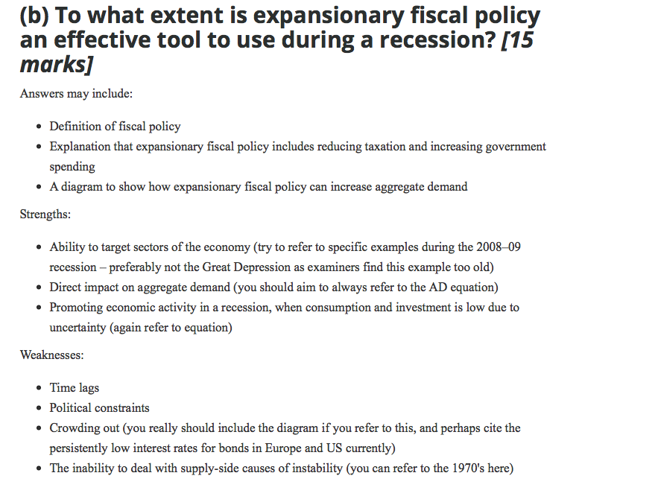

Slide 3
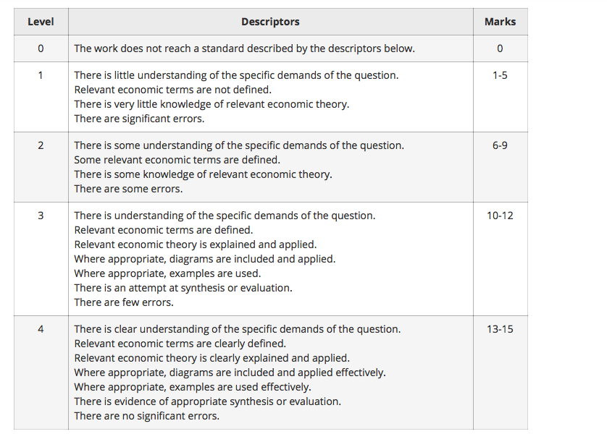

Slide 4
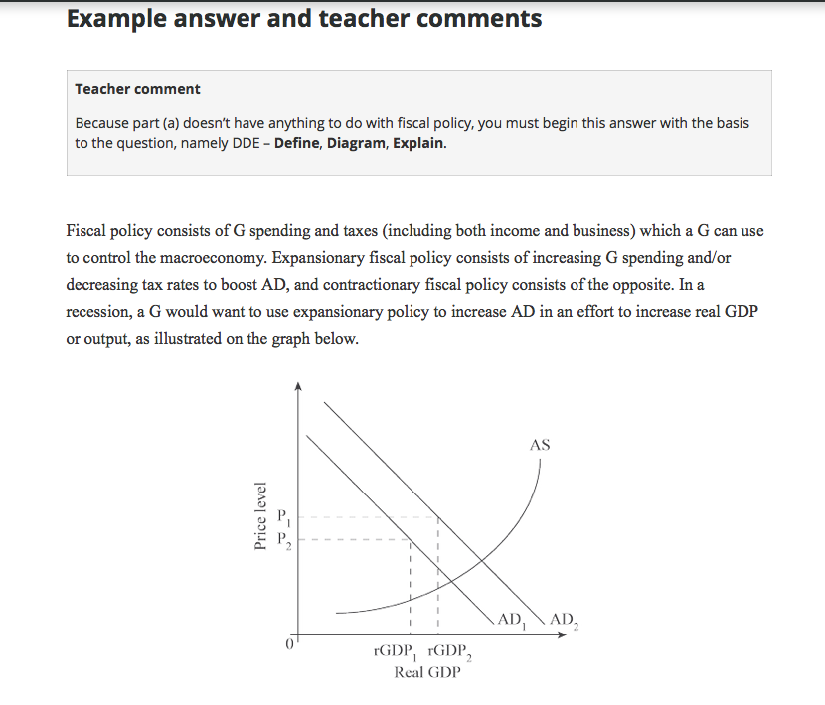

Slide 5
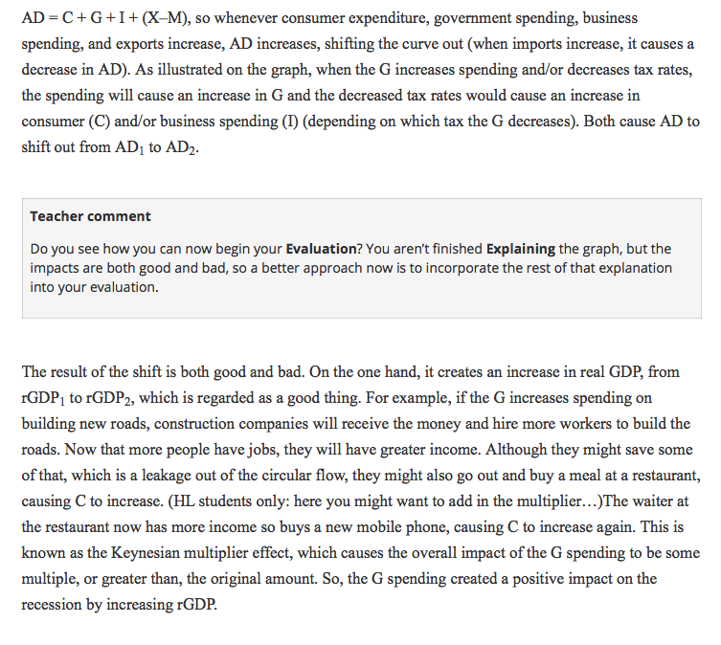

Slide 6
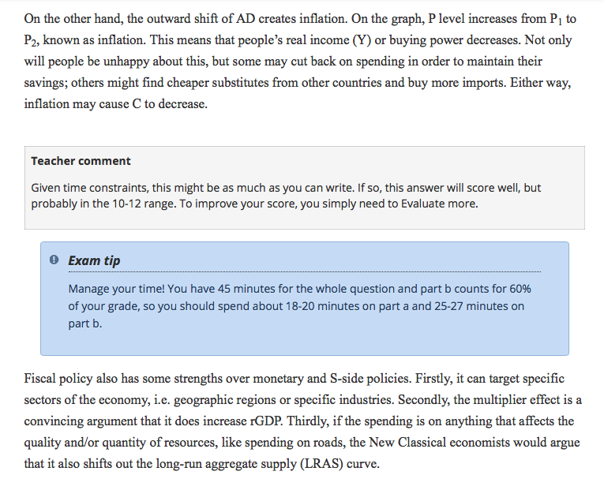

Slide 7
