Slide 1
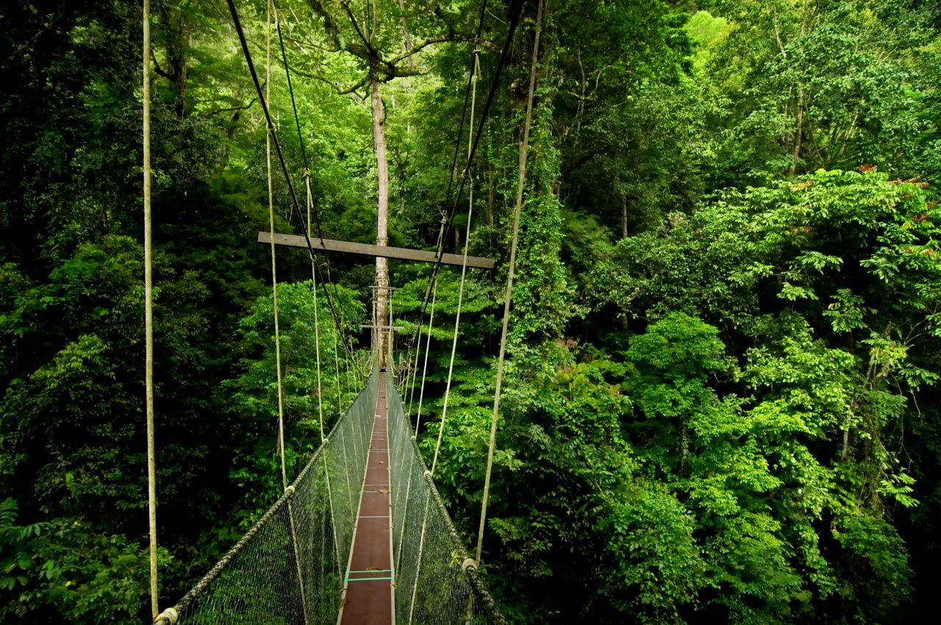
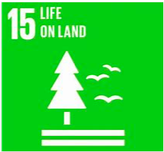
Final rainforest assessment
Can rainforests be managed more sustainably?

Slide 2
Rainforest final Assessment

Slide 3
A checklist of what you should include in your assessment:
A heading for your article, communicating what the issue is about
Outline the reasons why rainforests are so valuable (environmentally, economically and socially)- link to the characteristics of the rainforest
Outline what the rainforest is used for (including sustainable and unsustainable activities)
Explain what the consequences of deforestation are. Try to categorise the different types of consequences e.g. at the local, national and international level. You could also consider social, economic and environmental consequences.
What are the different viewpoints about the issue e.g. tribal groups, conservation groups (e.g. Greenpeace), global governments, TNCs (transnational companies)?
What are the ways in which rainforests could be managed more sustainably for the future?
Conclude by summarising your estimations for the future of the world’s rainforests
Link to the sustainable development goals

Slide 4
Assessment resources
Watch the video titled “Exploiting the Forest” from the Amazonia Documentary Series:
https://www.youtube.com/watch?v=RawJ875KCco (starts after 19 mins)
Some other useful sites for information concerning the consequences of deforestation:
http://rainforests.mongabay.com/amazon/amazon_destruction.html
https://www.nationalgeographic.com/environment/global-warming/deforestation/
http://www.theworldcounts.com/stories/Deforestation-Facts-for-Kids
http://www.activewild.com/what-is-deforestation-for-kids-information-and-facts/
https://www.nationalgeographic.org/education/amazon/

Slide 5
Level descriptors
Level 3 | You write clear accurate sentences about causes and impacts of deforestation. You use some skills and some appropriate key words
Level 4 | You describe the causes of deforestation and the impacts of each of these causes. You use a range of appropriate vocabulary. You start to explain your own views and those of other groups (e.g. tribal groups) on deforestation.
Level 5 | You describe and explain how different people’s activities in the rainforest causes deforestation and the impacts of this. You use a wide range of appropriate vocabulary and skills. You start to recognise the links between deforestation and the rest of the world.
Level 6 | You recognise how conflicting demands on the rainforest may arise. You recognise the impacts of deforestation at a variety of scales (local, national, international). You make a clear presentation of the problem showing different points of view (e.g., development vs. conservation). You decide which impacts are most serious.
Level 7 | You can show how deforestation is affected by other people’s actions and decisions. You show how changes can lead to conflict between different groups. You use a wide range of geographical language and present a well-argued point of view. You appreciate that the environment is a place and lives of the people who live there are affected by actions and events in other places. You recognise that human actions, including your own, may have unintended environmental consequences.

