Slide 1
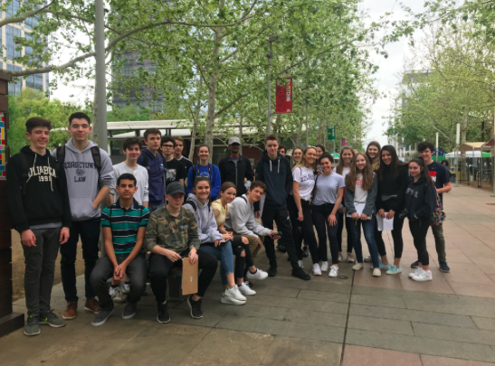
Field trip follow-up

Slide 2
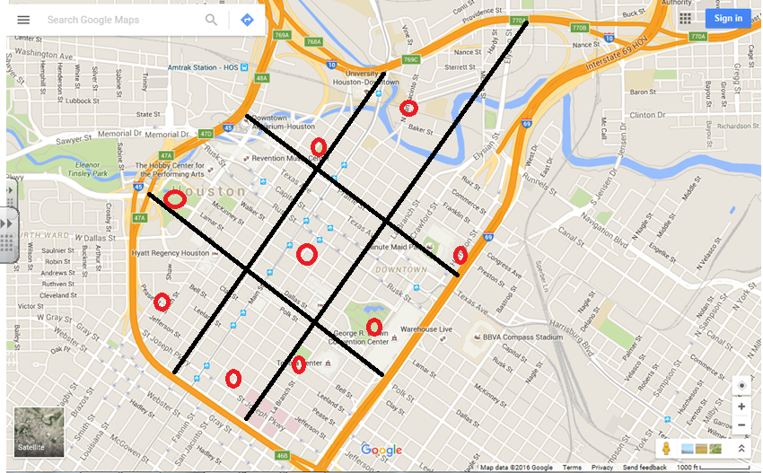
sites

Slide 3
Back ground theory

Slide 4
Suggestion- annotate core/ frame model related to Houston

Slide 5
Objectives:
1. To delimit the City Core / CBD of Houston
2. To distinguish the core, the frame, zone of assimilation and zone of discard by using a set of parameters e.g land use, building height etc.
3. To test the hypothesis formulated..
4. To explain any anomalies and uniqueness of the Houston city centre

Slide 6
Below are examples of hypothesis that you may choose:
The building height will decline as you move away from the core/ PVLI
The quality of the environment will worsen as you move away from the Core/ PVLI
The number of pedestrians will decrease as you move away from the core / PVLI
The quality of shops will decline as you move away from the core / PVLI
There will be more high order services in the core than the frame
2. The oil institutions tend to cluster near the core / PVLI

Slide 7
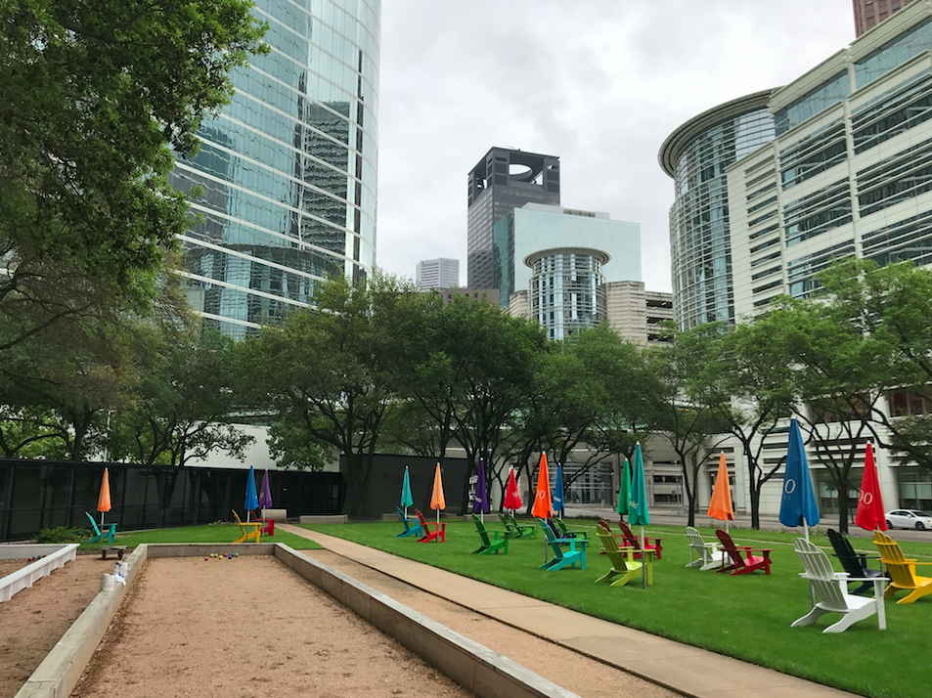
Site 1: Chevron buildings
Edge of CBD but does show some characteristics of the core (i.e. TNCs, tall buildings) but also car parks

Slide 8
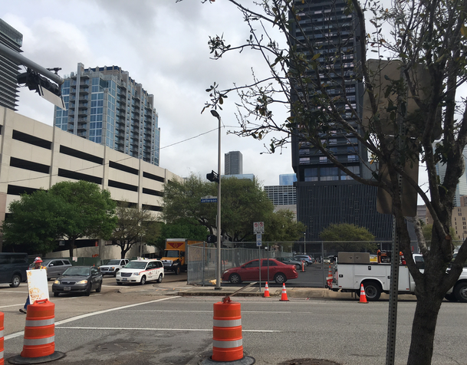
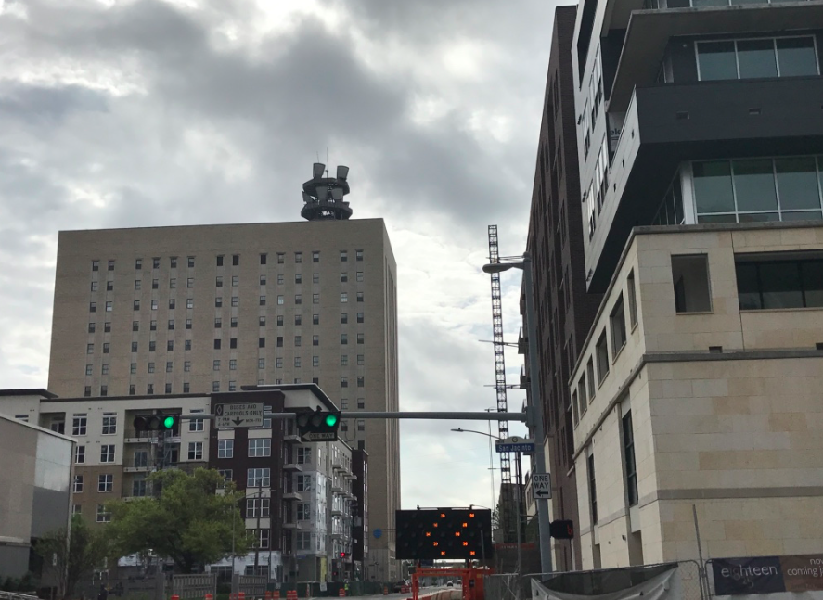
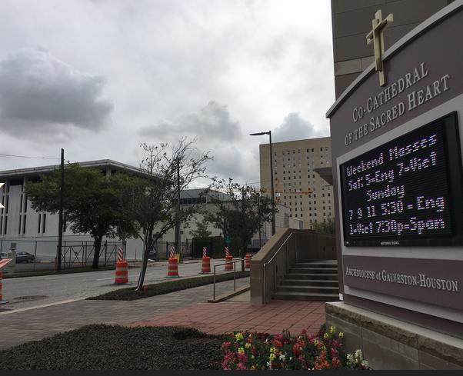
Site 2: Cathedral
Redevelopment- new apartments
Cathedral (modern) so on the edge.
Evidence of regeneration of brownfield sites around area- new hotels e.g. Holiday Inn and new apartments
St. Josepsh’s hospital nearby

Slide 9
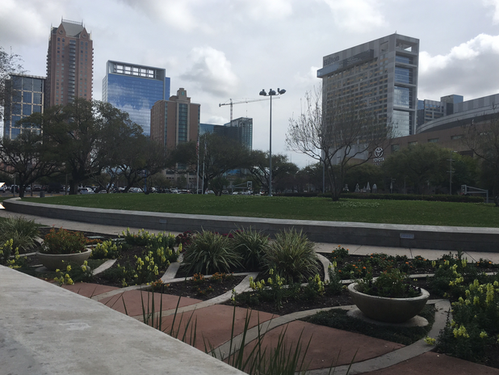
Site 3: Toyota Centre
Many car parks etc. to support major sports and concert venue
Landscaping/ park to make area attractive for visitors

Slide 10
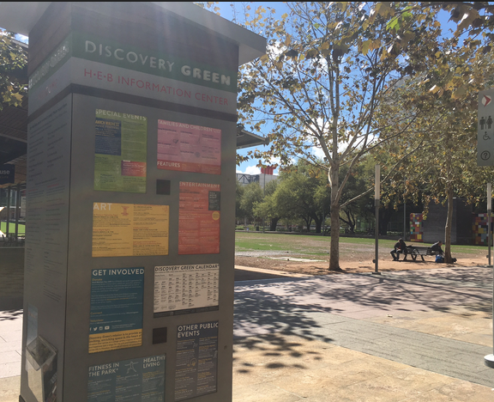
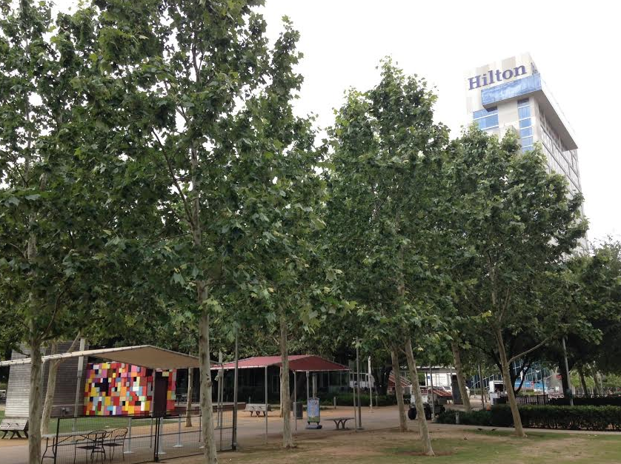
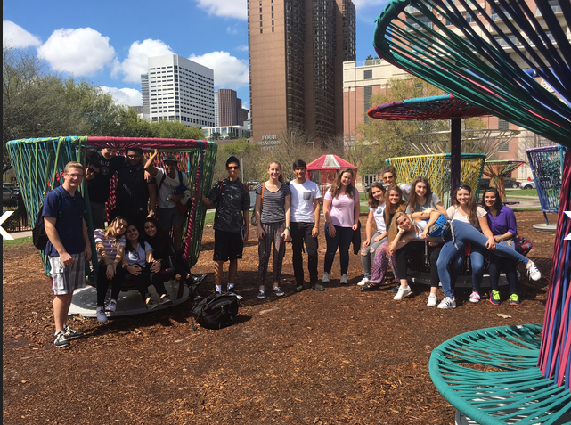
Site 4: Discovery Green (zone of assimilation?)
Green space- playgrounds/ lakes etc
New hotels
restaurants
Convention centre
New development - hotel
Centre for events in Houston i.e. Superbowl celebrations and marathon etc.

Slide 11
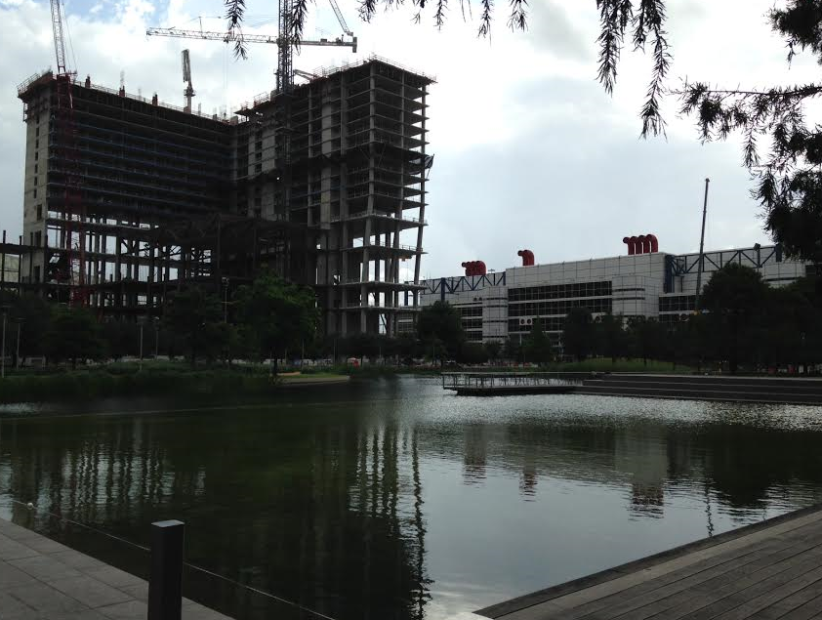
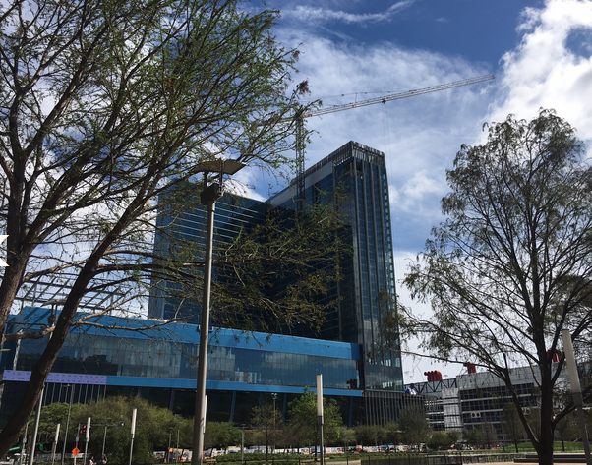
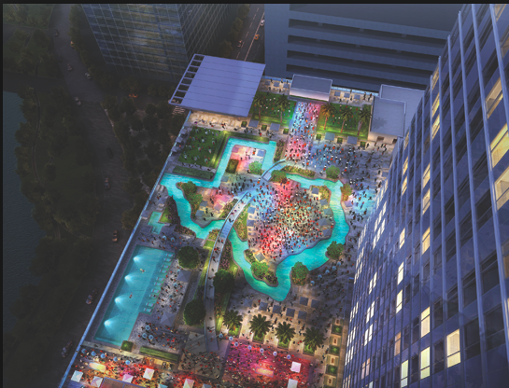
Redevelopment in area: Zone of assimilation
2017
2016
2015
http://www.cnn.com/2017/01/23/travel/marriott-marquis-houston-texas-shaped-lazy-river/
The $360 million Marriott Marquis, which opened in December, has 29 floors, 1,000 guest rooms and 52 event rooms with more than 100,000 square feet of space, including a 39,000 square-foot ballroom.

Slide 12
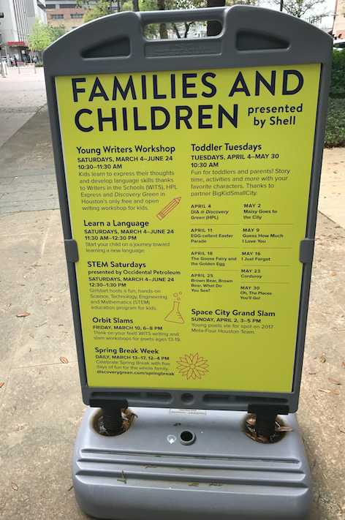
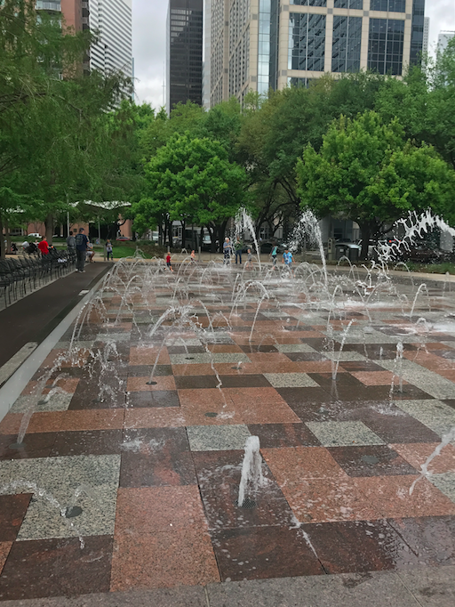
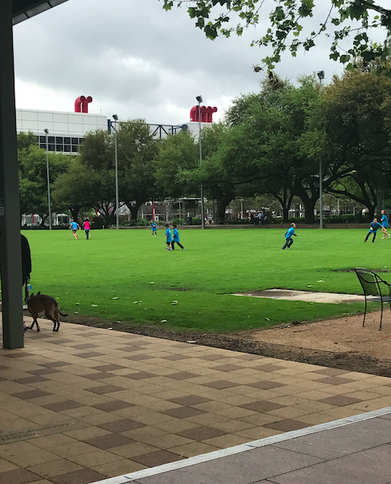
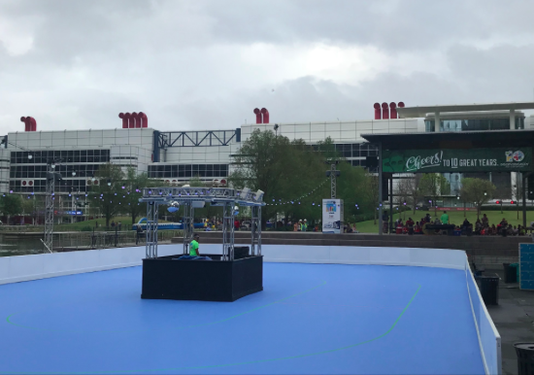
Discovery Green: Centre for activities

Slide 13
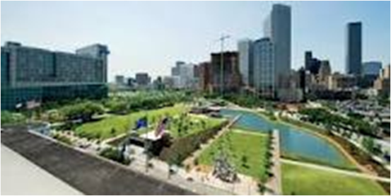
Possible theory
What is the importance of parks in urban areas?
Escape from urban stress
Moderate urban microclimates
Individual and community health benefits
Ecological understanding and sustainability
Preserve natural and cultural heritage- e.g. museums and woodlands
Prevent conflict in urban areas- skateboarders/ football/ cycling/ jogging etc…

Slide 14
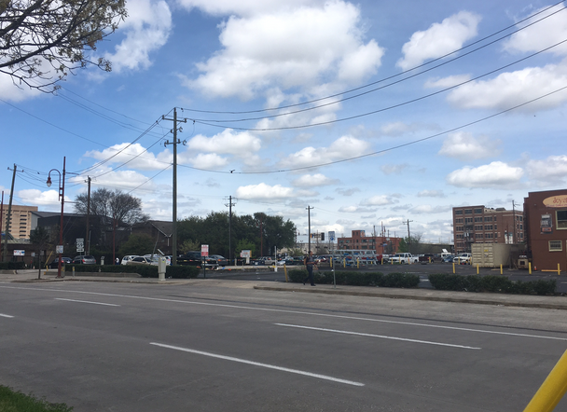
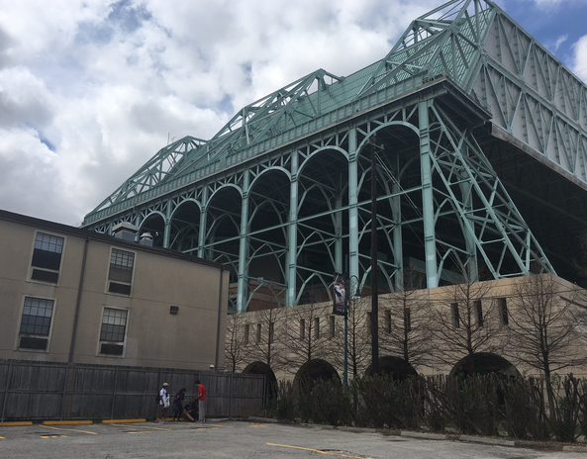
Site 5: Minute Maid Park (Crawford and Texas)
Baseball ground
Homeless shelters
Salvation army/ women's centre
Car parks
Bail bonds
Bars

Slide 15
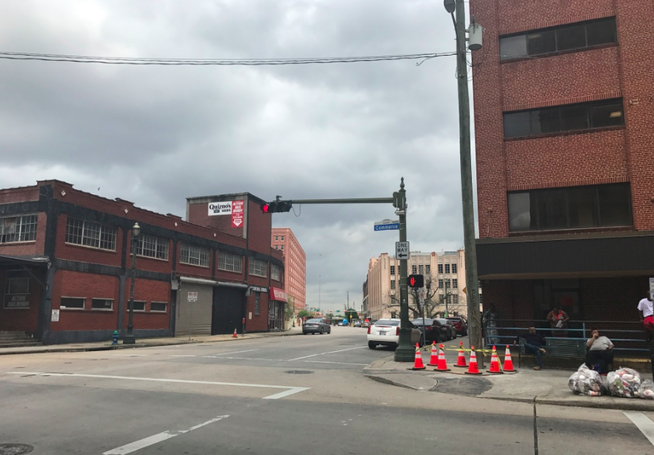
Site 6: Sheriffs office/ Jail – San Jacinto and Commerce (zone of Discard?)
Sheriffs office
Jail
Bail bonds
Residential
Near University of Houston

Slide 16
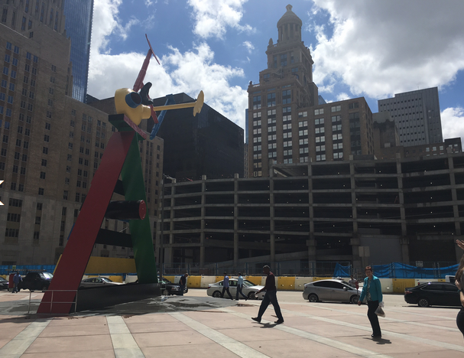
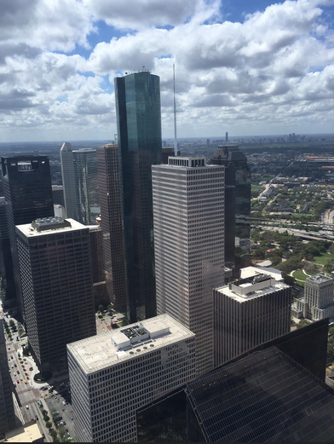
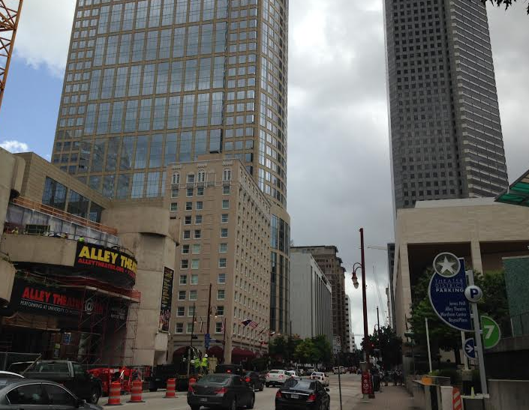
Site 7 : Theater District/ Chase Tower
Concentration of theatres- Alley/ Wortham Ballet )/ Jones Hall- symphony
Restaurants
Hotels
Concert venue
Chase- highest building- PVLI
Concentration of offices

Slide 17
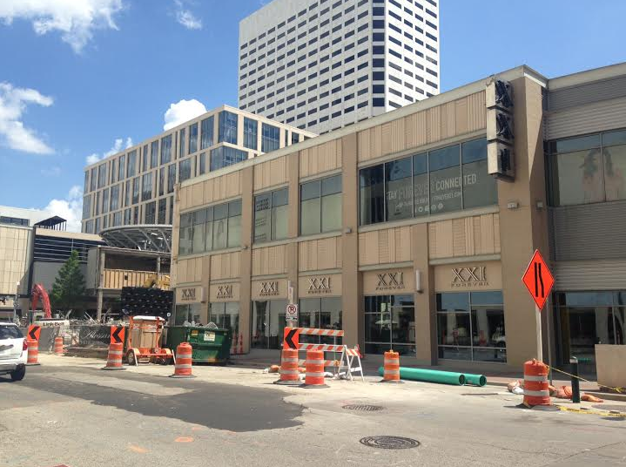
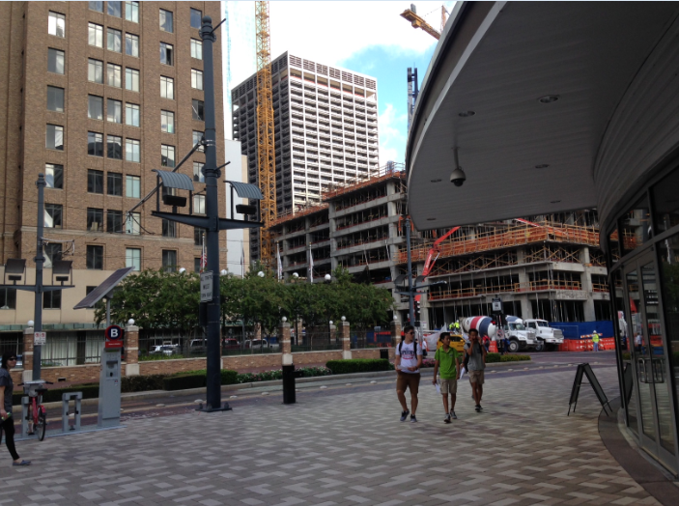
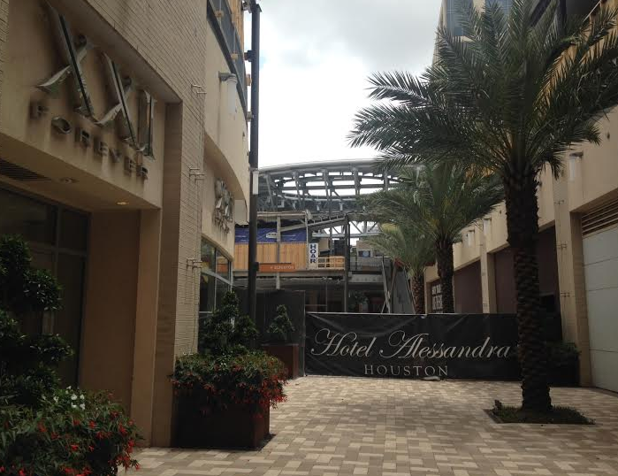
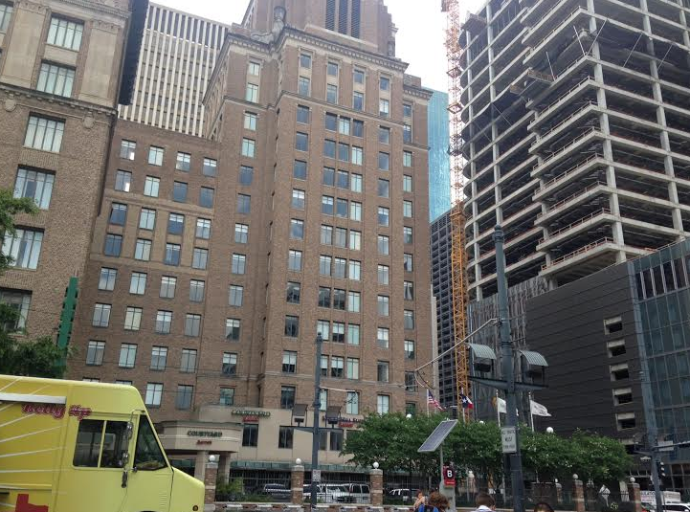
Site 8: Retail (under regeneration)- Main and Dallas
Shopping (but many abandoned- i.e. Macy’s)
Hotel
Cafes/ restaurants
Good access to sustainable transport

Slide 18
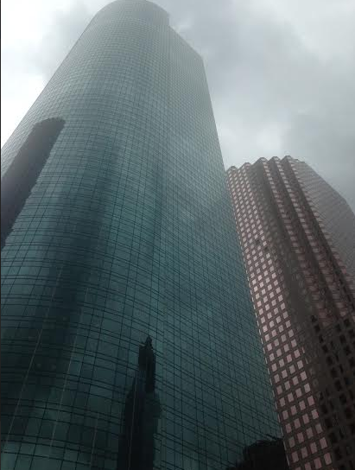
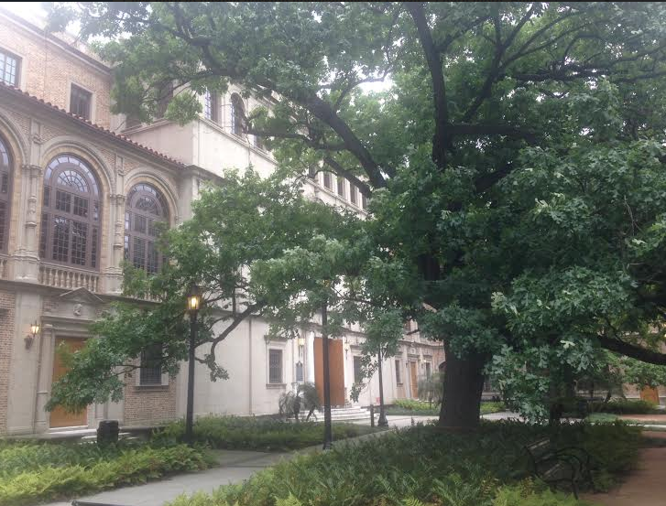
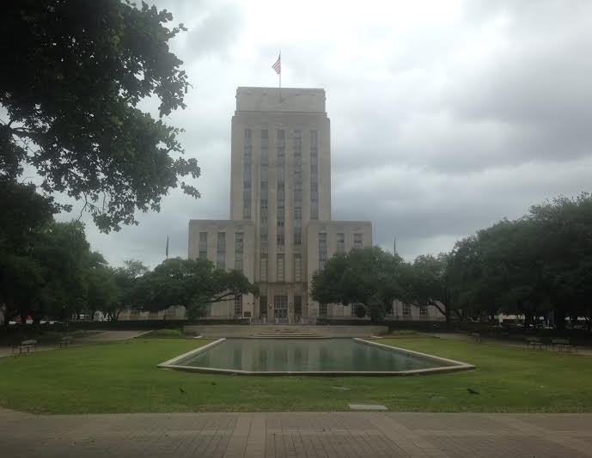
Site 9: Library/ Town Hall (core)
City hall- low density- parkland
Central Library
High rise office blocks

