Slide 1
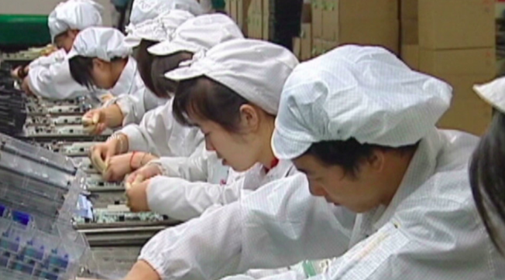
FDI & outsourcing by transnational corporations (TNCs)

Slide 2
What: Foreign Direct Investment (FDI) and outsourcing by transnational corporations (TNCs), and ways in which this networks places and markets
Why: To understand how different places become interconnected by global interactions

Slide 4
​What is 'Foreign Direct Investment - FDI'?
Foreign direct investment (FDI) is an investment made by a firm or individual in one country into business interests located in another country. Generally, FDI takes place when an investor establishes foreign business operations or acquires foreign business assets, including establishing ownership or controlling interest in a foreign company.

Slide 5
What is 'Outsourcing'?
Outsourcing is the business practice of hiring a party outside a company to perform services and create goods that traditionally were performed in-house by the company's own employees and staff. Usually done as a cost-cutting measure, it can affect jobs ranging from customer support to manufacturing to the back office.

Slide 7
Donald Trump’s view

Slide 8
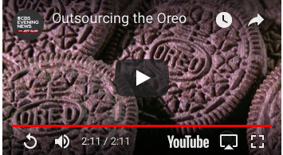
Examples of the range of products that can be outsourced

Slide 9
Global Services Location Index™ (GSLI)
"A.T. Kearney's Global Services Location Index™ (GSLI) offers a snapshot for both business leaders who must choose among a growing number of offshore locations, and the policy makers who seek to influence their decisions.
Established in 2004, the GSLI analyzes and ranks the top 50 countries worldwide as the best destinations for providing outsourcing activities, including IT services and support, contact centers and back-office support. Each country’s score is composed of a weighted combination of relative scores on 43 measurements, which are grouped into three categories: financial attractiveness, people skills and availability, business environment."

Slide 11
Impact of improved technology
Automation threatens hundreds of thousands of low-skilled and repetitive jobs in both developed and developing economies. As
technology becomes increasingly mature and ubiquitous, jobs in the business process outsourcing arena will be particularly at risk. Today, automation, still in its infancy, complements and augments existing human skills in these
industries, allowing workers to become more productive and efficient and
fewer in number while accomplishing the same amount of work. As technology
continues to improve and its implementation expands, our research finds that
more than 1 million jobs are at risk in the next five years in four countries alone: the United States, Poland, India, and the Philippines.
https://www.atkearney.com/digital-transformation/gsli

Slide 12
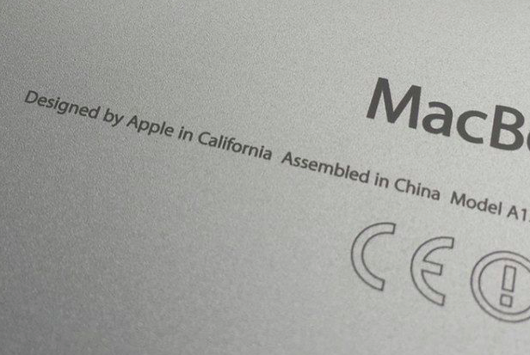
Case Study - Apple - "Designed by Apple in California, Assembled in China"
Primary Resource - From Mac World 17 Feb 2017 Starter - Watch the 'Made in the World' YouTube video beneath and pay extra attention to the mobile phone section. Then watch the Economist video too. Task 1. Outline the main features of an iPhone or iPad. What makes them so different to the competition (Android, HTC etc)? You might want to watch some of the Apple promo video here Task 2. Outline the reasons for iPad and iPhone production in China. Why has Apple manufacturing been internationally outsourced from the USA? Use this resource to help you. Task 3. What are the social and economic issues (positive and negative) associated with the global Apple production process? Watch this CNN news report Task 4 - Responses to outsourcing by Donald Trump. Click on this Sep 2018 Vox article to read about the issues caused by USA's trade war on Apple. Make notes on the content and what Trump is hoping Apple will eventually do. ​

Slide 13
Exam question example- May 2011:
Exam question example- Nov 2011:
Exam question example- new course:
Using examples, explain how FDI and outsourcing networks places. [12]

