Slide 1
Items of clothing are be labeled fall’s hottest back-to-school item, selling to teens for $14.99 each at malls across the United States.
This is what is known as fast fashion: trendy clothes designed, created, and sold to consumers as quickly as possible at extremely low prices. New looks arrive in stores weekly or even daily, and they cost so little that many people can afford to fill their closets with new outfits multiple times each year—then toss them the minute they go out of style.

Slide 2
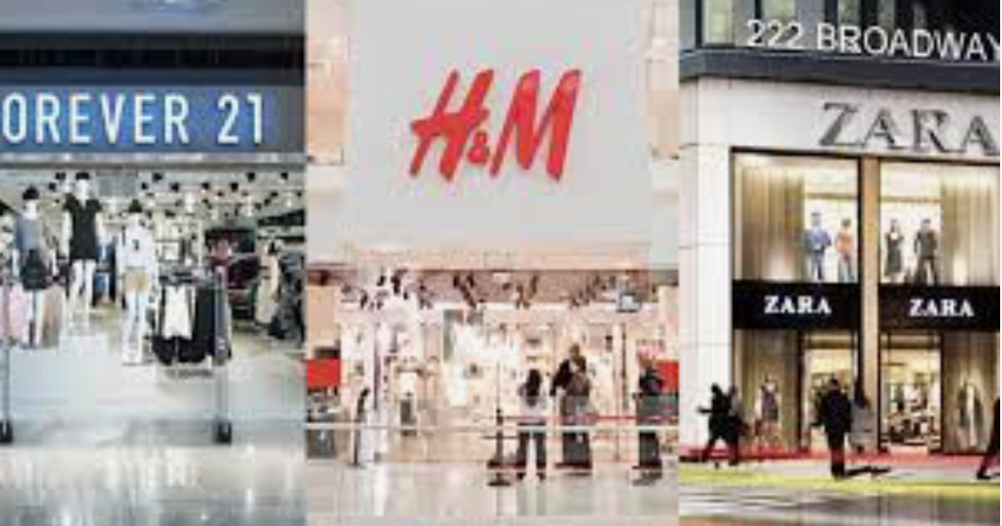
Chains such as H&M and Zara first popularized fast fashion in the early 2000s. It has since spread throughout the entire clothing industry. As a result, global clothing production has more than tripled since 2000. The industry now churns out more than 150 billion garments annually.

Slide 3
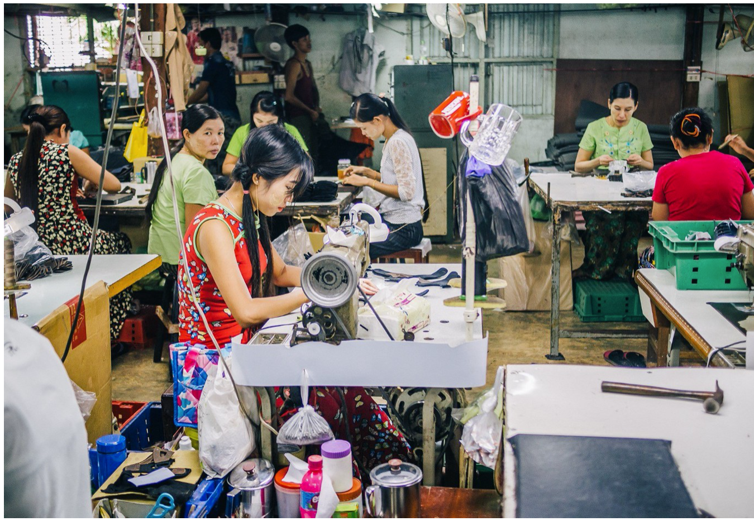
Young women hunch over sewing machines in a windowless workroom in Bangladesh. Elbow to elbow in the stifling heat, they assemble jackets. Together, the women must sew hundreds of jackets an hour, more than 1,000 a day. Their daily wage is less than $3.

Slide 4
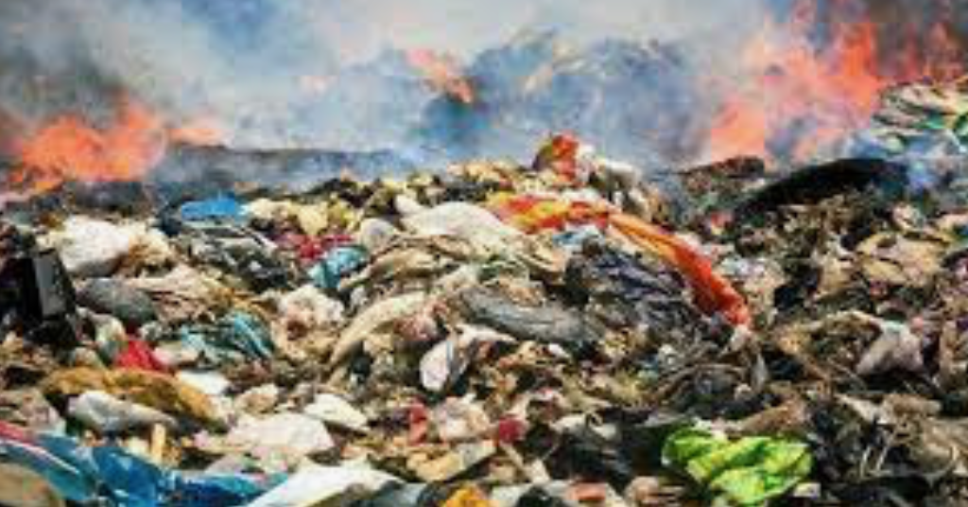
Fast fashion also hurts the environment. Garments are manufactured using toxic chemicals and then transported around the globe, making the fashion industry the world’s second-largest polluter, after the oil industry. And millions of tons of discarded clothing piles up in landfills each year.

Slide 5
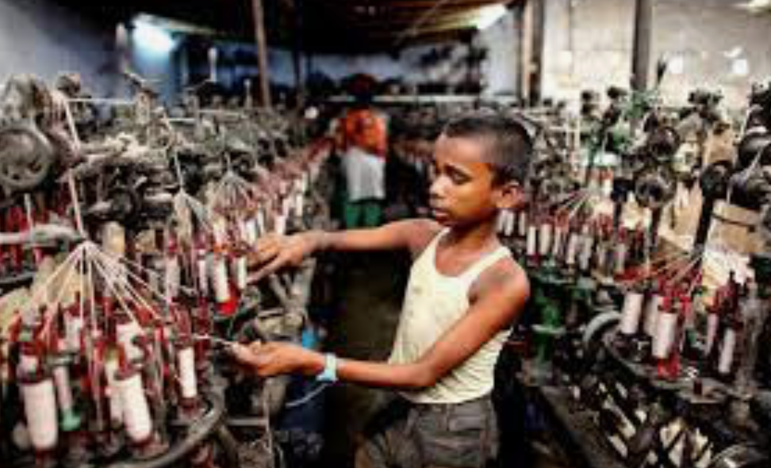
Fast fashion items may not cost you much at the cash register, but they come with a serious price: Tens of millions of people in developing countries, some just children, work long hours in dangerous conditions to make them, in the kinds of factories often labeled sweatshops. Most garment workers are paid barely enough to survive.

Slide 6
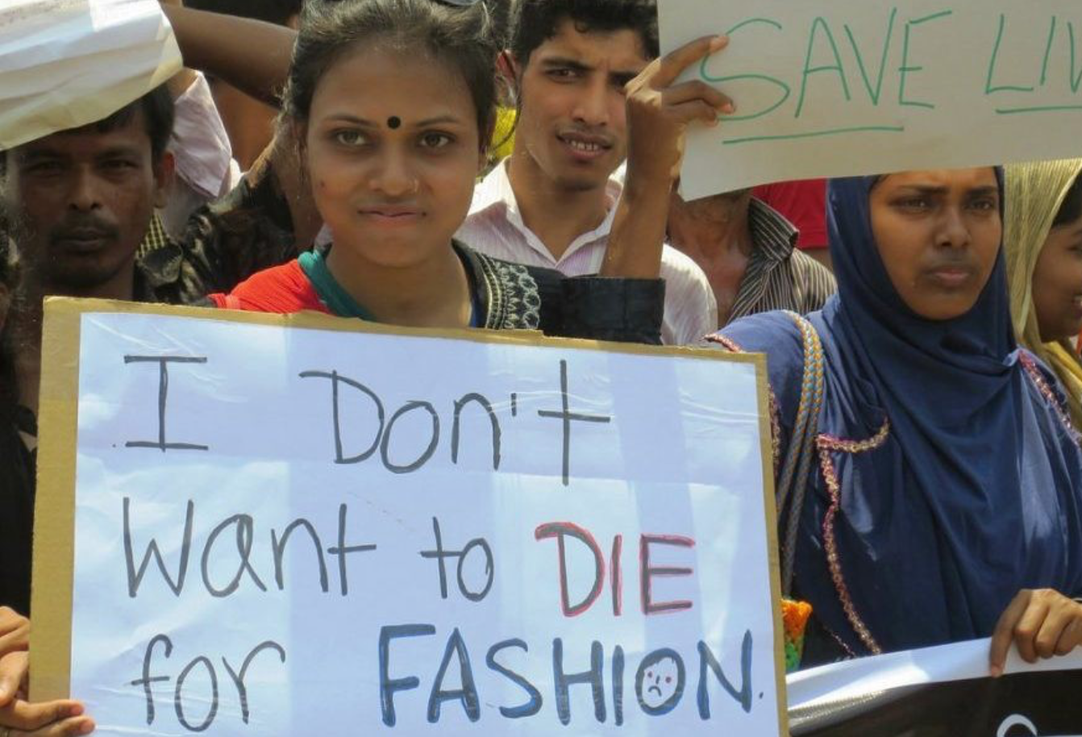
Today, many of the world’s 75 million garment workers live in China and Bangladesh, the top-two clothing producers. Workers often earn just a few dollars a day. Many are women in their teens.

Slide 7
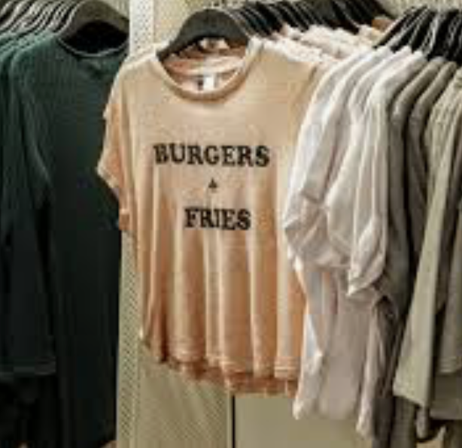
Most American clothing companies now manufacture their merchandise in developing countries in Asia. Workers there earn a fraction of what U.S. workers make—and have fewer protections. The lower labor costs translate to lower prices for shoppers (who then buy more clothing) and higher profits for retailers. That’s helped make fashion a $3 trillion global industry.

Slide 8
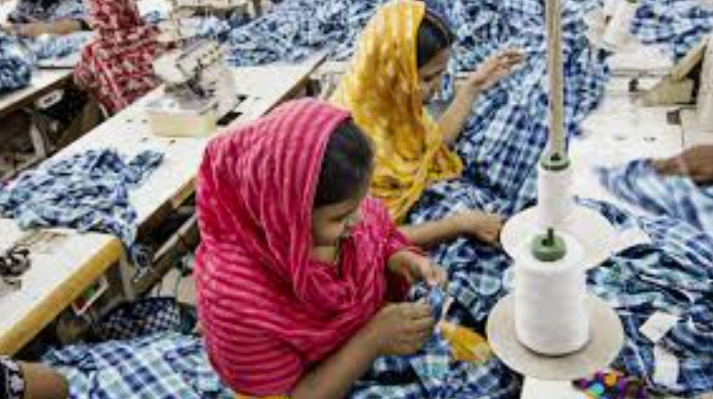
Garment workers often toil in windowless rooms thick with fumes from the chemicals used to manufacture and dye clothes. If they dare miss a day because they’re sick, they risk being fired.

Slide 9
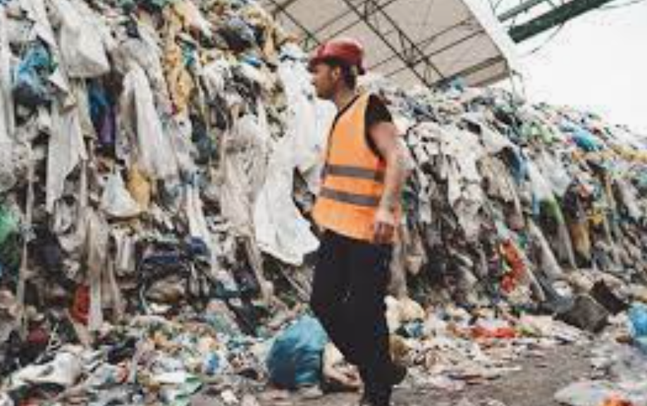
Americans on average trash more than 70 pounds of clothes and shoes a year. Most are burned or piled in landfills, where synthetic fibers can take hundreds of years to break down.

Slide 10
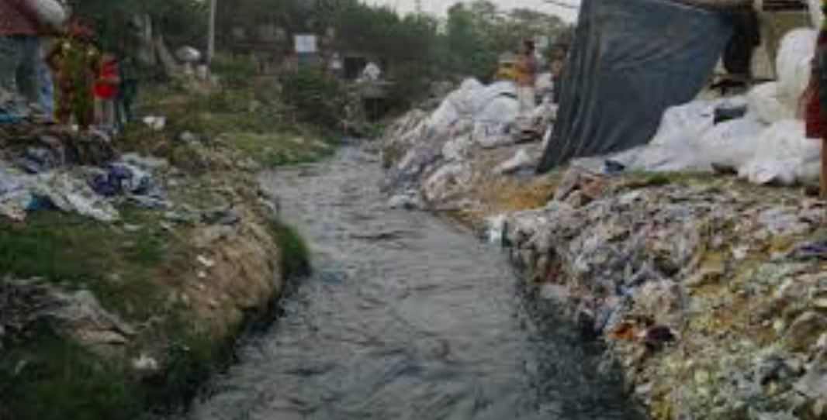
Fast fashion also takes a heavy toll on the environment. The industry consumes enormous amounts of water and other natural resources. Producing enough cotton for one pair of jeans takes about 1,800 gallons of water—the equivalent of about 105 showers

Slide 11
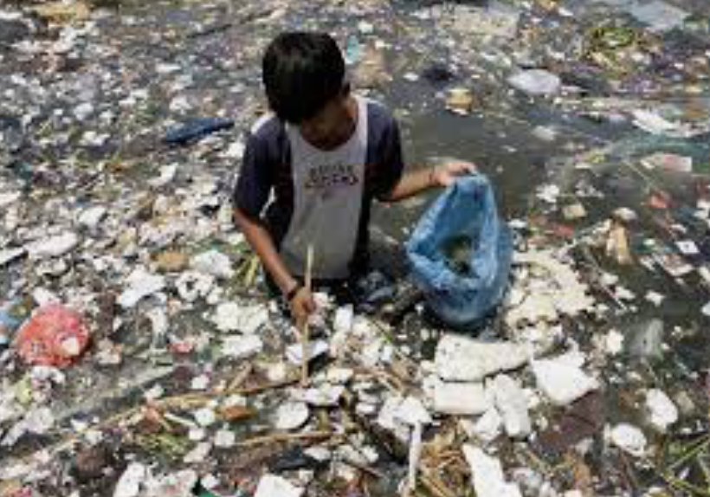
Manufacturing polyester, which is made from petroleum, releases dangerous gases into the air. And farming cotton accounts for a quarter of all pesticides used in the United States. (The U.S. sends about 70 percent of the cotton it grows overseas, where it’s turned into clothing.) Some of those pesticides can cause asthma and other health problems, and the chemicals pollute fresh water.

Slide 12
As more people have become aware of the ugly side of fast fashion, the push for ethically made clothing has grown. In the U.S., hundreds of start-ups are creating clothes out of recycled or organic fabrics. These companies use materials from U.S. factories, where they can better monitor working conditions. Big brands are trying to be more eco-conscious, as well. H&M, for example, offers customers store credit to recycle clothes at its retail locations.

Slide 13
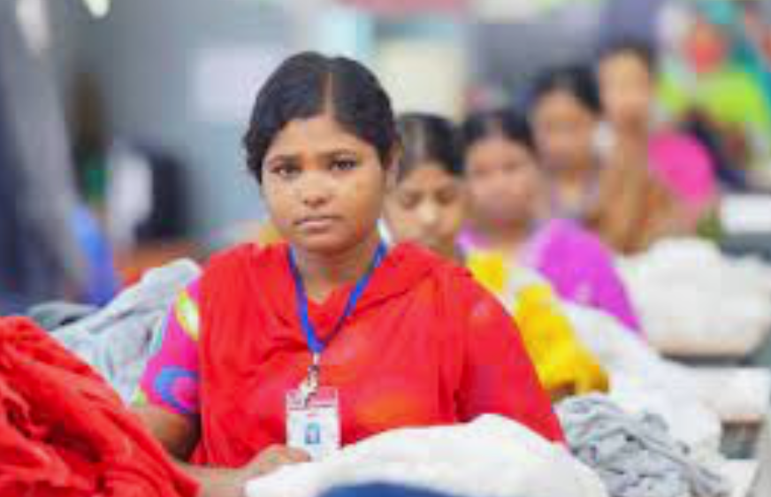
Until the 1970s, most apparel worn by Americans was made in the United States. Then clothing production, like a lot of manufacturing, began moving overseas, where labor costs were lower. As recently as 1990, half the clothes sold in the U.S. were made in the U.S. Today, it’s just 2 percent.

Slide 14
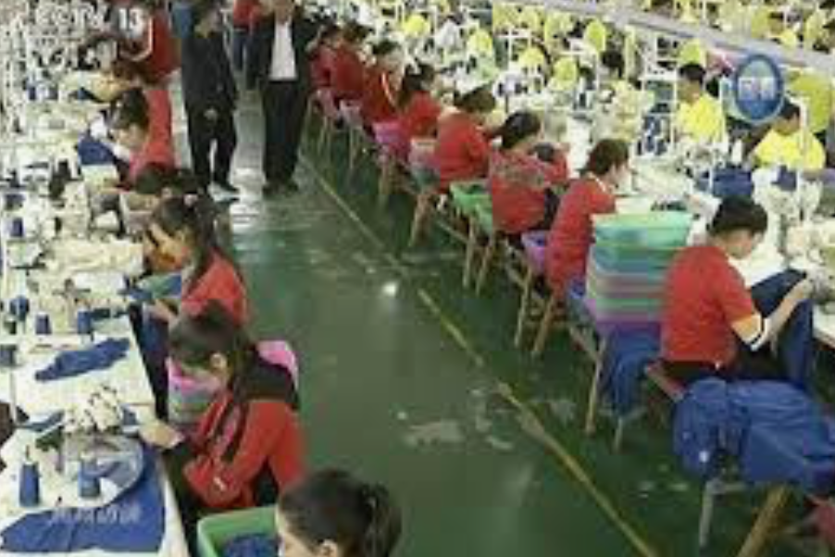
In southern China, many factories now offer safer conditions and better wages than they did a decade ago. In some areas, the minimum wage for garment workers reached $312 a month last year—42 percent more than the previous year.

Slide 15
Some factories can’t afford to make the major structural upgrades that are needed for them to be safe. (Of the 2,000 Bangladeshi factories that have been inspected so far, only 79 had passed final inspection as of March 2017.)

Slide 16
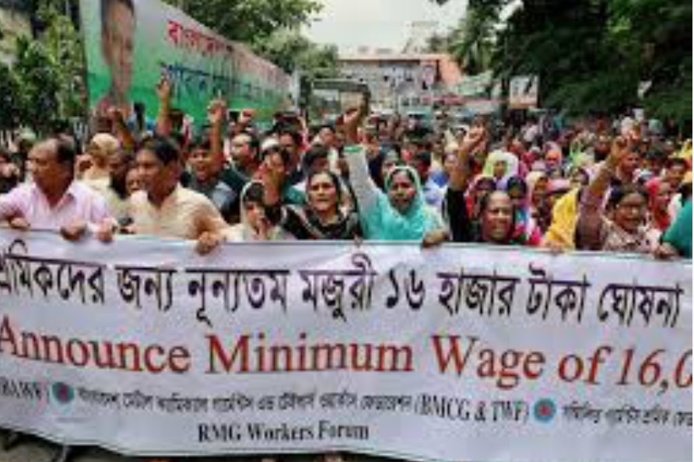
Better working conditions and wages come at a price, however. Some factories in Bangladesh have had to reduce their production capacity to afford higher employee pay and building repairs. That means the factories are less able to fill massive orders from big brands. As a result, big clothing companies may eventually shift their business to even poorer countries with fewer regulations, experts say.

Slide 17
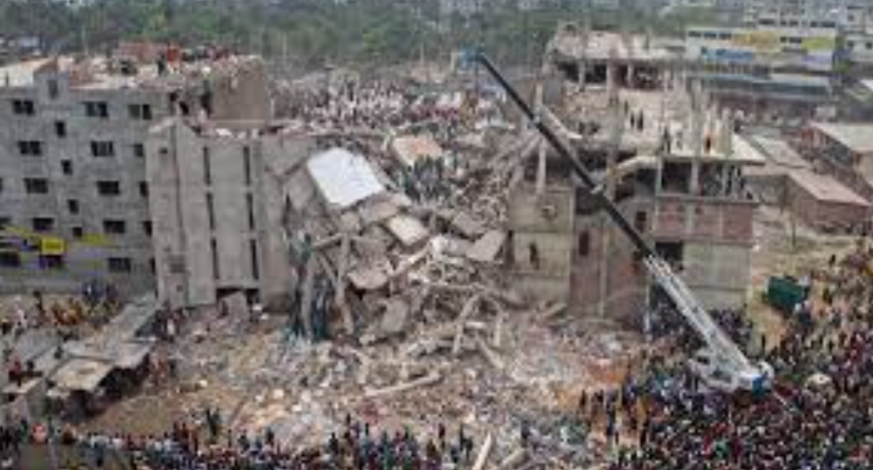
Many people didn’t give much thought to how their clothing was made until April 24, 2013, when the Rana Plaza factory building in Bangladesh collapsed. The deadliest accident in the history of the garment industry, it killed more than 1,100 workers and injured 2,500 others. The factory, overloaded with too many floors, workers, and equipment, had been making clothing for global brands such as Benetton, Joe Fresh, and Mango.
After the accident, many big brands pledged to improve garment factory conditions. About 200 major clothing companies partnered to create factory oversight programs in Bangladesh. In recent years, these programs have trained about 2 million workers in safety procedures. The companies have also hired independent engineers to inspect their factories.

