Slide 1
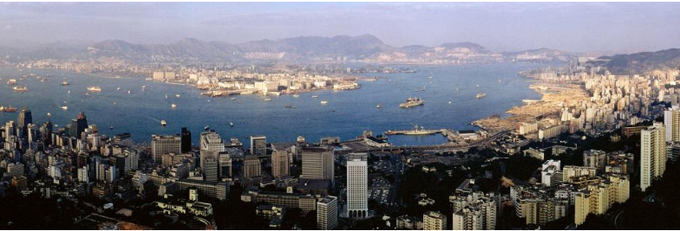
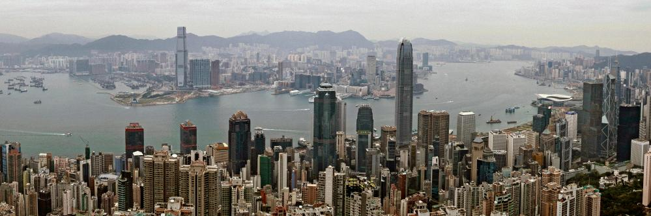
What do these two photographs show?
How do they link to what you’ve learnt about so far?
Extra challenge – Where is this?!
Notes:
Get students to discuss ideas related to last lesson – Urbanisation, Factors causing it. – Other slides show the same process of urbanisation
Pictures – Hong Kong.

Slide 2

Lesson title:
Factors affecting the rate of Urbanisation
Define key terms- Natural increase and Rural/Urban migration
Describe the patterns of urbanisation across the world.
Explain how Natural increase and Migration affect rates of urbanisation.

Slide 3
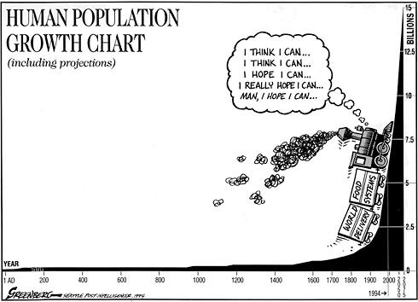
What message is being shown in this graph?
https://www.youtube.com/watch?v=VcSX4ytEfcE

Slide 4
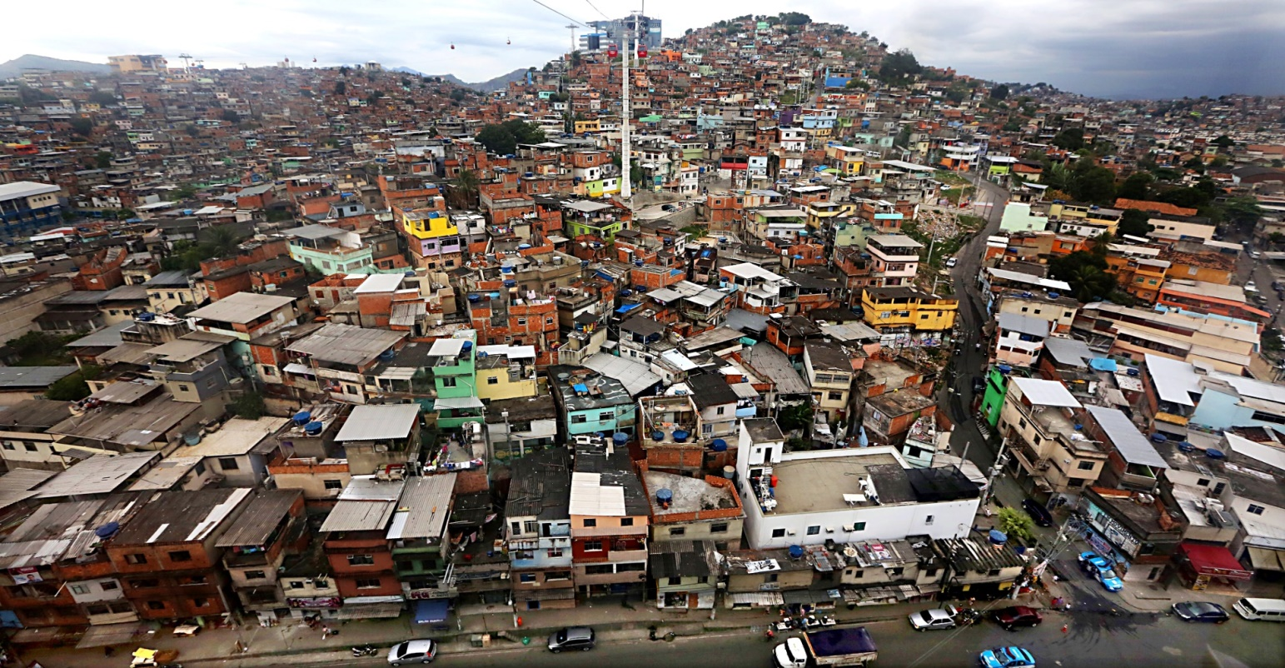
But what is urbanisation?
‘A process where an increasing proportion of the population lives in towns and cities resulting in their growth.’

Slide 5
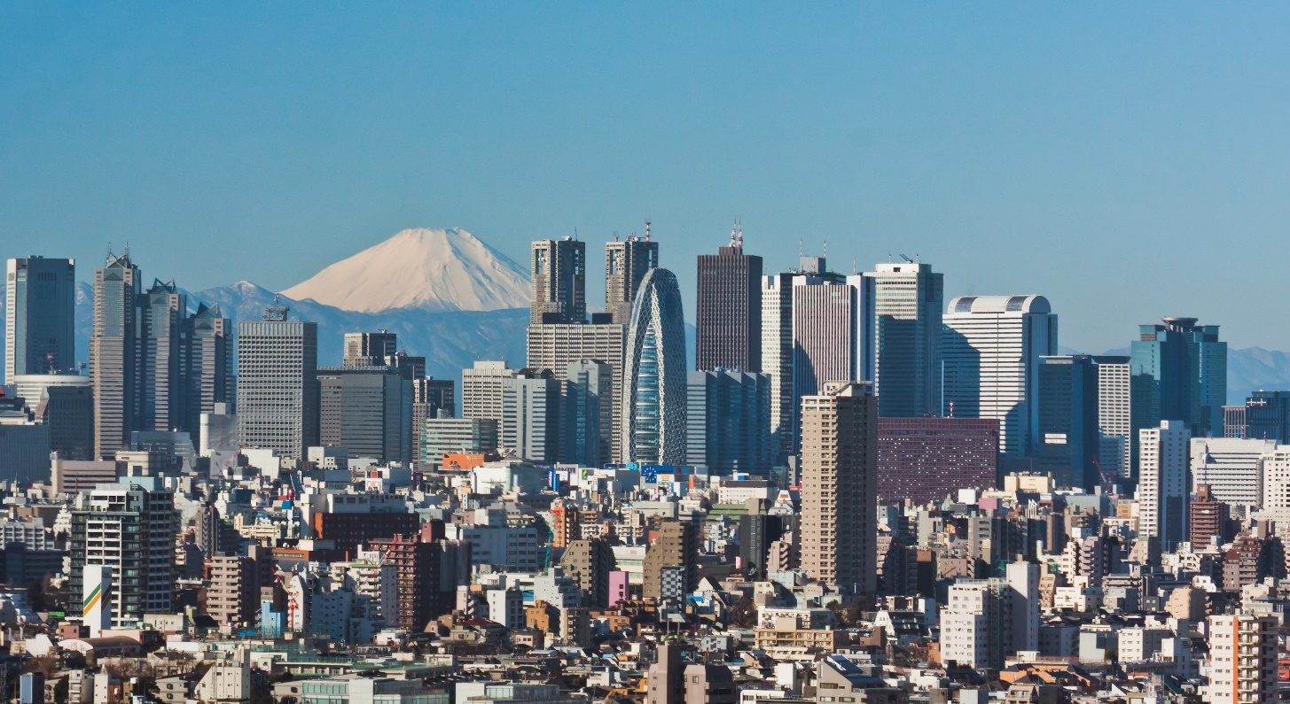
Quiz question – What percentage of people in the World today live in cities?
Discuss with your partner and then write your answer as a percentage and be ready to hold up your paper
The urban population in 2020 accounted for 56.2% of the total global population, up from 34% in 1960, and continues to grow.

Slide 6
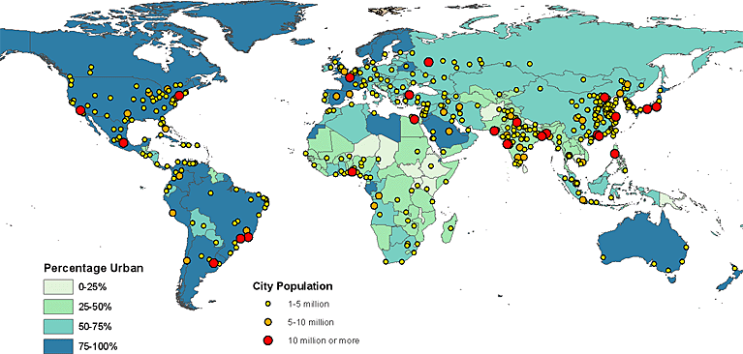
Describing the pattern
NORTH AMERICA
EUROPE
UK
ASIA
AFRICA
SOUTH AMERICA
AUSTRALASIA
Use the map above to describe the following:
Which areas have a high % of people in Urban areas?
Which areas have a low % ?
Is there any link between the % urban and the size of the cities?

Slide 7
Describing the pattern
NORTH AMERICA
EUROPE
UK
ASIA
AFRICA
SOUTH AMERICA
AUSTRALASIA
Use the map above to describe the following:
Which areas have a high % of people in Urban areas?
Which areas have a low % ?
Is there any link between the % urban and the size of the cities?

Slide 8
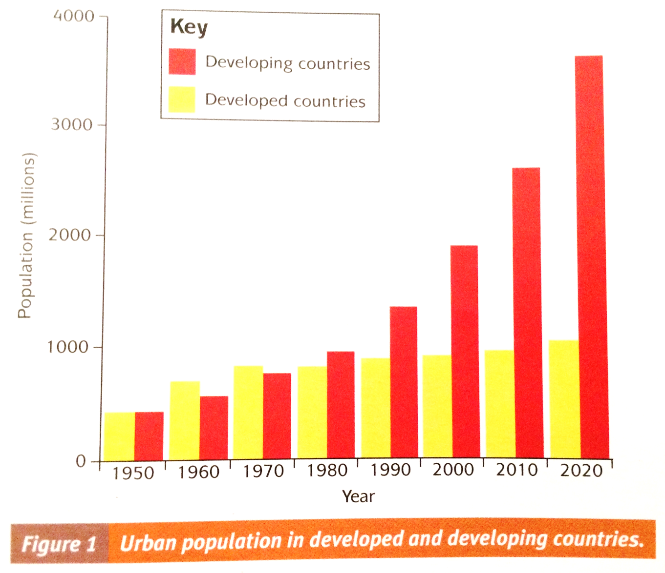
Question practice
Question - Using the graph on the right describe what has happened to the urban population over time (4 marks).
5 minutes

Slide 9

Peer assessment – graph description
Swap your answer with your partner
Generally, from 1950 – 2020 urban population rises in both developing and developed countries. However, this rise is much more rapid in developing countries than developed countries.
Specifically in 1950 urban population in developing and developed countries is about 450 million however by 2020 urban population in developing countries is 3700 million while in developed countries it is only 1000 million.
An exception to the general pattern would be in 1960 and 1970 where urban population in developed countries is actually higher than it is in developed countries. Specifically in 1960 population in developed countries is about 750million while in developing countries it is only about 550 million.
Use this answer as a guide to marking your partners answer.
Remember that to reach 3 or 4 marks you must be specific and use data from the graph.
When you are finished please write below what they have done well and what they could have done to improve their answer

Slide 10
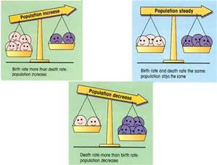

But what affects the rate of Urbanisation?
1. Natural Increase
2. Rural to Urban Migration

Slide 11

What is Natural increase?
Births lower than deaths =
Natural Decrease
Births
Deaths
Births higher than deaths =
Natural Increase
Deaths
Births

Slide 12
Rural to Urban migration
Write a definition in your notes
‘The movement of people from countryside to city areas’

Slide 13
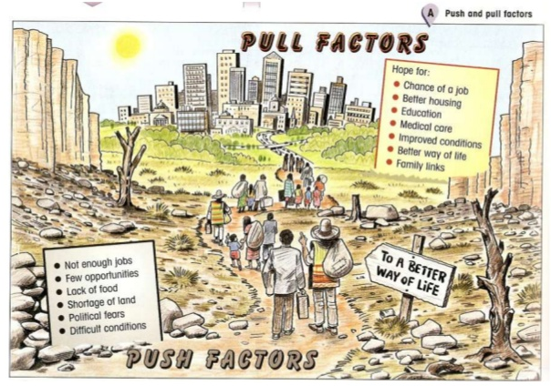
What is the difference between a push factor and a pull factor and how might that affect rates of urbanisation?

Slide 14
These are factors that literally push a person/family out of the rural countryside, and make them decide to migrate to the urban town/city.
These are factors that encourage a person/family to migrate to the urban town/city in search of a better life

Slide 15
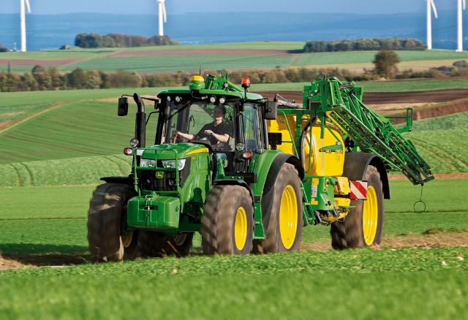
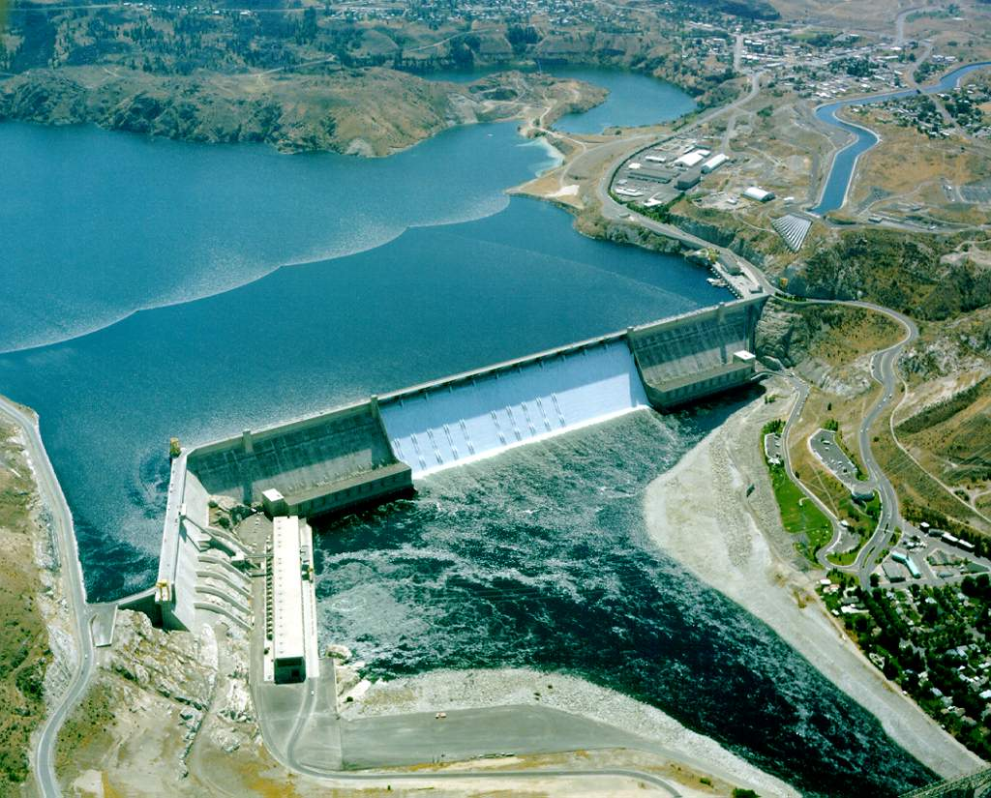
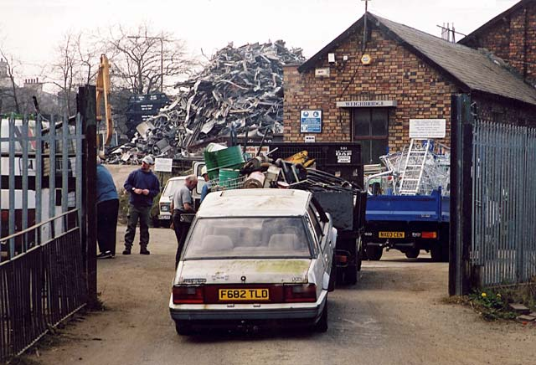

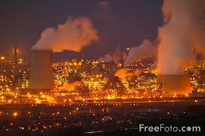
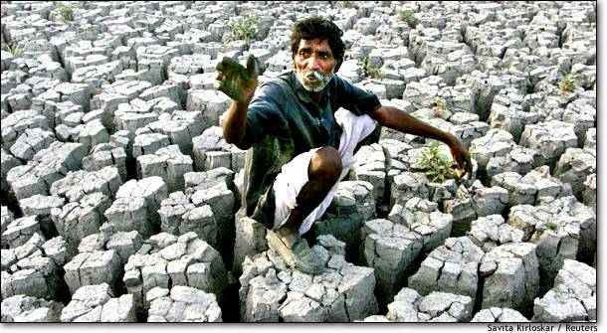
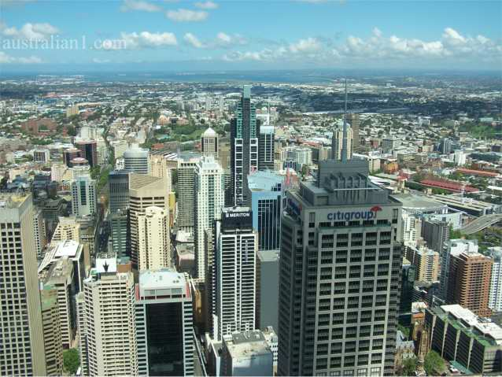
Use the list and colour code them as push or pull factors.
Push or pull?

Slide 16
Land scarce | Political and/or religious persecution | Civil War | Flooding
Lower risk from natural hazards | Higher employment | Over population | Better services
More wealth | Hope for a new life | Lack of services | High crime
Poverty | Lack of safety | Political stability | Drought
More fertile land | Good climate | Crop failure | Safer, less crime
Promise of freedom (religious and political) | “Streets paved with gold” | Mechanisation of farming

Slide 17
Land scarce | Political and/or religious persecution | Civil War | Flooding
Lower risk from natural hazards | Higher employment | Over population | Better services
More wealth | Hope for a new life | Lack of services | High crime
Poverty | Lack of safety | Political stability | Drought
More fertile land | Good climate | Crop failure | Safer, less crime
Promise of freedom (religious and political) | “Streets paved with gold” | Mechanisation of farming

Slide 18
To finish… Quick Questions
What has happened to urban areas?
Which areas have the largest urban populations?
What has happened to the rate of urbanisation?
What has caused urbanisation to increase?

Slide 19
Challenge 1: Calculate the natural increase % using the formula
Challenge 1: Calculate the natural increase % using the formula
Location | Birth Rate | Death Rate | Natural Increase = BR – DR/10
 | (births/1000 population) | (deaths/1000 population)
Pakistan | 24.3 | 6.8
Russia | 12.3 | 14.1 | -
United Kingdom | 12.3 | 9.3
Mumbai (2006) | 13.6 | 6.9
London (2013) | 15.3 | 5.7
Location | Birth Rate | Death Rate | Natural Increase = BR – DR/10
 | (births/1000 population) | (deaths/1000 population)
Pakistan | 24.3 | 6.8
Russia | 12.3 | 14.1 | -
United Kingdom | 12.3 | 9.3
Mumbai (2006) | 13.6 | 6.9
London (2013) | 15.3 | 5.7
Challenge 2: Suggest reasons why the rate of natural increase varies between locations.
Challenge 2: Suggest reasons why the rate of natural increase varies between locations.

Slide 22


