Slide 1
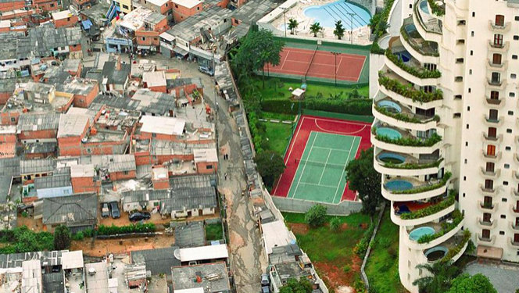
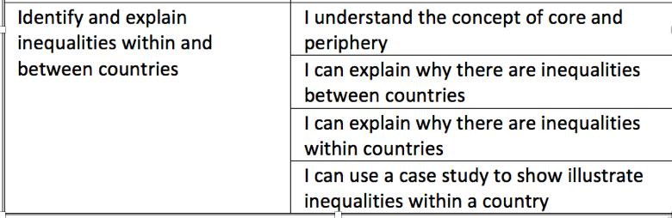
What are the causes of uneven development?
Why? So that….

Slide 2


What are the causes of uneven development?
Use the information from the card sort and the following slides to complete the table about the factors which have caused uneven development.
Cause | Description | Links to uneven development | Country example | Other information
Economic: Trade | LICs trade low value raw materials and HICs trade processed goods. The price of raw materials fluctuates and there is often a greater supply than demand for them. This causes a trade deficit for LICs and a trade surplus for HICs. | Raw materials are exported by LICs for a low profit therefore LICs are unable to strive towards development, keeping them poorer. | When the price of the coca bean plummeted during the 1990s Ghana’s development suffered greatly.
Explain one cause of global uneven development. (4 marks)
Literacy
Can you use these key terms:
Trade surplus
Trade deficit
Natural resources
Colonialism
Independence
Development gap
Poverty
Natural hazards
Development gap
Profit
Export
Import
Climate
Water shortage
One economic factor that causes uneven development is trade. LICs such as Ghana trade low value raw materials such as coca. Whereas, HICs such as America have the ability to process these raw materials and sell processed goods such as coffee. Furthermore, the price of raw materials fluctuates significantly causing the LIC great economic uncertainty. Consequently LICs end up in a trade deficit and HICs have a trade surplus. As a result the richer countries of the world get richer and the poor get poorer.
Grades C and below
You can describe the different factors which have caused and are causing uneven development across the world.
Grade B
You can give examples of countries that are poorer as a result of the cause that you have described.
Grades A-A*
You can explain how the cause you have described causes uneven development and the development gap.

Slide 3
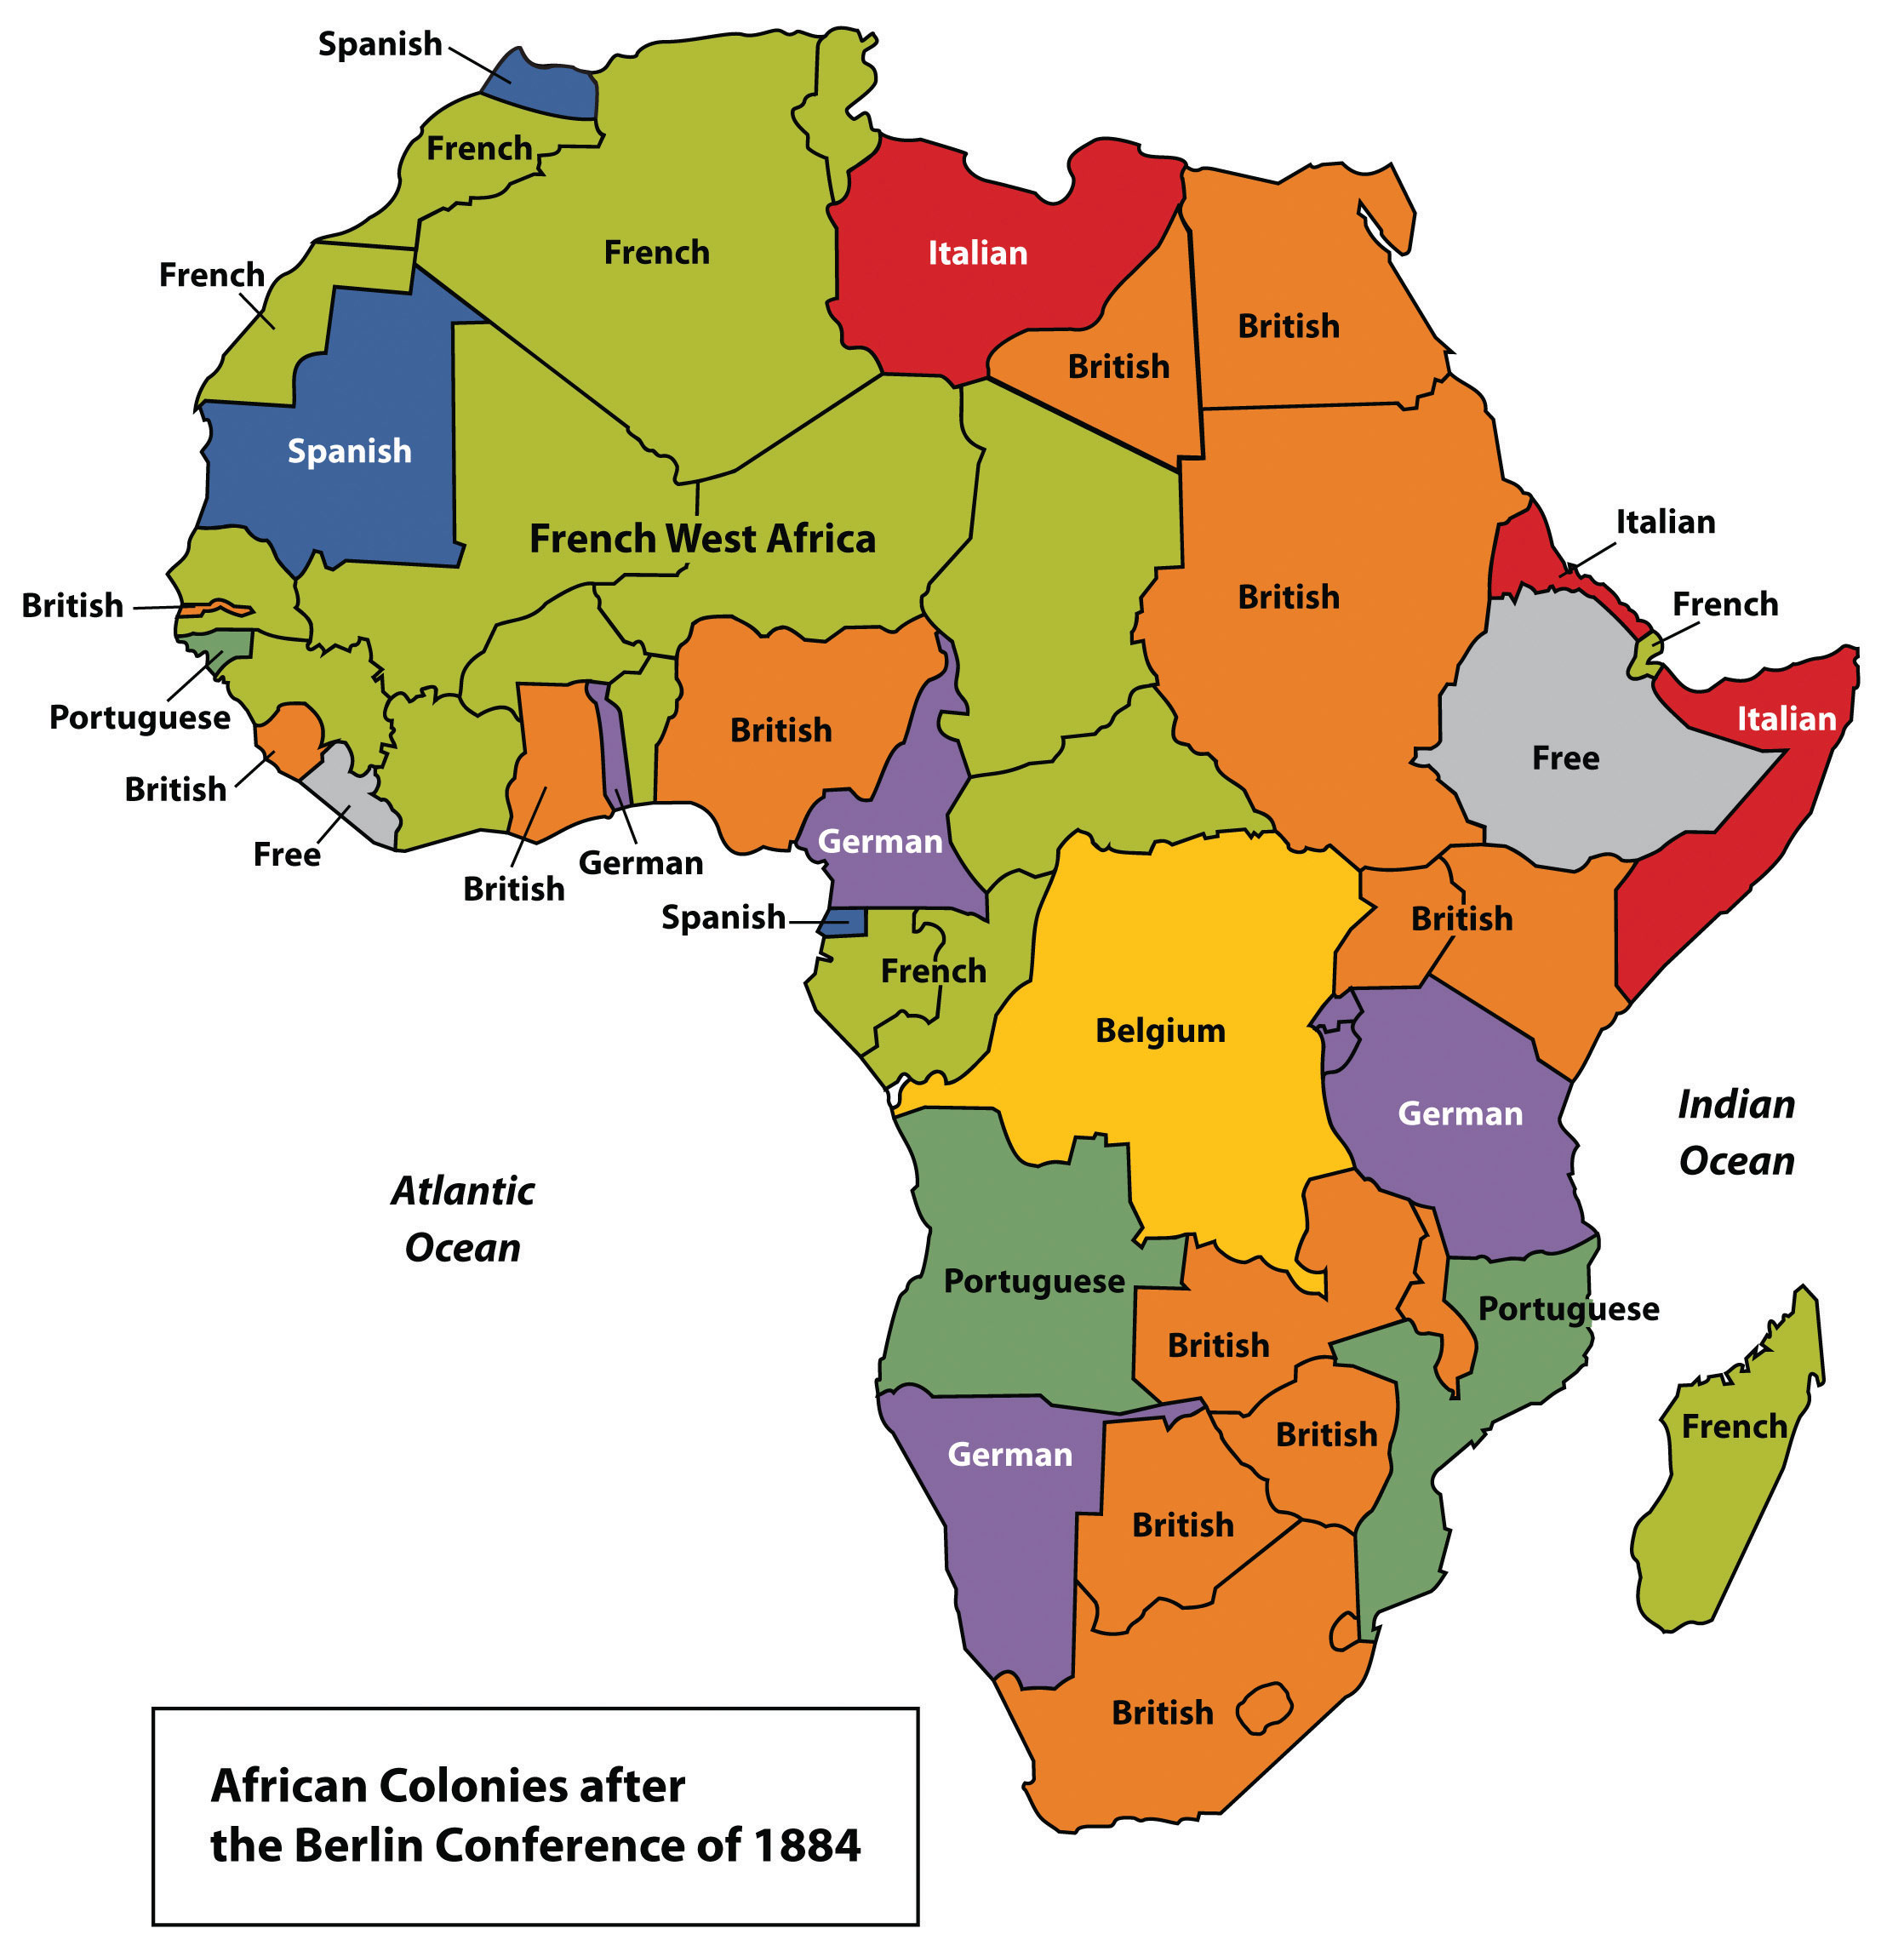
Historical reasons: Colonialism
Historically colonialism harmed many countries and sometimes created conflict, which continues today. During the 1700s and 1800s (and earlier in some cases), most of the global south was colonised by European nations such as Britain, France and Spain. Their aims were simple: to build global influence in order to better compete against rival European states and to access raw materials and labour. South American, Asian and African cultures were badly affected, especially those that became part of the transatlantic slave trade.
Key words
Transatlantic slave trade- the transportation of slaves across the world, mainly from Africa to the Americas.
Colonised- when a country has fully or partially been taken over by another country.
Conflict-
Colonialism- when one country acquires full or partial control over another.

Slide 4
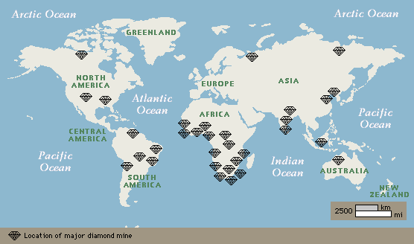
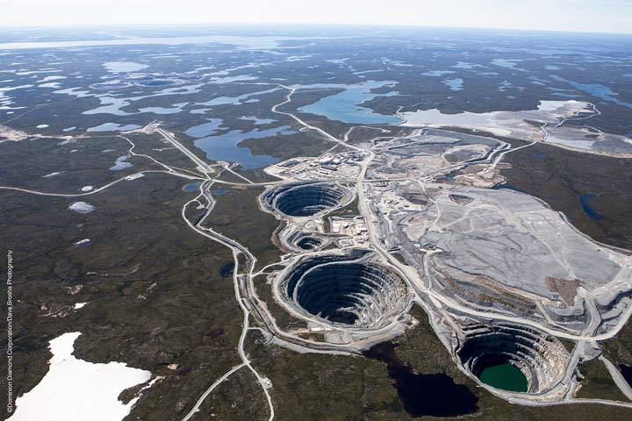
Historical reasons: Independence
Colonialism ended for the most part, in the twentieth centaury. For example, India and Nigeria gained independence from the UK in 1947 and 1960. But independence sometimes creates new problems. When the Democratic Republic of Congo gained freedom from Belgium in the 1960s, there were reputedly just 14 university graduates amongst its population, so badly had the Belgium's neglected the education system. Power struggles also often took place in newly independent countries, especially if rich natural resources like diamonds were at steak.
Key words
Colonialism- when a country acquires full or partial control over another.
Independence- when a country is able to take back control having been controlled by another country.
Natural resources- materials which occur naturally in nature and can be exploited for economic gain.

Slide 5
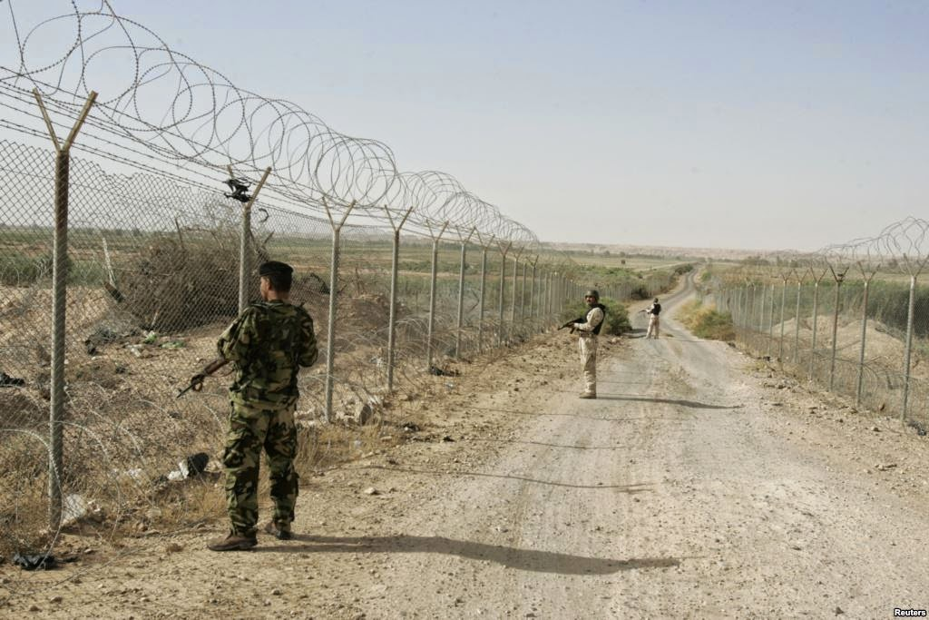
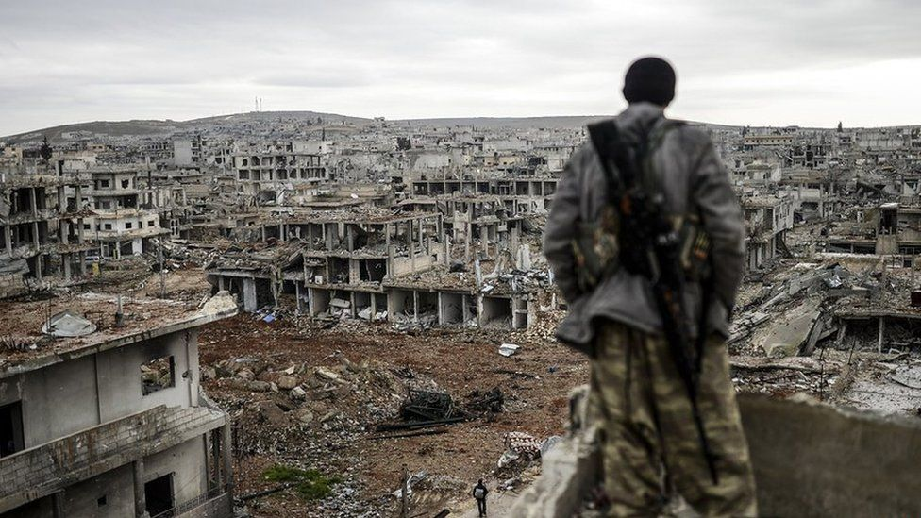
Historical reasons: Conflict
Conflict remains a major development obstacle for some LICs. Persistent political problems stem from the way that ancient African, Asian and middle eastern countries were divided and re-assembled in ways by competing European countries.
The modern borders of many Middle Eastern and central African countries fit badly with the distribution of different ethnic groups across these regions. Five million deaths have been linked with ethnic conflicts in DR Congo, Uganda ad Rwanda in the 1990s. Since the conflict in Syria began in 2012, six million people have lost their homes. Many now live in refugee camps more than half are aged under seventeen and 90 per cent of them no longer receive an education.
Key words
Conflict- a disagreement or argument between two groups of people
Modern borders- political boundaries that separate one country from another.
Ethnic groups- a group of people who share a common cultural background.

Slide 6
Economic factors: Trade
Trade between nations involves the import and export of goods and services. North America and Europe. The importance of Asia is growing as it includes Japan and the emerging economies of India and China. Most of the world’s trade is between richer countries. Furthermore most of the worlds most powerful international companies (TNCs) are based in the HICs. LICs have limited access to the markets. They have traditionally traded relatively low value raw materials such as agricultural products or minerals, rather than higher processed goods. The value of these raw materials has fluctuated widely, causing great uncertainty and instability as countries strive to become developed. There is also often more supply than demand for raw materials, which keep prices low. The processing of these raw materials, which adds value, takes place in the richer developed countries. In this way, the rich countries get richer and the poorer countries are not able to develop increasing the global development gap.
Key words
Trade- the actions of buying and selling goods and services between countries.
Raw materials- the basic (natural) materials from which a product is made.
Development gap- the widening difference between the richest and poorest countries of the world.
Import- when goods are brought from another country.
Export- when goods are sold to another country.
Trade surplus-when a country’s exports exceeds the value of its imports.
Trade deficit- the cost of a country’s imports exceeds that of its exports.
LICs and NEEs have traditionally exported primary products such as minerals and agricultural products. In the last 20 years many of these countries have developed manufacturing. Manufacturing products now make up about 80 per cent of the exports of NEEs. Some countries have trade surpluses, while others have trade deficits. This often leads to a ‘debt trap’ that makes further development difficult.

Slide 7
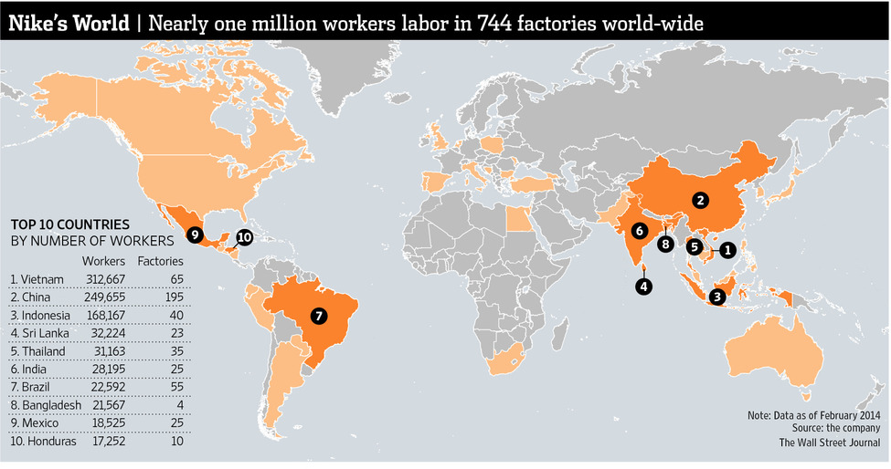
Economic factors: Trade
In the 1800s European powers took the raw materials they needed from other countries. Today, their TNCs buy materials and food from LICs, but at low prices that jeopardise economic development. There are several reasons for these low prices:
Unfair terms: international organisations like the World Trade Organization (WTO) have been criticised for not doing enough to establish fair terms of global trade for food and raw materials.
Corruption: Sometimes corrupt leaders of LICs have profited personally from selling resources cheaply to TNCs.
Food prices: food prices fluctuate wildly depending on competition and the quality of crops. The price of cocoa beans halved in the 1990s due to overproduction, slowing down economic development for Ghana and Ivory Coast.
In contrast, NEEs have benefited from global trade. China’s leaders in particular have focused on developing manufacturing industries, resulting in rapid economic growth in recent decades.
Key words
TNCs- Companies which operate in many countries across the world.
Raw materials-the basic (natural) materials from which a product is made.
Overproduction- when more of a product is created than is needed.
Rapid economic growth- an increase in a country’s capacity to produce goods and services.

Slide 8
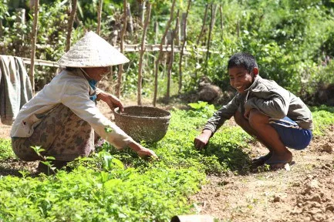
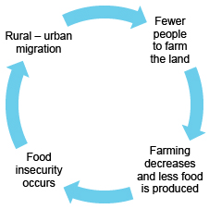
Economic factors: Poverty
The lack of money in a household, community or country slows development. It prevents improvements to living conditions, infrastructure and sanitation, education and training. Without the basics, developments in agriculture and industry will be extremely slow and an economy will simply fail to take off.
Overall it can be said that poverty causes poverty. Low life expectancy, frequent illness and the lack of a nutritious diet make economic development hard to achieve.
Key words
Poverty- when the people of a country are extremely poor and lack the basic things for a good quality of life.
Sanitation- the provision of clean water and sewage facilities.
Infrastructure- the basic physical and organisational structures needed to allow society to run.

Slide 9
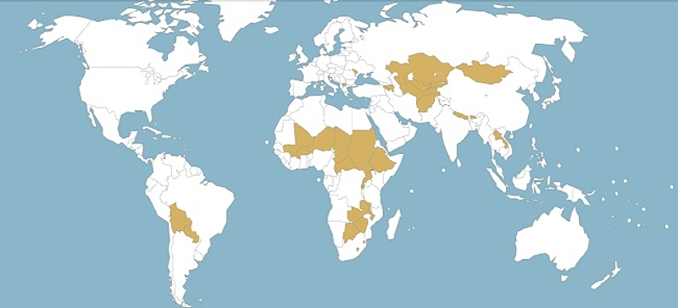
Physical factors
The physical geography of a country or region can create several challenges for economic development.
Factor | How it influences the rate and level of development.
Coastlines | There is quite a strong link between the lack of a coast (landlocked) and level levels of development. With a few exceptions the world’s 45 landlocked countries are LICs of NEEs. Of the fifteen lowest ranking HDI countries 8 have no coastline. The greatest development challenge is not being able to trade goods easily without ports.
Natural hazards | In 2010, a devastating earthquake struck Port-au-Prince, capital city of the Caribbean island of Haiti. 230,000 people died. Since then, the country has struggled to develop. But many countries with a high level of development suffer from hazards too. Japan, Italy and Iceland are all HICs located on plate boundaries. An extreme weather season such as a hurricane can slow development and it can be costly to repair damaged infrastructure.
Climate | The influence of climate on development is not very clear. For every poor hot desert country like Chad there is a rich one like Saudi Arabia. The same is true of tropical rainforest countries: while central Africa’s equatorial climate could be viewed as a development challenge, Brazil is the world’s eighth largest economy. Tropical environments are prone to pests and diseases which can spread rapidly. Diseases such as malaria can devastate communities and reduce peoples ability to work.
Water shortages | There are serious shortages of water, which is essential for life and for development, in some parts of the world, for examples in parts of Africa and the Middle East.
Relief | Mountainous regions, for examples countries such as Nepal, tend to be remote and have poor infrastructure. They are also subject to extreme weather conditions.
Key words
Landlocked- A country which borders another country(s) on all sides.
Trade- buying a selling goods and services.
Infrastructure- the basic physical and organisational structures needed to allow society to run.
Landlocked developing countries

Slide 10
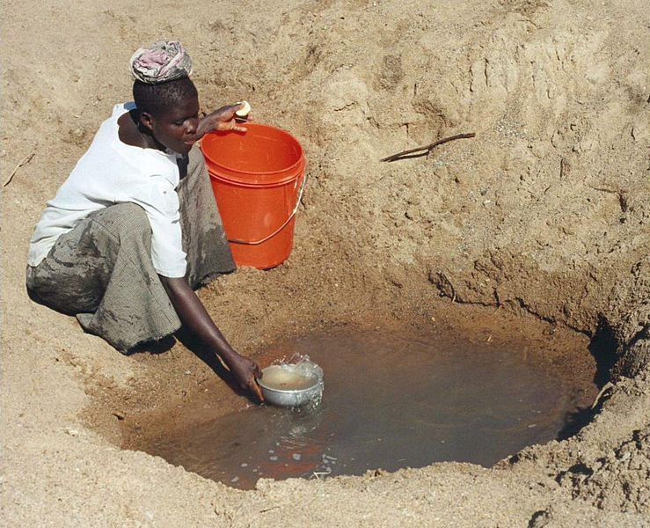
Physical factors
Physical factors undoubtedly play a role in hindering development. However it is wrong to ever place the blame entirely on physical factors. Physical factors alone do not explain a country’s development. All of the physical factors can be overcome with human ingenuity and money.
Drought affects many of the world’s poorer countries, particularly Africa
230,000 people are killed
Many children are orphaned
Many people are harmed.
Families lose a wage earner
People can waste several hours a day walking to collect water
300,000 people are injured
People can’t work- GNI falls.
7.0 earthquake strikes near the capital of Haiti in 2010.
Money spent treating the sick.
Poor irrigation limits the development of commercial farming
1,000,000 left homeless.
Many countries lack the money to develop water storage and distribution systems
300,000 homes are damaged
Clean water is essential to ensure good health and enable people to work effectively
Sickness in refugee camps
Buildings are damaged.
Key words
Landlocked- A country which borders another country(s) on all sides.
Trade- buying a selling goods and services.
Infrastructure- the basic physical and organisational structures needed to allow society to run.
25% of schools collapse
Literacy and numeracy fall
Less business investment

Slide 11

7
8
9
10
Annotate the alley in order to show which factor is the most significant in causing uneven development.
4
5
6
Corruption
Landlocked
Raw
materials
Trade
3
2
Colonialism
Poverty
Conflict
1
Natural
Hazards
Water
shortage
Success criteria:
You can justify the order that you place the causes in, in terms of how significant they are in causing uneven development.
Climate
Which factor is the most significant?
Notes:
Production costs have increased by 20%

Slide 12
7
8
9
10
4
5
6
Corruption
Landlocked
Raw
materials
Trade
3
2
Colonialism
Poverty
Conflict
1
Natural
Hazards
Water
shortage
Climate
Which factor is the most significant?
Notes:
Production costs have increased by 20%

Slide 13
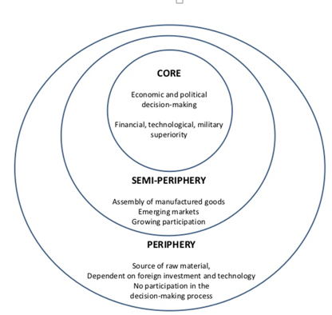
Core / Periphery
Definition:
The concept of a developed core
surrounded by an undeveloped
periphery.
The concept can be applied at
various scales.
More on core-periphery

Slide 14
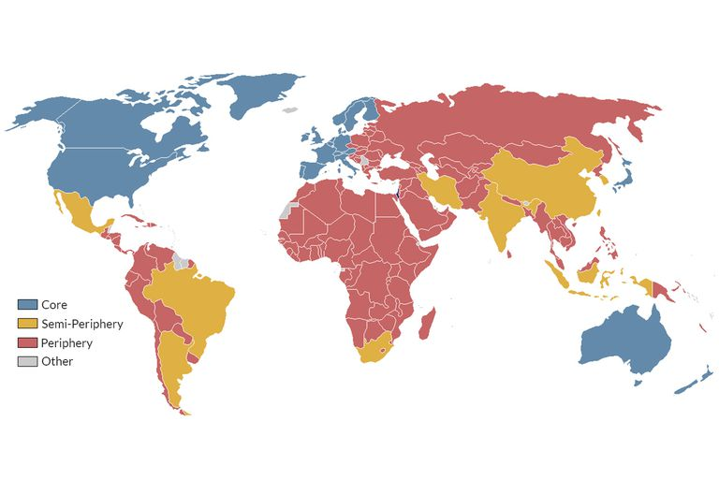
Core / Periphery Countries
Notes:
https://www.thoughtco.com/core-and-periphery-1435410

Slide 15
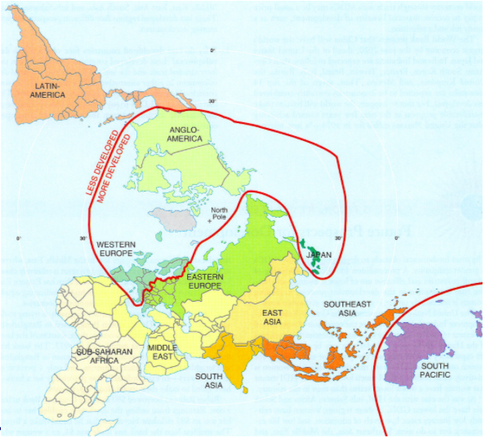

Slide 16
CASE STUDY: Inequalities in China

Slide 17
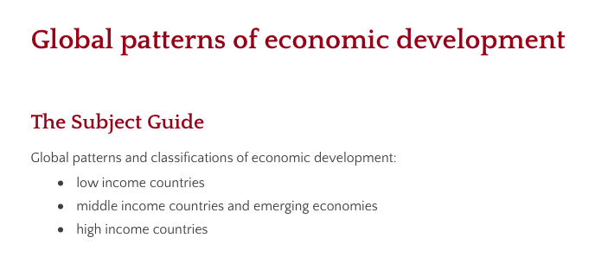

Global development patterns

Slide 18
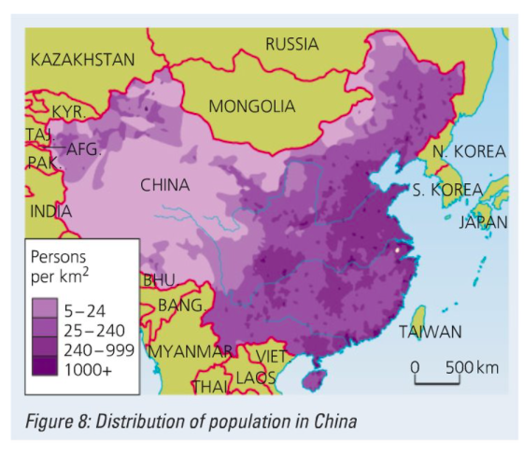
Describe the distribution of population in China (4)

Slide 19
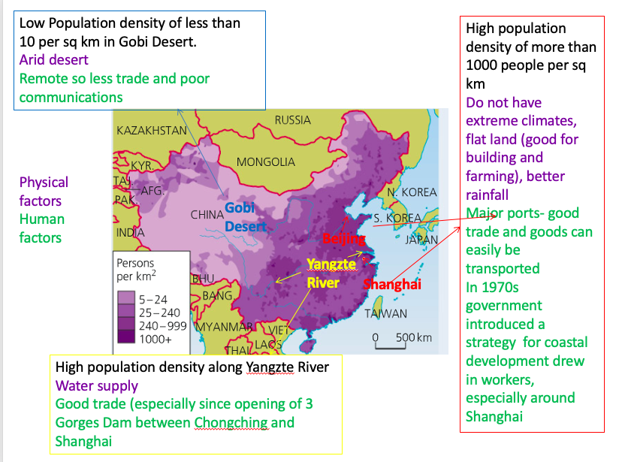

Slide 20
Urbanisation
With a growing population, an increasing middle class and the falling need for agricultural workers China also needs to deal with rising urbanisation.
Urbanisation is the movement of people from rural areas and agricultural employment to urban areas and employment in manufacturing and services.
Urban growth is the rate of population growth and expansion of urban areas. The more an urban area grows, the more employment opportunities are created.
Urban growth results from both rural-urban migration and natural increase from births in the cities exceeding deaths.

Slide 21
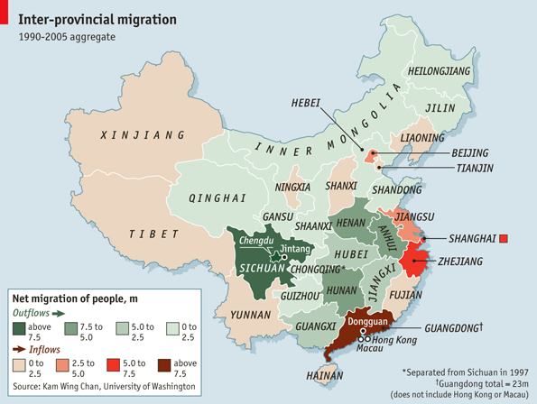
CASE STUDY: Inequalities in China
Review the Economist Article / Videographic:
https://www.youtube.com/watch?v=KNXg-kYk-LU&feature=emb_logo
a. How many people have left rural areas to seek work?
b. Outline the reasons why people left.
c. In 1978, how much did farmers earn?
d. What are the negative aspects of migration?
e. What has happened to the wealth gap over time?
f. What changes has Shenzhen seen since 1978?
g. Outline the comparative GDP values of coastal regions compared to western countries.
h. What change is China seeing in terms of location of manufacturing industry?
More information :
http://www.bbc.co.uk/bitesize/ks3/geography/places/contrasts_within_continent/revision/3/

Slide 22
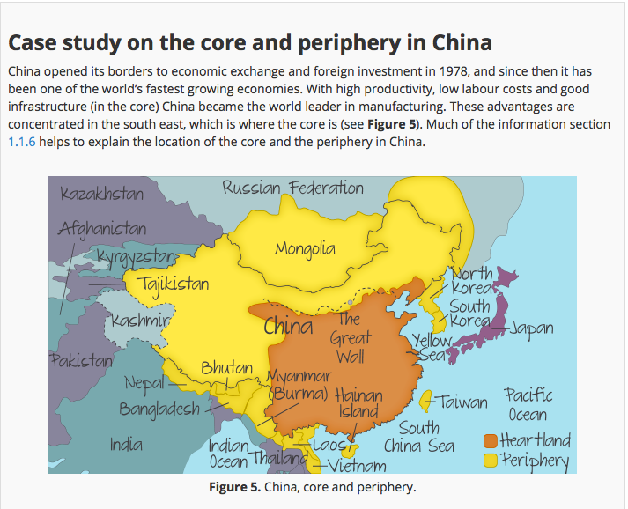
Core and Periphery in China

Slide 23
