Slide 1
Answer these questions:
How did the number of deaths from natural disasters per year change in the last century?
A: Doubled B: remained the same C: Decreased to half
2. How many years have 30- year old women spent in school . Male average is 8
A: 3 years B: 5 years C: 7 years
3: In the last 20 years, how did the percentage of people living in extreme poverty change?
A: doubled B: Remained the same C: Almost halved
4: What percentage of the world’s one year old children are vaccinated against measles?
A: 20 B: 50 C: 80

Slide 2
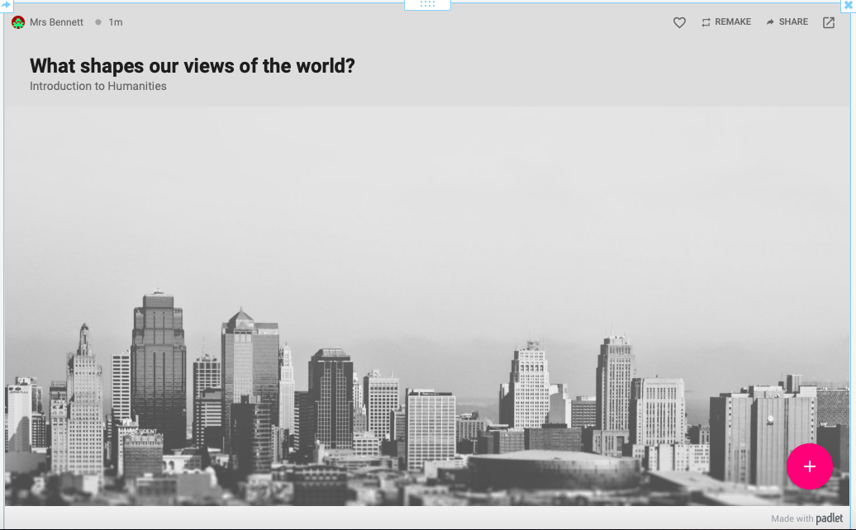
What shapes our ideas of the world?
https://www.youtube.com/watch?v=q-Y-z6HmRgI

Slide 3
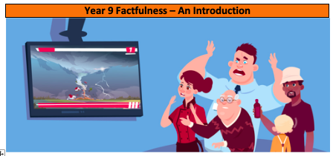

Learning objective:
What: To consider how our view of the world may diverge from reality
Why: To understand how we obtain our knowledge of the world (TOK link)
How:
Consider how others view the world and why
To construct a survey and analyse the results for a display

Slide 4
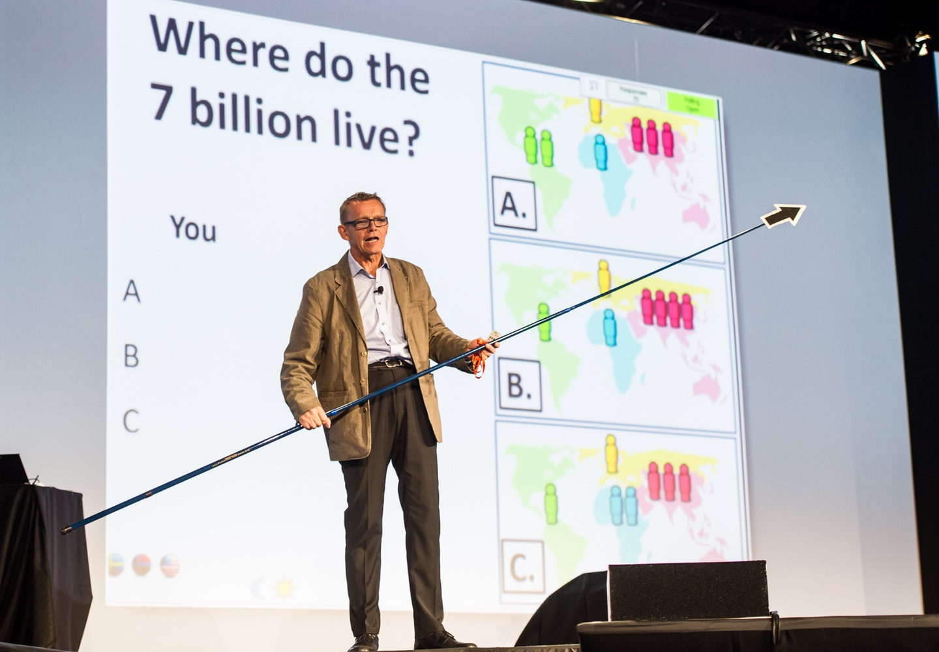
Who is Hans?
This is Hans Rosling (1948-2017). He was a Swedish physician and statistician who collated world statistics and, after developing his own extremely unique computing software, props and showmanship, presented and illuminated this facts and trends in such a way that made him a worldwide figure (and YouTube star!).
His latest (and last ☹) work was the production of his book Factfulness in which his family’s life work aiming to test your understanding of today’s modern world. So…
The Sword Swallowing Swedish Professor? ​
Start the video at 08:15: https://www.youtube.com/watch?v=TAMMPA4kg70

Slide 5

https://www.ted.com/talks/hans_and_ola_rosling_how_not_to_be_ignorant_about_the_world

Slide 6
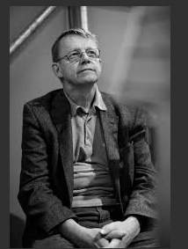

Think- pair- share
How has your opinion changed after watching the video?

Slide 7
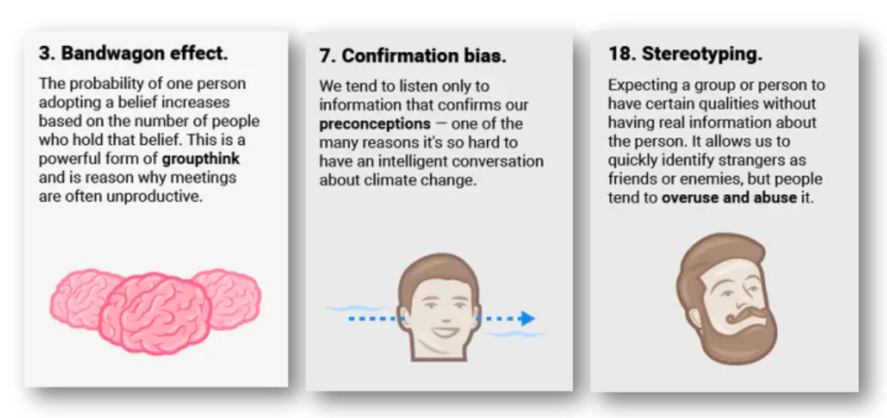

Slide 8
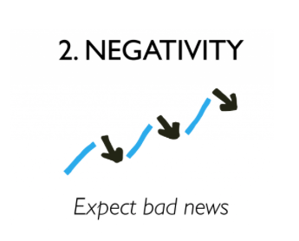
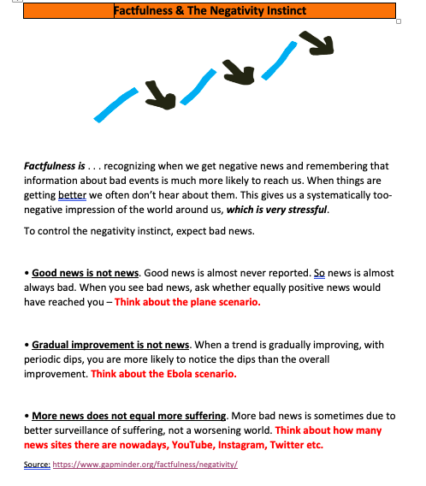

Slide 9
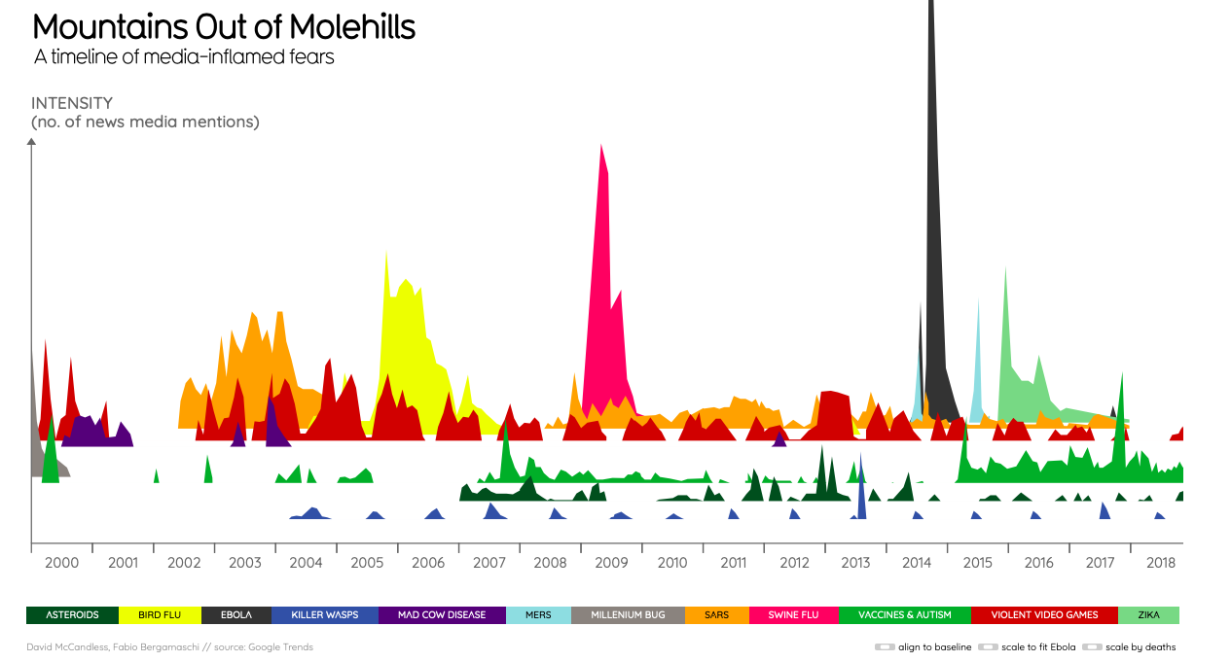
Complete the question sheet:

Slide 10

Beautiful news…..
Beautiful news

Slide 11
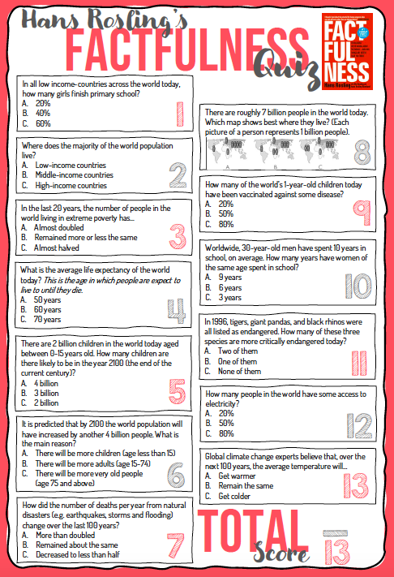
Take the (longer) Hans quiz again

