Slide 1
Think-pair-share…what is this cartoon showing?

Slide 2
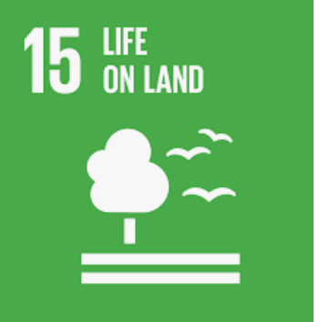
The importance of biodiversity
What: Extinction- the facts
Why: To understand the importance of biodiversity and understand the impact the humans are having on the planet
How: Watch ‘Extinction the facts’.
Make notes and consider the impact of humans actions on the planet

Slide 3
https://www.nationalgeographic.org/encyclopedia/biodiversity/

Slide 4
Why is biodiversity important?

Slide 7
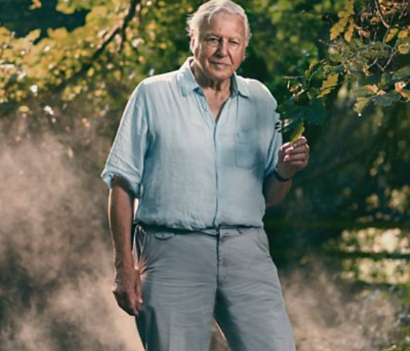
Extinction the facts
https://hdclump.com/extinction-the-facts/
https://www.dailymotion.com/video/x7w7wxr

Slide 8
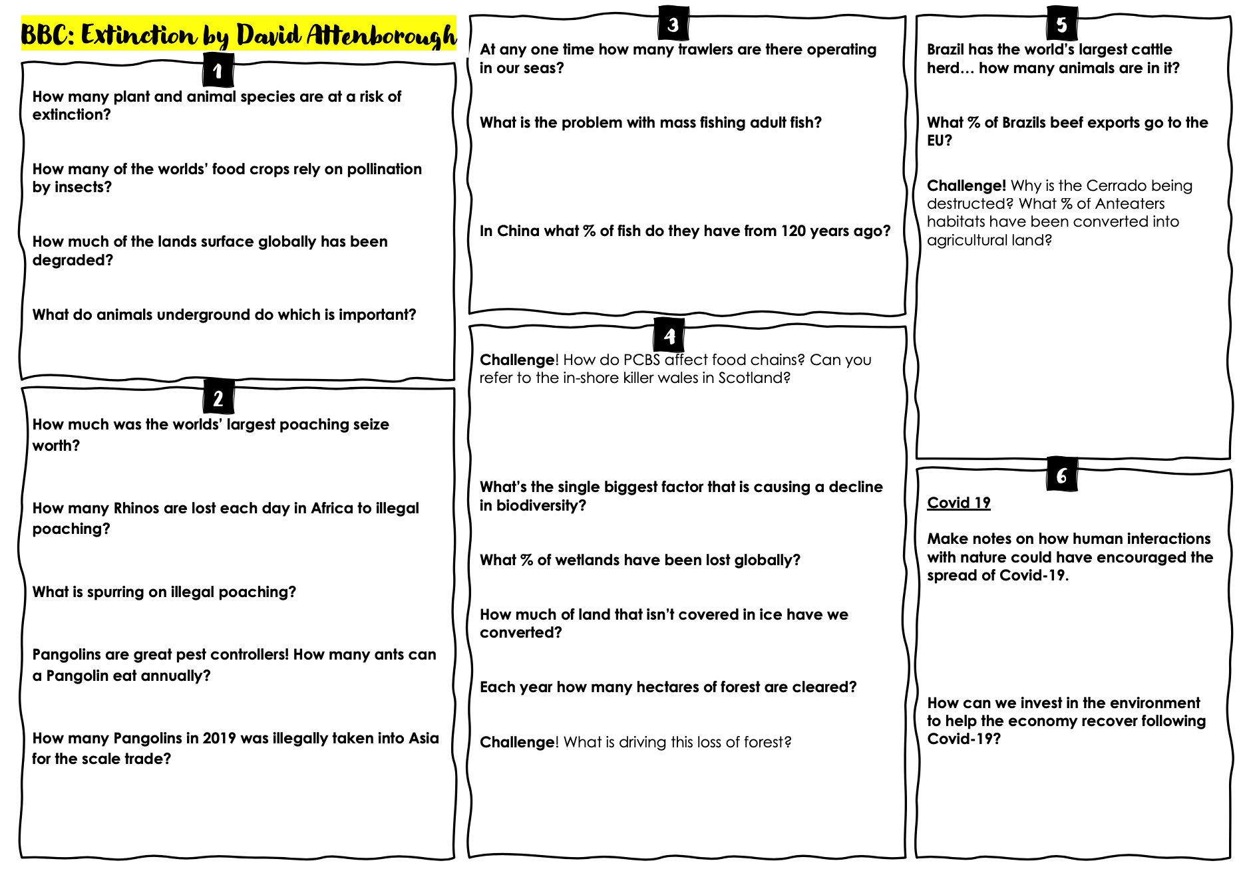

Slide 9
Assessment: A letter from the future
Task: write a 1-2 page letter from you in future explaining how your life is different in 2050 based on the changes we have faced
Consider:
If you an optimist or a pessimist?
Food- where from and are there any foods we now can’t get?
What major events have happened?
What species have been lost or saved? What impacts has this had?
How are LICs coping with the change?
Have there been any positive impacts? What led to this?
Have the SDGs been met? Has this had any impact?

Slide 10
Level descriptors: A letter from the future
Level | Success criteria
7 | As below plus…. Describes a range of potential impacts, both positive and negative, and explains them well. Critically evaluates their impact on future quality of life. Written work is backed by individual independent research. Presents work in a variety of appropriate ways
6 | Describes a range of potential impacts, both positive and negative, and explains them well. Excellent organisation, shows clear progression. Well developed sense of audience. Spelling and grammar is accurate.
5 | Describes the potential impacts of global biodiversity collapse and begins to offer explanation. Organised, shows progression. Developing sense of audience. Spelling and grammar is appropriate
4 | Brief descriptions of the potential impacts of biodiversity collapse, no explanation is given.

