Slide 1
Externalities: Costs and Benefits
To evaluate a range of different solutions for dealing with externalities
When a consumer buys and producer sells…cars, burgers, bottled water, books, mahoganey furniture, cigarettes, pork, wheat, phones, space shuttles etc etc etc

Slide 2
Define the following in your exercise book…
Externality
Private benefit
Private cost
Social benefit
Social cost

Slide 3
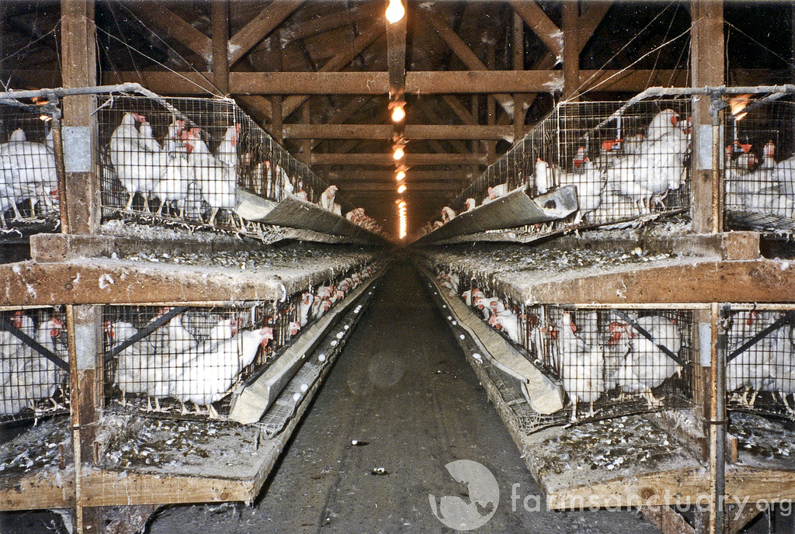
Externalities: Costs and benefits
Externalities: the spillover effects of consumption or production. They affect others and can be positive or negative

Slide 4
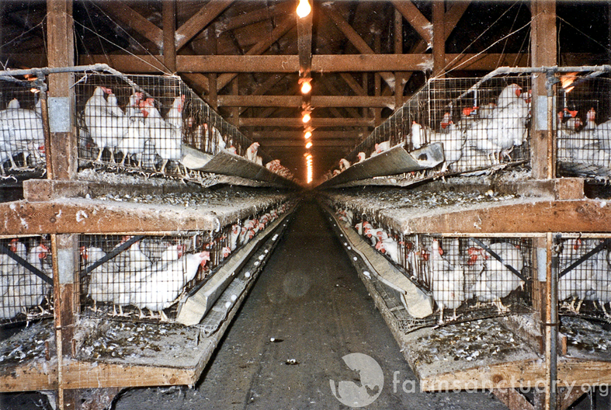
Negative externalities

Slide 5
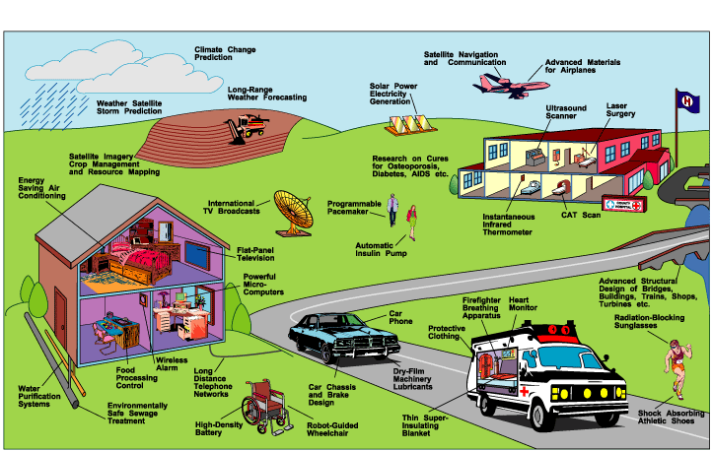
Positive externalities of US space program

Slide 6
The Real Benefits and Costs of Production
Private benefit + External benefit = Social Benefit
Private cost + External cost = Social Cost

Slide 7
Government Policies to deal with Externalities
Taxation
Subsidies
Fines
Government regulation
Other measures e.g. Congestion charges

Slide 8
The problem with microbeads?
What are microbeads?
Microbeads are very small bits of plastic that manufacturers use to supply scrubbing power to body washes, exfoliators, toothpastes, and other cleansing products. They look like tiny spheres. They range in size from 1 millimeter, about the size of a pinhead, to 1 micrometer, too small to be seen by the naked eye. According to an estimate from the United Nations Environment Program, a typical exfoliating shower gel might contain as much plastic in microbead form as there is in its plastic container.
Research has demonstrated that the tiny beads look like food to fish and other marine life. Eating the plastic is harmful enough on its own for these animals, but scientists have also shown that plastic pellets can harbor polluting chemicals, potentially causing problems for the food chain and our food supply. If you still think microplastic is a fish-only problem, consider this: dentists have expressed concern that microbeads that are intentionally added to toothpaste are getting stuck in patients’ gums, trapping harmful bacteria. Scientists in China found microbeads someplace they shouldn’t be: in table salt.

