Slide 1
Why did they begin to expand?
No one really knows
few written records
Booty?
Climatic change? – Population high, temperatures fell, pastures decreased
Population growth?
Steppelanders being steppelanders?
Task Read the extract from McLynn – create a spider diagram of the possible reasons for expansion.

Slide 2
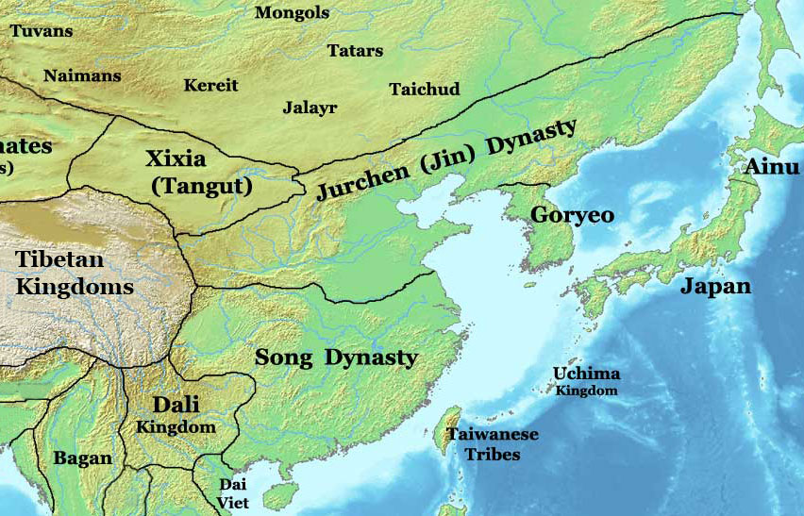

Slide 3
The Chinese Dynasties
The Area of modern day China consisted of many independent states and kingdoms - containing perhaps 1/3 of the worlds population.
The largest of the Chinese kingdoms was the Song Dynasty – based in Hangzhan and ruling approx 60 million people.
The second largest was the Jurchen who established the Jin Dynasty in 1127 - containing approx 50 million people.
In 1207 there existed a string of nomadic buffer states separating the Mongolian plateau from the Chinese Dynasties.
West of the Jurchen were the Tangut/Xia Dynasty, then the Uighur and finally the Black Khitan.
By 1207 the Uighur had already committed allegiance to GK

Slide 4
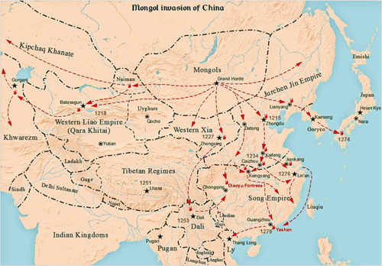

Slide 5
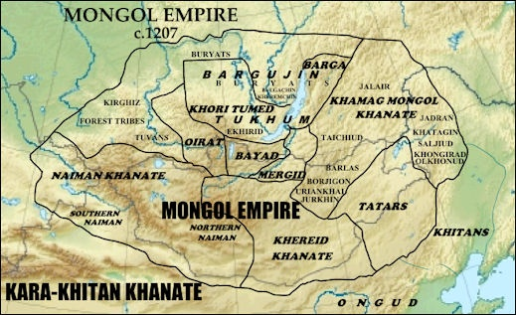
Consolidation of the Empire
1207 – the Kirghiz submitted to Genghis Khan
1208 – the Oirats also submitted
1209 – the Uighurs sent an envoy to offer suzerainty over them to GK

Slide 6
The Tangut/Western Xia
The Tangut were conquered by Genghis Khan in a series of raids between 1207 – 09 and acted as a dress rehearsal for the later attack on the Jin Dynasty.
The Tangut were Tibetan people who had created an empire of farmers and herders along the upper reaches of the Yellow River.
They held a weak line along the Oases in the interior Gobi desert that controlled the flow of goods from east to west.
The Tangut were well fortified and had an army of over 150,000 men, double the size of the Mongol army.
The Tangut raids spurred GK to learn new types of warfare against walled cities, moats and fortresses.
GK had no siege techniques and was forced to invent his own.

Slide 7
Task:
Read the two accounts of the Tangut campaign.
Compare and contrast the accounts;
Similarities
Differences
How do we account for the differences?

Slide 8
From 1211 – 1216 GK was absent from Mongolia, pursuing his golden dream of the conquest of northern China.
He approached his attack on the Jin in an ‘intelligent and analytical’ way. (McLynn)

Slide 9
Background to China
The Great Tang Dynasty collapsed in 907.
China entered a 400 year period of disunification and alien rule.
First into the power vacuum were the Khitan people – ‘forest-tribe’ of Manchuria – prominent on the Steppe since the 7th century.
The Khitans founded the Liao dynasty in 907 - great ruler A-Pao-Chi – first Liao Emperor.
In 960 a new dynasty, the Song was founded in southern China. They fought to push the Khitan out of China but the wars only succeded in strengtheing the Tangut who had been allowed to settle on the yellow river by the Tang Dynasty. The Song ended up paying tribute to the Liao and the Tangut.
1005 the Song agreed to a humiliating peace settlement.
Much of the 11th century was spent in peace with the Liao.

Slide 10
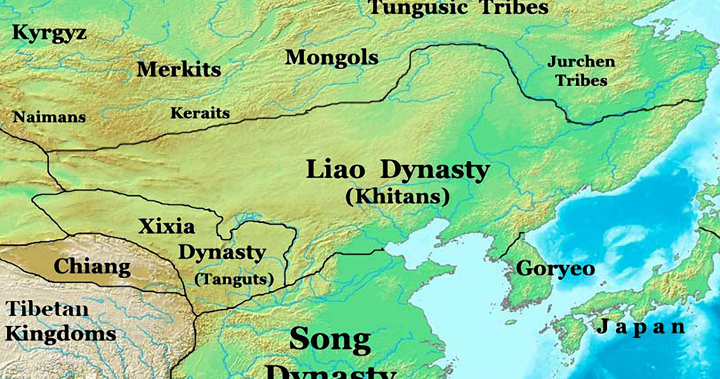
The Liao knew few years of peace at that time. – nomadic tribes made frequent incursions into their lands and concerned with the rising power of the Tanguts to their west they waged continuous wars with the state of Hsi-Hsia.
The Liao remained hemmed in by militants and were isolationist – cutting china off from western and central Asia.
The dynasty began to decline and ended quickly. An influx of Jurchen peoples from northern Manchuria began to weaken the state.
The Jurchen confederation - Chief Aguda- their aim was to defeat and replace the Liao.

Slide 11
The Jurchen – eastern Manchurian, semi-agricultural forest dwellers, dependent on hunting, fishing and farming were very different from Steppe nomads.
Their attack was so swift it could be described as a coup rather than a conquest.
The Jurchen made this conquest with the help of the Song through a variety of land and territorial agreements.
But Aguda died in 1123 and the new JIN emperor reneged on the deals and double crossed the Song driving them out of Northern China.
They went on to attack the heartlands of the Song but a peace deal was agreed in 1141 – effectively ending the dominance of the Song.
The JIN were tough opponents.

Slide 12
The Jurchen (JIN)
The Jurchen controlled the northern Chinese region and had proclaimed sovereignty over the Steppe Nations – Ong Khan had sworn allegiance to them during his reign.
Jurchen control came from their ability to control the flow of goods from China rather than their military prowess.
The Mongols had close ties with the Khitan but they had been defeated by the Jurchen and were dominated by them. Many Khitan, sensing the power of GK had fled to the Mongols.
In 1208 4 Khitan high court officials had deserted to the Mongols and urged GK to attack – fearful of a plot GK had refused.
In 1208 the unexpected death of the Golden Khan led to the ascension of Wan-Yen Yung Chi (Prince Shao of Wei). He had met Genghis before at the Khuriltai of 1206 where GK had taken a dislike to him.
When GK heard he had been selected he declared ‘he is an imbecile’.
The new emperor sent an envoy to Mongolia asking GK to kowtow as a sign of fealty.

Slide 13
Jin Weaknesses
Vulnerable spots in their armour.
Frequent rebellion – Jurchen were numerically weak only amounting to one tenth – the rest were Chinese. They accepted Liao rule but did not like the Jin.
Khitan never accepted their ousting. Some migrated but many stayed as a disgruntle problem under Jin rule.
Tribal Leaders and the military were dissatisfied with increasing centralization of the Jin dynasty.
They were known for their aggressive policy towards the outside world. They were resentful of the success of new states. When new states collaborated (Western Xia and Qara Khitai) the would often use economic warfare in response.

Slide 14
The Jin’s economy was strong (salt/wine) and they collected heavy taxes. They had once been a very wealthy state.
By 1191 the Jin reserves were depleted by: generous gifts and corruption.
The morale of the military was low and officers were known to be corrupt. They were also weakened by a shortage of horses.
They suffered from banditry in the East and the rebellious Khitans in the West.
Geographically the Jin were handicapped by the Yellow River and flooding was a constant problem.
At the turn of the century the Jin faced a number of simultaneous crises:
Flooding of the Yellow River
Financial collapse
Weak Emperors
Disputed succession
Khitan rebellion
Corruption
External Threats
Historians speculate that this was a difficult time for all Asian societies dependent on agriculture and a boom time for nomadic warriors.
The Jin were attacked by the Song in 1204 who crossed the Yellow River but were heavily defeated.
The Jin were no paper tiger – they attacked the Song in 1206 with 145,000 forces – forcing them to sue for a heavy peace. 1208 terms were very harsh including much gold and silver as well as key towns.

Slide 15
The Delegation - 1210
1210 – A Jurchen delegation arrived from Zhangdu (Beijing)
They sent an envoy to inform GK of the changes and demand his submission to the new Golden Khan.
The ritual ceremony of submission was a public act of complete submission and promise to be a Mongol slave.
At almost 50 yrs old GK would not submit to anyone.
GK is reported to have turned south, spat on the ground and unleashed a torrent of insults at the Golden Khan - mounted his horse and rode north leaving the envoy choking on his dust.
The disrespect was tantamount to a declaration of war.

Slide 16
Gains were wiped out by internal turmoil.
1207 – Khitan revolt in the North – many tribes joined in the insurrection – the Tanguts/Khitan and the Jin’s own demoralised army.
GK was behind the scenes stoking the flames.
The Khitan and the Mongols shared much and were quite close. They Khitans had been drifting from China to the Mongols since 1190’s.
There were some key escapees – Yelu Ahai – became a high general in the Mongol Army and was at Beljuna with GK
In 1208 – 4 native Chinese – senior Jin officials fled to Mongolia and endorsed that the Jin were vulnerable.
GK did not rush despite the issues facing the Jin. He waited until famine of 1210-11 had bitten deeply before crossing the Chinese border.
“GK was more a chess player than a gambler” McLynn
Reassured that his underbelly was secure and that he faced little chance of a flank attack by subduing the tribes on the Mongol southern frontier.

Slide 17
The Khuriltai - 1211
GK returned to his home base and summoned a Khuriltai on the decision to attack the Jurchen.
He allowed a long decision process that involved all member of the Mongol nation.
Everyone needed to understand the reasons for the campaign and be fully committed. Everyone had a voice.
He included representatives form the Uighur and Tangut nations to solidify relations with the newest allies and to ensure the exposed underbelly of the Mongol Nation
GK sold the mission on honour, avenging past wrongs and loot.
Once the nation stood with him he retired to the mountain to pray to the sky god.
The nation prayed and fasted whilst waiting until the fourth day for a response.
GK “The eternal blue sky has promised us victory and vengeance.’

Slide 18
2011
GK sent an advance force south under Jebe – the Jin responded by sending an army north to intercept him. However they could not stomach a march into the Gobi so spent their time looting Ongud tribes near the great wall.
Jebe came across this ‘disorganized’ rabble and easily routed them – prompting any ditherers to join the Mongols.
Wan Yen Yung Chi – furious with the defeat sent his generals and advisors to jail but was incredulous that the Mongols were attempting this impossible mission. He held a real derision for the Mongols – considering himself superior and he fully believed he could see off the Mongols.

Slide 19
The Jurchen (JIN) Campaign
The Jurchen seemed unconcerned with the approaching Mongol attack.
A Chinese scholar claimed the Golden Khan asked of GK ‘How can we fear you?’
GK had a clear plan: To conquer China and maintain his Steppe powerbase.
He used the merchants of the silk route for support and information on the Jin.
He outlined Jin weaknesses but warned of their strength. He believed the Jin would fight to the bitter end.
Military matters were also of concern – the number of Jin forces were far superior. 6 million were eligible for military service. They had a standing army of 500,000 infantry and 120,000 mounted bowman and impregnable fortresses.
But….......
The Mongols had greater mobility and accuracy. Mobilisation did not harm economic efficiency of nomads like it did the agriculturalists. It was expensive for the Jin to train archers – for nomads it was a way of life.
Their horses were very adaptable and they could move as a unit much easier than sedentary societies.
GK urged his followers to be ruthless and have no sympathy for the Jin.

Slide 20
Planning the Attack
GK was aware of the risks of the attack – if he was unsuccessful his recently united empire would implode.
Very careful planning would have to be made.
He probably set off with 110,000 troops, hoping to add 10 – 20,000 Onguds.
This force required 300,000 horses, all needing water and forage. Tens of thousands of sheep and cattle were needed to provide meat and camels and ox drawn carts would move the war equipment.
Even so rations would be needed – although the Mongols were used to travelling on little food.
The main problem was the Gobi – lack of water. The move was carefully planned to leave at the optimum time. In spring there were pockets of melting snow. He sent scouts to all parts of the Gobi – charting all possible crossing points and the best places to water and graze the herds.
GK left Temuge and Toquchor in charge of the Mongol Empire plus 20,000 men on a roving brief to proceed at once to any trouble spots in the Mongol rear.

Slide 21
The Forces - 1211
The Mongol army was divided into the western and eastern detachments.
The larger eastern force was subdivided to ease pressure on food and water.
The two eastern units left the River Kerluen in March 1211.
GK commanded the main force with Tolui as deputy and Mugali as commander on the left wing
On his left and to the east was another force under Jebe, Subedei and Qasar.
The westward detachment commanded by the 3 princes Jochi, Chagatai and Ogodei started from the River Tula and its target was the fortress of Chung-chou – 50 miles north of the Yellow River.
The army struck due south before veering S E to enter China at the extreme western edge of Ongud territory.

Slide 22
1211 - continued
March and April – the two armies marched along parallel lines in a south easterly direction – 230 miles apart. They kept in constant contact via fast post horses and could reunite in 48 hours if necessary.
The princes crossed the west Gobi desert with no opposition and reached Chung Chou in May and took it easily.
Awaiting Jin counter they surveyed the land and took advantage of the surrounding area to rest and feed troops and animals.
Meanwhile in May GK and Jebe reached the Jin walls marking the boundary of China.
This was not THE Great Wall (1368) but an early version. Completed in 1200 they were built in the north of Peking in 2 parallel lines. Since they were not linked to form a continuous chain the Mongols simply bypassed them.
The walls were manned by the Juyin who rebelled the second the Mongols invaded.
GK started by raiding the land between the walls and the Gobi – hoping to tempt the Jin into battle on more favorable terrain for the Mongols.
WYYC boxed clever and freed the imprisoned generals and put them under the command of two large armies. He sent an army commander to talk peace terms with GK – whether genuine or a stall tactic is unsure but it amounted to nothing.
He sent other commanders to strengthen mountain fortifications leading to the most important cities in the eastern part of the realm.
As the Jin refused to take the bait of a pitched battle GK decided to penetrate deeper into Chinese territory even if this meant fighting on Jin terms. His forces quickly overan the static Jin positions yet the two main Jin forces remained in tact.
It was quickly clear that the Jin strategy was to ignore the Princes to the west and focus on GK. Once defeated the Princes would have to run back to Mongolia.
The Jin split their forces – one threatened the Mongol right flank and were in a position to intercept the Princes if they marched east.

Slide 23
To counter GK decided to take out the smaller army before attacking the larger force.
He gave the task to Jebe who with Subedei had performed brilliantly – capturing two key fortresses.
Jebe marched due west behind GK and came across the smaller force. He swept upon them like a whirlwind, taking them by surprise and routed them, removing the threat to GK’s right flank.
Jebe demolished the fortifications and moved on to the next town. The governor there panicked and left his post – he offered his services to the Mongols. He was sent back to get the town to surrender which it did. He was given a job as a roving commissar – going round persuading other towns to capitulate.
Jebe rejoined GK at Fu Chou in late August just in time to storm another fortress.
Outwitted and with one army defeated the Jin tried to lure GK into an ambush.
There were two gateways from Mongolia to China
1. Wild Fox Ridge
2. Badger’s Snout
General Chih Chung prepared his army at Badger’s Snout – the numerical advantage would prove great when the Mongols were trapped in a tight space. Outnumbered 10-1 the Jin were strong but their men were not all trained. An envoy sent to GK to kill him defected and spilled the plot.
GK chose a spot where numbers would not matter – Chih Chung took the bait and offered battle. GK rained firepower on them and then delivered two lightening strikes. Forced back by sheer impetus the Jin cavalry ended up trampling itself and the army dissolved into chaos.
Chih Chung fled and rallied a strong force of Jurchen horsemen – they put up a good stand but were overrun by the Mongols.
Three pitched battles in September destroyed the Jin as a credible battlefield force and would now fight a war of attrition. The defeat attracted widespread revolt.
At the Imperial court Chih Chung was widely blamed for the debacle as GK captured key cities and fortresses in the north.

Slide 24
Beijing held out, isolated leaving the Mongols free to roam and loot at will. GK headed southward 300 Km to the Yellow River.
The Princes secured land along the Yellow River and in the east Jebe struck 300km into Manchuria crossing the frozen Liao River to attack Shenyang, the old Manchurian capital of Mukden – Jin’s second city after Beijing. It proved impregnable by direct assult.
Jebe pretended to flee and left baggage as if strewn in panic. When Jin scouts confirmed that the Mongols were 150km away the Jin began their New Years celebration (1212) by gathering up their unexpected windfall, drawing them further and further from the city walls. The Mongols sprang, after a 24 hr non-stop ride they found the city open and partying – the surprise and defeat was total.
From here GK withdrew to the borderlands for the winter and to rest.

Slide 25
Chinese failures
The Emperor was furious – 1211 was the only year in which the Jin could have defeated the Mongols.
He had not taken the threat seriously and had failed to call out the militia in response.
He had also failed to respond to the Tangut call for help during the Mongol attack. They were so angry they invaded China in a war that would last until 1225.
In 6 months he had lost his credibility. His advisors whispered behind his back and mocked him.
No great militray talent emerged from the Jin as opposed to the Mongols who possessed at least 3 captains of genius (Jebe, Subedei andMuqali) and many younger men making a name for themselves.
Despite this – the Jin could have won the war – the Mongols did not have the manpower to man the cities captured and when they retreated in 1211 the Jin captured back all land lost.

Slide 26
1212
In comparison to 1211 – 1212 was anti-climatic.
A major revolt of the Khitan saw the declaration of an independent territory of Manchuria and the reestablishment of the old ruling aristocracy. Yelu Like proclaimed himself king. This loss was not to be tolerated by the Jin who sent an army. Yelu appealed to Genghis who provided 3000 men to help rout the Jin army.
In return Yelu paid tribute to GK and was officially titled Liao Wang (Prince of Liao).
China continued to be wracked by famine, revolts increased and the Tangut attacked from the west.
In the autumn of 1212 the Mongols came back for more loot. They would have driven on to the capital if GK had not been injured by an arrow and ordered a withdrawal.

Slide 27
1213
The following summer he returned , retaking towns along the route with renewed attacks on the Wild Fox Ridge and its two massive fortresses. The road to Beijing was now open.
The Jin empire was under apocalyptic strain. Thousands of soldiers died in battle and famine was widespread. Beijing sank into political turmoil. The erratic general Chih-Chung, a favourite of Emperor WYYC, was pardoned for his earlier defeat and had shown his distain for the Mongols by organising raids with his own private army. On seeing the Mongols he realised the mission was suicidal but he had no intention of placing himself in the hands of his unreliable emperor. In September he staged a coup, slew the 500 soldiers guarding the Forbidden City, murdered the emperor, placed his own uncle on the throne (Xuanzong) and proclaimed himself regent, celebrating with a banquet.
Two months later the Mongol army surrounded the city. Chih - Chung dispatched 6000 men to oppose them, threatening the death for the commander, Gaoqi, should he fail – which he did.
To avoid the death he knew was waiting for him he turned assassin. He rode back ahead of the bad news with a small band of men. He cornered his commander and beheaded him. Still carrying the head he ran to the new emperor and confessed all. Whether out of relief at his own escape or terror at the grusome sight, the emperor made Gaoqi vice-commander of the empire.
Not that there was much of an empire. The emperor was pinned in his capital city and most towns were forzen with fear. GK sent off all but a small force to ravage the countryside and seize cities.

Slide 28
Still a nomad army without great siege gear the Mongols used the people as weapons. Corralling prisoners by the thousand, the Mongols forced them to head assaults. The besieged, often recognising relatives in the seething masses could not bear to attack and capitulated rather than fight.
Thus an army of 100,000 divided into 3 columns , rode rode south and west to the Yellow River and eastward to the Pacific, blotting up towns by the dozen across an area the size of Germany.

Slide 29
Mongol advantage
Military could travel light/speed/agility
All soldiers were cavalry
Decimal system made them highly mutable and mobile
Military organisation, camps and communication very effective
Trust of commanders and loyalty of warriors
Used psychological tactics to exploit divisions
Collected scholars to give advice and info
Use of locals as captives to support the army
Use of fear and displaced peasants
Crow storm – falling stars attack
Captured/enticed engineers of siege engines to work for them

Slide 30
Beijing (Zhongdu)
Beijing was a tough nut to crack. A century before it had been turned into an impenetrable fortress city. Outside the walls were four fortress villages, each with its own granery and arsenal, each linked to the capital by a tunnel. Three moats fed from the Kunming Lake protected the walls themselves, which formed a rectangle some 15 kms around and some some 15km thick at the base.
A crenellated parapet rose 12mtrs above the ground, with 13 gates and a guard tower every 15mtrs – over 900 of them in all.
Inside the walls the inhabitants deployed equally formidable weapons. Double and triple bow crossbows could fire 3mtr arrows a kilometre. Traction trebuchets could catapult from a distance – all could be adapted to fire incendiary devices.

Slide 31
Siege of Beijing (Zhongdu)
The siege lasted more than a year.

