Slide 1
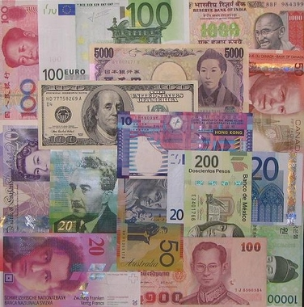
Exchange Rate Game

Slide 2
Objectives:
to understand that an exchange rate is the price of a currency in terms of another
To understand the determinants of the exchange rate between two countries
To understand how government and central bank policies can affect the exchange rate between countries

Slide 3
Scenario - in this 'game' that models a multi country world countries are free to trade with each other, indeed they are encouraged to.
Countries should maximize the production and consumption of a variety of goods, these goods represent desirable goods to all countries
Countries are successful through maximizing the production, trade and consumption

Slide 4
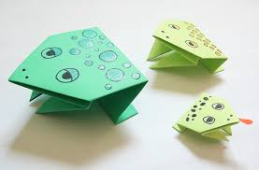
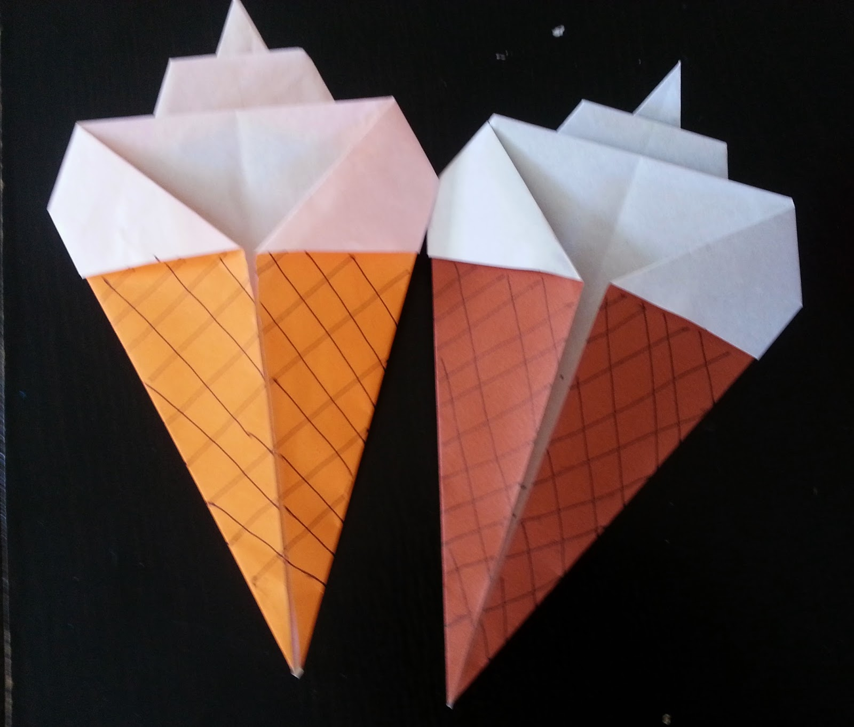
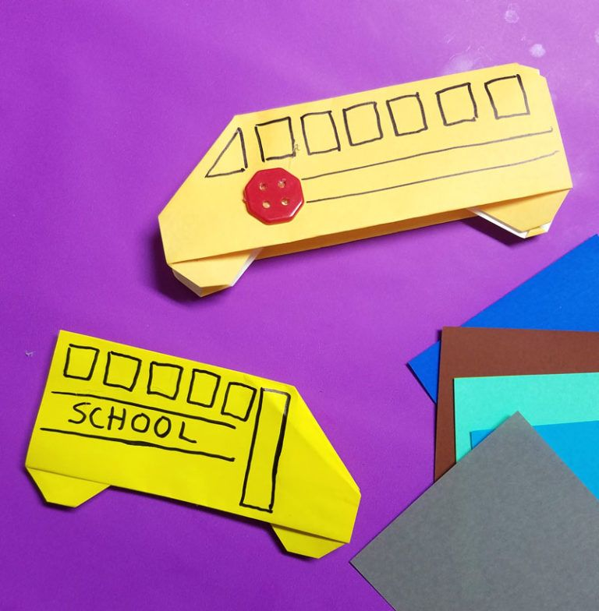
What each country needs
A currency
A banker
Some scissors and paper
You must set the price level in your own country for a variety of goods
Frogs Ice Creams Buses Fish

Slide 5
Round 1
You live in a world without an exchange rate and yet trade is necessary
Country A has paper but no pairs of scissors and no paper or pens
Country B has 10 sheets of paper but no pairs of scissors and no pens
Country C has 6 pens but no paper or scissors
Country D has 2 pens, 2 pieces of paper and 2 scissors
Before you can buy the produce from a country you need to buy its currency to allow the transaction to occur
Therefore the bankers must decide on an exchange rate

Slide 6
Round 1
You have 15 minutes to produce as many ‘products’ as possible
Remember that whilst you are competing against the other country you also want to maximize your trade…
Perhaps think about specialization?

Slide 7
The interest rate
At the end of the round if you are lacking foreign currency you can change your banks interest rate.
If you increase it, the other countries bank may be interested in depositing some of its wealth in your bank. Though it will of course need to buy up your currency, therefore creating demand for you currency and increasing the price/value of your currency in terms of theirs!

Slide 8
Round 2
You have 10 minutes to produce as many ‘products’ as possible
Remember that whilst you are competing against the other country you also want to maximize your trade…
Perhaps think about specialization?

Slide 9
Round 3
You have 10 minutes to produce as many ‘products’ as possible
Remember that whilst you are competing against the other country you also want to maximize your trade…
Perhaps think about specialization?

Slide 11
Market Forces
 | Country A | Country B
Frogs
Ice cream
Buses
Fish
Exchange rates
Interest Rate | 2% | 2%

