Slide 1
Knowledge check! - So, what does 8850 refer to then? What are we going to be learning about? Any ideas?

Slide 2
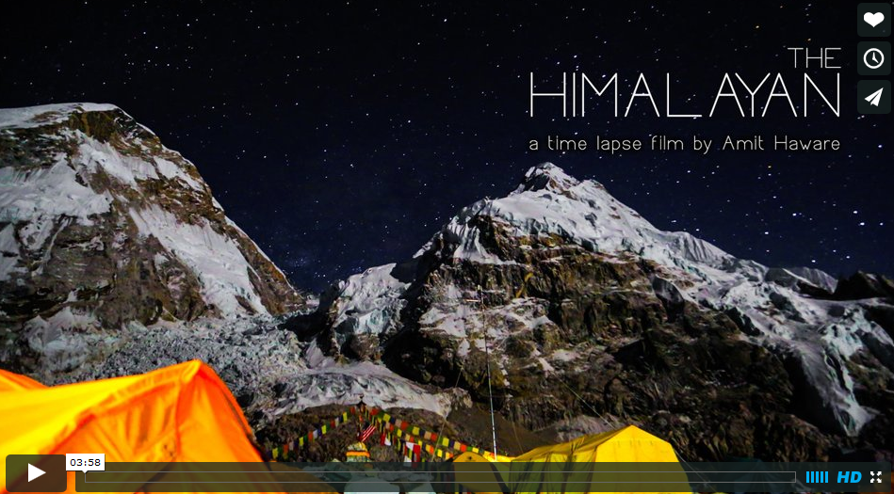
Starter: Check out one or both of the following videos - a really amazing time lapse short film.
http://vimeo.com/67992157
http://vimeo.com/70772167

Slide 3
Task 1 - Everest Feelings
Write down ten adjectives that you would use to describe Mount Everest from what you have seen in the video. Five must be under the title of 'Dangerous Everest' and the other five under the title of 'Incredible Everest'.
The music to the right should help to inspire https://play.spotify.com/album/0cFWx134naqFK3UPCS8M0U.

Slide 4
Task 2 - A 60 Year Anniversary
2013 was an important year for Mount Everest. i. Wind the clock back 60 years from 2013, what year would you be in? ii. Conduct a quick Google search with that year and 'Mount Everest' and find out why and what happened back then.

Slide 5
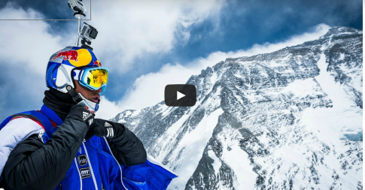
https://www.youtube.com/watch?v=uAfYbzL90Mo
Nearly 60 years to the day after the first ascent up Mount Everest, Russian extreme sport star Valery Rozov (48) flew off the north face of Mount Everest - the world's highest BASE jump ever - 7220 meters (23,688ft) above sea level.

Slide 6
https://www.youtube.com/watch?v=X4egTHmDYho
1953 was a big year for Mount Everest. After 50 million years on its own and left alone, at 11.30am on 28th May, two now famous explorers reached the summit of the highest land on earth.

Slide 7
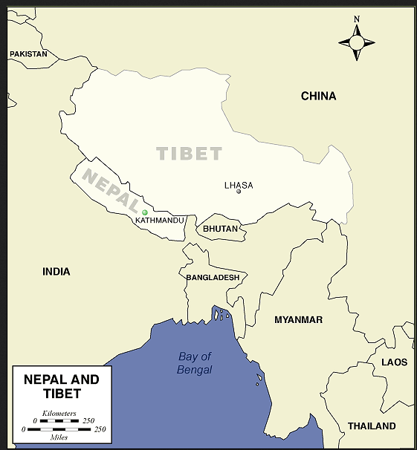
Objective: To find out about the conditions that surround the highest mountain in the world.
Using both the fact sheet and the map create your own annotated 'Where is Everest & What's it Like' fact sheet. You should include the location of Everest as well as your chosen 10 facts.

