Slide 1
Geography IA
How to write the evaluation
Complete draft deadline
11th June 11.59pm
‘To what extent does Houston fit the core-frame model?’

Slide 2
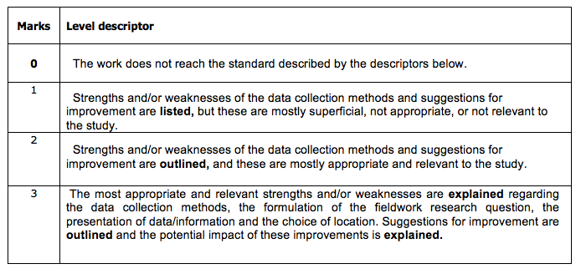
Evaluation
Students should review their investigative methodology, including methods of collecting primary information. Within this, they should consider any factors that may have affected the validity of the data, including personal bias and unpredicted external circumstances such as the weather.
Students should suggest specific and plausible ways in which the study might have been improved and could be extended in the future.
This criterion assesses the student's ability to review the investigative methodology, by weighing up the strengths and/or weaknesses of the chosen method, and suggest improvements.

Slide 3
What to include in the evaluation
300ish words
Can you save words by including as a table?
What were the strengths and weaknesses of the sites selected?
What were the strengths and weaknesses of your data collection methods?
Why was the fieldwork question appropriate?
Is there any way in which you could modify and improve the research question?
Why did you present the data in the way you did? Was it successful? Is there any way you could improve it?
What impact may these improvements have had on your results?

