Slide 1
Geography coursework:

Slide 2
Mark scheme

Slide 3
Reminder
Final deadline for coursework: Tuesday 20th February.

Slide 4
Writing an overall conclusion
Here you answer summarise the 2-3 sub-questions to answer the big question ‘To what extent does Katy show a shopping hierachy’
Success criteria
Should be about a paragraph long
Don’t bring in any new information
Ensure you answer the question
Checklist: | COMPLETE
Refer back to your research question, in one simple sentence try to provide an overview of your findings.
Refer to each of your three hypothesis, did you prove or disprove them? (briefly summarize your findings from the analysis section
Ensure that your hypothesis is consistent with what you are saying in your analysis.

Slide 6
Checklist for evaluation
Evaluation | Done?
I have explained the positives and negatives of the sites chosen
I have explained the positives of my data collection (primary and secondary)
I have explained any issues/ limitations with my data collection
I have give examples how these problems could be overcome
I have given suggestions for extensions to the study

Slide 7
Suggested format for completing the evaluation: a table
Method | Positives of data collection method | Limitations of data collection method | How could method be improved or extended?
Sites selected
Questionnaire
Land use mapping
People count

Slide 8
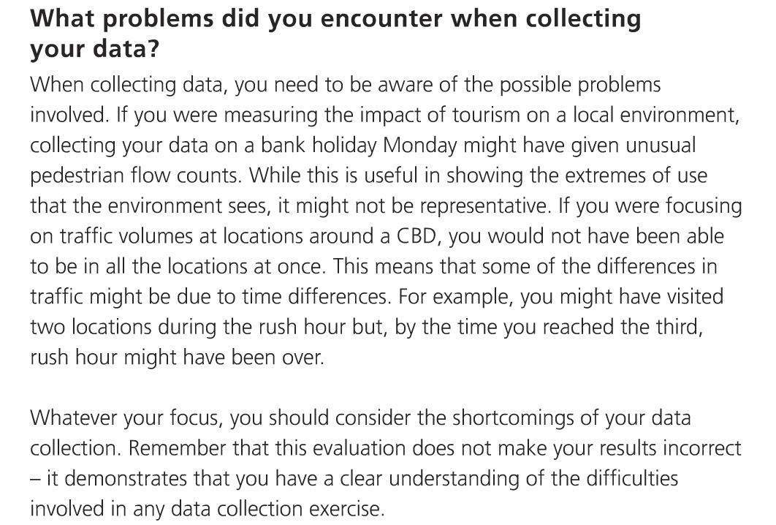

Slide 9
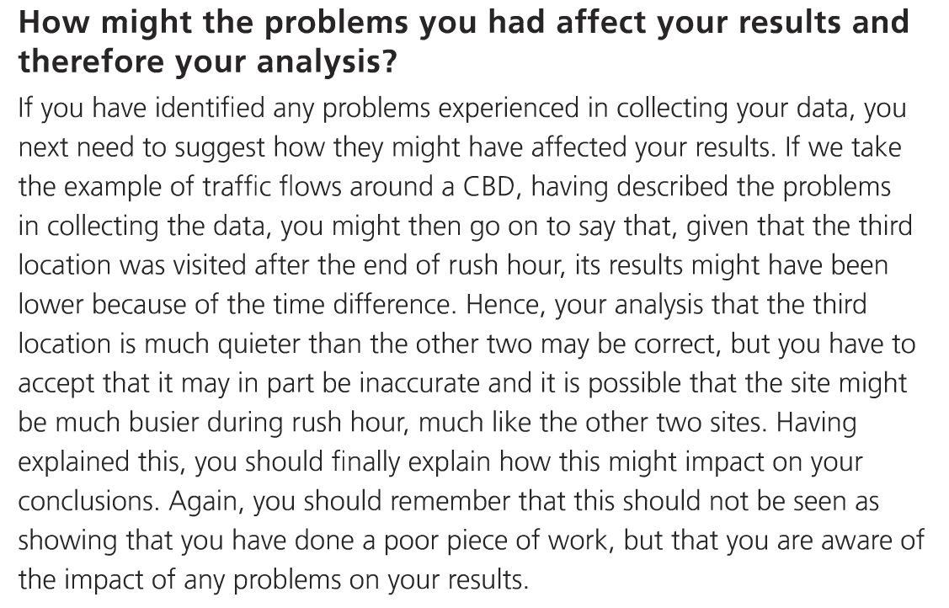

Slide 10
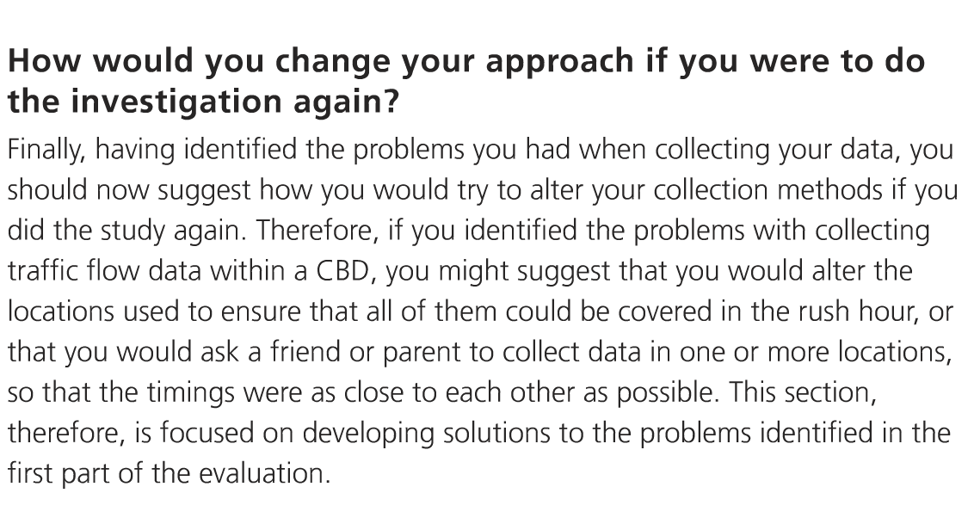

Slide 11
Examples from BISH: Data collection techniques

Slide 12
Example from BISH students- data collection

Slide 13
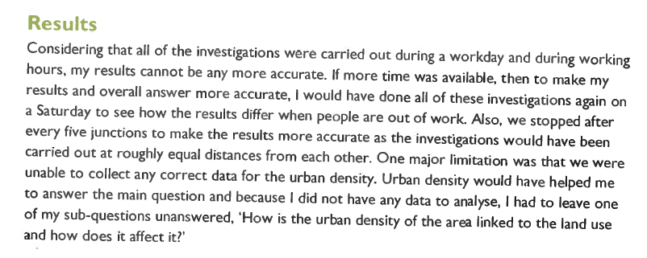
Examples from BISH: The overall conclusion

Slide 14
Examples from BISH students- overall conclusion

